Slide 1
Integrated Germ Management
Safe and Effective
Cleaning, Sanitizing, and Disinfecting for
Child Care Providers
This class was developed by the UCSF School of Nursing, California Childcare Health Program in partnership with the California Department of Pesticide Regulation.
Updated January 2023

Slide 2




Acknowledgments
Funding for this program was provided through a grant awarded by the California Department of Pesticide Regulation (DPR). The contents of this document do not necessarily reflect the views and policies of DPR nor does mention of trade names or commercial products constitute endorsement or recommendation for use.
Updated January 2023
Notes:
This Integrated Pest Management (IPM) workshop was funded by the California Department of Pesticide Regulation (DPR) and originally developed by the University of California (UC), San Francisco School of Nursing’s California Childcare Health Program, in collaboration with the UC Berkeley Center for Environmental Research and Children’s Health, and DPR. The contents of this document do not necessarily reflect the views and policies of DPR, nor does mention of trade names or commercial products constitute endorsement or recommendation for use.

Slide 3
What Is an Antimicrobial Pesticide?
Antimicrobial pesticides are substances used to destroy or suppress the growth of harmful microorganisms such as bacteria, viruses, or fungi (germs) on inanimate objects and surfaces. (EPA)
Sanitizers and disinfectants are antimicrobial pesticides and are widely used in child care settings.
Updated January 2023

Slide 4
Healthy Schools Act (HSA)Training Requirement
Anyone using antimicrobial pesticides (for example, bleach) in a school or a child care center is required to complete annual training*.
The training must include safe and effective use of antimicrobials for managing germs in relation to children’s health.
Updated January 2023
Notes:
*While training is required, antimicrobial pesticides are exempt from the reporting, recording, and notification requirements of the HSA.

Slide 5
Why are we here today?
Goal: To protect the health of children, child care staff, and the environment. You will learn about:
How germs cause illness
Safe use of sanitizers and disinfectants
An integrated approach for managing germs in child care facilities (Integrated Germ Management or IGM) that is healthy for children, staff, and the environment.
Updated January 2023

Slide 6
Updated January 2023

Slide 7
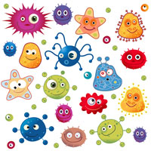
Infectious illnesses are caused by certain “germs” (also called “pathogens or microbes”)
Viruses
Bacteria
Fungi
Parasites
Updated January 2023
Notes:
Germs get can get into our bodies and multiply. This can cause a variety of symptoms that make us feel sick. Infectious illnesses are also called: communicable, contagious, or spreading illnesses.

Slide 8
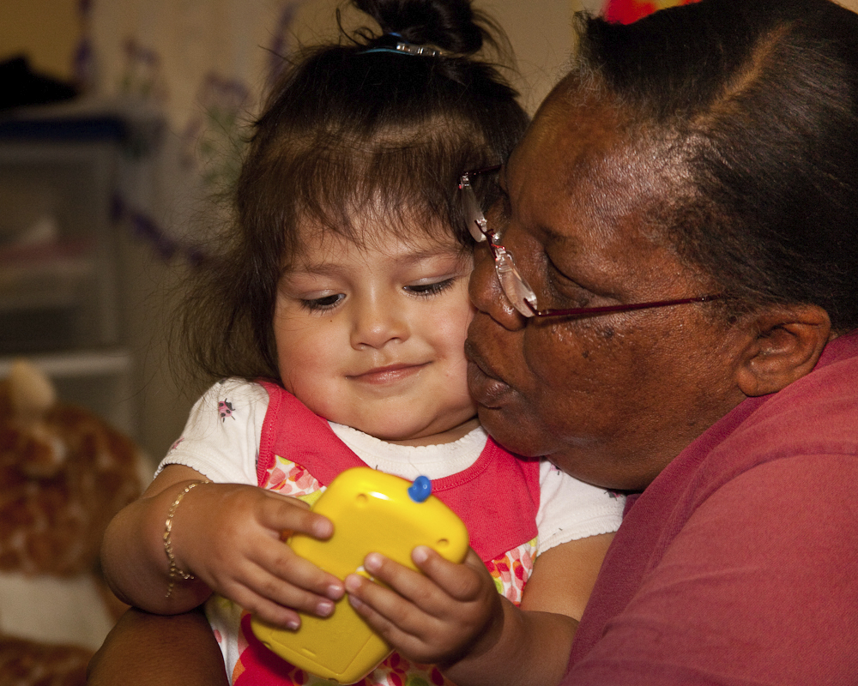
Question: Why are young children in child care settings are at higher risk for infectious illness?
Updated January 2023

Slide 9
Answer(s):
They are in close contact with other children and their caregivers.
They are curious and touch everything.
The often putting objects and their hands in their mouths.
They don’t have good personal hygiene skills.
They wear diapers or are in early stages of toilet learning.
They have immature immune systems leading to more illnesses and more sharing of germs.
They are not fully immunized.
They spend more time on the floor where germs collect.
Updated January 2023

Slide 10
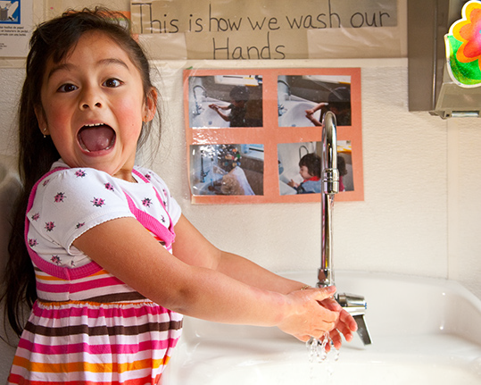
Germs spread easily among young children…
By breathing in germs that are in the air
By touching other people and surfaces with germs
By eating or drinking something with germs
Studies show that young children in child care
have symptoms of illness one third
to one half of the days out
of the year.
This is normal.
Updated January 2023
Notes:
Kids are sick a lot!
Blood borne illnesses spread when blood from and infected person enter another persons body. This is not common in child care.

Slide 11
Ways to stop the spread of infectious illness
Immunizations
Personal hygiene (coughing into a sleeve, frequent hand washing, proper diapering procedures etc.)
Staying home when ill
Covering rashes or open sores
Safe food handling
Cleaning, sanitizing, and disinfecting surfaces
Updated January 2023
Notes:
Handwashing is key to decreasing the spread of illness. The use of antimicrobial pesticides (sanitizers and disinfectants) is another way.

Slide 12
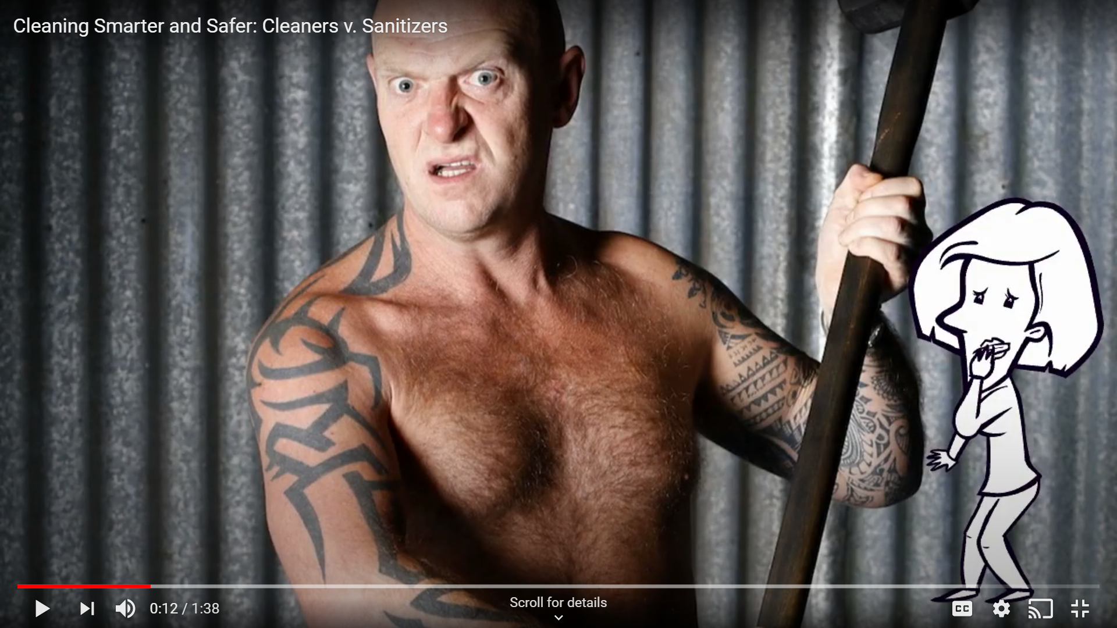
https://www.youtube.com/watch?v=xtwdyCE9F14&feature=youtu.be
Updated January 2023

Slide 13
What is the difference between cleaning, sanitizing, and disinfecting?
Definitions
Clean: To physically remove dirt, debris, and sticky film by washing, wiping, and rinsing.
Sanitize: to kill germs to a level that reduces the risk of becoming ill from contact with the surface.
Disinfect: A higher level of germ killing. To kill nearly all of the germs on a hard, non-porous surface.
Updated January 2023
Notes:
These terms are often used interchangeably but they do not mean the same thing. Let’s break them down.

Slide 14
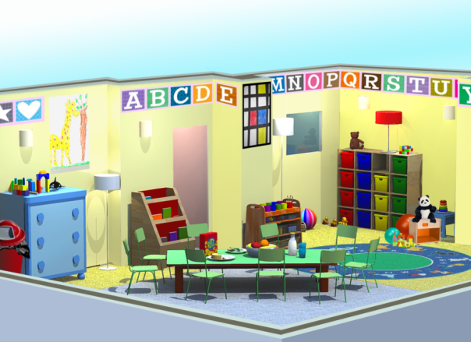
CLEAN
Why do we clean?
Updated January 2023
Notes:
Ask this open ended question to the class. There are lots of good reasons to maintain a clean environment…

Slide 15
A clean environment…
Has fewer germs that cause illness
Has fewer allergens (dust, food residue, grass, mold)
Does not attract pests
Reduces risk of exposure to lead dust, pesticides, and other toxins
Has better air quality
Has mental health benefits for children, families, and staff
Has less clutter where pests can hide
Is more attractive for staff, children, families, and visitors.
Updated January 2023
Notes:
Ask this open ended question to the class. We’ll be walking through the basics of cleaning.

Slide 16
Steps to reduce clutter:
Install storage shelves and cabinets.
Sell, recycle, or donate items you don’t use.
Rotate play things in and out of storage.
Send art projects home at the end of the day.
Keep surfaces clear.
Make “clean-up” part of your daily routine.
Keep a gift “wish list” for families to use at holidays so you only receive items you can use.
Updated January 2023
Notes:
It’s not possible to properly clean, sanitize, or disinfect a cluttered environment. The first step is to reduce clutter.

Slide 17


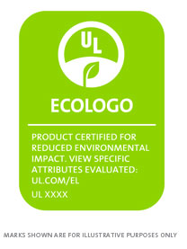
Choose cleaning products that are healthier for people and the environment.
fragrance-free
free of dyes
non-antibacterial
non- aerosols (propellant)
third-party certification
  Ecologo
  Green Seal
  EPA Safer Choice logo
*Remember, children are more vulnerable to exposure to chemicals and fumes because they are growing and developing. Their little bodies have a harder time breaking down toxins, and they breath twice as much per body weight as adults. They have softer, more absorbent skin and smaller airways. They also spend more time on the floor where chemical residues can collect.
Updated January 2023
Notes:
The next step is to choose a safe cleaning product. Many have strong fumes or try to mask odors with perfume leading to poor air quality. Some products may make marketing claims that they are “green”, but they may not be. Look for a third party certification to know if the product you are using is safer for human health and the environment. Some products are ready to use, some need to be diluted with water. Always follow label directions for proper use and use personal protective equipment such as gloves and eye wear as directed.

Slide 18
Tools for effective cleaning
Use microfiber cloths and mops.
Place mats at the door (inside and out) to keep dirt out.
Use a high efficiency particle air (HEPA) vacuum cleaner.
Updated January 2023
Notes:
Microfiber cloths and mops work well to trap and absorb dirt, oils, germs, debris from surfaces. They dry quickly and use less cleaning solution. Sponges harbor microbes and may spread germs rather than cleaning them up.
Walk-off mats placed at doors and entryways capture dirt tracked in on shoes. Vacuum the door mats daily. You might also consider a “shoe off” policy, especially in infant/toddler programs.
HEPA filter vacuums remove more dirt, dust, dander, allergens etc. than conventional vacuum cleaners.

Slide 19
What surfaces should be cleaned?
Toys
Bedding
Floors
Clothing (including hats)
Cribs, cots, and mats
Play equipment
Refrigerators
Always clean before applying a sanitizer or disinfectant
Updated January 2023
Notes:
Washing with soap and rinsing with water will clean these surfaces. The friction of cleaning removes most dirt.

Slide 20
SURFACE CLEANING STEPS
Put on gloves.*
Spray or squirt cleaning solution onto the surface.
Wipe and rub the surface, moving in one direction, until visible dirt and solids are gone so the surface looks clean.
Follow product label directions for dilution and rinsing.
Allow the surface to air dry or dry with a clean cloth.
Updated January 2023
Notes:
*Avoid latex gloves as they carry a risk of allergy.

Slide 21
SANITIZE
Why do we sanitize?
Updated January 2023
Notes:
Sanitizers kill germs at a level that reduces the risk of becoming ill from contact with the surface. Sanitizers are antimicrobial pesticides.

Slide 22
What surfaces should be sanitized?
Food preparation surfaces and appliances
Counter tops
Eating utensils and dishes
Eating tables and high chair trays
Mixed use tables (before using them for meals and snacks)
Plastic mouthed toys (if used by another child)
Pacifiers (if dirty or if used by another child)
Updated January 2023
Notes:
Appropriate for food contact surface sanitizing (dishes, utensils, cutting boards, high chair trays, tables), toys that children may place in their mouths (if used by another child), and pacifiers (if dirty or if used by another child)
Food contact surfaces (surfaces where food is served, stored, or prepared). Mixed use tables.
From Caring for Our Children
Sanitize pacifiers if dirty or used by another child.
✓ Use sanitizer safe for food contact OR
✓ Boil for 1 minute and air-dry OR
✓ Use dishwasher.
• Squeeze water through nipple hole to be sure it is clean

Slide 23
DISINFECT
Why do we disinfect?
Updated January 2023
Notes:
Disinfectants kill germs at a higher level than sanitizers. Disinfectants kill nearly all the germs on hard, non-porous surfaces. They are used for body fluids like blood, feces, vomit and high-touch surfaces like door knobs.

Slide 24
What surfaces should be disinfected?
Drinking fountains
Door and cabinet handles (high-touch)
Surfaces that have been soiled with blood or body fluids
Toileting and diapering areas:
  Diaper changing tables and diaper pails
  Counter tops in bathrooms
  Potty chairs
  Handwashing sinks and faucets
  Toilets
  Bathroom floors
Updated January 2023
Notes:
Appropriate for use on non-porous surfaces such as diaper change tables, counter tops, door and cabinet handles, toilets, and sinks used for toileting routines including facets, door knobs and basins
These are generally toileting areas or High-touch areas that are at high risk for collecting lots of germs, like doorknobs, bathroom faucets, and drinking fountains.

Slide 25
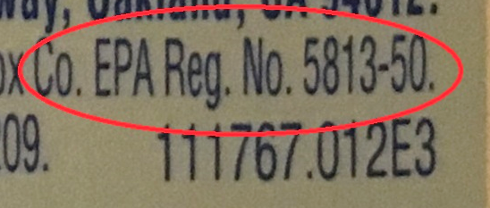
What products should I use for sanitizing and disinfecting?
Environmental Protection Agency (EPA) registered antimicrobial products
Check the product label for an EPA registration number
Updated January 2023
Notes:
Antimicrobial means the product kills germs.
A dishwasher that reaches 165 degrees F will also sanitize (dishes, toys). Choose a dishwasher that meets NSF International Standards for sanitizing.
A washing machine set to hot can sanitize cloth toys.

Slide 26
The Label is the Law
Always follow the instructions on the label for sanitizing and disinfecting.
Do you need to mix the product with water?
How long must the product be on the surface? (dwell time)
Is it okay to use the product on food surfaces?
Do you need to rinse the product off?
  CAUTION
  WARNING
  DANGER
Updated January 2023
Notes:
Check for approved surfaces. Sanitizers must be safe for food contact surfaces
Dwell time (the time the product must be left wet on the surface and in contact with the germs to kill them)

Slide 27
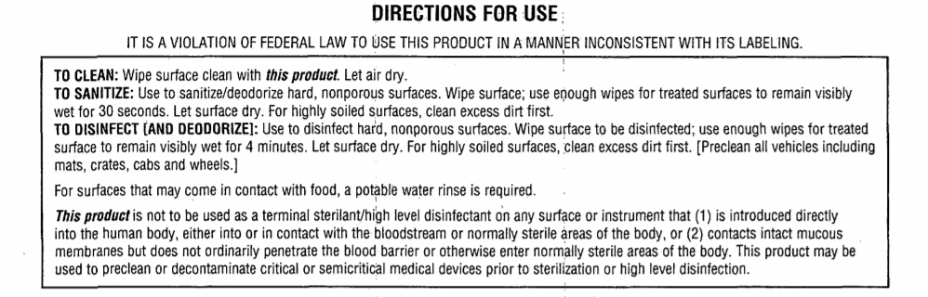
Updated January 2023
Notes:
Label reading practice
Dwell time?
Food surfaces?

Slide 28
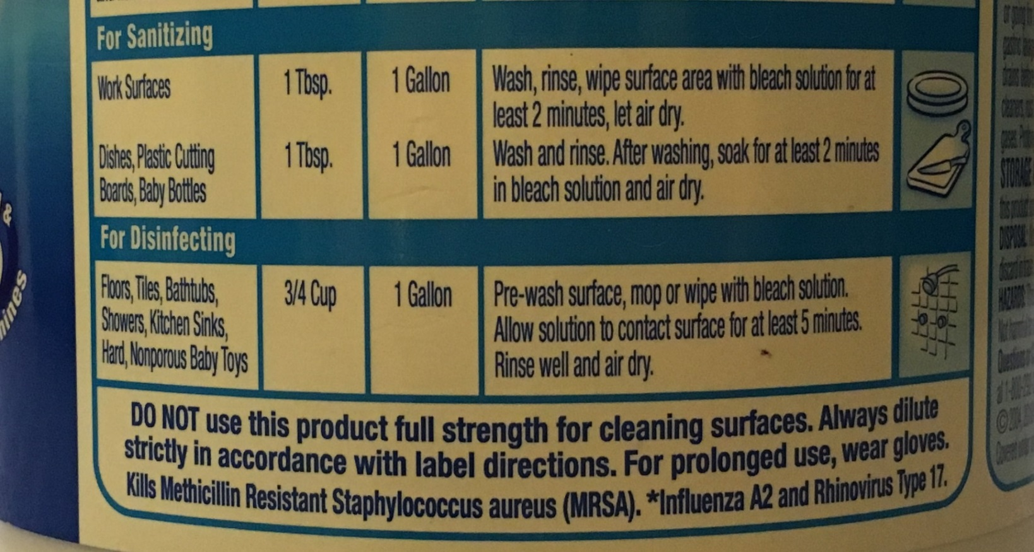
Updated January 2023
Notes:
Dwell time?
Food surfaces?

Slide 29
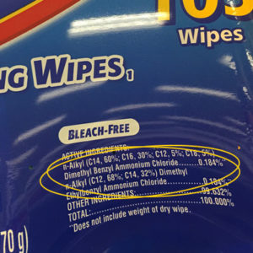
Ingredients Statement
Updated January 2023

Slide 30

Design for the Environment Logo
If you see the DfE logo on an EPA-authorized label for a sanitizer or disinfectant, you can be assured that the product uses a least-hazardous active ingredient:
Citric acid
Hydrogen peroxide
L-lactic acid
Ethanol
For a list of DfE products:
  https://www.epa.gov/pesticide-labels/dfe-certified-disinfectants
Updated January 2023
Notes:
Look for the new label! EPA’s Design for the Environment is the only program that authorizes sanitizers and disinfectants (antimicrobials)
It sets standards for ingredients and evaluates anti-microbial products as safer for human health and the environment.
Remember, safer antimicrobial products will still have an EPA registration number and must be used according to label instructions. All cleaning, sanitizing, and disinfecting products must be stored out of children's reach.

Slide 31
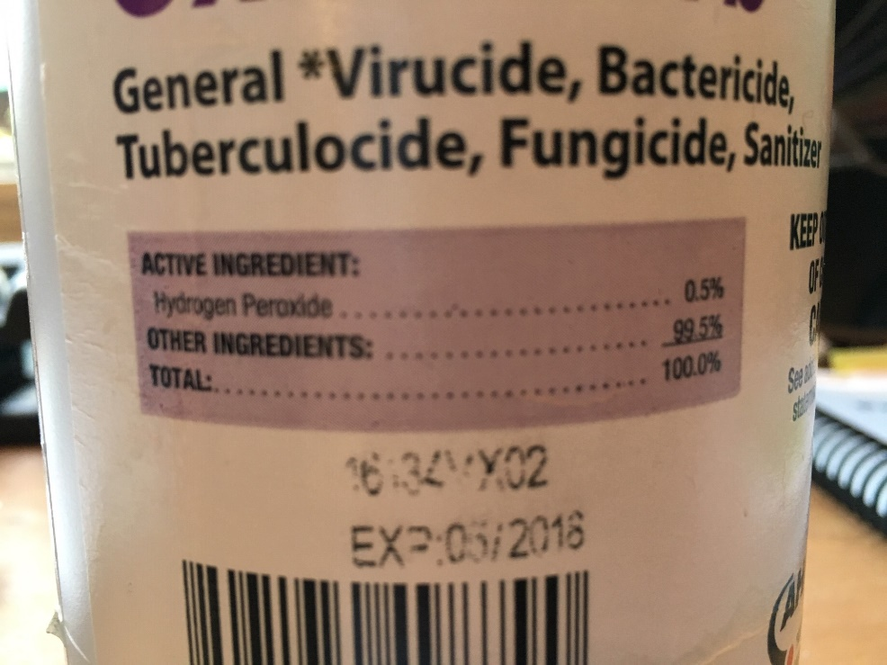
Ingredients Statement
Updated January 2023
Notes:
EPA’s Design for the Environment is the only program that authorizes sanitizers and disinfectants (antimicrobials)
It sets standards for ingredients and evaluates anti-microbial products as safer for human health and the environment.
Remember, safer antimicrobial products will still have an EPA registration number and must be used according to label instructions. All cleaning, sanitizing, and disinfecting products must be stored out of children's reach.

Slide 32
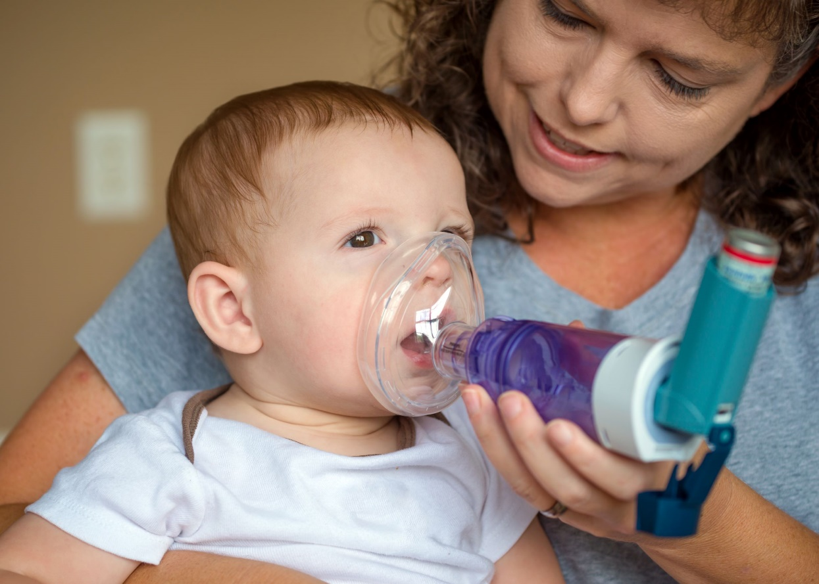
Did you know…
Approximately 15% of the population in California have ever been diagnosed with asthma.
4.6% of children 0-4 years old in California have ever been diagnosed with asthma.
14.5% of children/adolescents 5-17 years old in California have ever been diagnosed with asthma.
California Breathing, Dashboard, 2019-2020, https://www.cdph.ca.gov/Programs/CCDPHP/DEODC/EHIB/CPE/Pages/CaliforniaBreathingCountyAsthmaProfiles.aspx
Updated January 2023
Notes:
Accurate asthma diagnosis in young children 0-4 years is difficult because other common conditions can be responsible for asthma-like symptoms and measuring lung function is difficult in very young children.

Slide 33
Potential asthmagen active ingredients
Sodium hypochlorite (bleach)
  Mixed daily
  Protection is rarely worn
  Harmful fumes, especially full strength
Quaternary Ammonium Compounds or “Quats”
  Same respiratory risks as bleach
  Potential reproductive toxicity
  Becoming more common as a “bleach-free” product
Updated January 2023
Notes:
Some products create fumes that could trigger or even cause asthma. If you have children or staff with asthma, best to avoid products with these active ingredients.

Slide 34

COVID-19 Guidance
COVID-19 spreads mainly through the air
To reduce the risk of COVID-19 select disinfectant products on the EPA List N.
Look for products with asthma-safer ingredients (hydrogen peroxide, citric acid or lactic acid).
Use the List N Tool to search for products by active ingredient.
https://cfpub.epa.gov/wizards/disinfectants/
Updated January 2023

Slide 35
Worksheet #1
Name of cleaning product: _____________________
Does it have a 3rd-party certification by Green Seal, EcoLogo, or Safer Choice?
Does it have a list of ingredients?
Is it free of dyes?
Is it fragrance free?
Is it ready to use or does it need to be mixed with water?
Have I read all the label instructions?
It is in the original container?
Is it stored out of children’s reach?
Updated January 2023

Slide 36
Worksheet #2
Name of sanitizing product: _____________________
EPA-Registration No: ________________
Active Ingredient: __________________
Signal Word _______________________
Mixing Required?_______
Mixing Instructions_____________________
Dwell time: _______
Safe for food-contact surfaces?________
DfE logo or DfE-approved active ingredient? ________
Updated January 2023

Slide 37
Worksheet #3
Name of disinfecting product: _____________________
EPA-Registration No: ________________
Active Ingredient: __________________
Signal Word _______________________
Mixing Required?_______
Mixing Instructions_____________________
Dwell time: _______
Safe for food-contact surfaces?________
DfE logo or DfE-approved active ingredient? ________
Updated January 2023

Slide 38
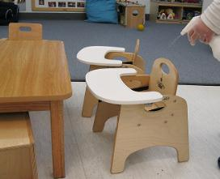
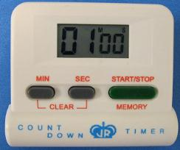
DISINFECTING AND SANITIZING STEPS
Step 1: Ensure that children are in another area
Step 2: Pre-clean using a non-antibacterial soap or detergent and water
Step 3: Apply the disinfectant or sanitizer according to product label
  Spray away from breathing zone
  Provide ventilation
Step 4: Leave the surface wet
  Check the product label for the appropriate contact (dwell) time
  Set an electronic timer, egg timer, watch, or smart phone to keep track of time
Step 5: Air dry or wipe the surface dry with a fresh paper towel or cloth
Updated January 2023
Notes:
Apply the sanitizer or disinfectant safely (no matter what product you use)

Slide 39
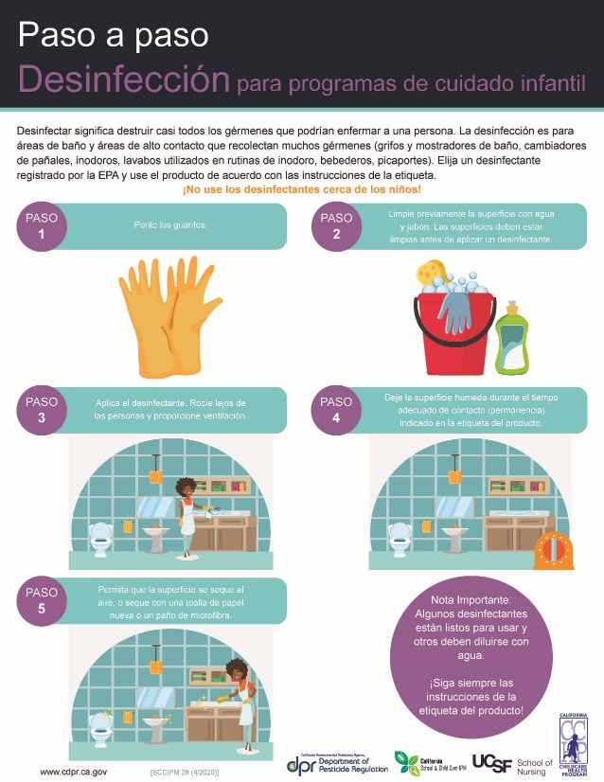
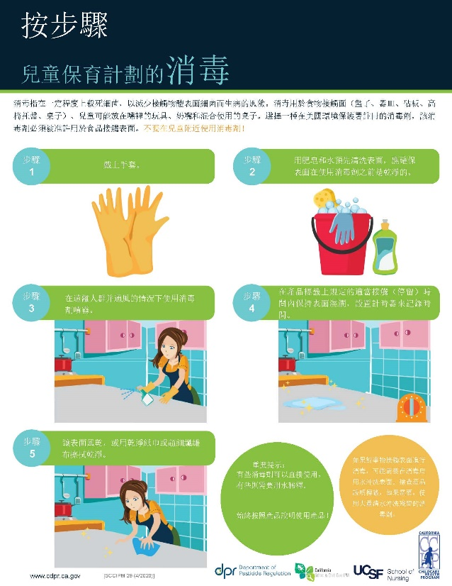
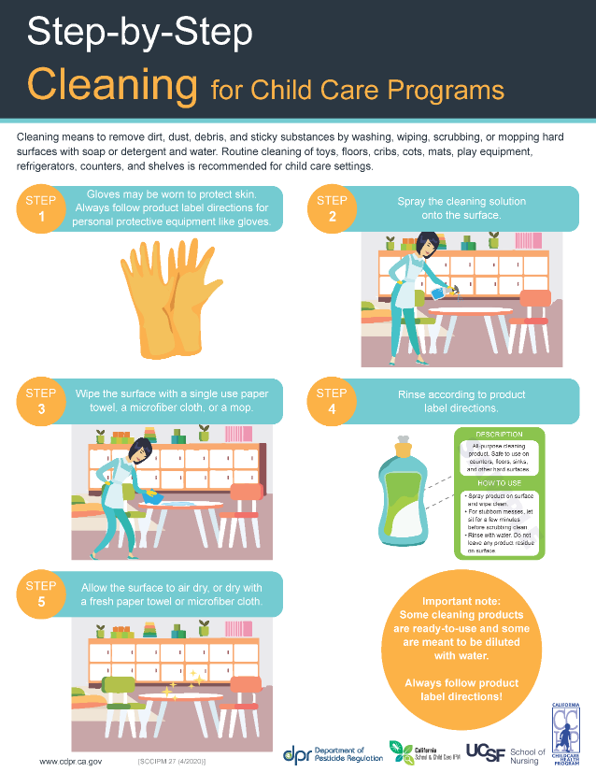
Updated January 2023

Slide 40
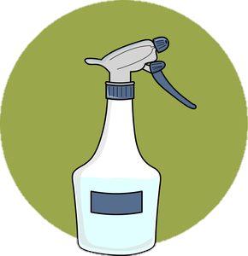
Always use caution with sanitizers and disinfectants
Provide ventilation
Hold the bottle at a safe distance away from the nose and mouth when spraying
Label spray bottle dilutions with product & date
Keep products out of children’s
reach, in a locked cabinet.
2/7/2020
bleach
Updated January 2023
Notes:
Label spray bottles with surfaces to use on (date mixed if applicable)
sanitize and disinfect when children are NOT in the area (provide a safe distance);
Never mix vinegar with bleach or ammonia with bleach
Avoid spraying sanitizers and disinfectants on surfaces close to the face (such as windows, mirrors, and partitions)

Slide 41
Always use caution with sanitizers and disinfectants
Wear personal protective equipment such as
(gloves, eyewear)
Sanitize and disinfect while children are not in area
The surface should be dry by the time the children return to the area
Do not mix products or reuse bottles for different products
2/7/2020
Never mix ammonia or vinegar with bleach!
Updated January 2023
Notes:
Label spray bottles with surfaces to use on (date mixed if applicable)
sanitize and disinfect when children are NOT in the area (provide a safe distance);
Never mix vinegar with bleach or ammonia with bleach
Avoid spraying sanitizers and disinfectants on surfaces close to the face (such as windows, mirrors, and partitions)

Slide 42
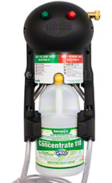
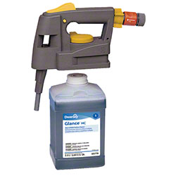
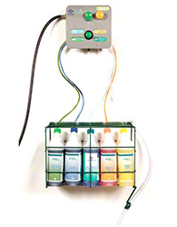
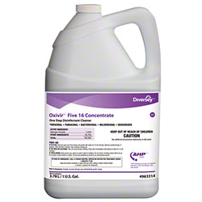
Purchasing Options: Dilution systems
Updated January 2023
Notes:
Used more by cleaning services
Fewer fumes, no mixing and measuring by hand
Cost-effective, buying concentrate

Slide 43
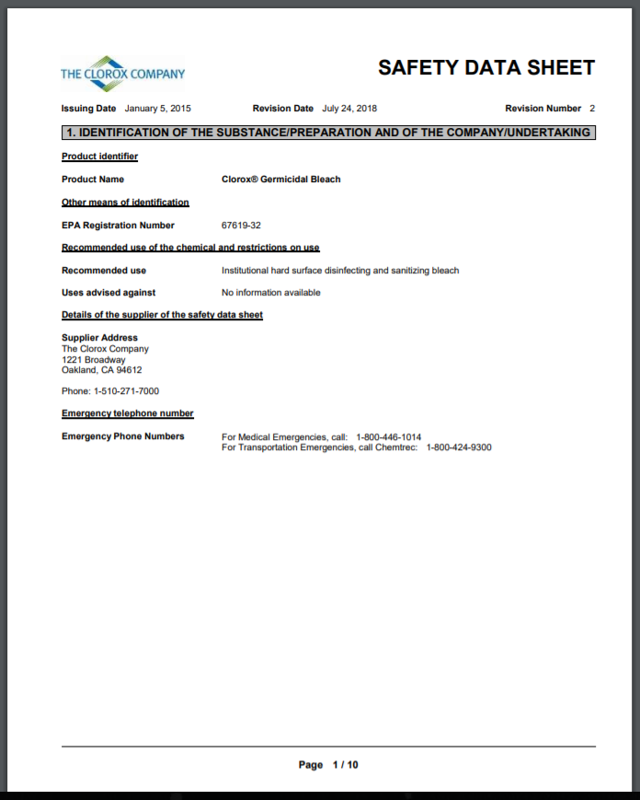
Safety Data Sheets (SDS)
Do you have SDS sheets for each chemical on-site?
Available online
Have a copy for every product
Keep SDS sheet with product
Includes information on:
  First aid
  Storage
  Incompatible products
  PPE
Updated January 2023
Notes:
Use personal protective equipment (eyewear, clothing, and gloves)
Maintaining SDS sheets for each chemical used on site are a Cal-OSHA requirement

Slide 44
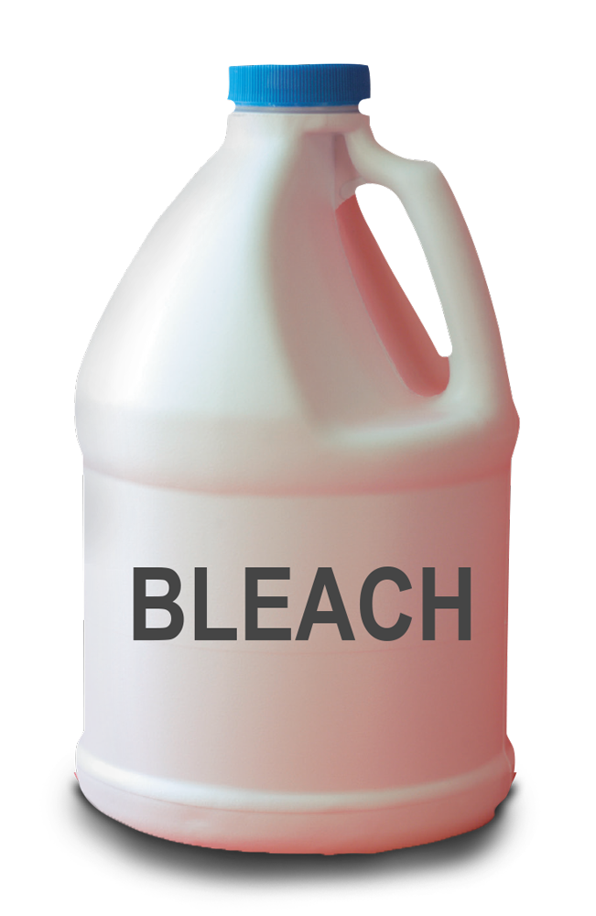
What about bleach?
Commonly used because it is:
  low cost
  effective (if used correctly)
  readily available
Use caution because it could:
  irritate the skin and eyes
  trigger asthma
  affect breathing (even if you don’t have asthma)
  damage clothing
  be corrosive
Notes:
*bleach has a short shelf life, it needs to be mixed with water daily. **Laundry bleach does not kill germs! Check the label.
Updated January 2023
Notes:
Bleach is widely used in child care settings to sanitize and disinfect surfaces.

Slide 45
If using bleach:
Check to make sure it is germicidal bleach, not laundry bleach.
Mix daily. Follow directions on the label for sanitizing and disinfecting.
Label the bottle with the date and the product
Mix in well ventilated areas
Wear gloves and protective eyewear when diluting
Use a funnel when mixing to decrease the amount of bleach inhaled
Mix bleach into cool water to reduce fumes (rather than adding water to bleach)
Always use a measuring device
Sanitize and disinfect surfaces when children are not present
Updated January 2023
Notes:
There are new concentrations of bleach and the user MUST read the label to identify the concentration and how to dilute it;

Slide 46
Are bleach-free products compliant with California Community Care Licensing
Title 22 Regulations?
YES!
“Commercial disinfecting solutions, including one-step cleaning/disinfecting solutions, may be used in accordance with label directions.”
CA Community Care Licensing Section 101438.1 (f)
All sanitizers or disinfectants must be registered with the USEPA.
NOTE: Sanitizers for use in child care settings should be registered as
“food contact sanitizers.”
Updated January 2023
Notes:
46

Slide 47
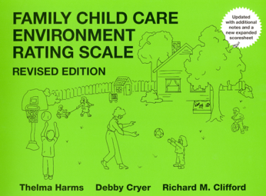
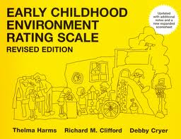
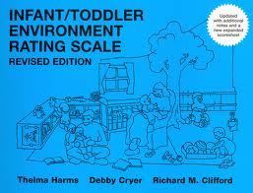
Are bleach-free products compliant the Environment Rating Scales-- ECERS, ITERS, and FCCERS? YES!
Meals/ snacks
(FCCERS: 9-1.3, 3.3, 5.3; ECERS: 10-1.3, 3.3; ITERS: 7-1.3, 3.3, 5.3)
“An alternative EPA approved ‘sanitizer’ may be used in place of the usual bleach and water solution as part of the table washing procedure or for high chair trays, and other food related surfaces. Check the label of the original container and look for the designation as an EPA sanitizer. ”
Diapering/ toileting
(FCCERS: 10-1.1, 3.1, 5.1, 7.1; ECERS 12-1.1,3.1; ITERS: 9-1.1, 3.1, 5.1, 7.1)
“An alternative EPA approved ‘disinfectant’ (not sanitizer) may be used in place of the usual bleach and water solution. Check the label of the original container and look for the designation as an EPA disinfectant.”
Updated January 2023
Notes:
47

Slide 48
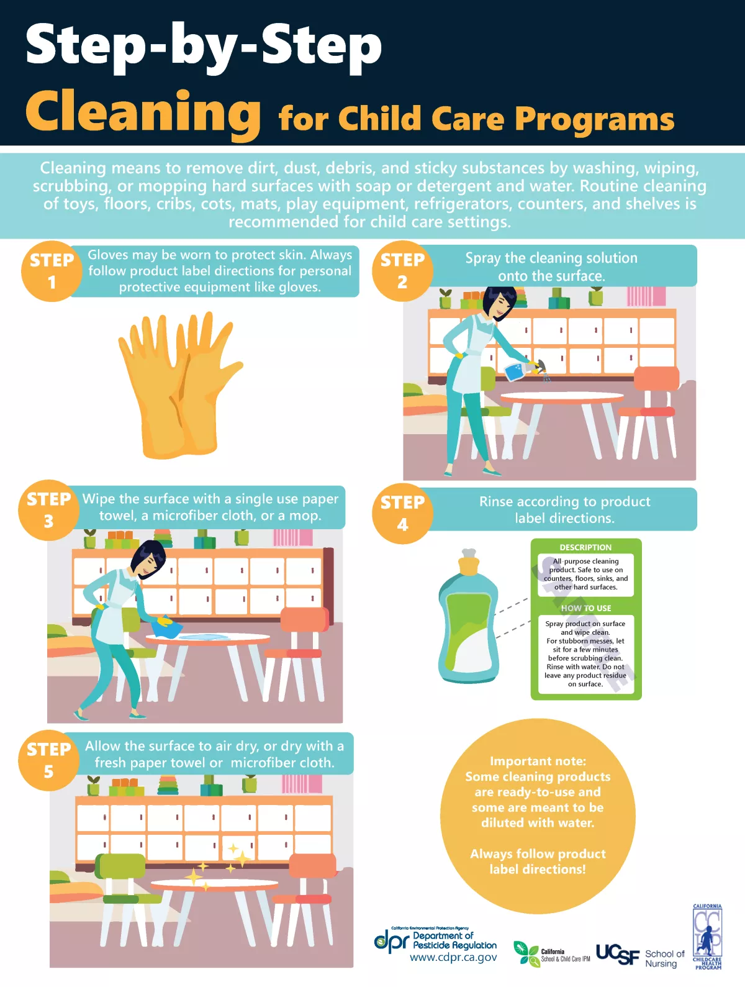
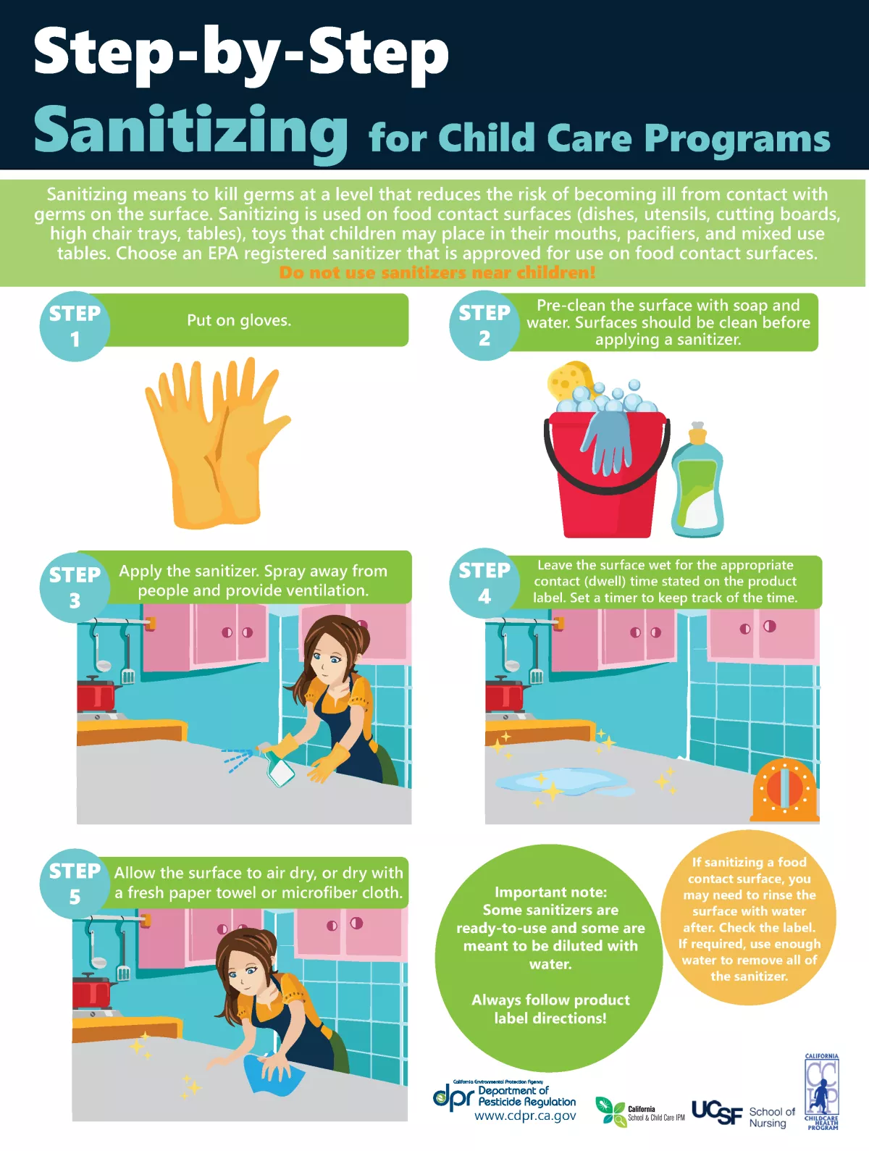
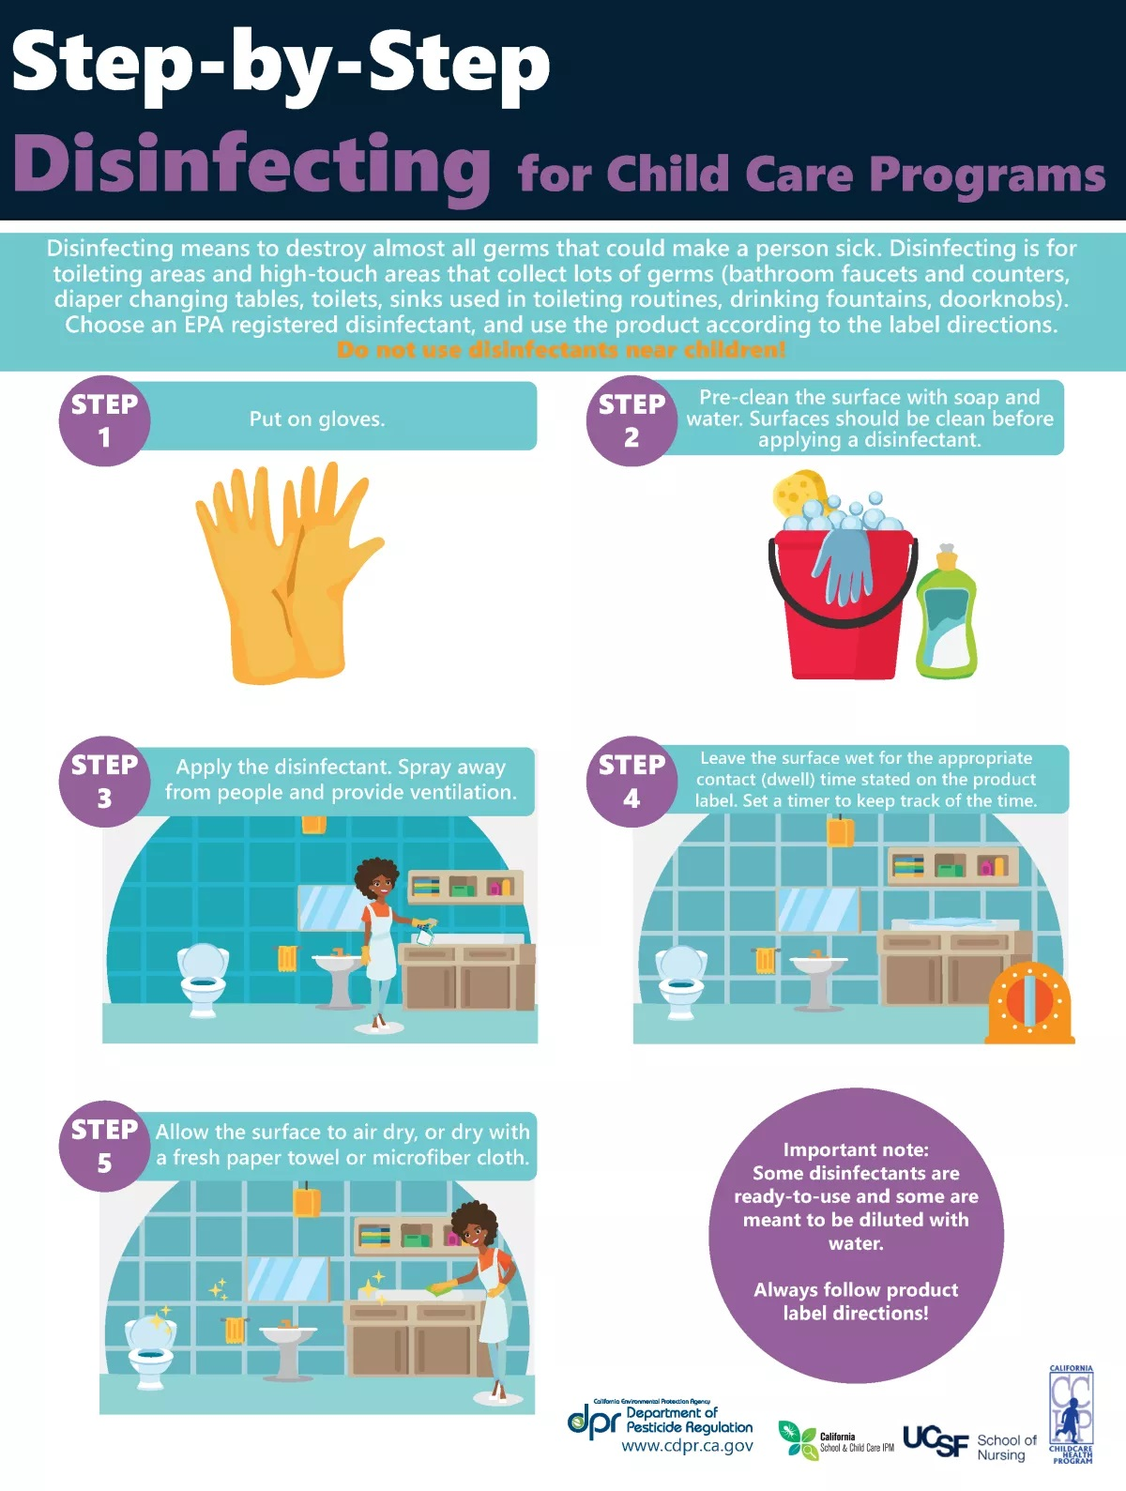
CCHP.ucsf.edu
Notes:
Here we have 3 posters to display cleaning, sanitizing, disinfecting, and available in 3 different languages: English, Spanish, and Chinese.

Slide 49
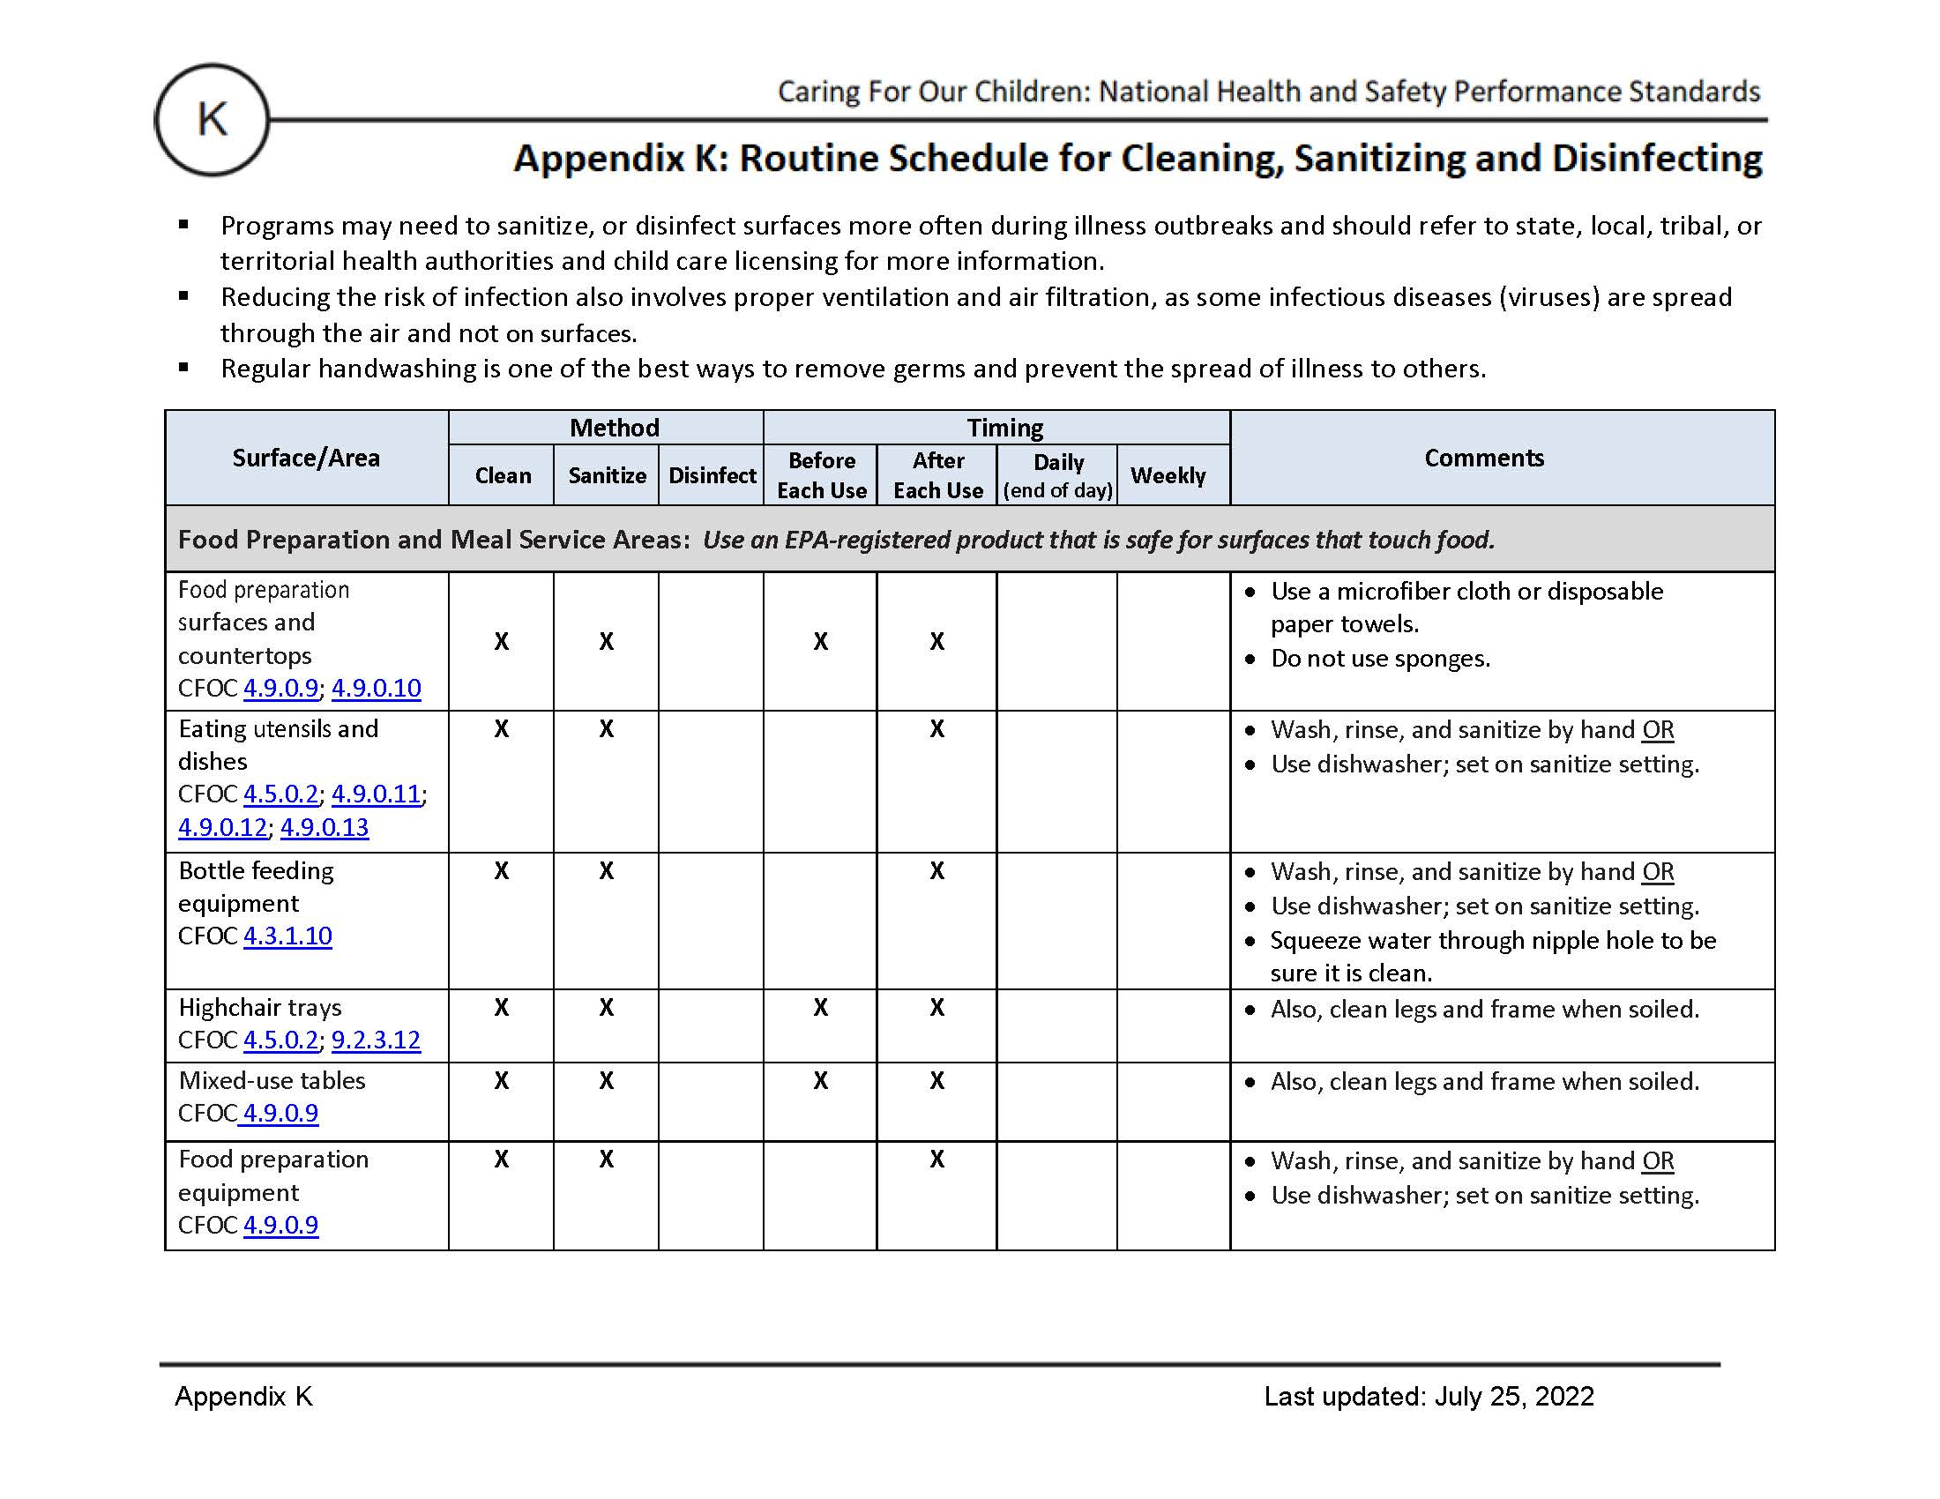
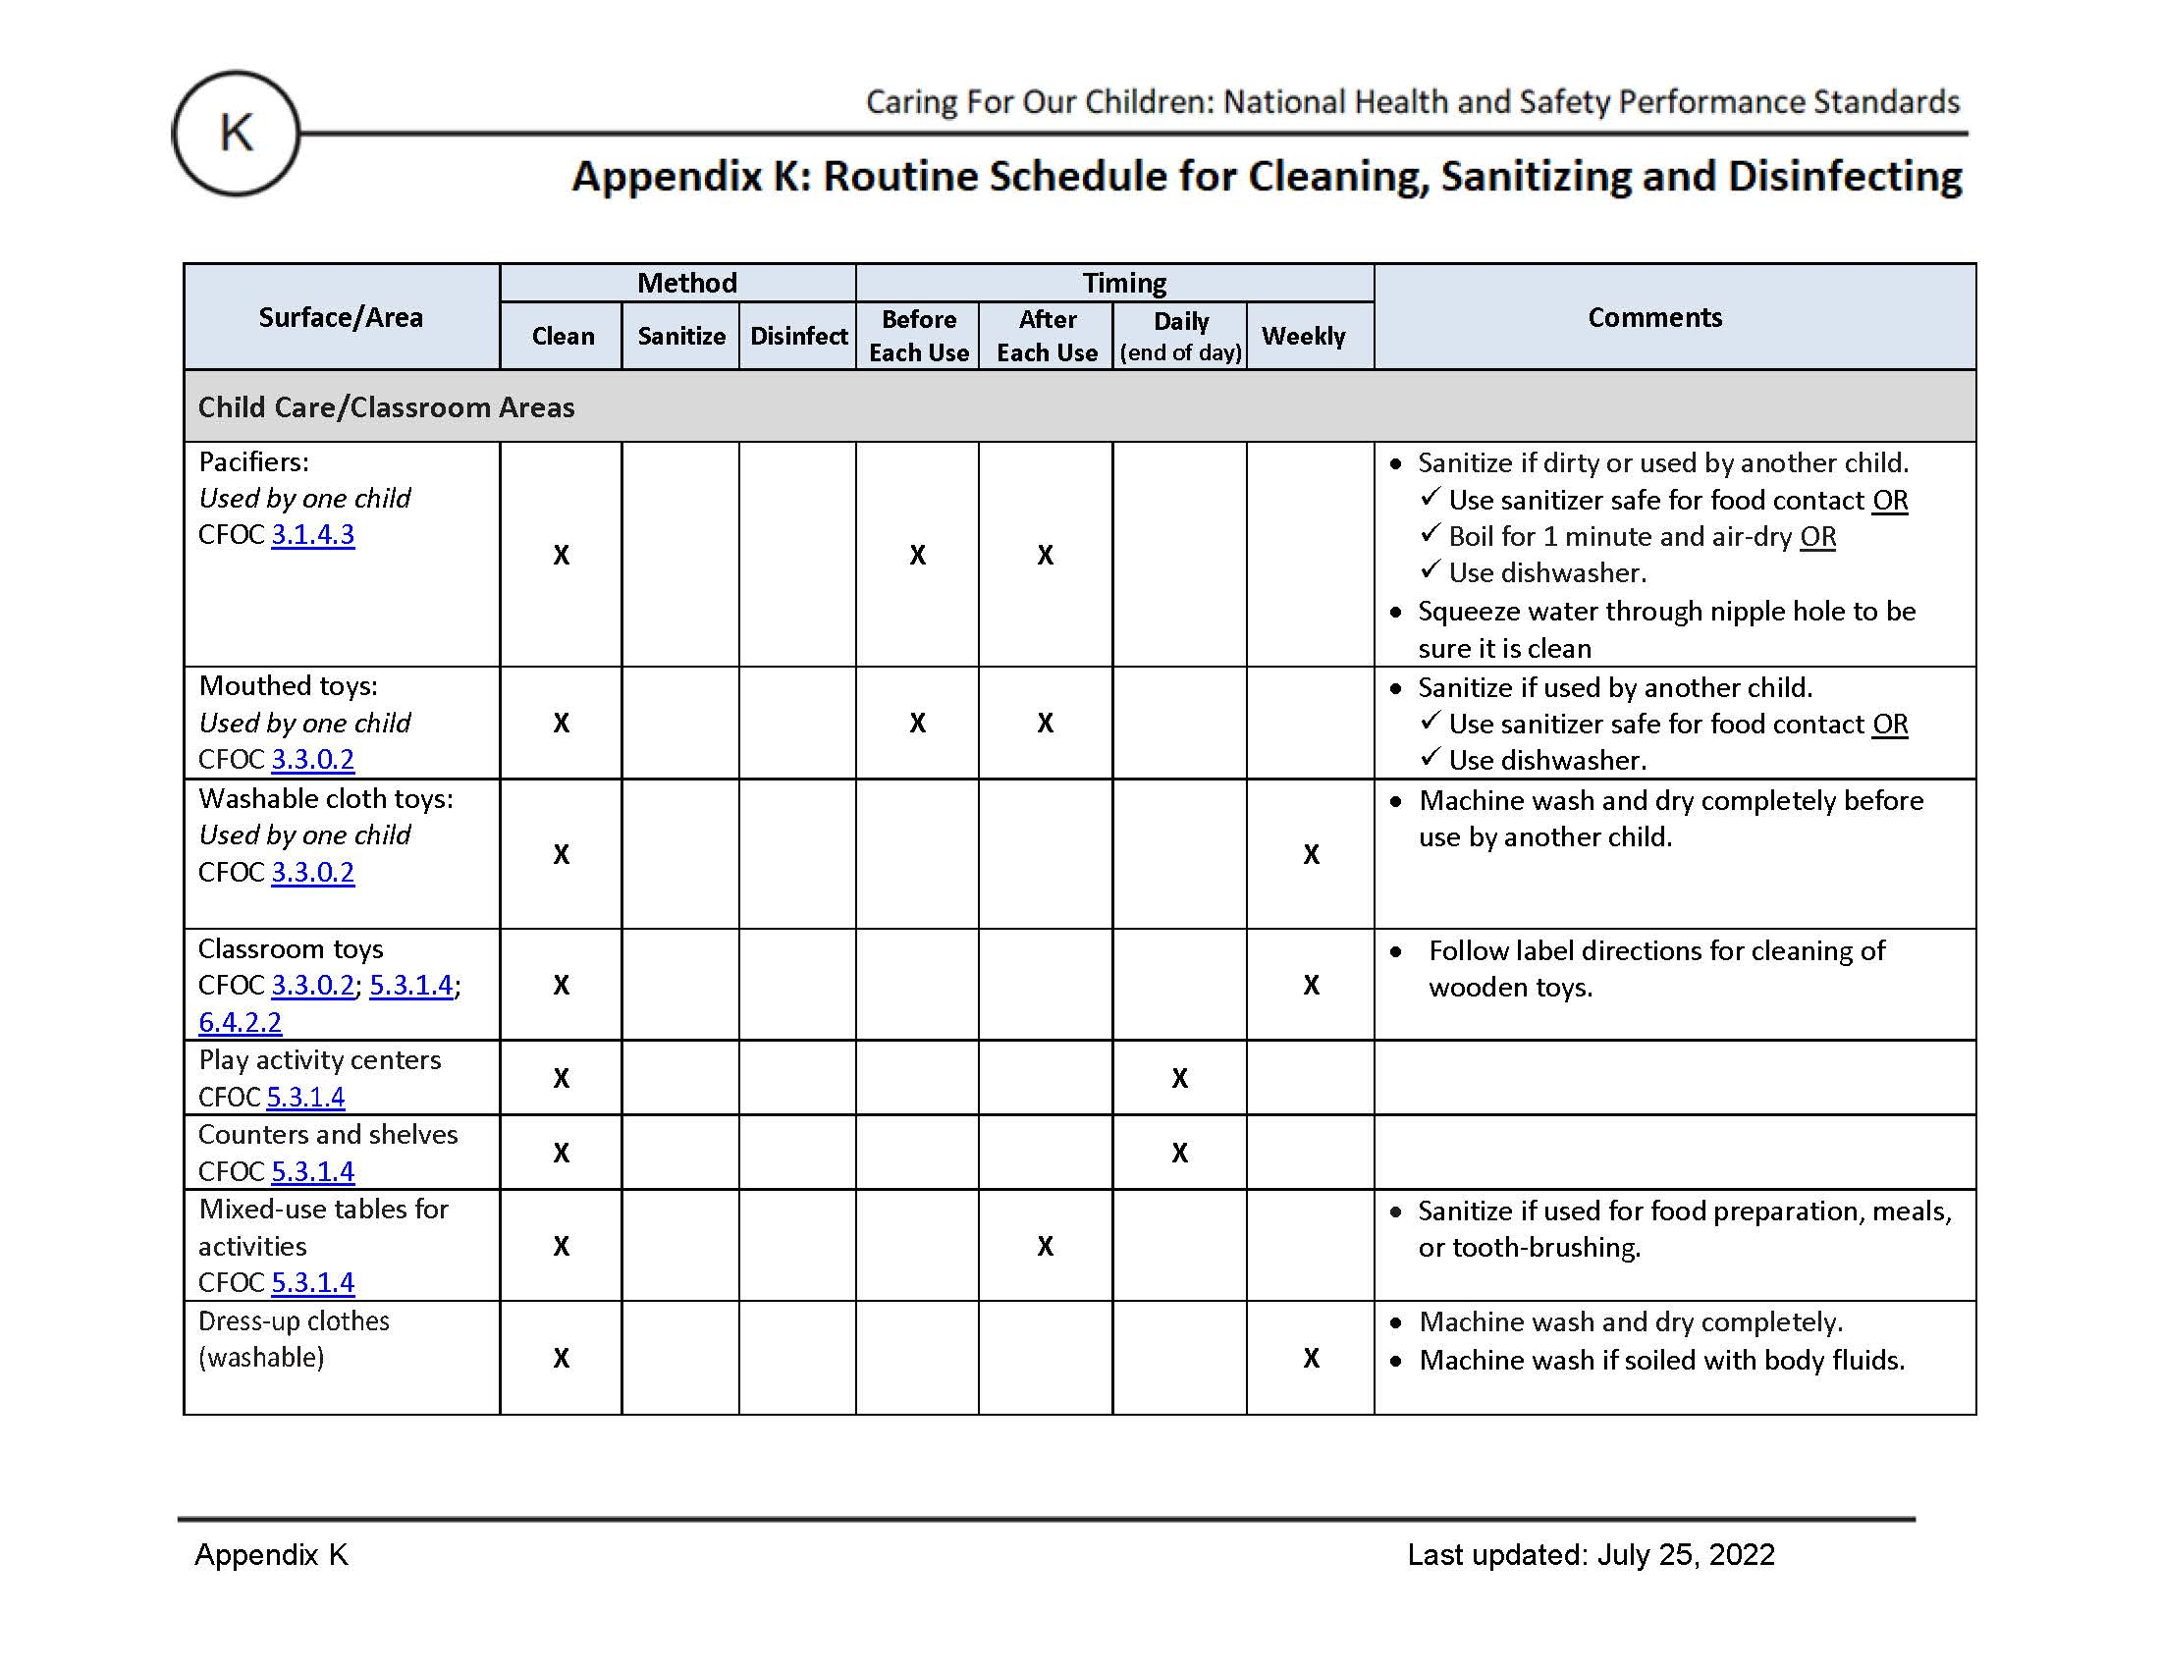
Updated January 2023
Notes:
Speaking of Caring for Our Children, there is an Updated Appendix K, 2022 version! Best practices on WHEN and WHERE to sanitize OR disinfect from Caring for Our Children
Note: Always clean first
Aligns with licensing and ECERS
8/2026 update: CFOC website has been inactive since October 2025. The only way to access this appendix is now directly through our website at CCHP.ucsf.edu

Slide 50
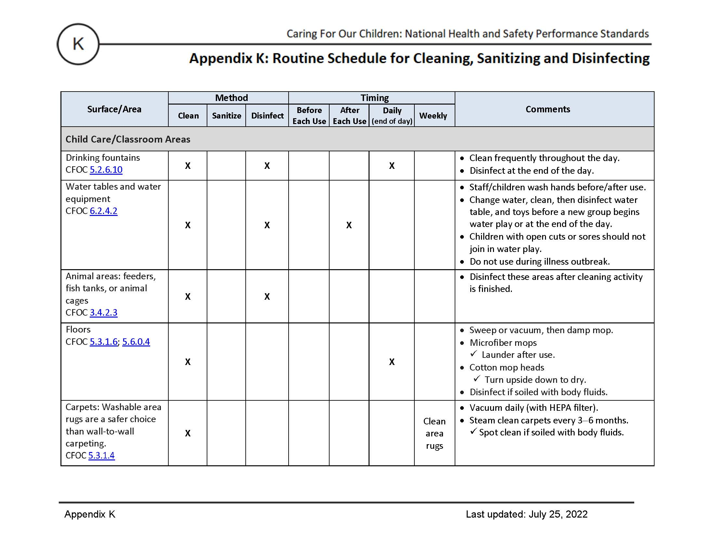
Updated January 2023
Notes:
Best practices on WHEN and WHERE to sanitize OR disinfect from Caring for Our Children
Note: Always clean first
Aligns with licensing and ECERS

Slide 51
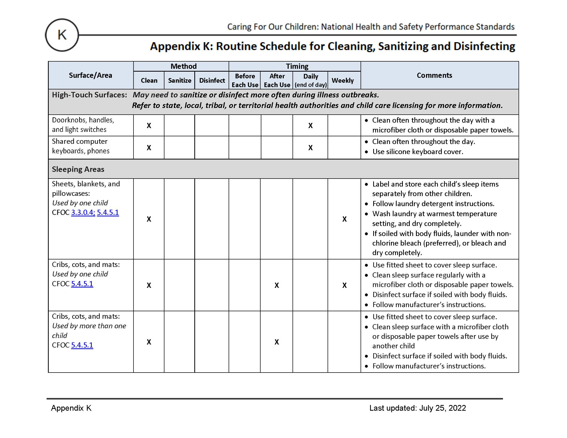
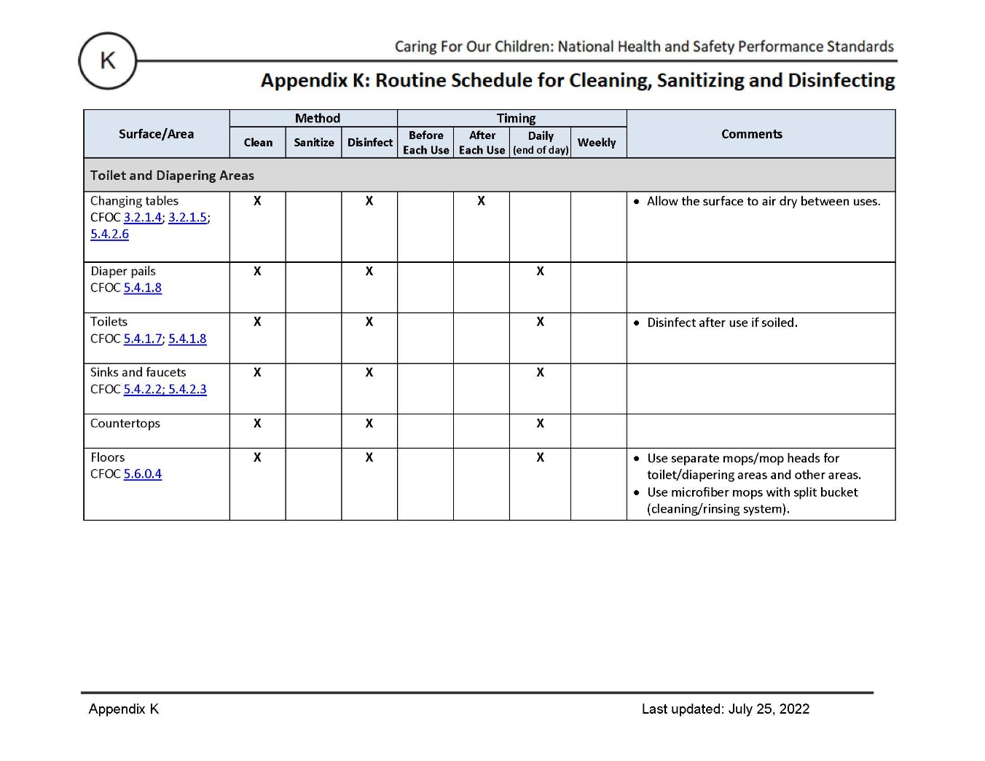
Updated January 2023
Notes:
Best practices on WHEN and WHERE to sanitize OR disinfect from Caring for Our Children
Note: Always clean first
Aligns with licensing and ECERS

Slide 52
Did you know?
Your body contains many more microbes (including bacteria and viruses) than human cells.
Even though some microbes can cause dangerous infections, you can't live without others.
Courtesy: National Human Genome Research Institute https://genome.gov
Exposure to microbes in early childhood is important for immune system development and digestive health.
Updated January 2023
Notes:
Only a small percentage of microbes cause disease. We are just beginning to understand the role that microbes play, but we are learning that they: help us to digest our food, regulate our immune system so it knows the difference between friend and foe (which prevents the development of allergies), and help protect us from disease-causing microbes (pathogens). It’s possible to do harm by over-sanitizing ( for example, creating super bugs and antimicrobial resistance). It’s important to use antimicrobials safely and not over use them.

Slide 53
Activity: Do you Clean, Sanitize or Disinfect?
Please refer to your handout Caring for Our Children, Appendix K
Mixed-use table
Changing table
Nap mat
Updated January 2023
Notes:
Appendix K.
List surface, have audience say sanitize or disinfect
Can you animate the slides and start with surfaces and have them identify either sanitize or disinfect? You can give them a slide with 5 rows - the full handout should be distributed with a reference to CFOC and our website - so they know where to find it online;

Slide 54
Activity: Do you Clean, Sanitize or Disinfect?
Please refer to your handout Caring for Our Children, Appendix K
Mixed-use table
Changing table
Nap mat
Clean & sanitize before serving food
Clean & disinfect after each use
Clean weekly or before use by another child or if soiled with body fluids.
Updated January 2023
Notes:
Appendix K.
List surface, have audience say sanitize or disinfect
Can you animate the slides and start with surfaces and have them identify either sanitize or disinfect? You can give them a slide with 5 rows - the full handout should be distributed with a reference to CFOC and our website - so they know where to find it online;

Slide 55
Cleaning, Sanitizing, and Disinfecting
Policy Activity
What are the key takeaway messages that can be put into a staff handbook or a parent handbook?
Updated January 2023

Slide 56
