Slide 1
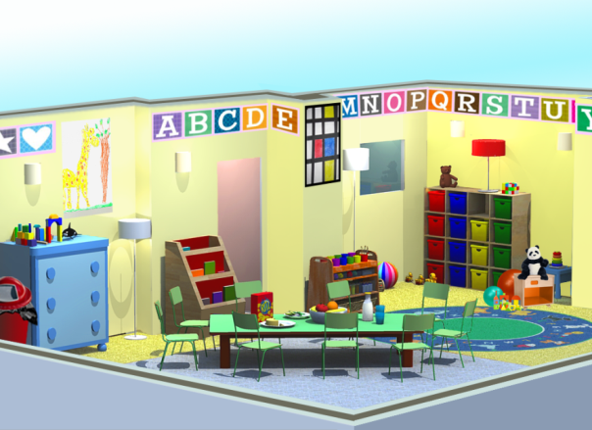
Integrated Pest Management (IPM) for Child Care Providers
UCSF School of Nursing, California Childcare Health Program
Healthy Schools Act Approved Course
Updated January, 2023
Notes:
Introduce yourself & project

Slide 2






Acknowledgements
Funding for this program was provided through a grant awarded by the California Department of Pesticide Regulation (DPR). The contents of this document do not necessarily reflect the views and policies of DPR nor does mention of trade names or commercial products constitute endorsement or recommendation for use.
Notes:
This Integrated Pest Management (IPM) workshop was funded by the California Department of Pesticide Regulation (DPR) and originally developed by the University of California (UC), San Francisco School of Nursing’s California Childcare Health Program, in collaboration with the UC Berkeley Center for Environmental Research and Children’s Health, the UC Statewide IPM Program, and DPR. The contents of this document do not necessarily reflect the views and policies of DPR, nor does mention of trade names or commercial products constitute endorsement or recommendation for use.

Slide 3
Icebreaker questions
What’s your name?
What’s the pest that bothers you the most?
Draw a simple picture of your favorite bug.

Slide 4
Why are we here today?
Goal: To protect the health of children, child care staff, and the environment.
You will learn about:
The Healthy Schools Act (HSA)
2. Pests and Pesticides: the risks of pests and pesticides to children & the environment
3. Integrated Pest Management (IPM): a safer approach to pest management

Slide 5
By the end of today, you will be able to:
Explain the requirements in California’s Healthy Schools Act.
Answer: What is a pest? What is a pesticide? What is integrated pest management (IPM)?
Explain why children are vulnerable to the potential health risks of pesticides.
Identify simple, common sense IPM methods to prevent or manage common pests.
Inspect and monitor your child care facility for pests or conditions that attract pests using the IPM Checklist.
Notes:
What are the five things we hope you’ll take away from this presentation?
There’s a strong relationship between pest, pesticides, children, and health and integrated pest management methods are designed with this in mind.
This presentation will teach you how you control pests both inside and outside of your center.
It will also teach you what IPM is and isn’t, and how you can implement an IPM program in your center.
In addition to this information being about best practices, it’s also about the law. Today we’ll learn more about the Healthy Schools Act and what your responsibilities are in order to be compliant with it.

Slide 6
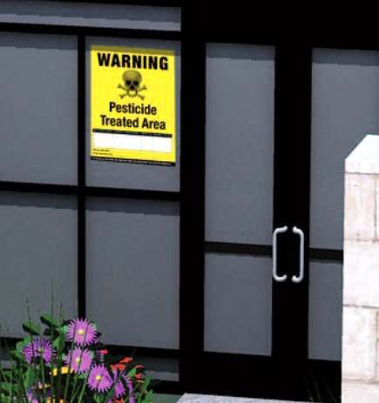
The Healthy Schools Act (HSA)
A right-to-know law that informs parents and staff about pesticide use at public schools and child care centers.
Assures healthy, safe learning and care environments for California children.
Applies to public K–12 schools and public and private licensed child care centers.
Does not apply to family child care homes.
Notes:
Has anyone heard of the Healthy Schools Act? What can you tell me about it?
In 2007, California Law AB 2865 extended the Healthy Schools Act to child care centers. Many ECE providers are unaware of their responsibilities under the HSA.
Even though the HSA does not apply to family child care homes, there is great value in protecting children’s health using IPM strategies in this setting. Guidance for safer pest management and IPM specific to family child care homes is available on the CCHP website: https://cchp.ucsf.edu/content/integrated-pest-management-toolkit-family-child-care-homes
Who is responsible for helping to implement the Healthy Schools Act? The California Department of Pesticide Regulation (DPR) is responsible for helping schools and child care centers implement IPM practices. You may request information from the California DPR about starting an IPM program in an ECE facility by contacting The California Department of Pesticide Regulation’s Growing Up Green Program. Contact information is available online at http://apps.cdpr.ca.gov/schoolipm/childcare/

Slide 7
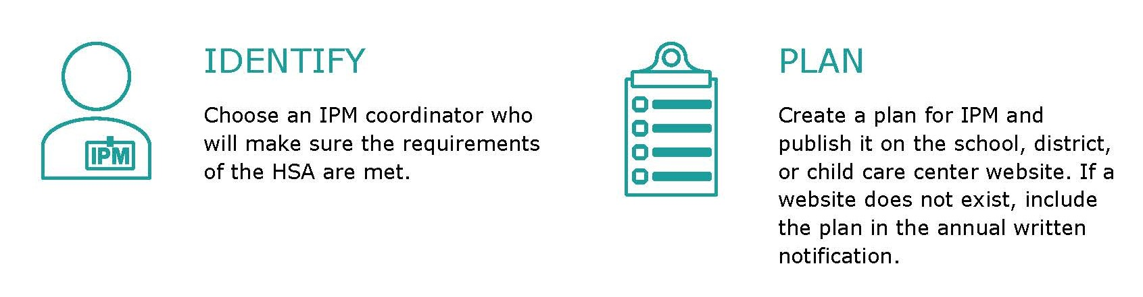
Healthy Schools Act Requirements
Notes:
You may be familiar with these requirements (next 4 slides):
1. Identify a person at the center to make sure the requirements are met, AKA the Integrated Pest Management Coordinator
2. Develop an IPM plan
Use the template provided by the Department of Pesticide Regulation (DPR); or get your own IPM plan approved by DPR;
Post the IPM plan on your program’s Web site; if you do not have a Web site send the IPM plan to all parents, guardians, and staff with the annual written notification
Post a paper copy of the plan in your center or school office

Slide 8
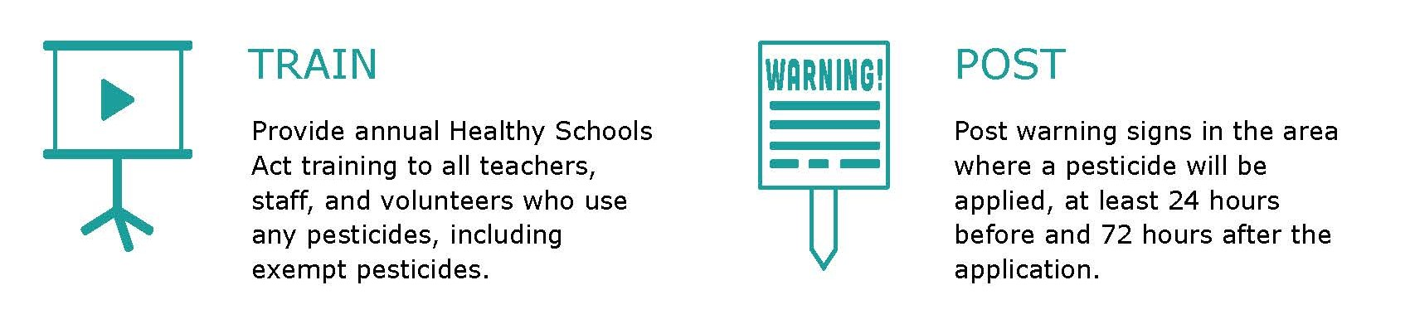
Healthy Schools Act Requirements
Notes:
Complete IPM training
This training is required for the IPM coordinator and anyone who will apply pesticides (including disinfectants) at the child care program
Training must be repeated every year
Post signs
Notify parents and staff before pesticides are applied
Post warning signs around each area where nonexempt pesticides will be applied (sprays, foggers, or uncontained pellets or powder) .
These signs should be posted 24 hours before and stay in place 72 hours after pesticides are used.

Slide 9
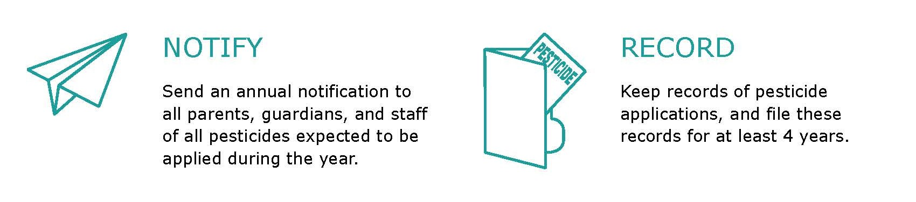
Healthy Schools Act Requirements
Notes:
Notify
Every year, let everyone know in writing which pesticides are expected to be applied by center staff or pest management professionals in the upcoming year.
Record
Keep records about nonexempt pesticides (sprays, foggers, or uncontained pellets or powder) used by staff and contractors in the past 4 years

Slide 10
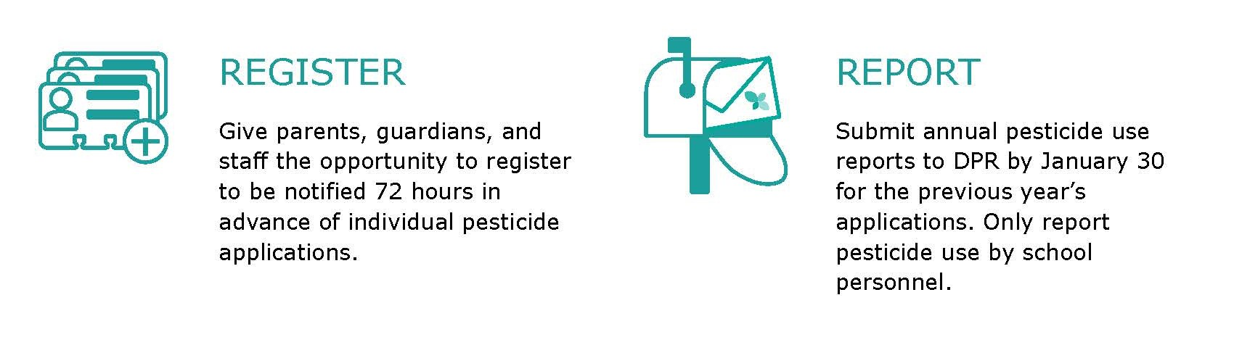
Healthy Schools Act Requirements
Notes:
Register
Maintain a list of parents and staff who want to be told when non exempt pesticides (sprays, foggers, pellets or powder if uncontained) are going to be used
Notify everyone on the register early--at least 72 hours before they are used
Make sure to report non exempt (sprays, foggers, or uncontained pellets or powder) pesticide use each year.
send pesticide use reports for pesticide applications made by schoolsite employees to DPR annually or more frequently
DO NOT submit pesticide use reports for pesticides applied by contractors; they will submit their own reports to DPR
submit reports no later than January 30 for the previous year (for example, submit your 2023 reports no later than January 30, 2022)
use the DPR form HSA-118 (Pesticide Use Reporting For School And Child Care Employees) which is available on the DPR School IPM Web site https://www.cdpr.ca.gov/docs/schoolipm/

Slide 11
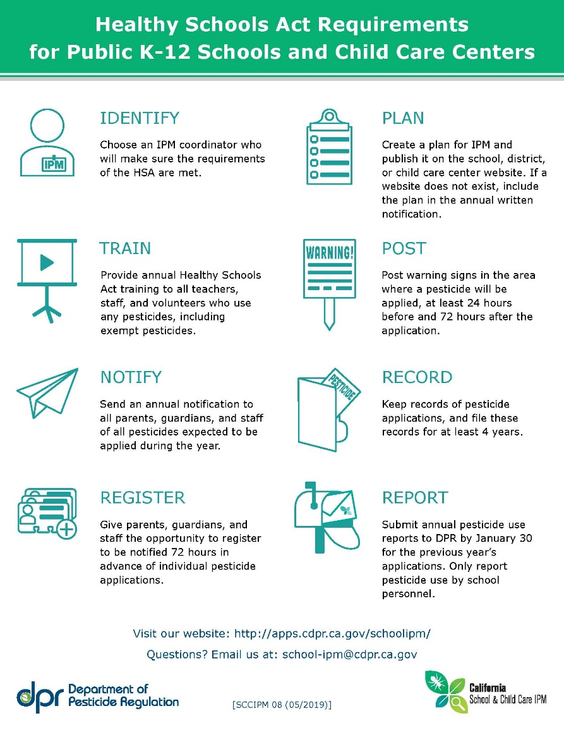

Slide 12

Be Sure to Communicate with…
Property Owners
Pest Management Professionals(PMP)
Custodians/Janitorial Service
Volunteers
Photo credit: UCSF
The Healthy Schools Act has specific requirements for property owners and pest management professionals. More information can be found on the DPR website.
Notes:
Sometime people are not informed about the HSA. The Healthy Schools Act has very specific requirements for property owners and pest management professionals. Be sure to share this information to protect children and staff in you center. It’s important to be aware of everyone who might be using pesticides in your center.

Slide 13
Exempt / Non- Exempt Products
HSA applies to pesticides that are in the form of:
Sprays
Foggers
Pellets or powder, if uncontained
Exempt Pesticides (no notification or records needed)
Products that use pesticides in a bait, trap, gel, or crack/crevice treatment
Products used to kill germs (antimicrobials), such as sanitizers and disinfectants
Minimum risk pesticides exempt from product registration with U.S. EPA, or 25(b)products
Annual training is required even when using exempt products!
Notes:
Pesticides in the form of sprays, foggers or pellets / powder are referred to as “nonexempt” in the Healthy Schools Act.
Products that use pesticides in a bait, trap, or gel or are used to kill germs (antimicrobials), such as sanitizers and disinfectants, are exempt (not covered by the law). this means that parents and staff do not need to be notified when these pesticide products are used, and records do not have to be kept of their application.
HOWEVER, if you apply any type of pesticide, exempt or not, you still have to take the IPM training.

Slide 14
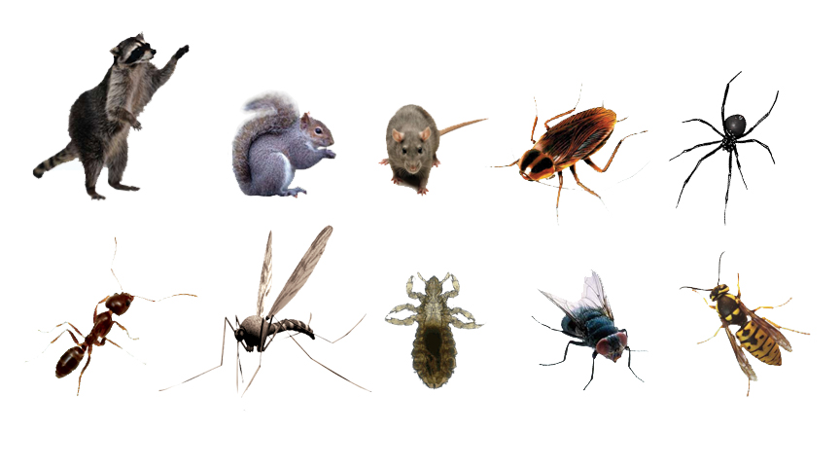
What is a pest?
A pest is any living organism that causes damage or discomfort, or transmits or produces disease.
Notes:
Who can tell me what a pest is? Let audience throw out some ideas before you click and show them the definition. Then, before showing the image with all of the pests, ask audience for some examples of pests.
A pest can also be something that is simply where it is not wanted, such as clover in a grass play area. Rats, mice, cockroaches, house flies, raccoons, skunks, pigeons, squirrels, ticks, ants, weeds, and bacteria are all examples of different types of pests. Make sure something is really a pest before you remove it. It’s important to remember: something that is a pest in one situation can play an important role in the environment in other settings. For example, Yellowjackets in ECE yards can sting, causing mild to highly allergic and life threatening reactions, but they also eat large numbers of caterpillars, house flies and other pest insects.

Slide 15
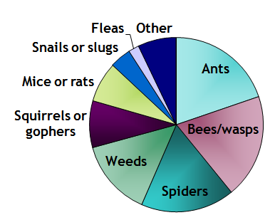
What are the most common OUTDOOR pests in California child care centers?
Bradman, A. , Dobson, C., Leonard, V. & Messenger, B. (2010). Pest Management and Pesticide Use in California Child Care Centers, Center for Children’ s Environmental Health Research, School of Public Health, UC Berkeley at apps.cdpr.ca.gov/schoolipm/childcare/pest_mgt_childcare.pdf.
Notes:
What outdoor pests are you dealing with or have you dealt with? Ask staff about their experiences? People like to share their stories but make sure to cap it at a few comments!

Slide 16
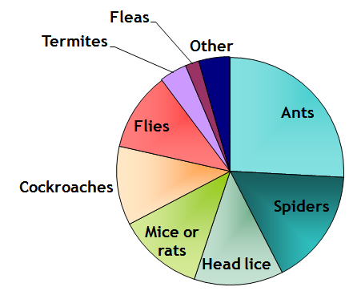
What are the most common INDOOR pests in California child care centers?
Bradman, A. , Dobson, C., Leonard, V. & Messenger, B. (2010). Pest Management and Pesticide Use in California Child Care Centers, Center for Children’ s Environmental Health Research, School of Public Health, UC Berkeley at apps.cdpr.ca.gov/schoolipm/childcare/pest_mgt_childcare.pdf.
Notes:
What outdoor pests are you dealing with or have you dealt with? Ask staff about their experiences? People like to share their stories but make sure to cap it at a few comments!

Slide 17
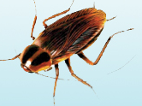

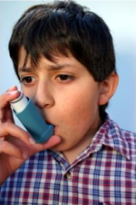
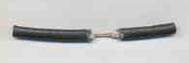
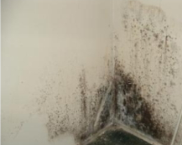
What problems can pests cause?
Health Problems
Building Damage
Spread Bacteria
Allergies
Trigger Asthma
Parents & staff are upset when they see pests
Rats Eat Wires
Mold & Termites Damage Building
Notes:
So we’ve seen some of the pest problems in childcare facilities, but why do we care? How are pests bad for children?
There are three major categories of concern with pests. The first one is health problems. Pests such as cockroaches or mice can spread bacteria. For instance, a roach can walk across the toilet or in the trash on uncooked meat or rotting food and then across plates and tables where we eat. Pests can also cause allergies or asthma. Roaches can trigger asthma because when they shed their skin to grow, they release a “dander” much like a cat. This has been shown to be an asthma trigger. Mice have also been shown to trigger asthma because of their fur and urine smells.
Pests can also cause building damage. Rats can through wires, which can be an electrical danger. Mold and termites can damage the structural integrity of a building.
Parents and staff are upset when they see pests, and often want to get rid of them as quickly as possible.

Slide 18
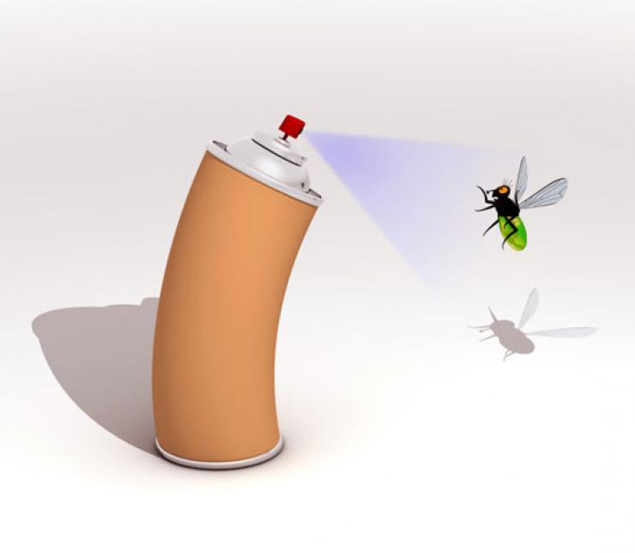
What are pesticides?
Examples:
Roach and ant spray
Flea bombs
Rat poison
Weed killer
Mothballs
Insecticide chalk
Also disinfectants and contained pesticides such as baits and gels
Pesticides are poisons that are designed to kill or control living things.
Notes:
We’ve seen that pest problems exist in child care centers. Now let’s take a look at one traditional solution to pests (pesticides) and why this is no longer the recommended method of pest management. Later today, we’ll go through and learn about what is recommended!
What are pesticides? Can anyone come up with a definition? Think about why we use pesticides…
A pesticide is a poison that is designed to kill or control living things such as weeds, bugs, spiders, or anything that you do not want to live in your child care facility or yard. All pesticides are potentially harmful. This is particularly the case if the label instructions are not followed precisely. Pesticides should be used as a last resort. Pesticide sprays and foggers are especially harmful and should be avoided in child care programs.
Can anyone think of some examples of pesticides? Show pesticide examples.
Today, we’ll teach you safer, non-toxic alternatives to pest management.

Slide 19
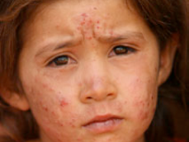
Concerns about Pesticide-Use
Potential Health Outcomes
Immediate
Flu-like symptoms
Skin Rash
Breathing problems
Long-Term
Asthma
Cancer
Damage to brain and nervous system
Immune system damage
Endocrine disruption
www.toxicsoy.org/toxicsoy/news/Artikelen/2009/7/1_Girl_suffering_from_pesticide_poisoning.html
Notes:
There are many concerns associated with pesticide-use. In fact, risk from exposure may outweigh the benefit of killing pests. One significant concern is health outcomes. Many studies have shown that exposure to pesticides can cause immediate reactions, and we know that there can also be long-term health problems.
Exposure to pesticides over a long time may also cause sickness or affect development. New studies show that children regularly exposed to low levels of pesticides may not be poisoned or get sick right away, but they may suffer from health problems that don’t show up for many years.
This image is from a study from Mexico on exposure to pesticides. Children ages 4-5 years old in two different communities were asked to draw a picture of a person. On the left are children’s drawings who lived in the foothills where pesticide were not used and on the right are children’s drawings who lived in the valley where pesticide use was used widely. You can see the difference in the drawings of the kids.

Slide 20

Concerns about Pesticide-Use
Potential Health Outcomes
Vulnerable Populations
• Children
• Pregnant women
• Elderly
• People with breathing or lung disorders
Notes:
Though exposure to pesticides can be harmful to anyone, it’s particularly harmful to certain, more sensitive populations. Children are at the top of this list, but pregnant women, the elderly, and anyone with breathing or lung problems are also at a higher risk.

Slide 21
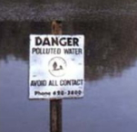
Concerns about Pesticide-Use
Potential Health Outcomes
Vulnerable Populations
Potential Environmental Damage
Ground & surface water contamination
Poisoning of aquatic animals
Notes:
In addition to human health, pesticides are also a concern for environmental health. Pesticide use can contaminate ground water and surface water, and poison aquatic animals.

Slide 22
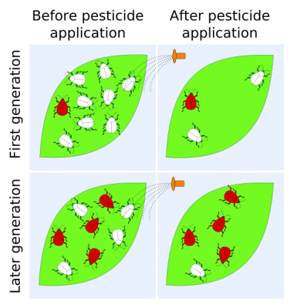
Concerns about Pesticide-Use
Potential Health Outcomes
Vulnerable Populations
Potential Environmental Damage
Pest Resistance
Pests can become resistant
en.wikipedia.org/wiki/File:Pest_resistance_labelled_light.svg
Notes:
There is a risk that pest populations will become resistant to pesticides, which means you’ll need to use stronger pesticides to achieve the same effects.

Slide 23
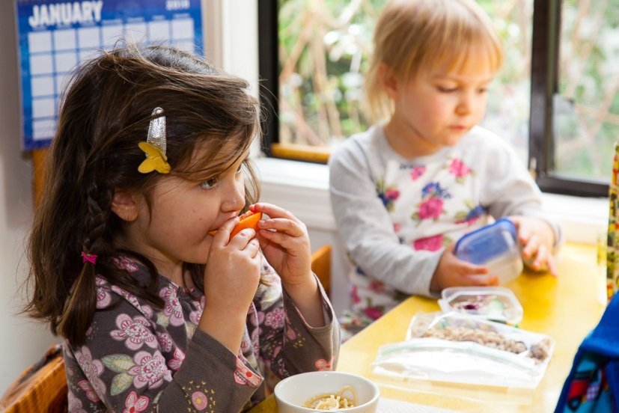
Why are young children vulnerable?
1. They have a higher risk of exposure because they:
play on the ground or floor, where pesticides can collect
have more hand-to-mouth activity
eat, drink, and breathe more per pound
spend most of their time indoors
Notes:
Children have a special vulnerability to pesticides: they breathe the air closer to the ground level where pesticides are applied and settle in dust, are more likely to put their hands in their mouths or rub their eyes without washing their hands, and spend most of their time indoors. They have a less varied diet and eat, drink, and breath about two times as much per kilogram as adults.

Slide 24

Why are children more vulnerable?
2. They are growing and developing
Brain and organ development
Nervous system development
Notes:
In addition to having a higher exposure, children also have a harder time breaking down toxins. Their bodies — and their defenses against toxins — are still developing. Toxic exposure during development damages function.
Because they’re young and unable to read labels, or understand warnings, they don’t recognize the hazards of going near areas where pesticides have been applied.

Slide 25
Why are children more vulnerable?
3. They don’t recognize hazards
Can’t read labels
Naturally curious and get into everything
Almost half of all reports to the Poison Control Center are about children under age 6 years.
United States Poison Control Center reported over 31,000 cases of possible pesticide poisoning in young children (under age 6 years) for 2020.
David D. Gummin, James B. Mowry, Michael C. Beuhler, Daniel A. Spyker, Alvin C. Bronstein, Laura J. Rivers, Nathaniel P. T. Pham & Julie Weber (2021) 2020 Annual Report of the American Association of Poison Control Centers’ National Poison Data System (NPDS): 38th Annual Report
Notes:
In addition to having a higher exposure, children also have a harder time breaking down toxins. Their bodies — and their defenses against toxins — are still developing. Toxic exposure during childhood can damage organ function and neurological development.
Because they’re young and unable to read labels, or understand warnings, they don’t recognize the hazards of going near areas where pesticides have been applied.

Slide 26
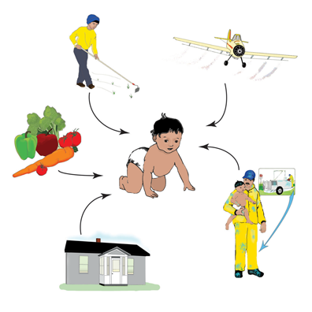

What are the Possible Pathways of Exposure for Children?
By eating
By breathing
Through skin
Across the placenta (in the womb)
Notes:
We know that children are more vulnerable – let’s take a look at ways that pesticides can get into children’s bodies
Most pesticide exposure is through the skin—the largest organ—and children have much more skin surface area for their size than adults. Similarly, their higher respiratory rate means they inhale airborne pesticides at a faster rate.
Although pesticides contaminate air, soil, food, water, and surfaces, studies that examine children’s pesticide exposure indicate that the largest number and highest concentrations of chemicals often accumulate in household dust. Because children’s breathing zones are closer to the ground, they incur greater exposure to pesticides in carpets and dust than adults. Some pesticides can linger indoors for months and years.

Slide 27
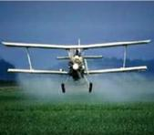
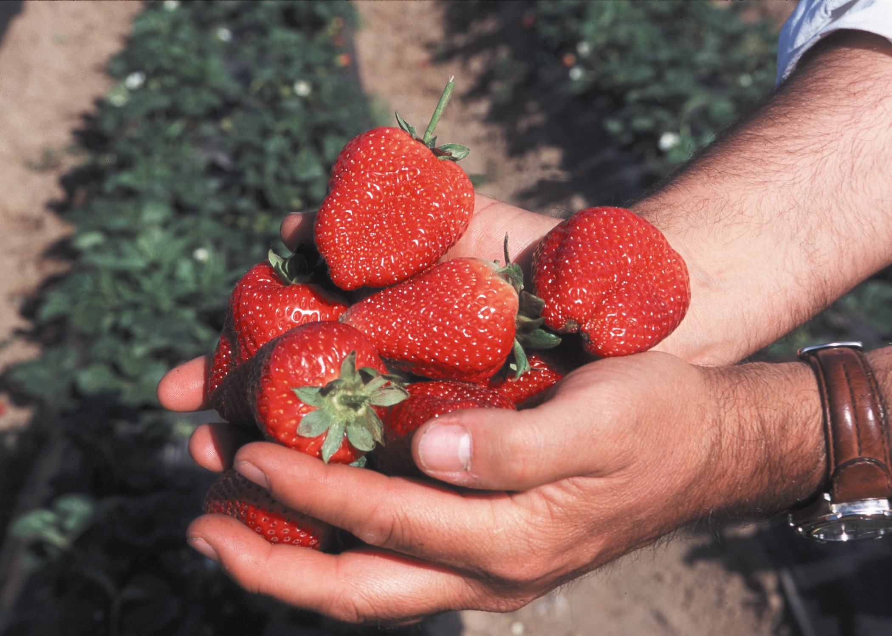
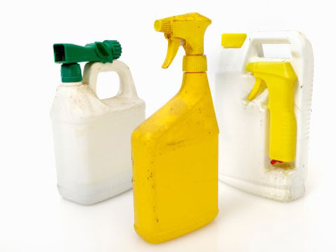
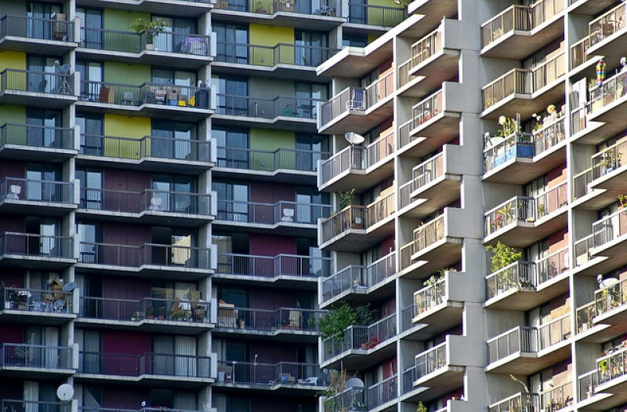

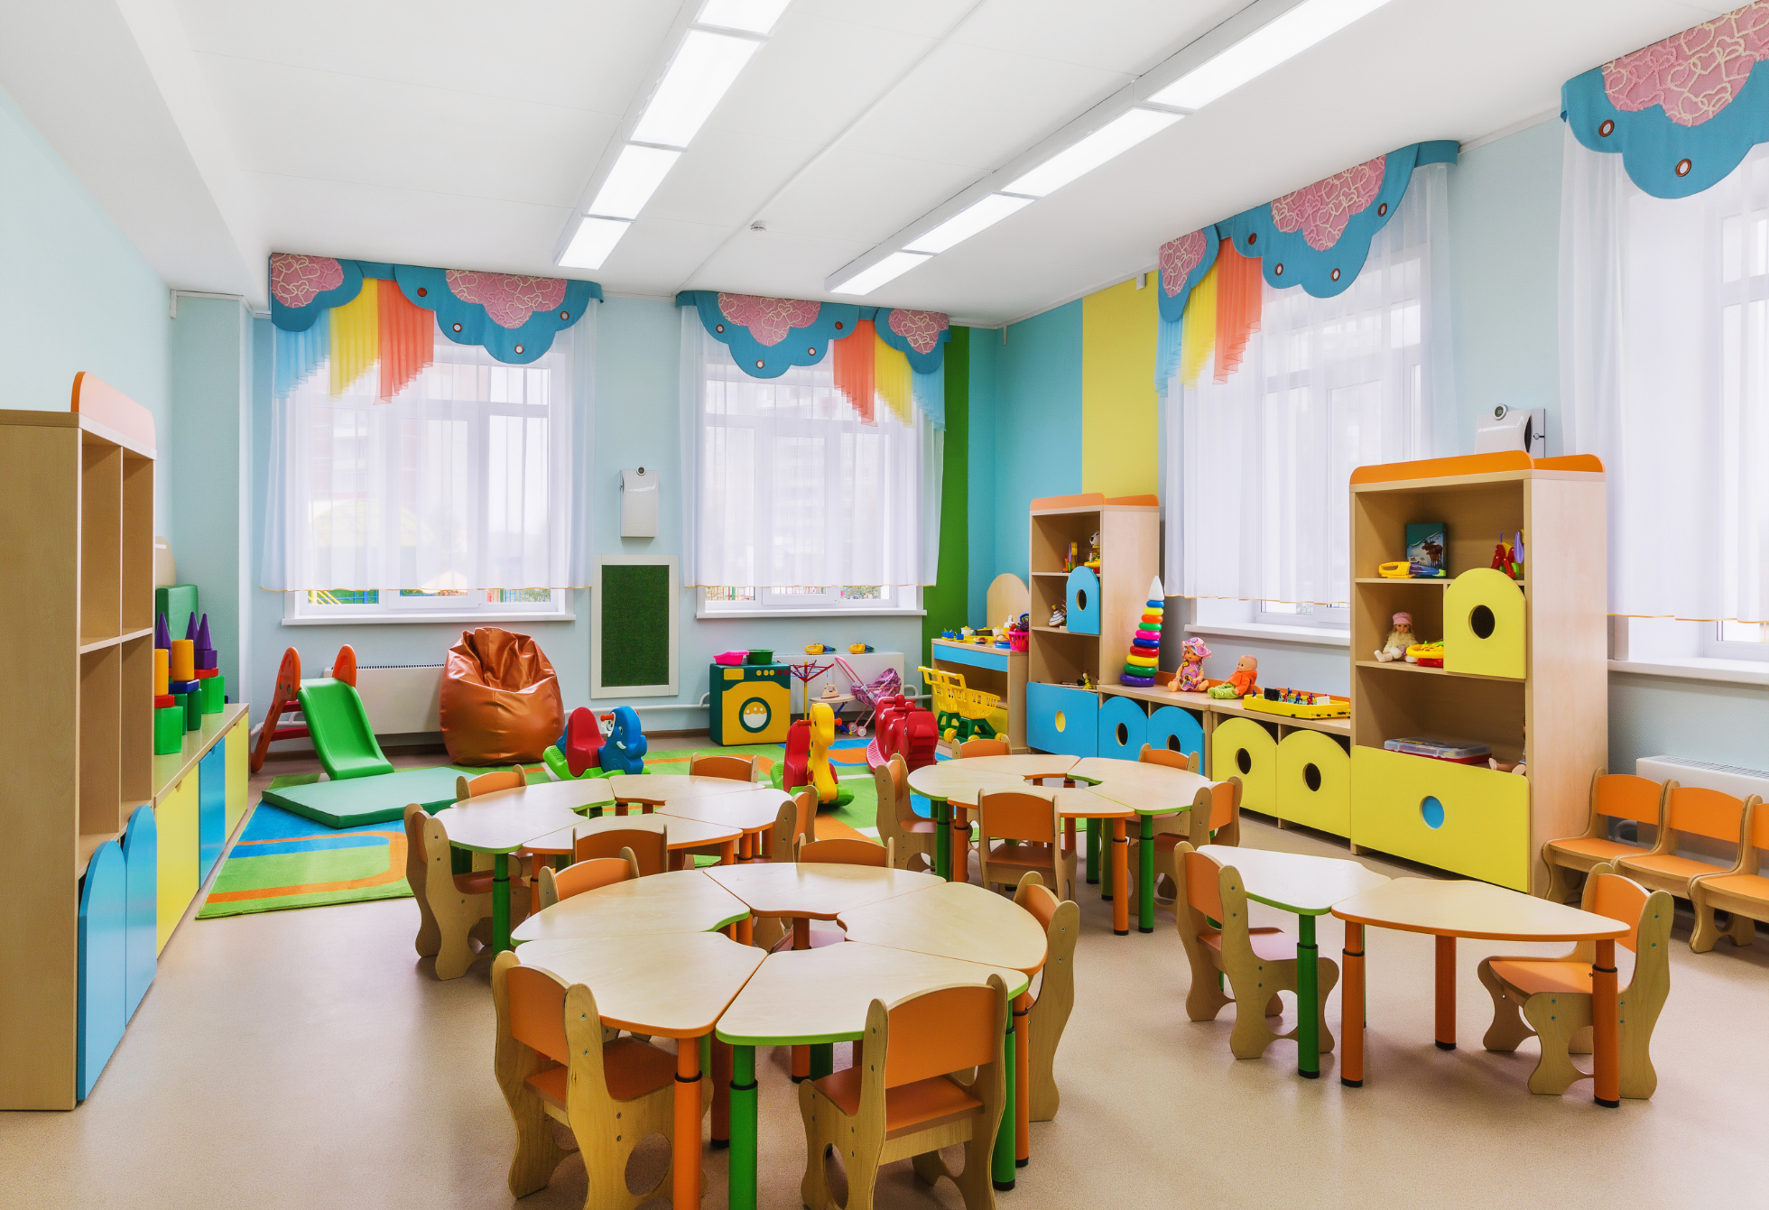
Where could pesticides be found?
Fruits & Vegetables
Agricultural Fields
Household Products
Child Care Homes
& Centers
Housing
Contaminated
Water
Sanborn et al. Identifying and Managing Adverse Environmental Health Effects: 4
Pesticides. CMAJ May 28, 2002: 166 (11): 1431-1436
Notes:
Just to give you an idea of how pervasive and present pesticides are in our daily lives, let’s look at where they can be found. This helps us think about where we need to put our attention and energy to make sure that children have the lowest pesticide-exposure possible.
Pesticides can be used outside, such as in gardens. They are also commonly used in and around buildings such as homes and classrooms.

Slide 28
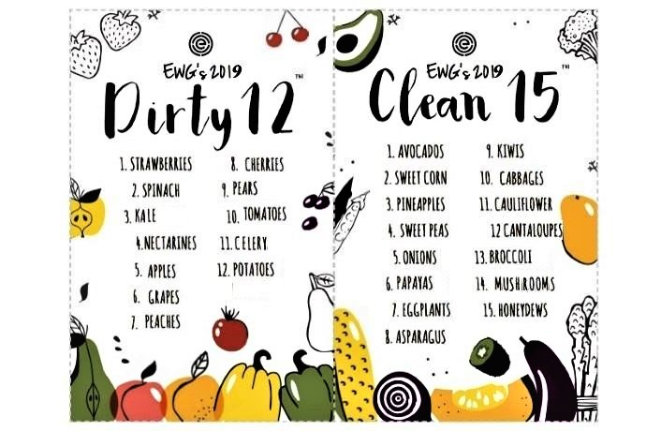
Environmental Working Group (EWG)
Find the guide at http://www.ewg.org/foodnews/
*List based on pesticide residue data from USDA and FDA from 2003-2017
Notes:
We know that pesticides are found in fruits and vegetables, but not everyone can afford to buy organic produce all the time. The Environmental Working Group (EWG) puts together an annual guide to help shoppers prioritize which produce to buy organic.
EWG’s Shopper’s Guide to Pesticides in Produce™, updated every year since 2004, ranks pesticide contamination on 48 popular fruits and vegetables.
Parents looking for help in lowering their children’s exposure to pesticides while still eating plenty of healthy fruits and vegetables can turn to EWG’s guide as an easy-to-use resource when shopping at the store.

Slide 29
How common is pesticide-use?
California Child Care Pest Management Survey
Pest problem present | 90%
Using any pesticides | 55%
Using spray or fogger | 47%
Using at least one IPM approach | 65%
Aware of IPM | 25%
Bradman, A. , Dobson, C., Leonard, V. & Messenger, B. (2010). Pest Management and Pesticide Use in California Child Care Centers, Center for Children’ s Environmental Health Research, School of Public Health, UC Berkeley at apps.cdpr.ca.gov/schoolipm/childcare/pest_mgt_childcare.pdf.
Notes:
The Department of Pesticide Regulation funded a survey of child care centers in California that will be released shortly. This table outlines what the survey found. Before we show you, does anyone have any guesses about what percent of child care centers in California have pest problems? What about use pesticides?
Despite what we know about the consequences of using pesticides, we’re still using them. Notice especially that 55% of centers are using pesticides, and 47% are using sprays or foggers which are the most dangerous, and uncontained form of pesticides.
We have a problem: We just learned how harmful pesticides can be, especially to children, and now we see that over half of the child care centers surveyed use them. This leads us to our next slide..

Slide 30
Notes:
Evidence of EPA review. Look for How to Use safely.

Slide 31

Pesticide Storage
Store pesticides in the original, labeled containers.
Keep Safety Data Sheets (SDS) on site for each toxic substance/chemical.
Toxic substances should be inaccessible to children and stored in a locked room or cabinet when not in active use.
Bleach solutions are labeled with contents and date mixed.

Slide 32
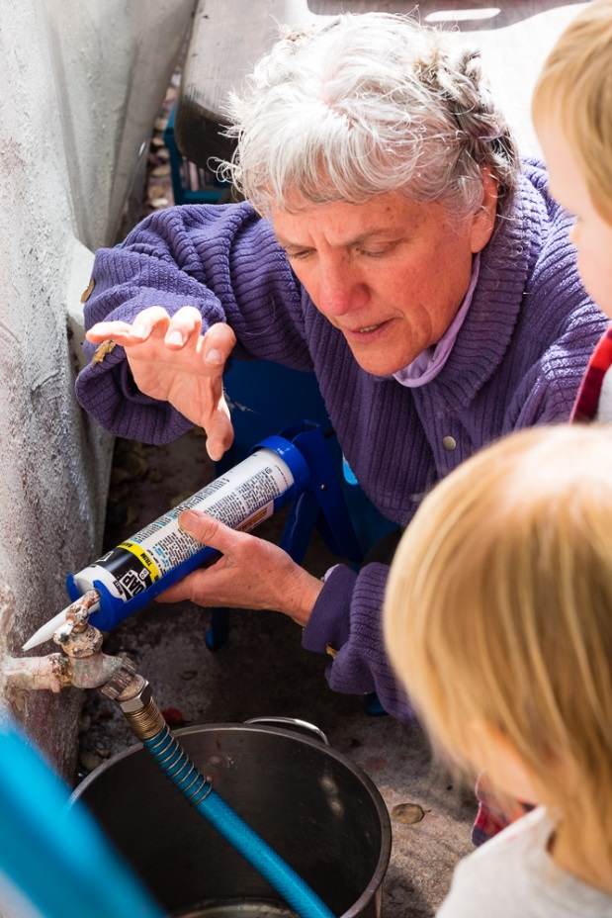
What is Integrated Pest Management (IPM)?
An approach to managing pests that focuses on:
Preventing infestations (by keeping pests out and getting rid of food, water, and shelter)
Monitoring pests
Reducing the use of pesticides
Minimizing health risks to people and the environment.
Notes:
IPM keeps pests out while reducing the use of pesticides
Integrated Pest Management (IPM) is an approach to controlling pests in safer, more effective, and longer-lasting ways.
Manages pest problems by
Using non-chemical approaches.
Using least-toxic pesticides
IPM works because combined approaches for pest management are more effective in the end than a single approach, like spraying pesticides.

Slide 33
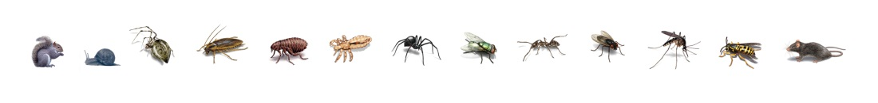
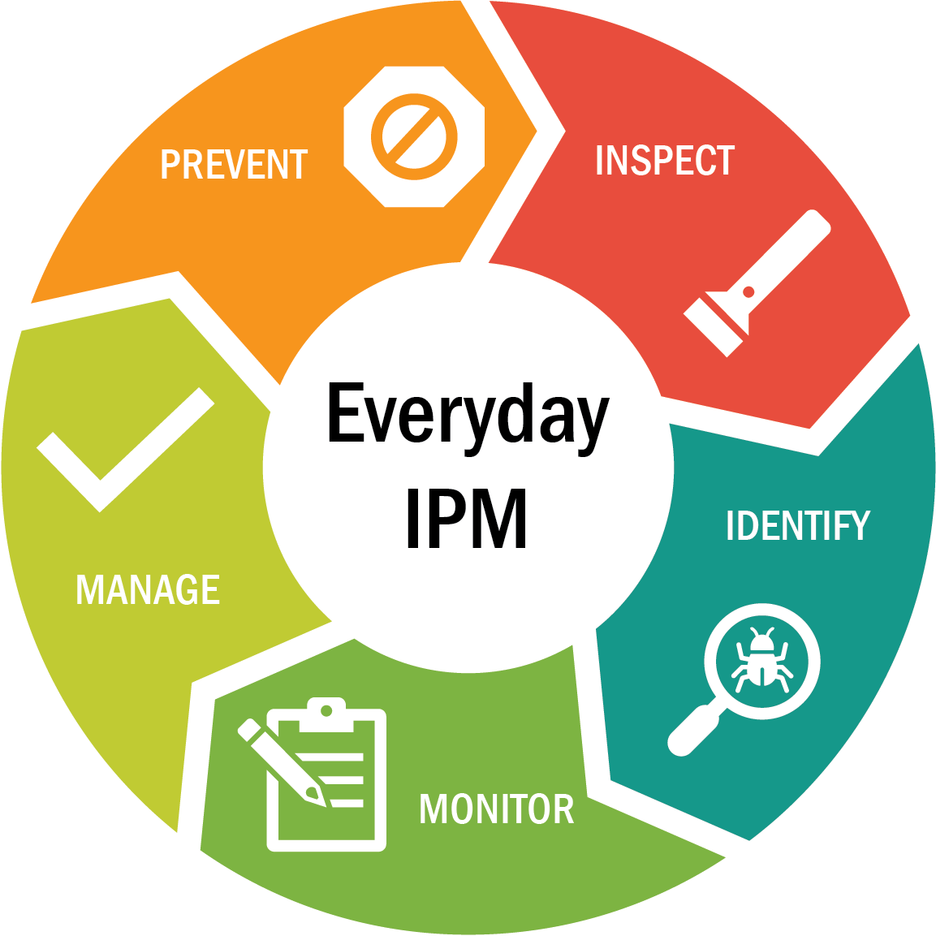
The Integrated Pest Management (IPM) Cycle
Notes:
Prevention: Keep pests out; Remove pests' food, water, and shelter
Inspect - Look for signs of pests; Evidence, Damage, The pests themselves; Where and how are they coming in?
Identify Pests - What kind of pests are you finding? Where do they live? What do they eat? What is their life cycle?
Monitor - Continue inspecting and evaluating; Use the IPM Checklist for FCCHs
Manage existing pest problems: Clean thoroughly ; Vacuum and trap; Use baits and gels, not sprays
Out of all of the strategies, prevention is the key to IPM. In practice, many of the strategies we describe in these categories are used in more than one category of IPM. For example, keeping ants out of your building is an important prevention strategy, but it is also a strategy used when managing an ant infestation.

Slide 34
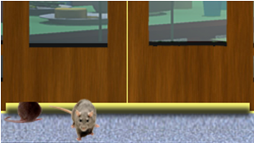
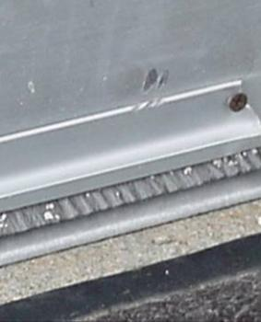
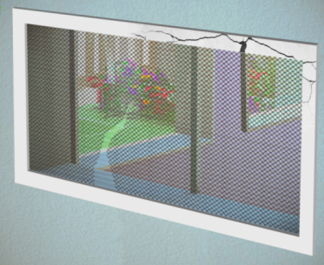
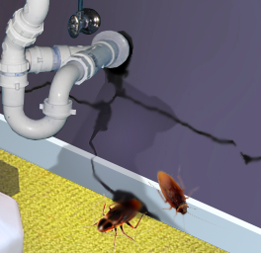
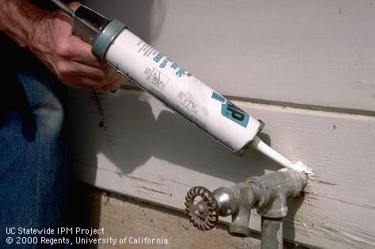
Prevention: Keep Pests Out
Seal or block gaps around doors.
Install doorsweeps.
Take home message: Close off entryways so pests can’t get into your facility in the first place!
Patch holes in screens
Seal gaps around pipes
Notes:
Create physical barriers on the outside of the building so pests cannot enter the facility:
Prevention is always the preferred way to manage pests in an IPM program.
It is a popular misconception that pest infestations (i.e. cockroaches and rats) are the sole result of uncleanliness. While uncleanliness may exacerbate an infestation, the problem itself is often due to a structural issue (i.e., cracks in the walls, leaky pipes, excessive moisture from to plants situated too close to the structure).
34

Slide 35
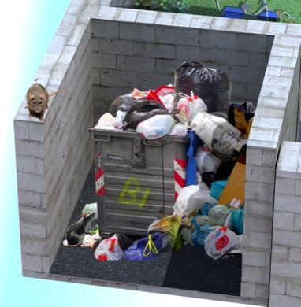
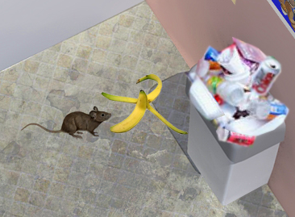
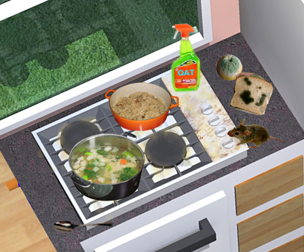
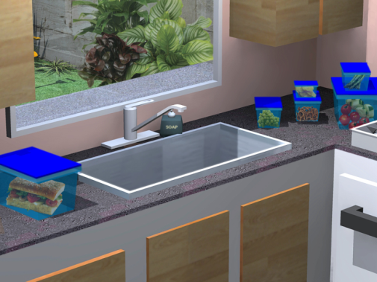
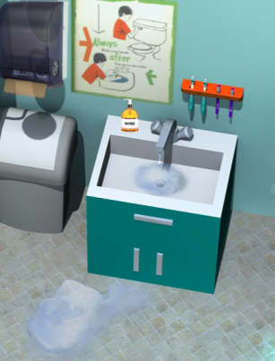
Prevention: Remove Pests’ Food & Water
Eliminate sanitation & garbage problems
Clean up food before pests are attracted to leftovers
Take home message: Pests need food and water to survive. Take away their access to these things, and you’re taking away their diet!
Eliminate standing water, clogged sinks & leaking faucets
Store food & art supplies
in sealed containers
Notes:
Like any living being, pests needs three things to survive: food, water, and shelter. Without food, water or shelter, pests will leave or die. Taking away these things, one-by-one, is the best and safest way to control pests!

Slide 36

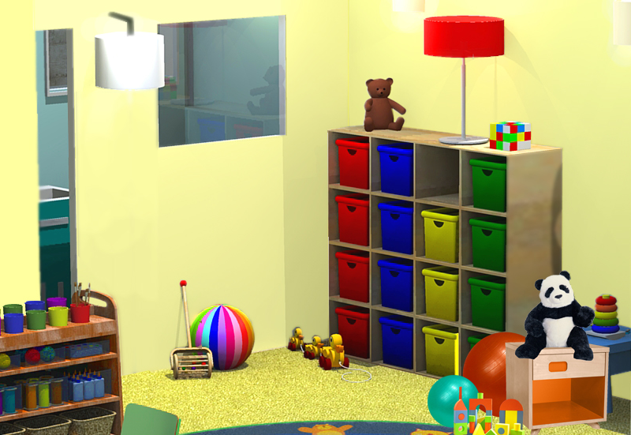
Prevention: Remove Pests’ Shelter
Replace cardboard boxes with plastic containers with lids
Take Home Message: Without shelter, pests will pack their bags and find a new home outside of your ECE facility.
Organize! Clutter provides hiding spots for pests and covers up their evidence
Notes:
Cockroaches love cardboard boxes. They lays their eggs in cells and eat the paste.

Slide 37

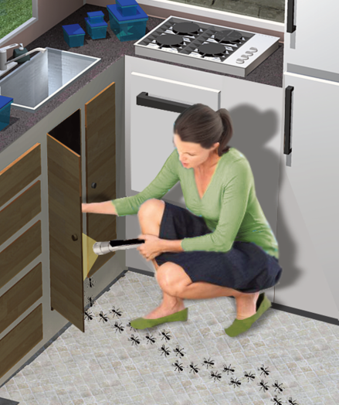
Inspection
Use the IPM Checklist to look for:
pests
signs of pests and their damage
conditions that might attract pests
Notes:
Use checklist to focus on problem areas and find any evidence of pest problems. The IPM Checklist is available on the CCHP website www.ucsfchildcarehealth.org under publications/training curriculum.

Slide 38

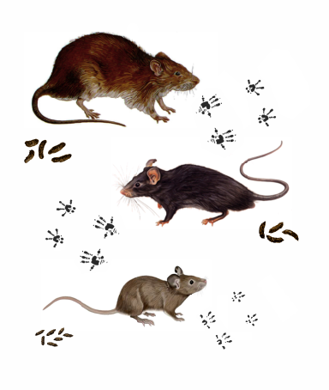
Identification
Identify what kind of pest you have.
Use Health & Safety Notes to understand pests’ lifecycle, food and shelter.
Visit the Statewide IPM program website for additional information www.ipm.ucdavis.edu
Norway Rat
roof rat
house mouse
Notes:
When you practice IPM, you have to identify the pests in your facility and know their characteristics and life cycles. If you don’t know which pests are present, you may use the wrong management approach, choose the wrong pesticide, or treat too often or at the wrong time and do more harm than good.
Use H&S Notes to help with identification
-Pest prevention begins with correct identification of the pest and knowledge of its needs and entry points. Available food, water, hiding places and entry points must be eliminated for long-term suppression of a pest.
Food: What foods do they eat?
Water: What are their sources of water?
Shelter: How do they get inside? Where do they hide?
Do they burrow or find their way into existing cracks and holes?
Do they enter a building on cardboard boxes or in food?
What damage does a pest cause?
Life cycle of pests:
How long does it take for a pest to grow to adulthood and reproduce?
At what stage of its life cycle does it cause the most problems?
How fast do the pests reproduce?

Slide 39
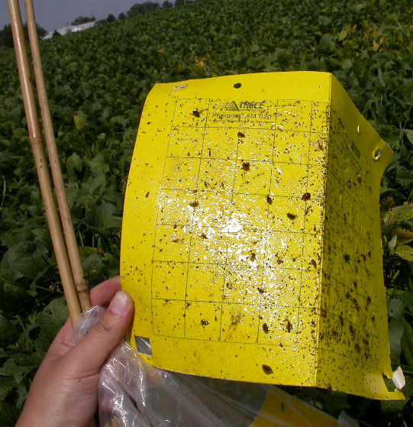
Monitoring
Regularly inspect the facility for pests and pest damage.
Identify sources of food, water and shelter that might attract pests.
Identify where pests are living and breeding.
Determine if and when treatment is needed.
Assess whether current actions are working.
Take Home Message: Monitoring is an ongoing process!
http://ipcm.wisc.edu/Portals/0/Blog/Files/19/199/sticky%20trap.JPG
Notes:
Place traps wisely and have schedule to check and replace them
Always look for pests in the buildings and grounds to identify pest problems early and to:
determine if and when treatment is needed
determine whether current strategies are working
39

Slide 40
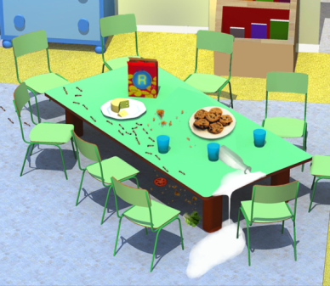
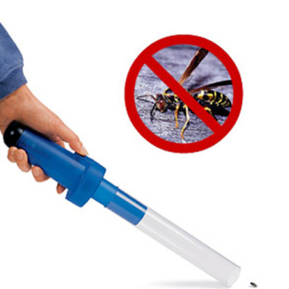
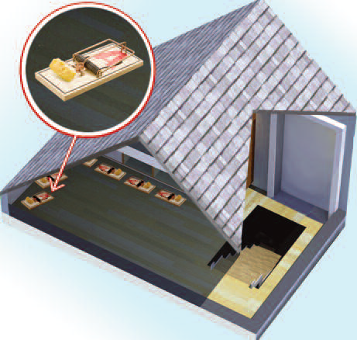
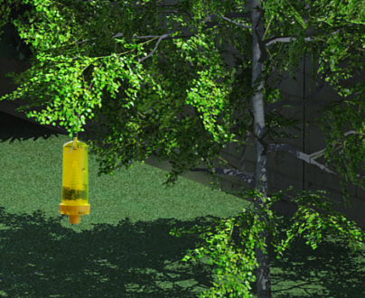
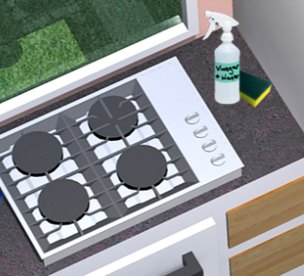
Management
Often you can manage pests without using chemicals. IPM-recommended techniques include:
Vacuum to remove pests
Prevention
http://reviews.walgreens.com/2001/prod3447245/koolatron-mini-bug-vacuum-1ea-reviews/reviews.htm
Take Home Message: Keeping things clean and in good repair is key to IPM!
Wash areas with soap and water
Place traps
Notes:
Not all pest problems require chemical solutions. For example, vacuum cleaners, sanitation and caulking may be enough.
When pests become a problem, you will need to do something to manage or suppress them. The IPM approach encourages use of materials and practices that maximize safety and reduce pesticide exposure to children and staff. Often you can manage pests with nonchemical steps. If you use pesticides, choose least harmful pesticides such as bait stations or gels. Combine them with preventive practices so pests won’t come back.
40

Slide 41
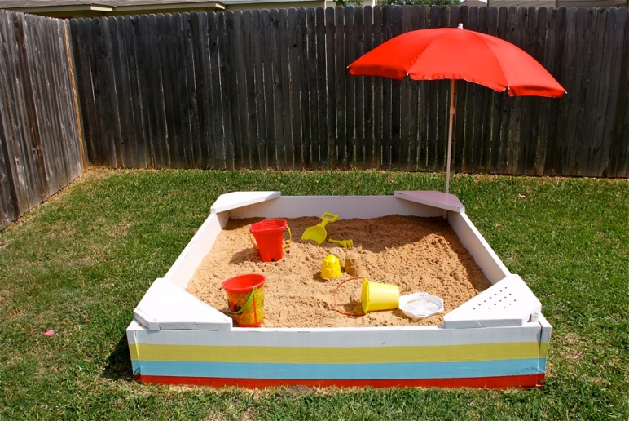
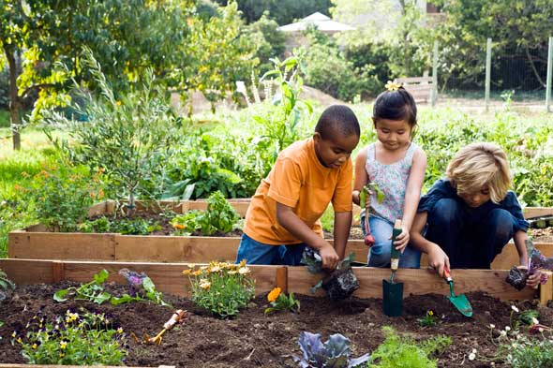

Managing the outdoor environment
Place traps
Cover sandboxes
Take Home Message: Not all insects are pests! A well maintained outdoor space will keep bothersome pests away.
Keep cans clean and in good repair
Weed by hand and avoid over-fertilizing
Notes:
Sandboxes: keep covered when not in use, keep separate from other play areas, good drainage.
Place Yellowjacket traps 20 feet away from eating and play areas.
Waste cans in good repair, area clean, hard surface.
On-site compost – closed bin
Gardening – is it a pest?
Lawn – don’t over fertilize, pull weeds by hand, apply mulch / compost

Slide 42





Management: Selecting a pesticide
LOW RISK
USE CAUTION
Take Home Message: Use pesticides as a last resort! If needed, choose the least harmful application methods.
Baits, gels, traps
Sprays and foggers
Notes:
If non-chemical approaches are not effective by themselves you may need to use pesticides. Some pesticides have less risk of exposure than others.
-Use pesticides that are exempt from the Healthy Schools Act requirements (contained pesticides - baits, gels, and traps)
Use pesticides registered for use by the EPA and DPR, illegal pesticides include chalk, tres pasitos, mothballs
Use caution when choosing organic, green, or natural products
Always avoid foggers and sprays. They broadcast pesticides into the air and have a high risk of exposure.

Slide 43

Management: Hiring a pest management professional (PMP)
Must be licensed
with DPR, and
with Structural Pest Control Board
Must be trained in IPM for schools and child care
Free DPR online Advanced course for PMPs: www.cdpr.ca.gov/schoolipm
Request UC IPM free online training: www.ipm.ucdavis.edu/training/school-and-child-care-ipm.html
Notes:
A PMP can help you implement an effective IPM program. It is important to use a professional if your outdoor area has fire ants.
All pest management professionals (PMPs) must be licensed by the State of California. You can verify whether a company or an individual has a license issued by the Structural Pest Control Board at www.pestboard.ca.gov. Having a structural pest control board license means you have passed the exam and you have completed your live scan finger print process.
2. PMPs should be trained in IPM for schools and child care. The UC Statewide IPM Program offers a free online course for PMPs titled Providing IPM Services in Schools and Child Care Settings. Ask for proof that your PMP has taken the course
3. Consider hiring a PMP with a third-party IPM certification, such as EcoWise, GreenPro, or Green Shield.

Slide 44



Management: Hiring a pest management professional (PMP)
Third party certification:
EcoWise: https://www.ecowisecertified.com/ecowise_find.html
GreenPro: https://greenshieldcertified.org/
GreenShield: https://www.qualitypro.org/certified-services/greenpro/
Notes:
Consider hiring a PMP with a third-party IPM certification, such as EcoWise, GreenPro, or Green Shield.

Slide 45
Keeping Pests Out of Your Child Care Center Videos
https://www.youtube.com/watch?v=IfdCtx3LqEc&list=PLgU4sA8HrUfrrheC4rNNgB1ou7JlnpKvP&index=3&t=0s
https://www.youtube.com/watch?v=ph5xXTbLwG0&list=PLgU4sA8HrUfrrheC4rNNgB1ou7JlnpKvP&index=4

Slide 46

Tool box demo and poll

Slide 47

IPM/IGM Toolbox
Notes:
Poll

Slide 48
Small group activity
Instructions:
Read pest scenario
Using the corresponding pest sheet, list the 5 Steps of IPM for that pest
Report back
Notes:
Use pest sheets: ants, yellowjackets, cockroaches, gophers, rodents, spiders
What they can do at their center or home and what they can tell parents to do at home

Slide 49
Hint: 5 Steps of IPM:
Prevent, Inspect, Identify, Monitor, Manage
Ants
Today, you find yourself facing the effects of a drought and heat wave. As if that wasn’t enough, as you are making breakfast you find a trail of ants under your kitchen sink. You have the children arriving for the day in 30 minutes. Using the 5 steps to IPM, how will you successfully handle your ant problem?
https://cchp.ucsf.edu/content/integrated-pest-management-ants-0
Mice/Rats
You arrive at work to set up for the day and hear the sound of little feet scurrying inside the walls of your classroom. During your search with a flashlight, you found a small rodent, but it ran so fast back into the false ceiling hole in your hallway, that you didn’t have time to identify specifics. Using the 5 steps to IPM, how will you successfully handle your rodent problem?
https://cchp.ucsf.edu/content/integrated-pest-management-rodents

Slide 50
Hint: 5 Steps of IPM:
Prevent, Inspect, Identify, Monitor, Manage
BONUS!
https://cchp.ucsf.edu/content/integrated-pest-management-cockroaches

Slide 51
Small group activities
IPM Checklist Activity
https://cchp.ucsf.edu/content/ipm-checklist-0
IPM Tool Box Review
Poll
HSA Passport Activity
Notes:
\

