Slide 1


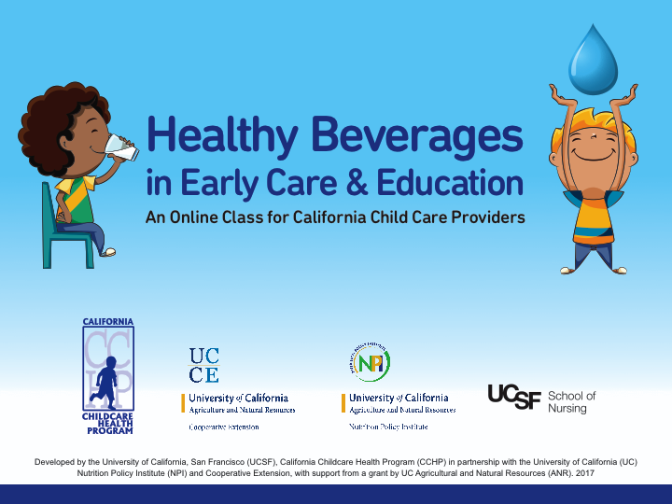
Notes:
Script
Welcome to Healthy Beverages in Early Care and Education! This class was developed by the University of California, San Francisco California Childcare Health Program in partnership with the University of California Nutrition Policy Institute and Cooperative Extension, with support from a grant by UC Agriculture and Natural Resources.
A few tips about completing this class:

Slide 2

Why drinks are important to children’s health.
Best practices for serving drinks in child care programs.
Four key messages in the California Healthy Beverages in Child Care Act (AB 2084).
Notes:
Script
Meet your guide Dewy the Droplet.
G: Hi! I'm Dewy the Droplet.
G: By the end of this class, you will learn:
K:
1. Why drinks are important to children's health.
2. Best practices for serving drinks in child care programs that are easy and affordable.
3. And the four key messages from the California Healthy Beverages in Child Care Act (AB 2084).

Slide 3

Introduction
Every day, you make a difference in children’s health and wellbeing.
Forming healthy habits at a young age lays a solid foundation for lifelong health.
A young child can share healthy messages with the whole family!
Notes:
Script
As a Child Care Provider, you can make a big difference in children's health and future wellbeing.
Children who form healthy habits at a young age are more likely to enjoy good health throughout their lives. And the younger we start the better! Children learn by observing what's happening around them and, child care providers can play an important role in children's health by modelling healthy habits. Not only that, children bring home the lessons they learn in their early care and education programs. A young child can teach healthy habits to the whole family!

Slide 4
Why are drinks important to children’s health?
Scientific studies link sugary drinks with obesity, diabetes, dental decay, and other diseases.
Drinking water and milk instead of sugary drinks helps children grow strong!
Notes:
Script
Scientific studies show that young children with healthy habits are more likely to grow strong and at a healthy weight, other studies link sugar and sugary drinks with obesity, diabetes, and dental decay. Active children need plenty of fluids and the healthiest choices for drinks are water and milk. Water doesn't add extra calories and reduces the risk for tooth decay by clearing food and acids in the mouth. And milk provides protein, calcium, and vitamins for growing children.
Sugary drinks like sports drinks, sweet teas, juice drinks with added sugars, chocolate flavored milk and soda, leave sugar residue on teeth that can lead to tooth decay.
Have you noticed how young children who are served sugary drinks can develop a preference for sweetened beverages? Serving sugary drinks to young children can lead to habits that are hard to break. It's easier to form healthy habits from the start!

Slide 5
Healthy Beverages Laws and Regulations
AB 2084, Healthy Beverages in Child Care Act
AB 290, 16 hour Health and Safety Training
Child and Adult Care Food Program (CACFP)
Notes:
Script
In California, we have some of the most comprehensive laws in the county about beverages served in licensed child care centers and family child care homes. AB 2084, or the Healthy Beverages in Child Care Act, went into effect in 2012. Health and Safety training required to be a licensed child care provider includes training on healthy beverages. And the federally funded Child and Adult Care Food Program (CACFP), includes nutrition standards for healthy beverages. To find out more about participating in CACFP, contact your local CACFP Sponsor. A list of CACFP sponsors can be found in the Resources Section of this class.
Now let’s talk about each of the four key messages in the Healthy Beverages in Child Care Act plus best practices for young children’s beverage consumption.

Slide 6
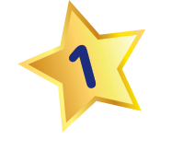

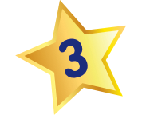
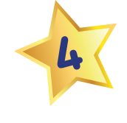
Four Key Messages of Healthy Beverages in Child Care Act (AB 2084)
Notes:
Here are the key messages in the Healthy Beverages in Child Care Act. You may already be familiar with them.
Only unflavored, unsweetened, non-fat or low fat (1%) milk can be served to children two years of age or older.
No beverages with added sweeteners, natural or artificial, can be served, including sports drinks, sweet teas, juice drinks with added sugars, flavored milk, soda and diet drinks.
A maximum of one serving that's 4-6 ounces for 1-6 year olds, of 100% juice is allowed per day.
Clean and safe drinking water must be readily available at all times; indoors and outdoors and with meals and snacks.
Now let’s go through each message one-by-one.

Slide 7
Notes:
Script
Let's start with milk. The Healthy Beverages in Child Care Act states: Only unflavored, unsweetened, non-fat, skim, or lowfat milk can be served to children two years of age or older.
Milk provides nutrition and fluids that growing children need. When children reach age two, switch from serving whole milk to 1% lowfat milk or non-fat milk--also known as fat-free or skim milk.
You'll know the type of milk by reading the milk carton.
Infants need the fat from breastmilk or formula, and toddlers need the fat from whole milk for their growing brains. However, children need less fat from milk as they grow because they get fat from a variety of other foods such as avocados, nut butters, fatty fish, and olive oil.

Slide 8

To summarize:
Infants from birth to 12 months drink breast milk or infant formula.
Toddlers one to two years old drink whole fat milk.
Children two years and older drink 1% fat or non-fat milk.
Notes:
To summarize:
Infants from birth to 12 months drink breast milk or iron-fortified infant formula.
Starting when a child turns one year until two years old, serve whole milk.
Serve 1% fat or non-fat (also known as fat free or skim milk ) to children two years and older.

Slide 9
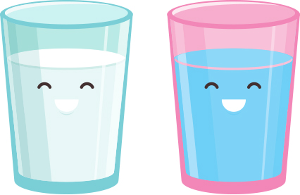
Ideas for serving milk in child care programs:
Provide self-serve pitchers for children.
Use color-coded cups for milk and water.
Follow breastfeeding friendly practices.
Notes:
Script
Here are some ideas for serving milk in child care programs:
Provide self-serve pitchers for children when developmentally ready - usually around age 2 years - to help children become independent and build skills.
Use color coded cups for milk to help with different fat content requirements when serving milk to mixed age groups. Use separate color cups for milk and water to ensure that both are available to children at mealtime.
Make your program breastfeeding friendly! If possible, provide a private space with a comfortable chair and an electrical outlet for moms to feed their babies, or pump before they leave and when they return at the end of the day. Ensure that child care staff are trained in safe storage, handling, and feeding of breastmilk brought into your program. Breastfeeding resources can be found in the resource section of this class.

Slide 10

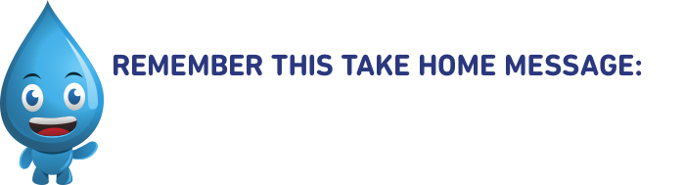
As children grow, fat from milk can go… once a child reaches age 2, low or non-fat milk will do!

Slide 11
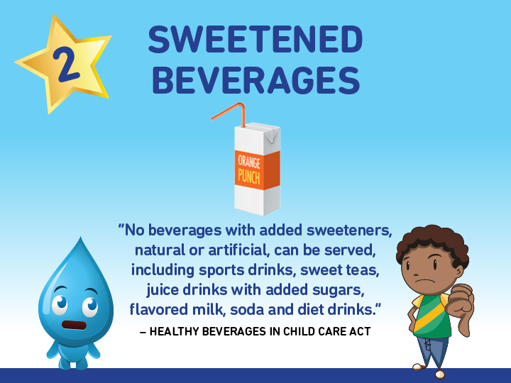
Notes:
Script
Now let’s talk about Sweetened Beverages also known as Sugary Drinks.
The Healthy Beverages in Child Care Act says No beverages with added sweeteners, natural or artificial, can be served, including sports drinks, sweet teas, juice drinks with added sugars, flavored milk, soda, and diet drinks.
When children consume sugary drinks, including flavored milk, they often learn to prefer them to water when they are thirsty. And their little bodies can begin to crave sugar to feel satisfied. Sugary drinks, add extra calories without satisfying hunger or providing the nutrients that growing children need. Many drinks have added sugar that you may not be aware of unless you read the label. So always check the label to be sure.

Slide 12
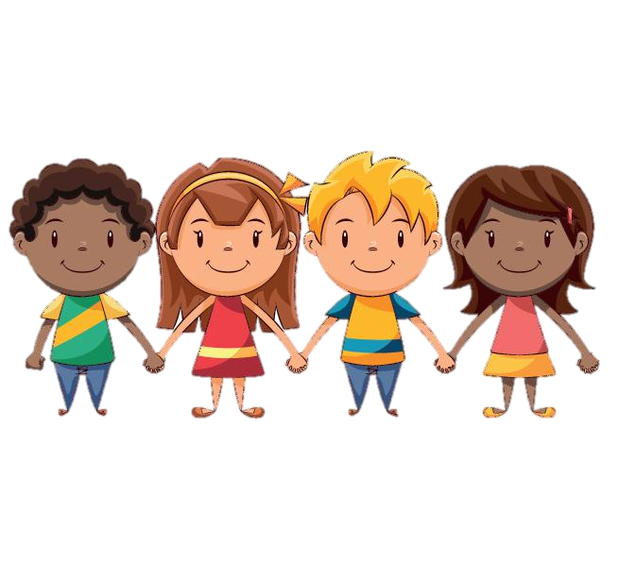


23% of California children ages 2-5 years drink one or more sugar-sweetened beverages per day
Sugar sweetened juice drinks marketed for children commonly have 3 teaspoons of sugar in one child-sized serving!
(4 grams of sugar = 1 teaspoon)
Data Source: As cited on kidsdata.org, Custom tabulation from UCLA Center for Health Policy Research, California Health Interview Survey (Apr. 2016); Babey, S. H., et al. (2013). Still bubbling over: California adolescents drinking more soda and other sugar-sweetened beverages. UCLA Center for Health Policy Research & California Center for Public Health Advocacy.
Notes:
Sugary drinks are the leading source of added sugar in the American diet, and reducing or eliminating sugary drinks from the diet is thought to be key in reversing the habit of consuming too much added sugar.
Sugar sweetened juice drinks marketed for children commonly have 3 teaspoons of sugar in one child-sized serving.
A recent study showed that about 1 in 4 California children ages 2-5 drink one or more sugar-sweetened beverages per day.
That number increases as children get older, so let's start when children are young to build healthy habits!

Slide 13
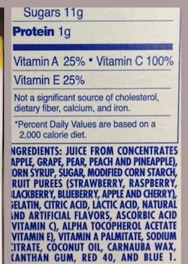
Food producers must list all ingredients on food and drinks.
Nutrition Facts
Serving Size 1 bottle
Amount per serving
Calories 0
 | % Daily Value*
Total Fat 0g | 0%
Sodium 10mg | 1%
Total Carbohydrate 0g | 0%
INGREDIENTS: CARBONATED WATER, CITRIC ACID, TEA, ASPARTAME, PHOSPHORIC ACID, POTASSIUM BENZOATE, ACESULFAME POTASSIUM, NATURAL AND ARTIFICIAL FLAVOR
Notes:
The U.S. Food and Drug Administration (FDA) requires food producers to list all ingredients. Ingredients are listed in order of quantity from most to least.
Added sweeteners come in many forms – including natural, artificial, and zero-calorie. The Healthy Beverages in Child Care Act prohibits serving drinks with any added sweeteners.
There are many different names for sugar listed on food labels, some of the more common names, are sucrose, cane sugar, sugar, corn syrup, barley malt, dextrose, maltose, and rice syrup.
Some other natural sweeteners are agave, honey, and maple syrup.
And common zero-calorie sweeteners include stevia, aspartame, sucralose, saccharin, neotame, and ace-sul-fame potassium (ace-K). Drinks with these sweeteners usually are sold as ‘diet’ drinks.
Again, no drinks with any added sweeteners should be served to children.

Slide 14
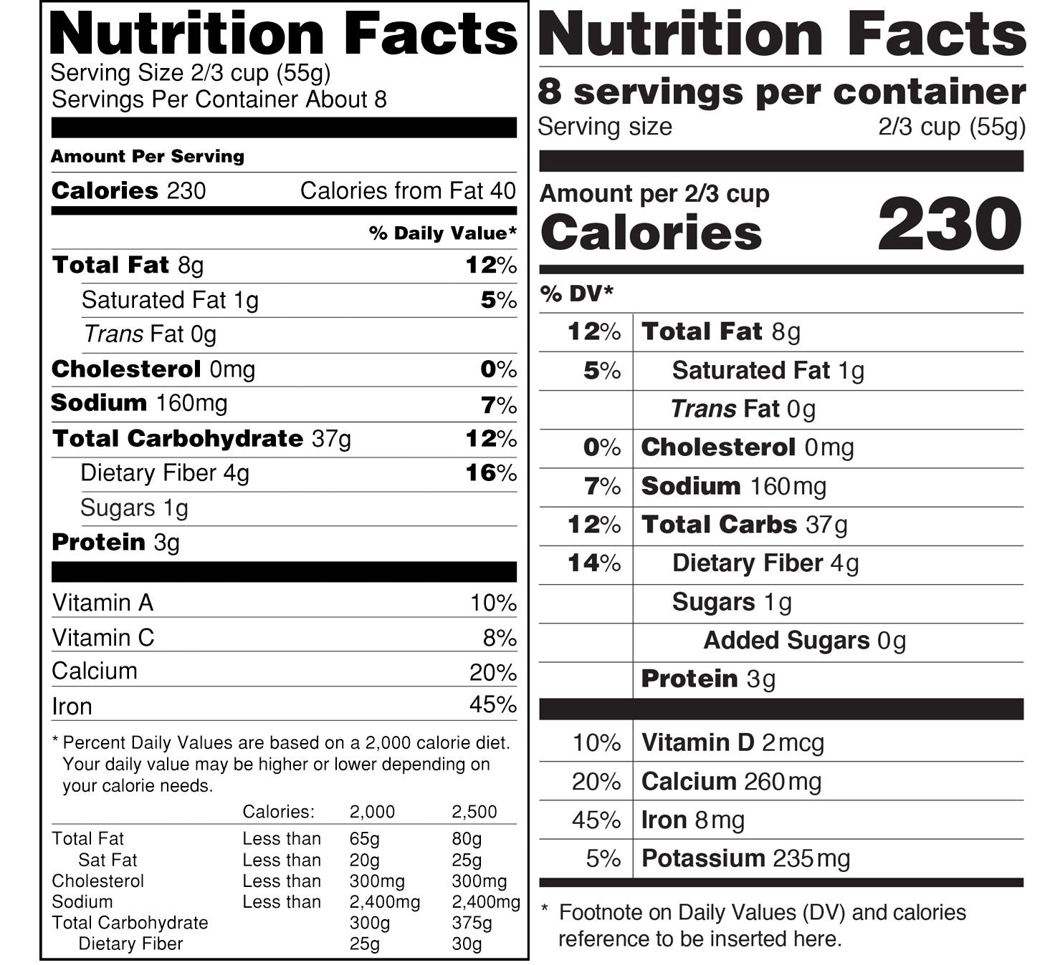
Notes:
Recently, the FDA, decided to change the nutrition label on products to include “added sugar” to make it easier for consumers to know what they are purchasing. Other changes include the serving size in larger and in bolder type, the calories are in larger type, daily values have been updated, and actual amounts are stated.
Here’s where you’ll find the information on added sugars. Look for beverages with zero added sugar.

Slide 15

Ideas for alternatives to drinks with added sweeteners
Water is the best choice for thirsty children!
Make water appealing and fun!
Notes:
Script
Overall, plain water is the best choice when children are thirsty. Make sure clean, safe drinking water is available inside and outside, at snacks, and at mealtime.
Children may prefer chilled water, especially on hot days. And children might also enjoy a hands-on learning activity of adding sliced fruits or herbs to water or ice cubes. As long as plain water is also available and food safety guidelines are followed, it’s okay to experiment with making infused water. Here are some fun and tasty combinations:
Strawberry + kiwi
Cucumber +mint
Berries + basil
Lemon + lime
and
Apple + cinnamon
You can also ask the children what flavors they'd like to try.

Slide 16
Bye-Bye
Sweetened
Drinks!

Slide 17
Notes:
Script
Now let’s talk about 100% juice. The Healthy Beverages in Child Care Act says:
A maximum of one serving of 100% juice is allowed per day. A child sized serving is 4-6 ounces for 1-6 year olds.
It’s important that children not drink too much fruit or vegetable juice. 100% juice does not need to be banned entirely, but it needs to be limited to no more than one child-sized serving per day. The American Academy of Pediatrics recommends no more than one serving of juice in a 24 hour day. Since children may have juice at home either before or after child care, many child care programs have taken juice off the menu entirely and serve only water and milk to drink. Eating whole fruits and vegetables, rather than drinking juice, provides more nutrients and dietary fiber which makes children feel more satisfied and prevents constipation.
Young children don’t need juice at all, but if your going to offer it, make sure it’s 100% juice without added sugar and wait until an infant is at least 12 months old. Limit the use of sippy cups to mealtime since frequent sipping can lead to dental decay and never put juice in a bottle.

Slide 18
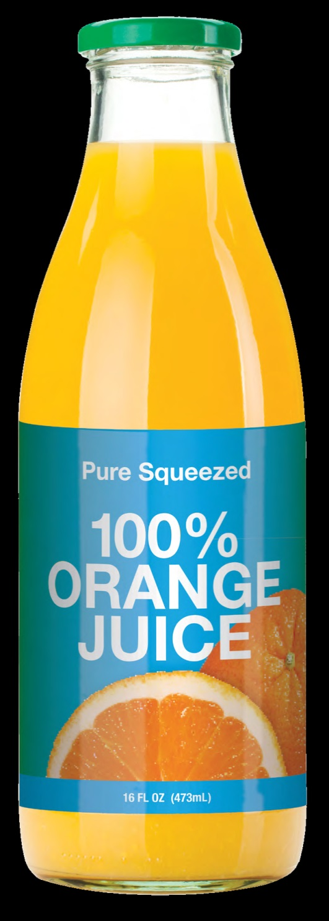
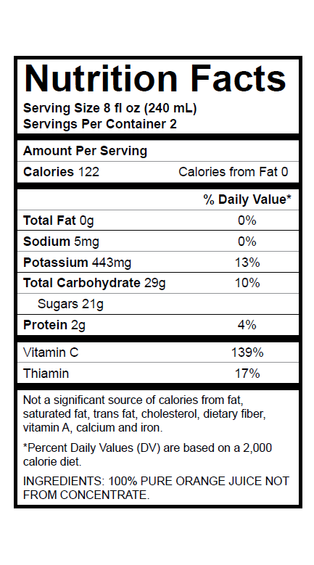
100% juice
Notes:
You’ll know if a product is 100% fruit juice by reading the information on the label.

Slide 19
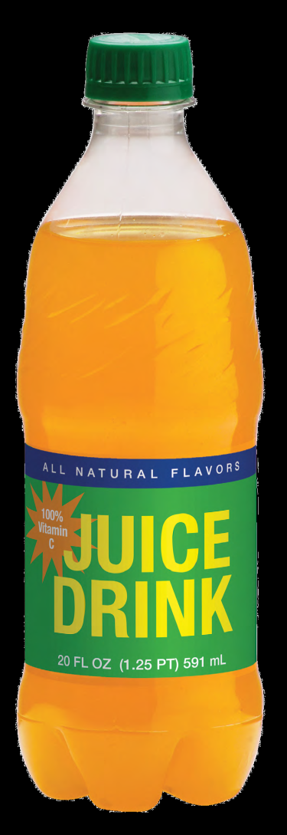
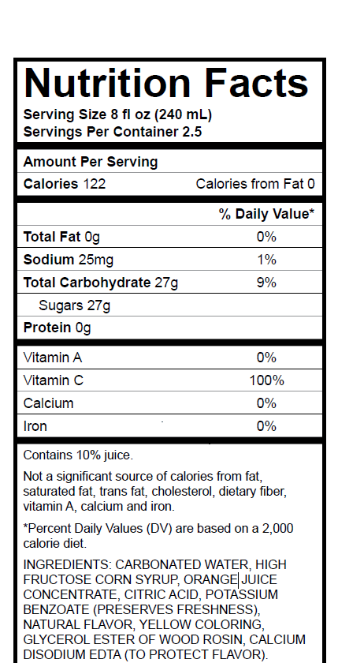
Notes:
Juices that are not 100% juice have names like juice drink, juice cocktail, fruit punch, and lemonade. It will say on the label that these drinks are less than 100% juice.
You'll note on this ingredients list that the first two ingredients are water and corn syrup, NOT juice.

Slide 20
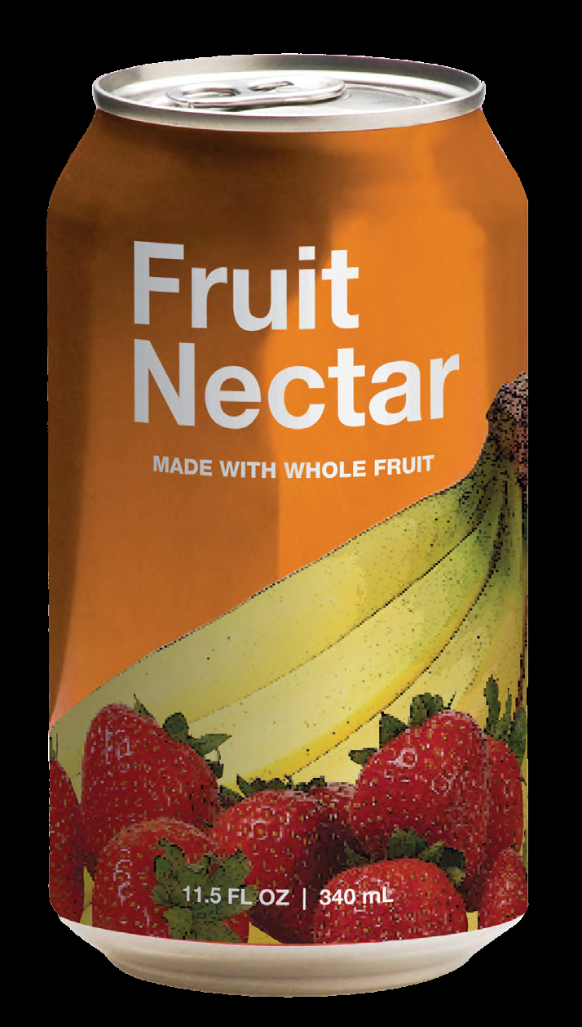
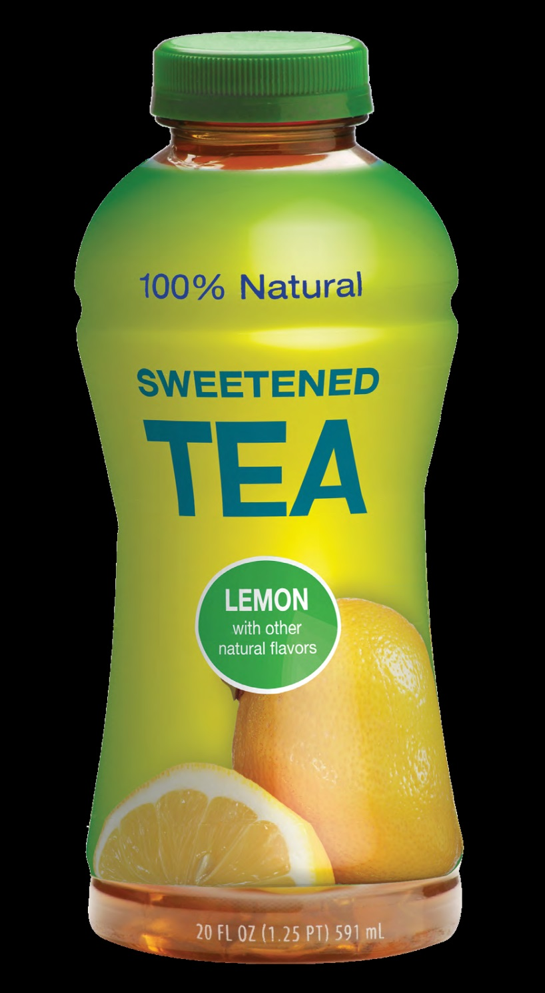
Notes:
Product packaging and marketing can be confusing for shoppers. Just because a product has a picture of fruit does not mean it’s 100% fruit juice. Or a product can boast of being 100% Natural which could easily be mistaken for 100% juice if you don’t read the label carefully.

Slide 21
Ideas for serving less juice
Serve lots of fruit!
Include fresh fruit in cooking and gardening projects. Try:
Popsicles made from chopped fruit and water or low fat yogurt
Fruit kabobs
Fruit salad
Make your own juice using fresh
fruit or vegetables.
Notes:
Script
Here are some ideas for serving less juice:
Serving whole fruit and water is the best alternative to juice. During the winter months when fresh fruit costs more and is less available, frozen fruit or fruit canned in its own juice or water (not syrup) are healthy alternatives.
Include fresh fruit in cooking and gardening projects. Try:
Popsicles made from chopped fruit and water or low fat yogurt
Fruit kabobs
Fruit salad
Make your own juice using fresh fruit or vegetables.
If you occasionally serve 100% fruit juice, use child sized cups and don’t serve too much.

Slide 22
Eat fruit, drink water!
Be 100% sure it’s 100% juice!

Slide 23
Notes:
Script
Now let's talk about water- Cool, clear, water! Water is refreshing, healthy, and is nearly free!
The Healthy Beverages in Child Care Act says: Clean and safe drinking water must be readily available at all times; indoors and outdoors and with meals and snacks.
Children naturally get thirsty after playing, sleeping, and when eating. A well hydrated child can happily play, explore, and focus. Drinking water supports children's learning and behavior! Teach children to pay attention to cues of thirst, and make it easy for them to choose water when they are thirsty.
What does available mean?
“Available” can mean something different at various developmental stages. Children gradually become more independent as they grow. While you may need to offer water to toddlers and they may need help to sip water from a cup, preschoolers and school age children can serve themselves. Preschoolers and older children should always have easy access to water when they are thirsty, so that they don't have to ask for it.

Slide 24
Clean and Safe Drinking Water
Tap water is usually the first choice for drinking water.
Drinking tap water is planet friendly.
Tap water is easy, convenient, and nearly free.
Notes:
Script
Tap water is usually the first choice for drinking water.
Community water systems are required to meet strict federal and state water quality standards, and bottled water does not have to meet the same standard. Still, there may be water safety concerns in some communities with heavy pesticide use, farm runoff, or old pipes, or if get your water from a private well.
To find out more about tap water safety go to the Resources Section of this class for the Health and Safety Note: How to Find out if Your Drinking Water is Safe.
Drinking tap water is planet friendly. Beverage companies use energy and other resources to produce sugary drinks, juice, and bottled water. For example, one soda requires water; corn syrup or sugar to sweeten it; aluminum, glass, or plastic to bottle it; and energy and fuel to bring it to you.
Then when the drink is finished, most bottles are not recycled. Millions of plastic beverage bottles are used in the U.S. every day! Serving clean and safe tap water makes sense for your budget and our planet.
Most counties in California add fluoride to tap water to prevent tooth decay. Fluoride in community water is safe and effective in preventing tooth decay by at least 25% in both children and adults.

Slide 25
What about water and CACFP?
While drinking water must be available to children during meal times and throughout the day…
It is not part of the CACFP reimbursable meal pattern and may not be served instead of milk.
Notes:
Script
While drinking water must be available during meal times and offered throughout the day, water is not part of the reimbursable meal and may not be served instead of milk for CACFP.
In facilities where safe water is not available, purchasing water for children may be considered an allowable CACFP cost. But you'll need to discuss this with your CACFP sponsor first.

Slide 26

Choose water first for thirst!

Slide 27

Caring for Children with Special Needs
What if a child in my program has a milk allergy, lactose intolerance, or other special need?
Notes:
Some children have special nutritional needs such as milk allergy, lactose intolerance, or if their pediatrician is concerned about their weight.
Complete a Special Health Care Plan or a Special Nutrition and Feeding Care plan on all children who need special diets, positioning, or adaptive equipment. Samples of these plans can be found in the resource section of this class.
The healthy beverage in child care act allows exemptions for children with special nutritional needs. You’ll need a note from the child’s health care provider to be exempt.

Slide 28


Parent and Family Engagement
Notes:
Script:
Children grow and thrive when messages for health and learning are the same at home as in school or child care. Studies show that involving families is key to making postive changes in what children eat and drink in child care.
Communicate with parents about which beverages you serve in your program and why.
Create an environment where everyone feels respected by inviting families to meetings, pot luck events, and educational workshops. Ask local health professionals like dentists, doctors, nurses, or dieticians to speak at family events. Work with families to understand their child’s unique developmental needs. Provide opportunities for families to ask questions, share ideas, and contribute their cultural perspectives.
Consider using a variety of forms of communication, such as electronic and print newsletters, social media, and bulletin boards, to make sure you are reaching all the families. You can also offer prizes for participation.
In the Resources Section, you'll find a Fact Sheet for Families on Healthy Drinks for Young Children and a sample letter to parents about healthy beverages.

Slide 29

Written Policies
Healthy celebrations
Lunches brought from home
Staff health
Notes:
Script:
The Healthy Beverages in Child Care Act does not apply to drinks provided by a parent or legal guardian for his or her child. However, clear written policies improve communication, reduce conflict, and support healthy habits for everyone.
Explain your policies regarding drinks to parents upon enrollment. Role play with staff about how to respond to situations, such as a parent who sends sugary drinks for celebrations or in their child's lunch. Share policies in parent and staff handbooks.
Create an environment where it's easy for staff to model healthy habits, such as having water available for staff to drink throughout the day.
Sample policies can be found in the resource section of this class.

Slide 30

Ideas for Your Curriculum
Books about water
Art & music with water themes
Science, Technology, Engineering and Math activities about healthy habits and water
Planet friendly activities
Notes:
Script:
Children learn best by doing. There are lots of good ways you can incorporate lessons about healthy drinks into your daily routines and curriculum. Help children understand the importance of water in daily life and for their health. Teach children that water is a precious resource and how to use it wisely.
For example:
There are many children's books about water that support literacy, and lots of great ideas for art projects and music.
And there are loads of lessons for children with Science, Technology, Engineering, and Math themes, and Planet Friendly activities that children love!
Refer to the handout called “Ideas for Your Curriculum” in the resources section of this class for some good activities to add to your curriculum!

Slide 31
Better together…
Healthy children!
Healthy staff!
Healthy families!
Healthy planet!

Slide 32

Thank you!
Notes:
Thank you! You do so much, keep up the good work! By working together with common goals and planet friendly practices, you can make a positive difference in the health of children, families, and staff in your program!

Slide 33

Acknowledgements
The following individuals contributed to development, review, and editing of this online class:
Abbey Alkon, Bobbie Rose, Kim Hazard: University of California San Francisco (UCSF) School of Nursing, California Childcare Health Program (CCHP);
Lorrene Ritchie, Christina Hecht, Kenneth Hecht, Gemma DiMatteo: Nutrition Policy Institute (NPI), UC Agriculture and Natural Resources (UC ANR);
Anisha Patel: UCSF, Department of Pediatrics;
Marisa Neelon: UC Cooperative Extension (UCCE), UC ANR, Contra Costa and Alameda Counties;
Katherine Soule: UCCE, ANR, San Luis Obispo County and Santa Barbara Counties;
Karina Diaz-Rios: UC ANR, Health Sciences Research Institute at UC Merced;
Genevieve Pyeatt: Child Development Inc.;
Paula James: Contra Costa Child Care Council and Child Care Food Program Roundtable;
Siobhan Tellez, Allison Beattie, Alison Borrman, Nicole Chamness: UCSF School of Nursing, student contributors.
Laura Myers Design
Notes:
Acknowledgments Slide (last slide):
The following individuals contributed to development, review, and editing of this online class:
Abbey Alkon, Bobbie Rose, Kim Hazard: UCSF, School of Nursing, CCHP;
Lorrene Ritchie, Christina Hecht, Kenneth Hecht, Gemma DiMatteo: Nutrition Policy Institute (NPI), UC ANR;
Anisha Patel: UCSF, Department of Pediatrics;
Marisa Neelon: UC Cooperative Extension (CE), ANR, Contra Costa and Alameda Counties;
Katherine Soule: UCCE, ANR, San Luis Obispo County and Santa Barbara Counties;
Karina Diaz-Rios: UC ANR, Health Sciences Research Institute at UC Merced;
Genevieve Pyeatt: Child Development Inc.;
Paula James: Contra Costa Child Care Council and Child Care Food Program Roundtable;
Kelley Knapp, Stephanie Salazar: California Department of Education, Nutrition Services Division;
Siobhan Tellez, Allison Beattie, Alison Borrman, Nicole Chamness: UCSF School of Nursing, student contributors.
Design: Laura Meyers Design

