Slide 1
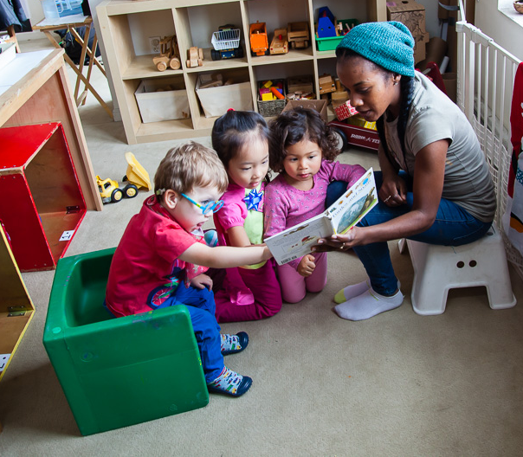
Integrated Pest management in Family Child care homes
University of California, San Francisco (UCSF) School of Nursing
California Childcare Health Program (CCHP)
Funded by California Department of Pesticide Regulation (DPR)

Slide 2
Icebreaker questions
What’s your name?
What’s the pest that bothers you the most?
What would you like to learn from today’s workshop?
© UCSF CCHP 2016

Slide 3




Alliance Team partners
Funding for this project has been provided in full or in part through a grant awarded by the California Department of Pesticide Regulation (DPR). The contents of this document do not necessarily reflect the views and policies of DPR nor does mention of trade names or commercial products constitute endorsement or recommendation for use.
Notes:
This Integrated Pest Management (IPM) Toolkit was funded by the California Department of Pesticide Regulation (DPR) and developed by the University of California (UC), San Francisco School of Nursing’s California Childcare Health Program, in collaboration with the UC Statewide IPM Program and DPR. The contents of this document do not necessarily reflect the views and policies of DPR, nor does mention of trade names or commercial products constitute endorsement or recommendation for use.
CCHP mission: to improve the quality of child care by initiating and strengthening linkages between the health, safety and child care communities and the families they serve.

Slide 4

To reduce the exposure of pesticides for young children in family child care homes.
Protect children’s health
Protect the health of providers and family members
Protect the environment
Notes:
Overall project goal and purpose of this training

Slide 5

AGENDA
Pests
Pesticides
Integrated Pest Management(IPM)
Group Activity: Pest Scenarios with Pest Sheets
Notes:
Today you will learn about pests, the importance of reducing children’s and provider’s exposures to harmful pesticides, and
how to implement Integrated Pest Management in your home.

Slide 6
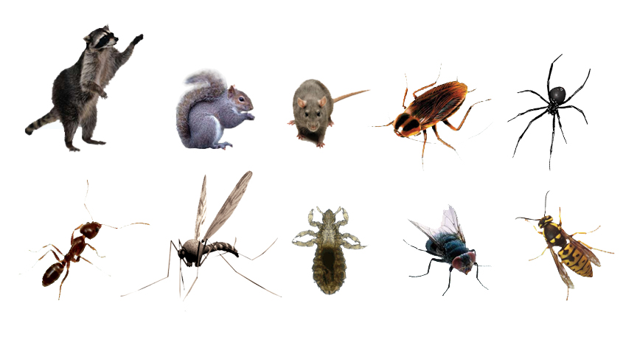
What is a pest?
A pest is any living organism that causes
damage or discomfort, or transmits or
produces disease.
Notes:
Ask audience for some examples of pests before explaining the definition. Rats, mice, cockroaches, house flies, raccoons, skunks, pigeons, squirrels, ticks, ants, weeds, and bacteria are all examples of different types of pests.
A pest can also be something that is simply where it is not wanted, such as clover in a grass play area. Make sure something is really a pest before you remove it. It’s important to remember: something that is a pest in one situation can play an important role in the environment in other settings. For example, Yellowjackets in ECE yards can sting, but they also eat large numbers of caterpillars, house flies and other pest insects.

Slide 7
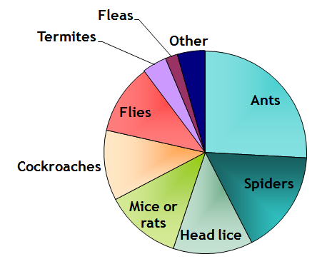
What are the most common INDOOR pests in California child care centers?
Bradman, A. , Dobson, C., Leonard, V. & Messenger, B. (2010). Pest Management and Pesticide Use in California Child Care Centers, Center for Children’ s Environmental Health Research, School of Public Health, UC Berkeley at apps.cdpr.ca.gov/schoolipm/childcare/pest_mgt_childcare.pdf.
Notes:
What indoor pests are you dealing with or have you dealt with? People like to share their stories but make sure to cap it at a few comments!
We don't have data for Family child care, but through our focus groups, we found the trend to be the same.

Slide 8
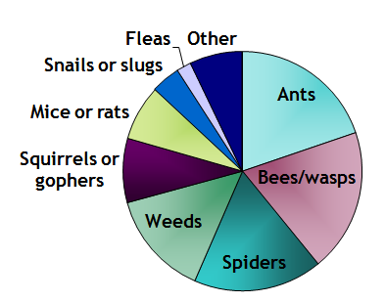
What are the most common OUTDOOR pests in California child care centers?
Bradman, A. , Dobson, C., Leonard, V. & Messenger, B. (2010). Pest Management and Pesticide Use in California Child Care Centers, Center for Children’ s Environmental Health Research, School of Public Health, UC Berkeley at apps.cdpr.ca.gov/schoolipm/childcare/pest_mgt_childcare.pdf.
Notes:
What outdoor pests are you dealing with or have you dealt with? Ask staff about their experiences? People like to share their stories but make sure to cap it at a few comments!

Slide 9
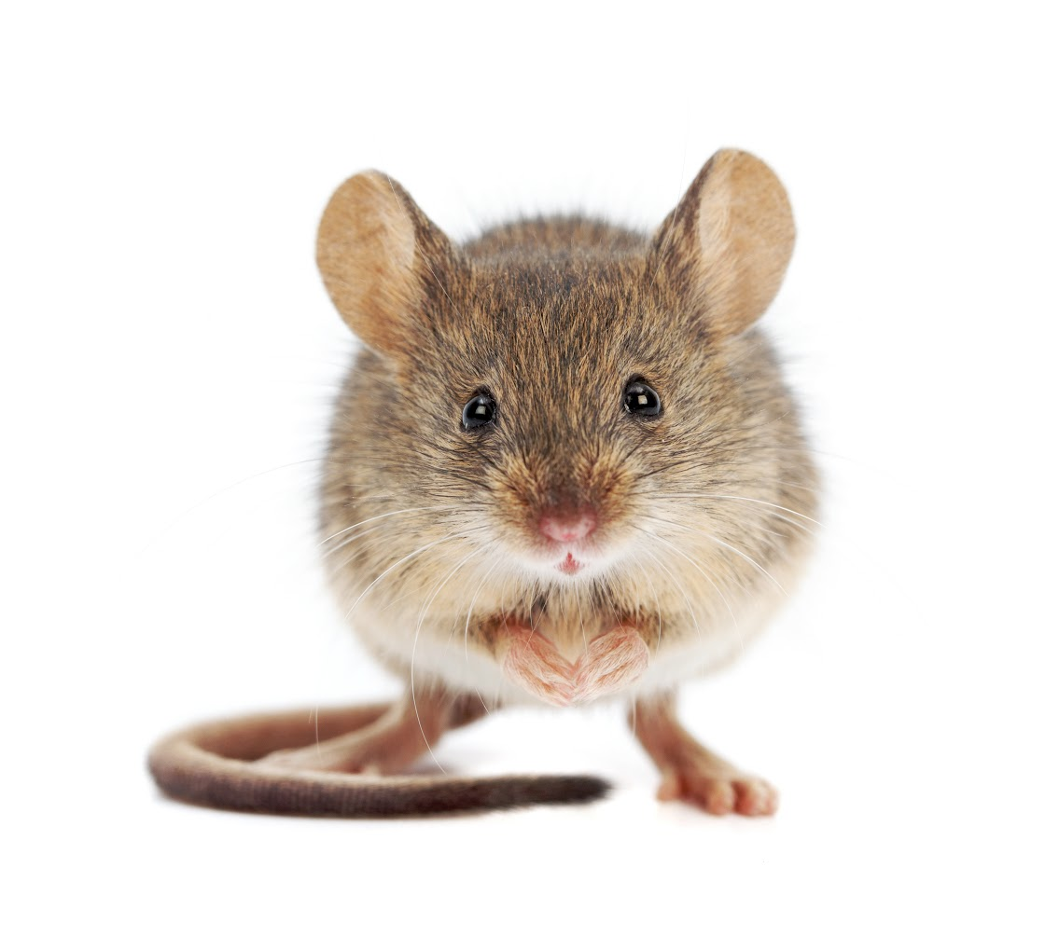
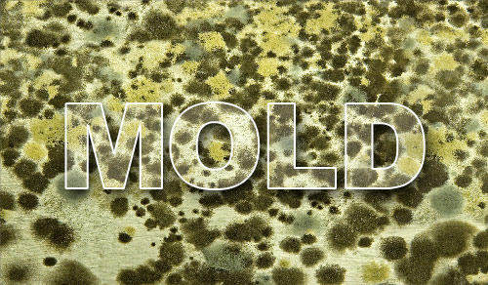
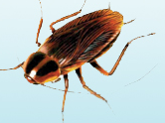

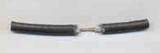
What problems do pests cause?
Health problems
Damage to your home
Discomfort
Rats Eat Wires
Spread Bacteria
Allergies & Asthma
Notes:
Why do we care about pests? How are pests bad for children or for family child care providers?
There are three major categories of concern with pests.
The first one is health problems. Pests such as cockroaches or mice can spread bacteria. For instance, a roach can walk across the toilet or in the trash on uncooked meat or rotting food and then across plates and tables where we eat.
Pests can also cause allergies or asthma. Roaches can trigger asthma because when they shed their skin to grow, they release a “dander” much like a cat. This has been shown to be an asthma trigger. Mice have also been shown to trigger asthma because of their fur and urine smells. Mold also is an asthma trigger.
Pests can also cause building damage. Rats can through wires, which can be an electrical danger. Mold and termites can damage the structural integrity of a building.
Parents and staff are upset when they see pests, and often want to get rid of them as quickly as possible.

Slide 10
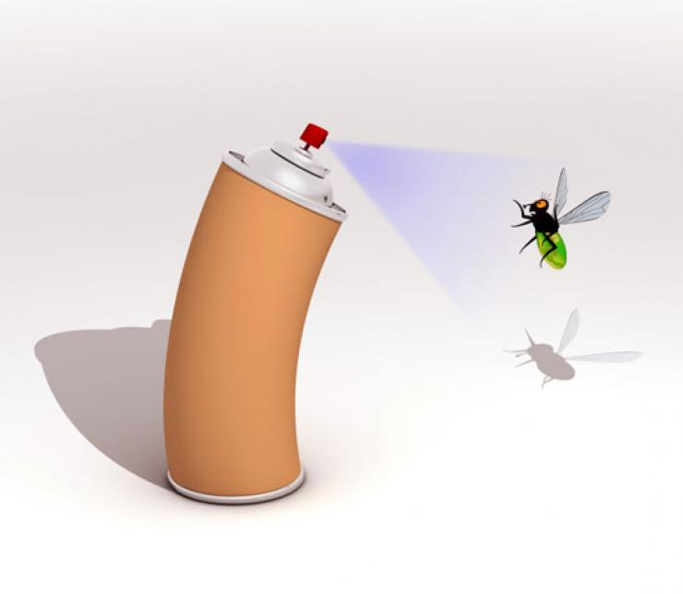
What are pesticides?
Examples:
Roach and ant spray
Flea bombs
Rat poison
Weed killer
Mothballs
Insecticide chalk
Also disinfectants, contained pesticides such as baits and gels, or even some toothpastes
Pesticides are poisons that are designed to kill or control living things.
Notes:
We’ve seen that pest problems exist in child care centers. Now let’s take a look at one traditional solution to pests (pesticides) and why this is no longer the recommended method of pest management. Later today, we’ll go through and learn about what is recommended!
What are pesticides? Can anyone come up with a definition? Think about why we use pesticides…
A pesticide is a poison that is designed to kill or control living things such as weeds, bugs, spiders, or anything that you do not want to live in your child care facility or yard. All pesticides are potentially harmful. This is particularly the case if the label instructions are not followed precisely. Pesticides should be used as a last resort. Pesticide sprays and foggers are especially harmful and should be avoided in child care programs.
Can anyone think of some examples of pesticides? Show pesticide examples.
Today, we’ll teach you safer, non-toxic alternatives to pest management.

Slide 11
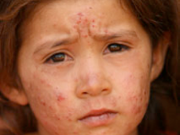
Concerns about Pesticide-Use
Health Outcomes
Immediate
Flu-like symptoms
Skin Rash
Breathing problems
Long-Term
Asthma
Cancer
Damage to brain and nervous system
Immune system damage
Endocrine disruption
www.toxicsoy.org/toxicsoy/news/Artikelen/2009/7/1_Girl_suffering_from_pesticide_poisoning.html
Notes:
There are many concerns associated with pesticide-use. In fact, risk from exposure may outweigh the benefit of killing pests. One significant concern is health outcomes. Many studies have shown that exposure to pesticides can cause immediate reactions, and we know that there can also be long-term health problems.
Exposure to pesticides over a long time may also cause sickness or affect development. New studies show that children regularly exposed to low levels of pesticides may not be poisoned or get sick right away, but they may suffer from health problems that don’t show up for many years.
This image is from a study from Mexico on exposure to pesticides. Children ages 4-5 years old in two different communities were asked to draw a picture of a person. On the left are children’s drawings who lived in the foothills where pesticide were not used and on the right are children’s drawings who lived in the valley where pesticide use was used widely. You can see the difference in the drawings of the kids.

Slide 12

Concerns about Pesticide-Use
Health Outcomes
Vulnerable Populations
• Children
• Pregnant women
• Elderly
• People with breathing or lung disorders
Notes:
Though exposure to pesticides can be harmful to anyone, it’s particularly harmful to certain, more sensitive populations. Children are at the top of this list, but pregnant women, the elderly, and anyone with breathing or lung problems are also at a higher risk.

Slide 13
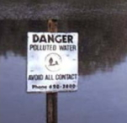
Concerns about Pesticide-Use
Health Outcomes
Vulnerable Populations
Environmental Damage
Ground & surface water contamination
Poisoning of aquatic animals
Notes:
In addition to human health, pesticides are also a concern for environmental health. Pesticide use can contaminate ground water and surface water, and poison aquatic animals.

Slide 14
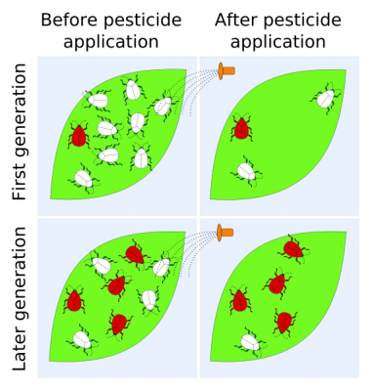
Concerns about Pesticide-Use
Health Outcomes
Vulnerable Populations
Environmental Damage
Pest Resistance
Pests can become resistant
en.wikipedia.org/wiki/File:Pest_resistance_labelled_light.svg
Notes:
There is a risk that pest populations will become resistant to pesticides, which means you’ll need to use stronger pesticides to achieve the same effects.

Slide 15
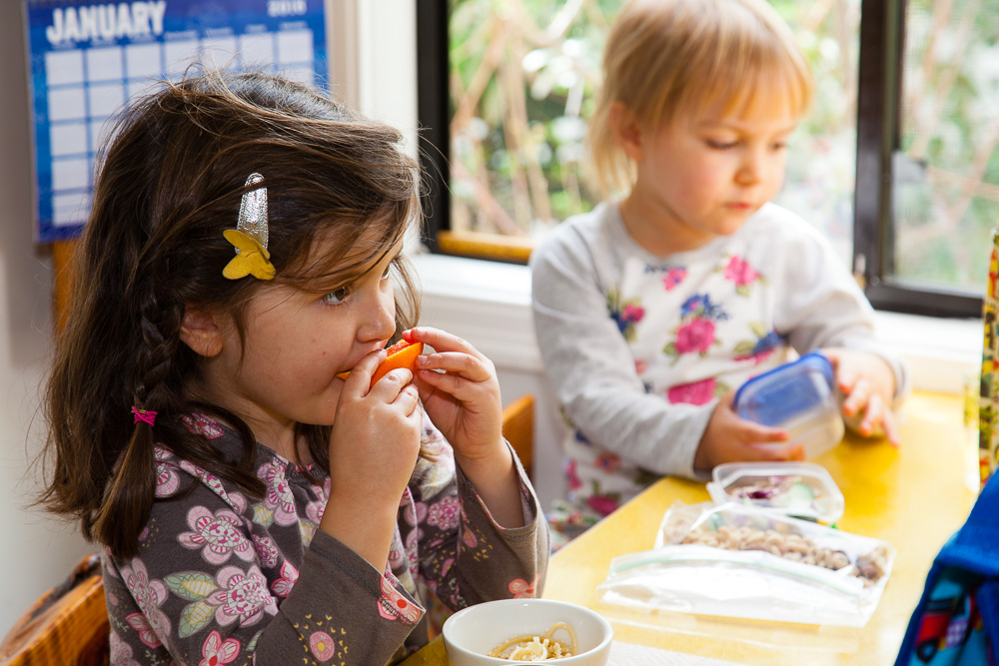
Why are children more vulnerable?
1. Higher exposures
Frequent contact with the ground or floor, where pesticides collect
Hand-to-mouth activity
Eat, drink, and breathe more per pound
Spend most of their time indoors
Notes:
Children have a special vulnerability to pesticides: they breathe the air closer to the ground level where pesticides are applied and settle in dust, are more likely to put their hands in their mouths or rub their eyes without washing their hands, and spend most of their time indoors. They have a less varied diet and eat, drink, and breath about two times as much per kilogram as adults.

Slide 16

Why are children more vulnerable?
2. Development
Brain and organ development
Nervous system development
3. Don’t recognize hazards
Can’t read labels
Get into everything
In 2014, the United States Poison Control Center reported 35,152 cases of possible pesticide poisoning in children younger than five.
James B. Mowry PharmD, Daniel A. Spyker PhD, MD, Daniel E. Brooks MD, Naya McMillan DrPH, MS & Jay L. Schauben PharmD (2015) 2014 Annual Report of the American Association of Poison Control Centers’ National Poison Data System (NPDS): 32nd Annual Report, Clinical Toxicology, 53:10, 962-1147, DOI: 10.3109/15563650.2015.1102927
Notes:
In addition to having a higher exposure, children also have a harder time breaking down toxins. Their bodies — and their defenses against toxins — are still developing. Toxic exposure during development damages function.
Because they’re young and unable to read labels, or understand warnings, they don’t recognize the hazards of going near areas where pesticides have been applied.

Slide 17
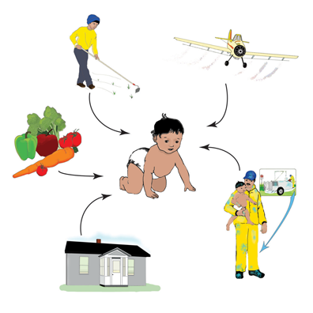

What are the Pathways of Exposure for Children?
By eating
By breathing
Through skin
Across the placenta (in the womb)
Notes:
We know that children are more vulnerable – let’s take a look at ways that pesticides can get into children’s bodies
Most pesticide exposure is through the skin—the largest organ—and children have much more skin surface area for their size than adults. Similarly, their higher respiratory rate means they inhale airborne pesticides at a faster rate.
Although pesticides contaminate air, soil, food, water, and surfaces, studies that examine children’s pesticide exposure indicate that the largest number and highest concentrations of chemicals often accumulate in household dust. Because children’s breathing zones are closer to the ground, they incur greater exposure to pesticides in carpets and dust than adults. Some pesticides can linger indoors for months and years.

Slide 18
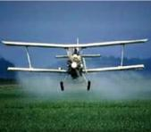
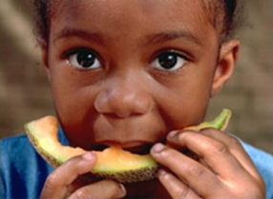
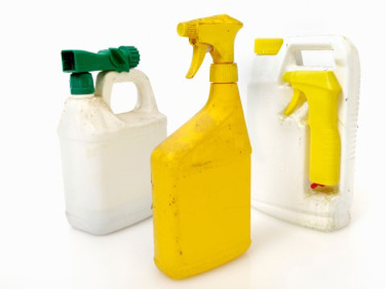
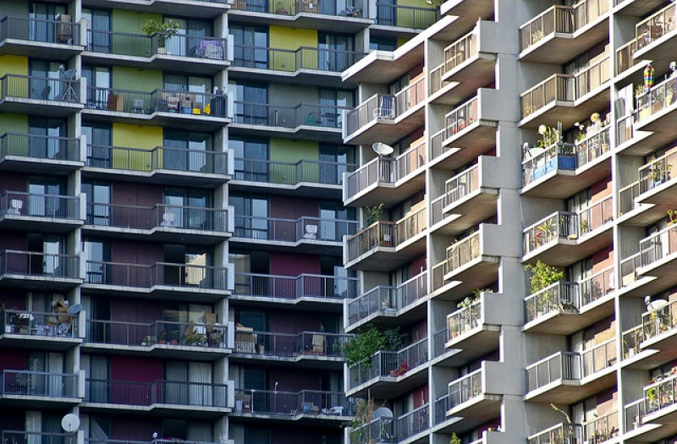


Where are pesticides found?
Agricultural Fields
Pesticide Drift
Household Products
Fruits & Vegetables
Housing
Contaminated
Water
Child Care Homes
& Centers
Sanborn et al. Identifying and Managing Adverse Environmental Health Effects: 4
Pesticides. CMAJ May 28, 2002: 166 (11): 1431-1436
Notes:
Just to give you an idea of how pervasive and present pesticides are in our daily lives, let’s look at where they can be found. This helps us think about where we need to put our attention and energy to make sure that children have the lowest pesticide-exposure possible.
Pesticides can be used outside, such as in gardens. They are also commonly used in and around buildings such as homes and classrooms.

Slide 19
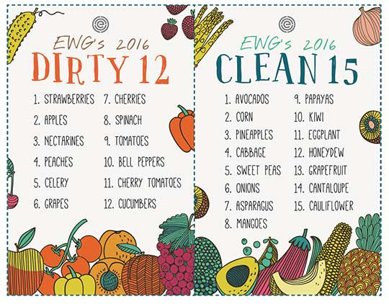
Environmental Working Group (EWG)
Find the guide at http://www.ewg.org/foodnews/
Notes:
We know that pesticides are found in fruits and vegetables, but not everyone can afford to buy organic produce all the time. The Environmental Working Group (EWG) puts together an annual guide to help shoppers prioritize which produce to buy organic.
EWG’s Shopper’s Guide to Pesticides in Produce™, updated every year since 2004, ranks pesticide contamination on 48 popular fruits and vegetables.
Parents looking for help in lowering their children’s exposure to pesticides while still eating plenty of healthy fruits and vegetables can turn to EWG’s guide as an easy-to-use resource when shopping at the store.

Slide 20
How common is pesticide-use in child care centers?
California Child Care Pest Management Survey
Pest problem present | 90%
Using any pesticides | 55%
Using spray or fogger | 47%
Using at least one IPM approach | 65%
Aware of IPM | 25%
Bradman, A. , Dobson, C., Leonard, V. & Messenger, B. (2010). Pest Management and Pesticide Use in California Child Care Centers, Center for Children’ s Environmental Health Research, School of Public Health, UC Berkeley at apps.cdpr.ca.gov/schoolipm/childcare/pest_mgt_childcare.pdf.
Notes:
The Department of Pesticide Regulation funded a survey of child care centers in California that will be released shortly. This table outlines what the survey found. Before we show you, does anyone have any guesses about what percent of child care centers in California have pest problems? What about use pesticides?
Despite what we know about the consequences of using pesticides, we’re still using them. Notice especially that 55% of centers are using pesticides, and 47% are using sprays or foggers which are the most dangerous, and uncontained form of pesticides.
We have a problem: We just learned how harmful pesticides can be, especially to children, and now we see that over half of the child care centers surveyed use them. This leads us to our next slide..

Slide 21
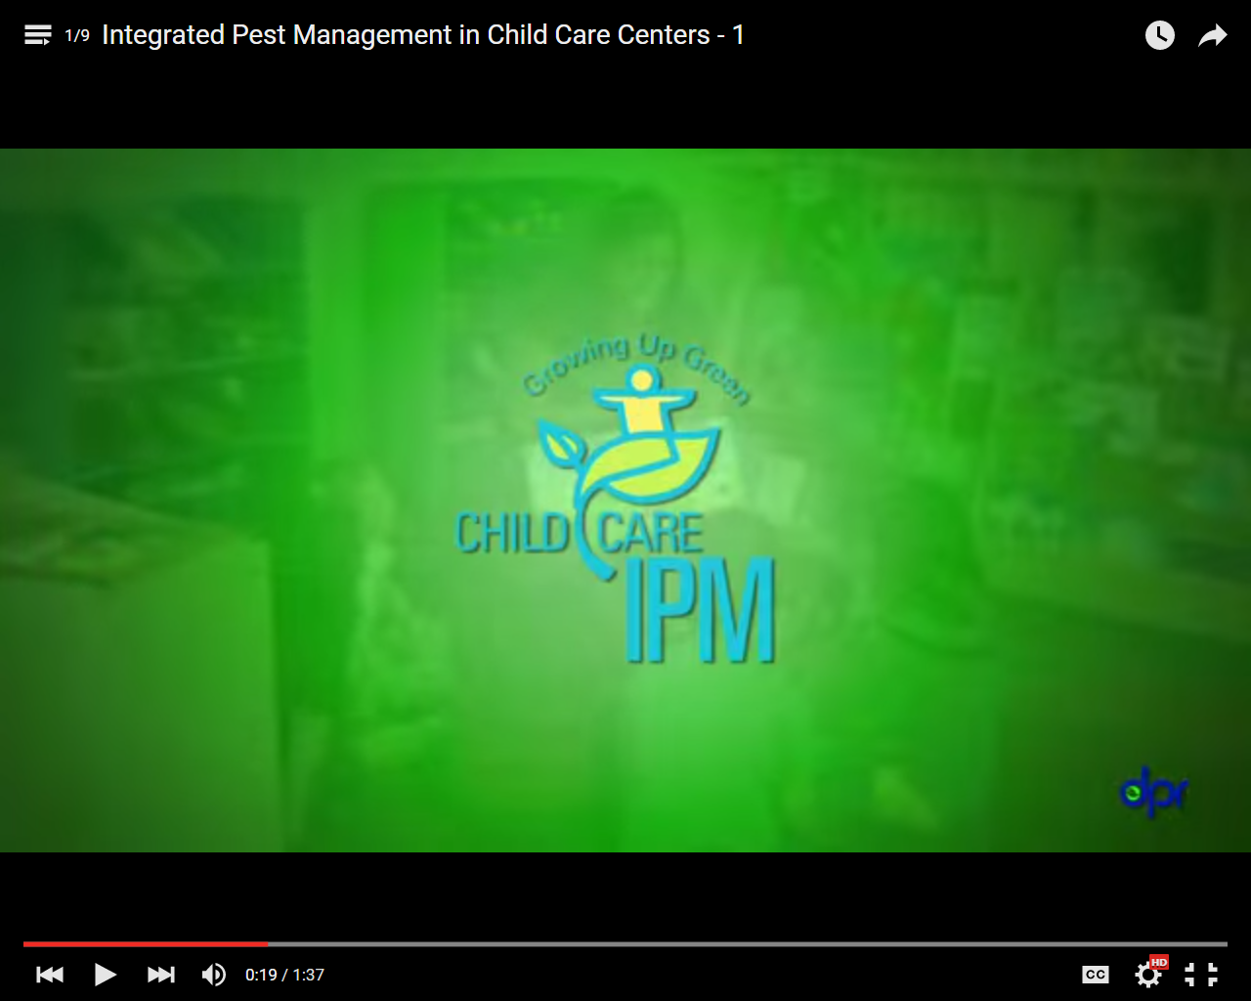
www.youtube.com/watch?v=wEh2dl36iME&index=1&list=PLgU4sA8HrUfrrheC4rNNgB1ou7JlnpKvP
Notes:
Show video if time permits
https://www.youtube.com/watch?v=wEh2dl36iME&index=1&list=PLgU4sA8HrUfrrheC4rNNgB1ou7JlnpKvP

Slide 22
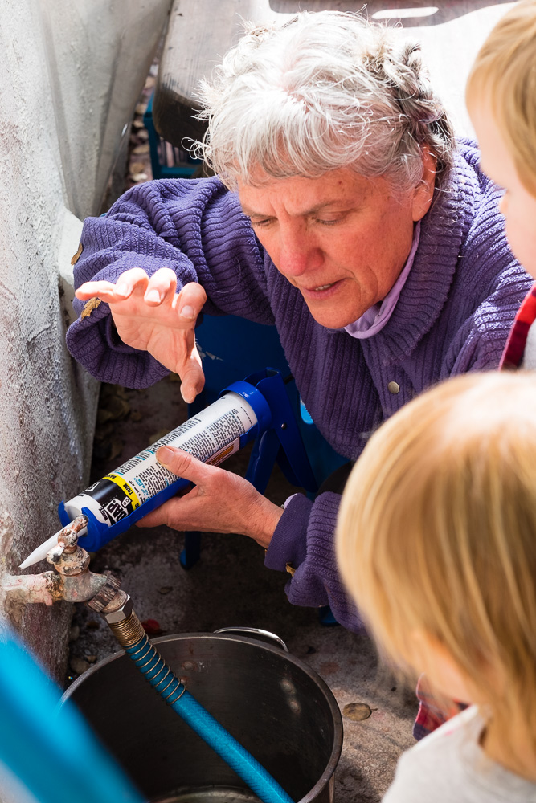
What is Integrated Pest Management (IPM)?
An approach to managing pests that focuses on:
Preventing infestations (by keeping pests out and getting rid of food, water, and shelter)
Monitoring pests
Reducing the use of harmful pesticides
Minimizing health risks to people and the environment.
Notes:
IPM keeps pests out while reducing the use of pesticides
Integrated Pest Management (IPM) is an approach to controlling pests in safer, more effective, and longer-lasting ways.
Manages pest problems by
Using non-chemical approaches.
Using least-toxic pesticides
IPM works because combined approaches for pest management are more effective in the end than a single approach, like spraying pesticides.

Slide 23
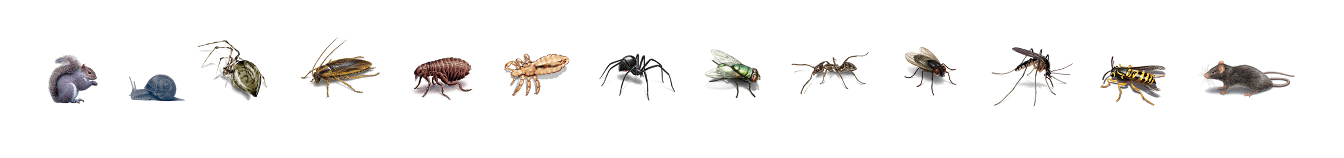
The Integrated Pest Management (IPM) Cycle
Notes:
Prevention: Keep pests out; Remove pests' food, water, and shelter
Inspect - Look for signs of pests; Evidence, Damage, The pests themselves; Where and how are they coming in?
Identify Pests - What kind of pests are you finding? Where do they live? What do they eat? What is their life cycle?
Monitor - Continue inspecting and evaluating; Use the IPM Checklist for FCCHs
Manage existing pest problems: Clean thoroughly ; Vacuum and trap; Use baits and gels, not sprays
Out of all of the strategies, prevention is the key to IPM. In practice, many of the strategies we describe in these categories are used in more than one category of IPM. For example, keeping ants out of your building is an important prevention strategy, but it is also a strategy used when managing an ant infestation.

Slide 24
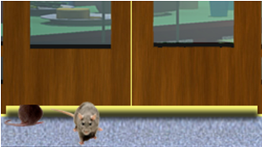
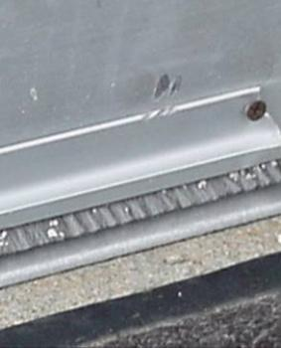
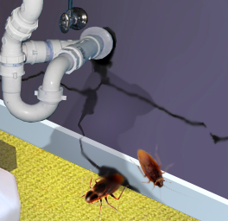

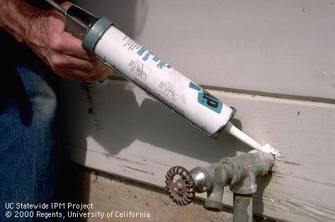
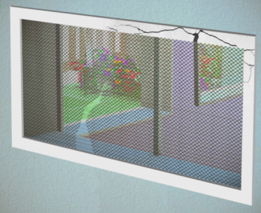
Prevention: Keep Pests Out
Seal or block gaps around doors.
Install doorsweeps.
Take home message: Close off entryways so pests can’t get into your home in the first place!
Seal gaps around pipes
Patch holes in screens
24
Notes:
Create physical barriers on the outside of the building so pests cannot enter the facility:
Prevention is always the preferred way to manage pests in an IPM program.
It is a popular misconception that pest infestations (i.e. cockroaches and rats) are the sole result of uncleanliness. While uncleanliness may exacerbate an infestation, the problem itself is often due to a structural issue (i.e., cracks in the walls, leaky pipes, excessive moisture from to plants situated too close to the structure).
24

Slide 25
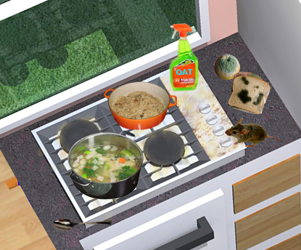
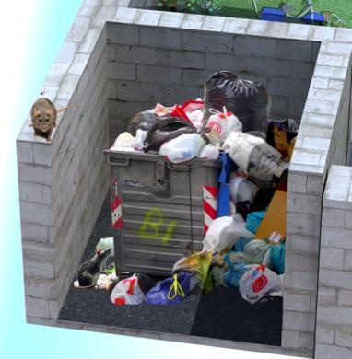
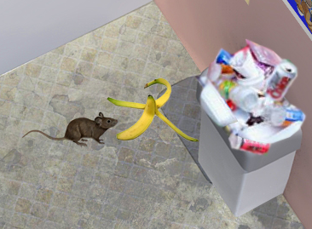
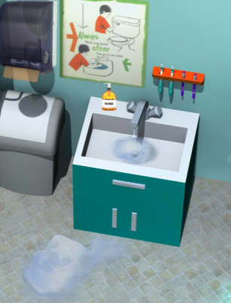
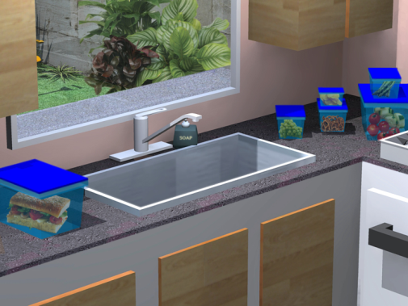
Prevention: Remove Pests’ Food & Water
Clean up food before pests are attracted to leftovers
Eliminate sanitation & garbage problems
Take home message: Pests need food and water to survive. Take away their access to these things, and you’re taking away their diet!
Eliminate standing water, clogged sinks & leaking faucets
Store food & art supplies
in sealed containers
Notes:
Like any living being, pests needs three things to survive: food, water, and shelter. Without food, water or shelter, pests will leave or die. Taking away these things, one-by-one, is the best and safest way to control pests!

Slide 26

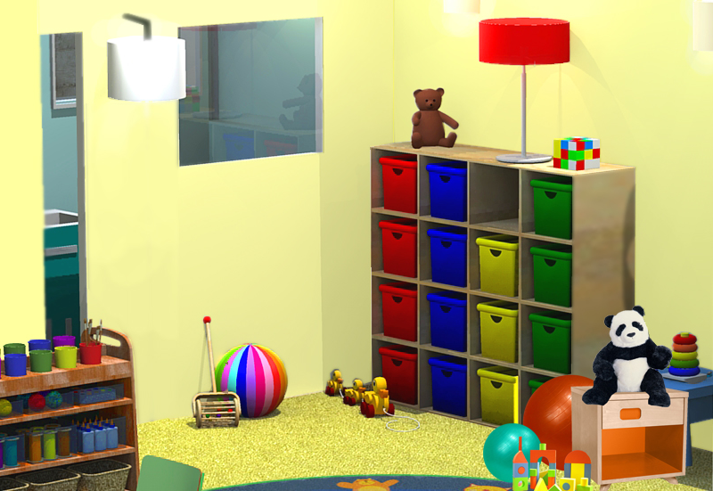
Prevention: Remove Pests’ Shelter
Replace cardboard boxes with plastic containers with lids
Take Home Message: Without shelter, pests will pack their bags and find a new home.
Organize! Clutter provides hiding spots for pests and covers up their evidence
Notes:
Cockroaches love cardboard boxes. They lays their eggs in cells and eat the paste.

Slide 27

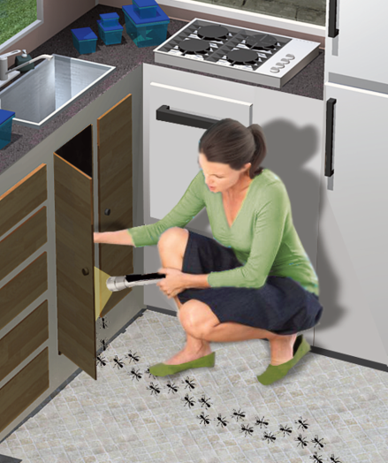
Inspection
Use the IPM Checklist to look for:
pests
signs of pests and their damage and
conditions that might attract pests.
Notes:
Use checklist to focus on problem areas and find any evidence of pest problems. The IPM Checklist is available on the CCHP website www.ucsfchildcarehealth.org under publications/training curriculum.

Slide 28

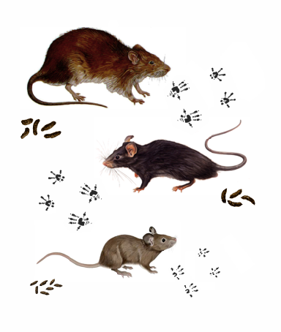
Identification
The next step is to identify what kind of pest you have.
Use the handouts on individual pests in IPM Toolkit to understand pests’ lifecycle, food, and shelter.
UC IPM program is a great resource: www.ipm.ucdavis.edu
Norway Rat
roof rat
house mouse
Notes:
When you practice IPM, you have to identify the pests in your facility and know their characteristics and life cycles. If you don’t know which pests are present, you may use the wrong management approach, choose the wrong pesticide, or treat too often or at the wrong time and do more harm than good.
Use H&S Notes to help with identification
-Pest prevention begins with correct identification of the pest and knowledge of its needs and entry points. Available food, water, hiding places and entry points must be eliminated for long-term suppression of a pest.
Food: What foods do they eat?
Water: What are their sources of water?
Shelter: How do they get inside? Where do they hide?
Do they burrow or find their way into existing cracks and holes?
Do they enter a building on cardboard boxes or in food?
What damage does a pest cause?
Life cycle of pests:
How long does it take for a pest to grow to adulthood and reproduce?
At what stage of its life cycle does it cause the most problems?
How fast do the pests reproduce?

Slide 29
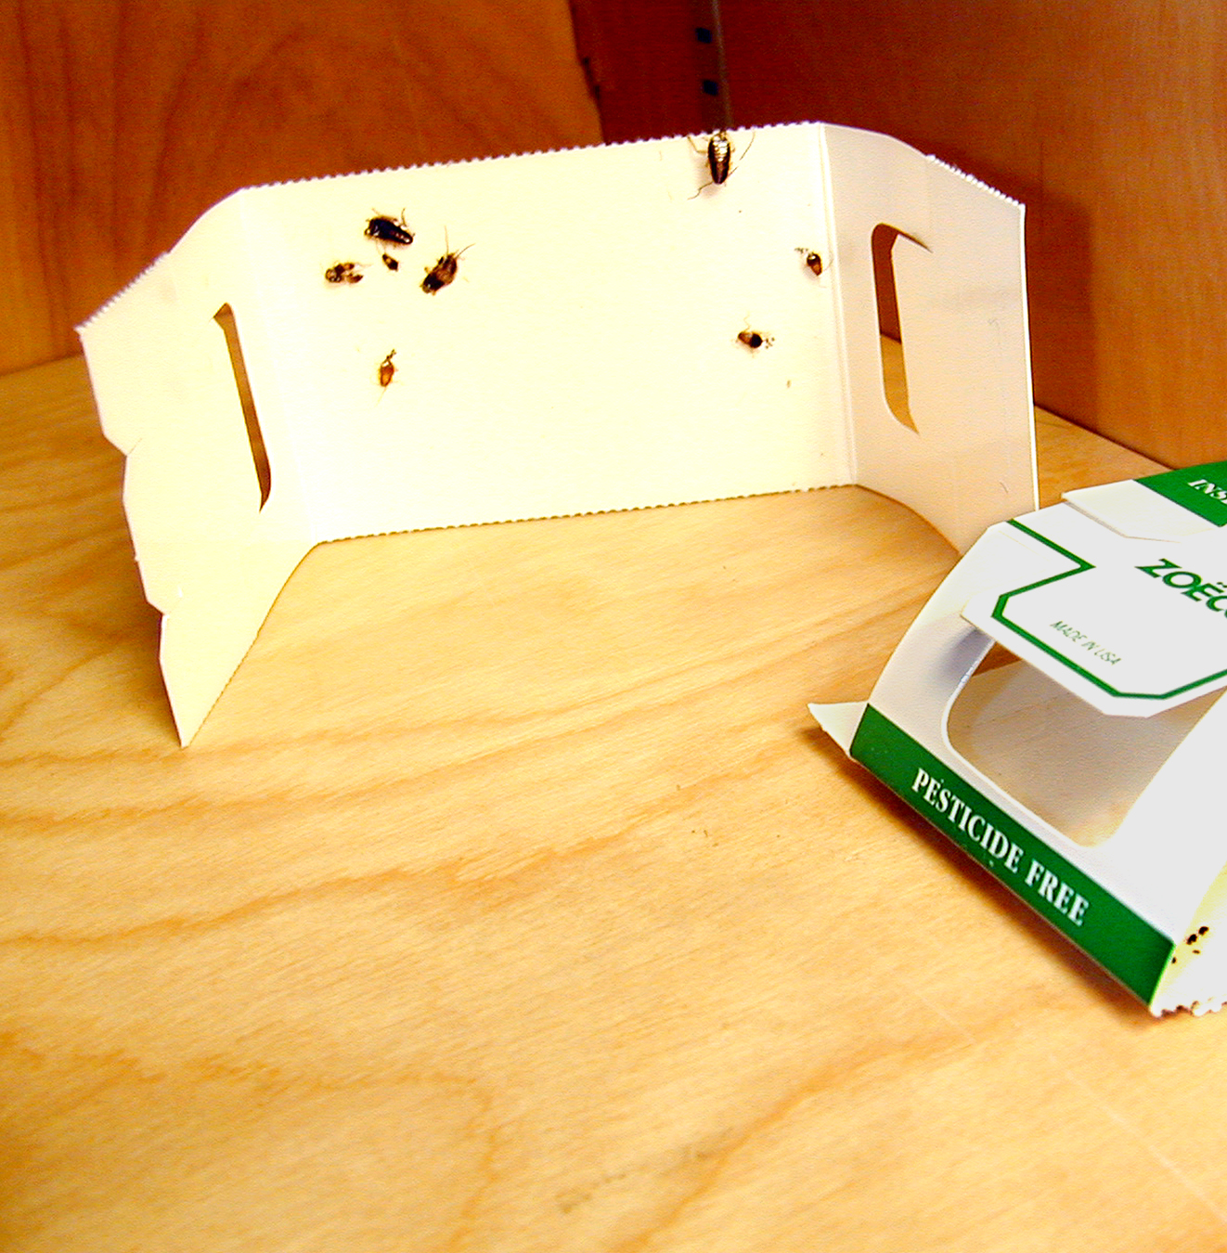
Monitoring
Regularly inspect the facility for pests and pest damage.
Identify sources of food, water, and shelter that might attract pests.
Identify where pests are living and breeding.
Determine if and when treatment is needed.
Assess whether current actions are working.
Take Home Message: Monitoring is an ongoing process!
citybugs.tamu.edu/factsheets/ipm/what-is-a-sticky-trap/
29
Notes:
Place traps wisely and have schedule to check and replace them
Always look for pests in the buildings and grounds to identify pest problems early and to:
determine if and when treatment is needed
determine whether current strategies are working
29

Slide 30
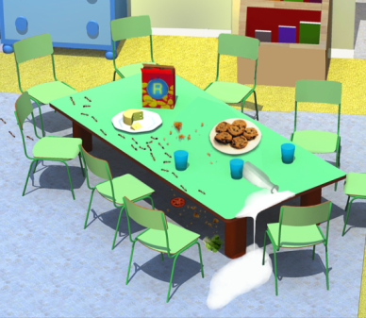

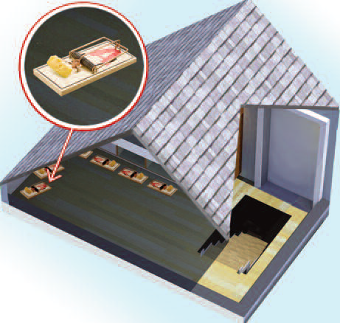
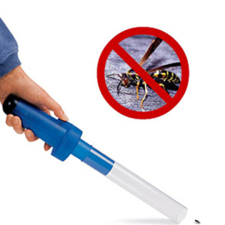
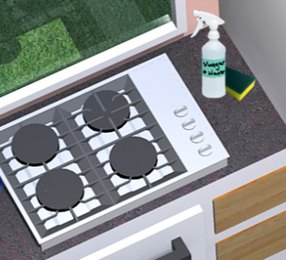
management
Often you can manage pests without using chemicals. IPM recommended techniques include:
Place traps
Take Home Message: Keeping things clean and in good repair is key to IPM!
Prevention
Wash areas with soap and water
Vacuum to remove pests
http://reviews.walgreens.com/2001/prod3447245/koolatron-mini-bug-vacuum-1ea-reviews/reviews.htm
30
Notes:
Not all pest problems require chemical solutions. For example, vacuum cleaners, sanitation and caulking may be enough.
When pests become a problem, you will need to do something to manage or suppress them. The IPM approach encourages use of materials and practices that maximize safety and reduce pesticide exposure to children and staff. Often you can manage pests with nonchemical steps. If you use pesticides, choose least harmful pesticides such as bait stations or gels. Combine them with preventive practices so pests won’t come back.
30

Slide 31
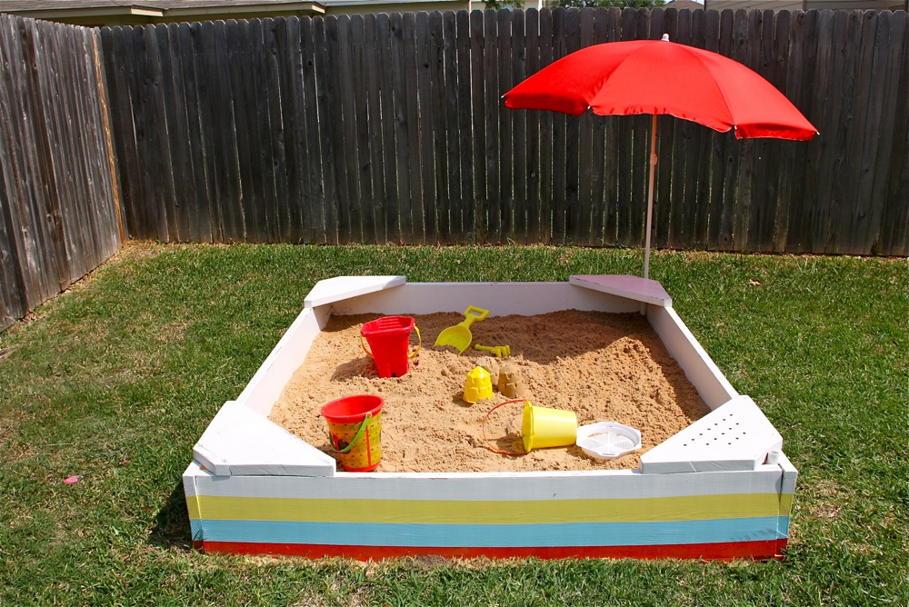
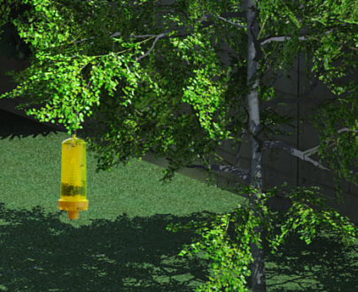
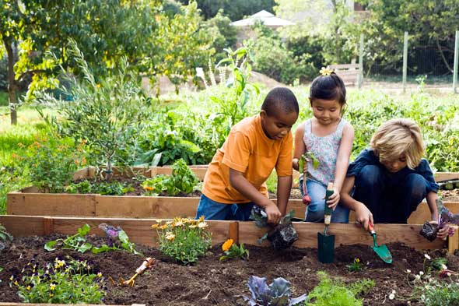
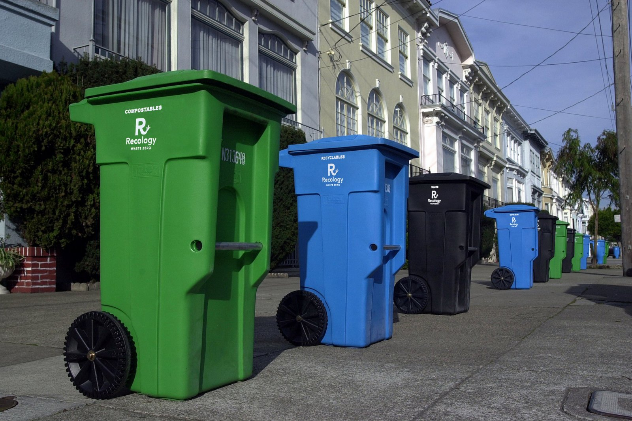
Managing the outdoor environment
Cover sandboxes
Place traps
Take Home Message: Not all insects are pests! A well maintained outdoor space will keep bothersome pests away.
Weed by hand and avoid over-fertilizing
Keep cans clean and in good repair
Notes:
Sandboxes: keep covered when not in use, keep separate from other play areas, good drainage.
Place Yellowjacket traps 20 feet away from eating and play areas.
Waste cans in good repair, area clean, hard surface.
On-site compost – closed bin
Gardening – is it a pest?
Lawn – don’t over fertilize, pull weeds by hand, apply mulch / compost

Slide 32
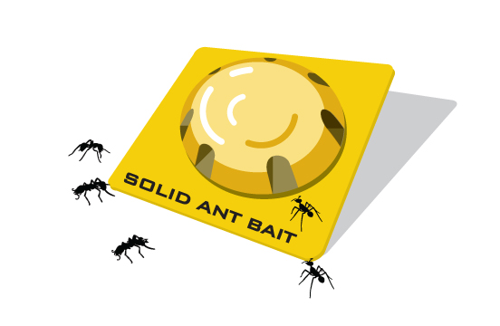
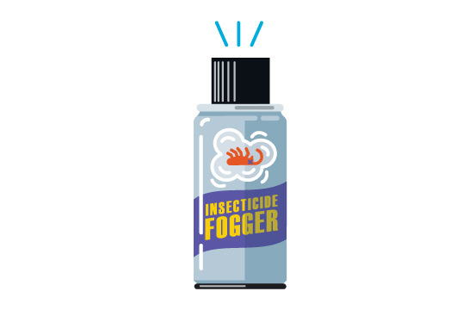
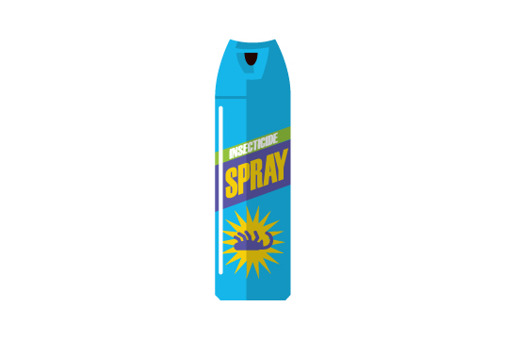
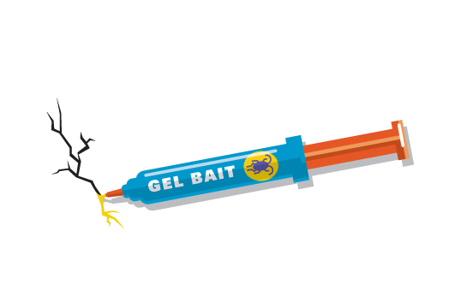
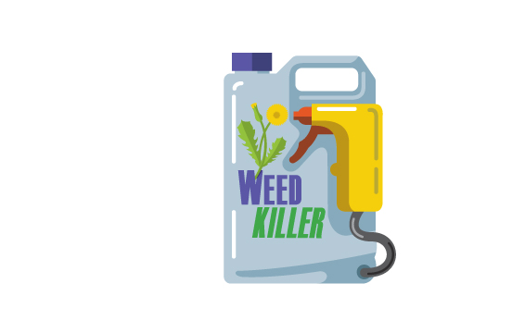
Management Selecting a pesticide
CHOOSE
USE CAUTION
Take Home Message: Use pesticides as a last resort! If needed, choose the least harmful application methods.
Sprays and foggers
Baits, gels, traps
Notes:
If non-chemical approaches are not effective by themselves you may need to use pesticides. Some pesticides have less risk of exposure than others.
-Use pesticides that are exempt from the Healthy Schools Act requirements (contained pesticides - baits, gels, and traps)
Use pesticides registered for use by the EPA and DPR, illegal pesticides include chalk, tres pasitos, mothballs
Use caution when choosing organic, green, or natural products
Always avoid foggers and sprays. They broadcast pesticides into the air and have a high risk of exposure.

Slide 33
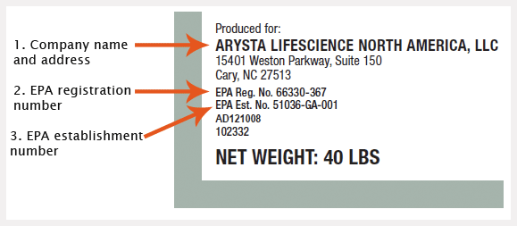

Reading the label
Notes:
Only use pesticides and disinfectants that have an EPA registration number on its label.
Always use products according to its label.
An EPA registration number means it is legal, but it does not mean that it is necessarily safe to use.

Slide 34

Management: Hiring a pest management professional (PMP)
Must be licensed
Should be trained in IPM for schools and child care
Request UC IPM free online training www.ipm.ucdavis.edu/training/school-and-child-care-ipm.html
3rd party certification:
EcoWise, www.ecowisecertified.org
GreenPro, www.whatisgreenpro.org
GreenShield, www.greenshieldcertified.org
Notes:
A PMP can help you implement an effective IPM program.
All pest management professionals (PMPs) must be licensed by the State of California. You can verify whether a company or an individual has a license issued by the Structural Pest Control Board at www.pestboard.ca.gov.
2. PMPs should be trained in IPM for schools and child care. The UC Statewide IPM Program offers a free online course for PMPs titled Providing IPM Services in Schools and Child Care Settings. Ask your PMP to take the course
3. Consider hiring a PMP with a third-party IPM certification, such as EcoWise, GreenPro, or Green Shield.

Slide 35
key resources for ipm support
CA Department of Pesticide Regulation(DPR)
“Growing Up Green” Child Care IPM: apps.cdpr.ca.gov/schoolipm/childcare/
YouTube Video Series for Child Care Centers
Free Online Healthy Schools Act IPM Training Courses
UC Statewide Integrated Pest Management Program (UC IPM)
www.ipm.ucdavis.edu
Pest Sheets
Free Online Training for PMPs
Notes:
DPR:
Many resources for child care centers including YouTube videos and a 1-hour online course for providers. It is NOT required for family child care providers, but it offers great information and you can get continuing education units (CEUs).
UC IPM:
Look up any pest to help identify and manage.
Training for PMPs (offers CEUs): Providing IPM Services in Schools and Child Care Settings

Slide 36
Small group activity
Instructions:
Read pest scenario
Using the corresponding pest sheet, list the 5 Steps of IPM for that pest
Report back
5 Steps of IPM:
Prevent
Inspect
Identify
Monitor
Manage

Slide 37
Contact Information
cchp.ucsf.edu
Your Name
Contact Information
UCSF Contact:
Kimberly Hazard
Project Coordinator,
UCSF IPM Project
Kimberly.Hazard@ucsf.edu

