Slide 1

Preventive Health and Safety in the Child Care Setting
A Curriculum for the Training of Child Care Providers
FIFTH EDITION
Funded through the California Department of Social Services

Slide 2
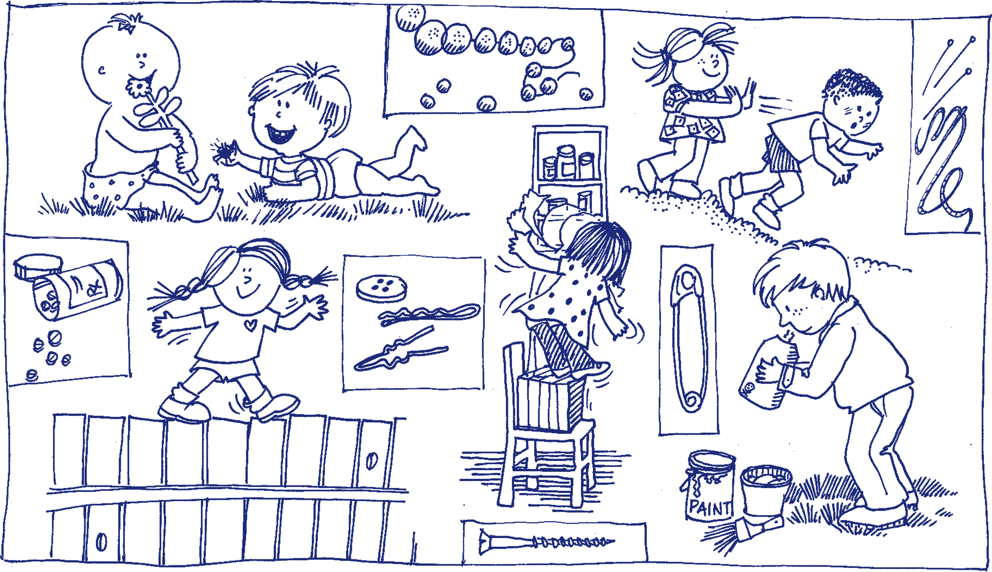
Understanding Childhood Injuries
Notes:
Injuries usually occur because of some combination of unsafe conditions and supervision and children’s participation in activities which are not developmentally appropriate. Strategies to prevention injuries include:
• Conducting regular safety checks to identify hazards
• Modifying the environment to reduce hazards
• Supervising children
• Setting and enforcing rules for activities (indoors and outdoors)
• Educating children, parents, and staff members about injury prevention

Slide 3
Where are children injured?
Most injuries occur on the playground, accounting for 50 to 60 percent of all injuries child care settings.
Furniture, equipment, stairs, windows, or slipping and tripping hazards are often involved.
Injuries occur in and around cars and other vehicles.

Slide 4
How are children injured in child care settings?
Falls are the leading cause of serious injuries.
A child may injure another child (for example, they might fight, push, collide, throw objects, or bite).
Children may collide with objects such as moving playground equipment (swings), furniture, part of the building, plants, toys, a fence, gate, etc.
Children may be cut by a sharp edge; burned by a hot surface, hot tap water or heater; or poisoned by toxic materials.
Notes:
Most injuries in child care settings are minor resulting in cuts, scrapes and bruises. But severe injuries such as head injuries, broken bones, internal injuries,
dislocations, burns, or dental injuries can also occur. Injuries like poisoning, drowning, choking, and suffocation are of special concern because they are life threatening.

Slide 5
Risk of Injury and Developmental Stages
Injury rates are low for infants and increase with the age of the child.
Children ages two to five years old get injured most frequently.
Notes:
Growing children are at risk for injuries as they develop new physical, mental, and emotional abilities. They grow quickly and want to test and master their
skills and environment. Their curiosity, fearlessness and lack of safety knowledge put them at risk of attempting actions for which they may lack the skills and physical capabilities. The type of injuries that may occur are related to their development.

Slide 6

Young Infants (birth-6 months old)
Characteristics
Types of Injuries
Eat, sleep, cry
Strong sucking reflex
Begin grasping
Can roll over unexpectedly
Need support of head and neck
Learning to sit with support
Falls from couches, tables, changing tables, and beds
Burns from hot liquids
Heat-related injuries
Suffocation/choking
SIDS and
Other sleep related infant deaths
Notes:
Have participants work in small groups or pairs to predict what injuries may occur at this developmental stage.

Slide 7

Mobile Infants (6-12 months old)
Characteristics
Types of Injuries
Sit with minimal or no support
Play with open hands
Reach for objects
Mouth objects and toys
Want to explore and play outside
Imitate older children/adults
Begin eating table food
Are curious: want to test, touch, shake
Increasingly mobile: crawl, cruise, walk
Vehicle occupant injuries
Falls
Burns
Suffocation/choking
SIDS and other sleep related infant deaths
Shaken Baby Syndrome
Heat-related injury
Drowning
Notes:
Have participants work in small groups or pairs to predict what injuries may occur at this developmental stage.

Slide 8

Toddlers (1-3 years old)
Characteristics
Types of Injuries
Like to go fast, run
Are unsteady
Reach for objects
Can go up and down stairs
Can push and pull objects
Can open doors, drawers, gates, windows
Can throw balls and other
objects
Can talk, but cannot always
express needs
Eat a greater variety of foods
Motor vehicle injuries
Falls
Burns
Poisoning
Choking
Drowning
Heat related injury
Furniture pull over
Collisions with objects and
other children
Child abuse
Notes:
Have participants work in small groups or pairs to predict what injuries may occur at this developmental stage.

Slide 9

Preschoolers (3-5 years old)
Characteristics
Types of Injuries
Have lots of energy
Begin making choices
Seek approval
Seek attention
Motor vehicle/traffic injuries
Burns
Playground injuries/falls
Poisoning
Using tools and equipment
Collisions
Heat related injuries
Notes:
Have participants work in small groups or pairs to predict what injuries may occur at this developmental stage. Refer to table on page 2.6-2.9

Slide 10

Developmental Delay
Children with developmental delays may have unique risks for injury.
For more information on developmental milestones and developmental delay go to the CDC website Learn the Signs. Act Early. www.cdc.gov/ncbddd/actearly/index.html

Slide 11
Preventing Childhood Injuries
Topics
SIDS and Other Sleep-Related Infant Deaths
Shaken Baby Syndrome
Brain Injury and Concussion
Child Abuse Prevention
Burns and Fire
Heat-illness
Choking, Strangulation, Suffocation
Falls
Poisoning
Lead Poisoning
Drowning
Young Children and Disasters
Child Passenger Safety
Field Trip Safety
School Bus Safety
Notes:
Now we will talk about each of these topics in more detail.

Slide 12
Active Supervision
Set up your space so that it’s free of clutter and hazards and you have easy access to children.
Position yourself so you can see and hear every child and respond quickly if necessary.
Scan and count so you know where everyone is. Count children regularly, especially during transitions.
Listen for sounds of potential danger or warning.
Anticipate children’s behavior so you are aware of when they might do something dangerous.
Pay attention to when children are unable to solve problems on their own so you can redirect.
Notes:
Active supervision means you are always watching so you can step in quickly in order to prevent injury or harm to a child. Here are some strategies that support active supervision.

Slide 13
Sudden Infant Death Syndrome(SIDS) &
Other Sleep-Related Infant Deaths
SIDS is the death of an infant younger than 1 year of age that is unexplained after a thorough scene investigation, autopsy, and review of the clinical history.
Ninety percent of SIDS deaths occur before an infant reaches 6 months of age, and peak between 1 and 4 months of age.
Other sleep-related infant deaths include suffocation, asphyxia, entrapment, and strangulation.
Notes:
It is a truly tragic event when a seemingly healthy infant dies suddenly and unexpectedly. And when the death
happens in a child care program, it can be devastating; not only for the family of the child, but also for the child
care provider and other families in the program. Safe infant sleep practices and environments reduce the risk
of Sudden Infant Death Syndrome (SIDS) and other sleep-related infant deaths.

Slide 14
SIDS and Child Care
Research shows that unexpected infant deaths in child care were more likely to happen during the first week. Infants are at greater risk when they are:
used to sleeping on their backs at home and are placed on their stomachs for sleep in child care
allowed to sleep in an unsafe sleep environment in child care (for example: a car seat, stroller, futon, pillow, or bean bag)

Slide 15

Eunice Kennedy Shriver National Institute of Child Health and Human Development (NICHD), NIH, HHS; http://www.nichd.nih.gov.
Notes:
This is what a safe sleep environment looks like.

Slide 16
How to Reduce the Risk of SIDS in Child Care
Always put infants to sleep on their backs until 1 year of age.
Place infants on a firm mattress, with a fitted crib sheet, in a crib or play yard that meets the Consumer Product Safety Commission (CPSC) safety standards.
Keep the crib free of toys, mobiles, soft objects, stuffed animals, pillows, bumper pads, blankets, positioning devices and extra bedding.
Notes:
The next slides provide details for the recommendations for safe sleep in child care settings.

Slide 17
How to Reduce the Risk of SIDS in Child Care
Do not overdress infants – no more than one extra layer than an adult. Keep the infant’s head uncovered for sleep. Remove bibs and clothing with hoods.
If additional warmth is needed for sleep, a one-piece blanket sleeper or sleep sack may be used after getting a waiver*
Ventilate the sleeping area. Keep the temperature comfortable for a lightly clothed adult.
Actively observe sleeping infants by sight and sound.
Notes:
Providers who want to dress an infant in a sleep sack need to apply to their Child Care Licensing Regional Office for a waiver. Contact your Licensing Analyst for more information on how to request a waiver.
Safe Sleep Frequently Asked Questions: https://www.cdss.ca.gov/Portals/9/CCLD/CCP%20Documents/Safe_Sleep_FAQs_Final_June_2021.pdf

Slide 18
How to Reduce the Risk of SIDS in Child Care
Do not allow infants to sleep on a sofa/couch, chair cushion, bed, pillow, or in a car seat, stroller, swing or bouncy chair.
If an infant falls asleep any place other than a crib, move the infant to a crib right away.
If an infant arrives asleep in a car seat, move the infant to a crib right away.
Space cribs three feet apart with one infant per crib.

Slide 19
How to Reduce the Risk of SIDS in Child Care
If provided by the parent, offer a pacifier for sleep.
Do not attach pacifiers to an infants clothing.
When able to roll back and forth from back to front, place infants to sleep on their backs and allow them to assume a preferred sleep position.

Slide 20
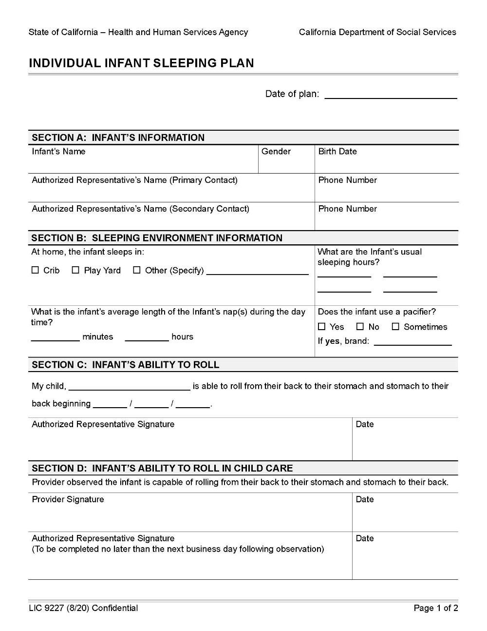
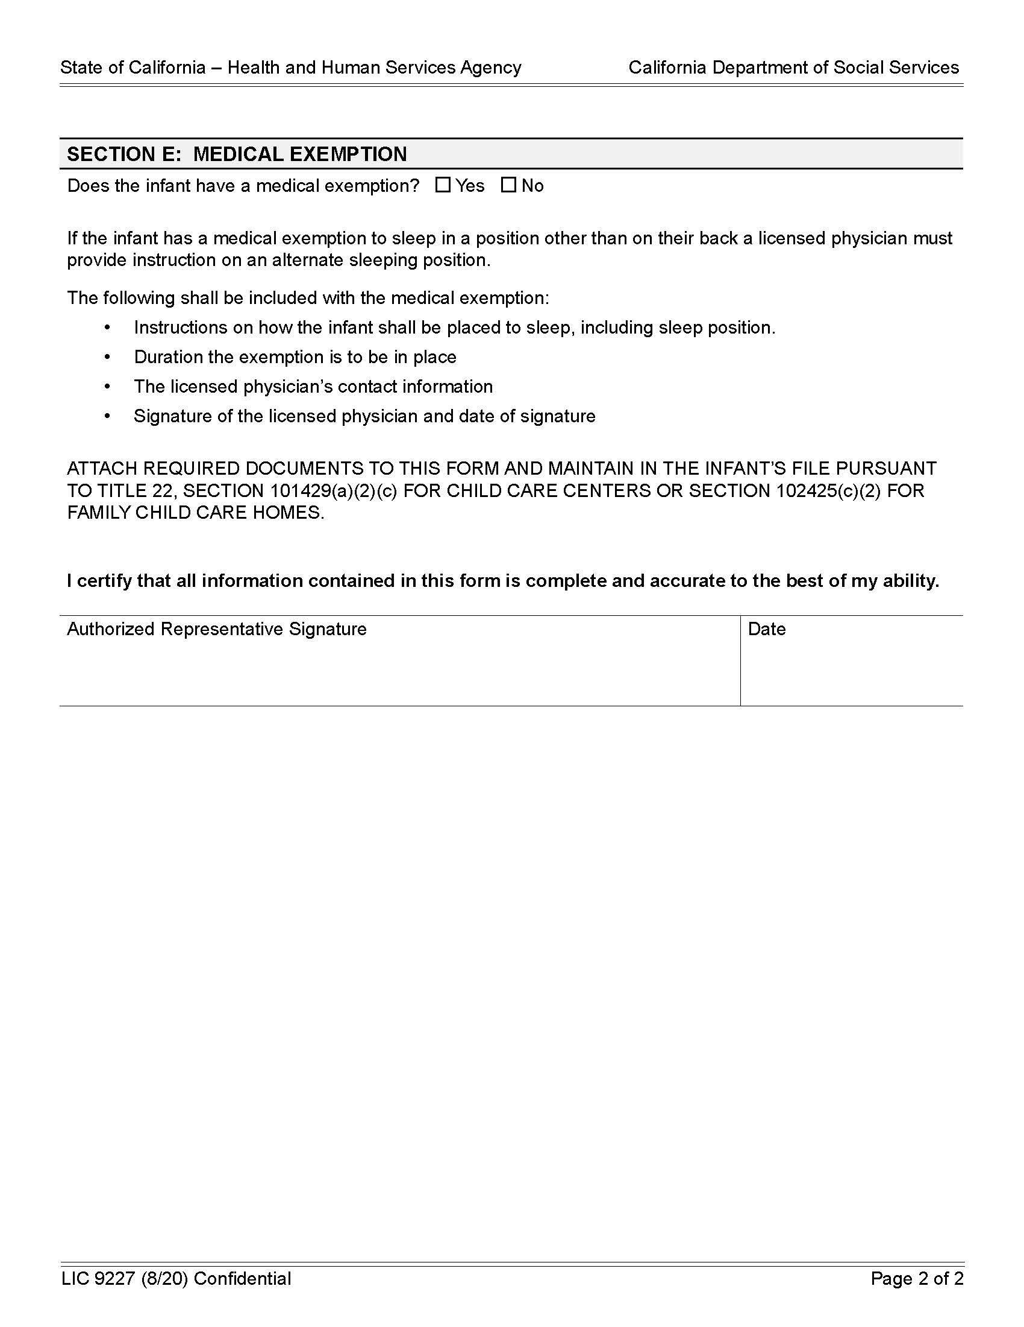

Slide 21
Safe Infant Sleep Supervision
Check sleeping infants every 15 minutes and document.
Look for signs of distress, including, but not limited to labored breathing, flushed skin color, increase in body temperature, and restlessness.
*Refer to sample log for documenting your every 15 minute check.
Notes:
FAMILY CHILD CARE HOME SPECIFIC REQUIREMENTS
If an infant is sleeping in a separate room from where the provider is stationed, the door to the room the infant is sleeping in shall remain open at all times. •The provider shall be able to visually observe the infant without moving the door. •The provider shall be near enough to the sleeping infant to be able to hear them wake up.

Slide 22

More ways to Reduce the Risk of SIDS in Child Care
Keep your child care program smoke-free.
Support breastfeeding families.
Provide supervised “Tummy Time”.

Slide 23

Tummy Time
Eunice Kennedy Shriver National Institute of Child Health and Human Development (NICHD), NIH, HHS; http://www.nichd.nih.gov.
Notes:
Infants spending all their time on their backs or in car seats, swings, and high chairs are at risk for developing motor delays. Make sure that infants have supervised tummy time when they are awake so they can grow strong.

Slide 24
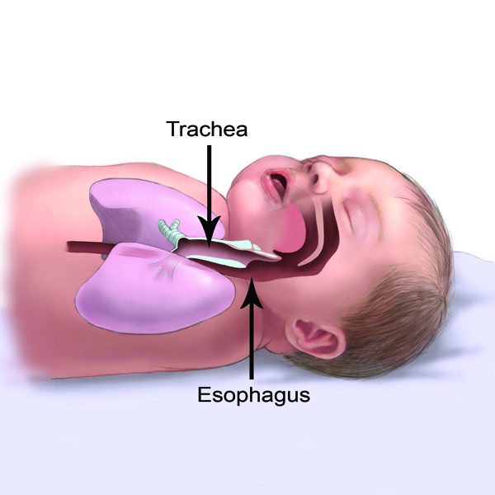
Eunice Kennedy Shriver National Institute of Child Health and Human Development (NICHD), NIH, HHS; http://www.nichd.nih.gov.
Notes:
Some people are concerned that baby will choke if put to sleep on their back. This picture shows how the trachea (wind pipe) is on top the esophagus when babies on their backs. This makes it unlikely for the baby to choke on spit up.

Slide 25
What about swaddling?
Although some newborns and young infants may be swaddled for sleep at home, swaddling of infants is not allowed in child care programs.
The risk of death is high if swaddled infants are placed on, or roll onto, their stomachs.
In a child’s home, swaddling should not be used once an infant shows signs of trying to roll over (usually before an infant is three months old).
Notes:
Use baby model to show a baby in a sleep sack positioned on their back.

Slide 26
Shaken Baby Syndrome
The term “shaken baby syndrome” describes a set of symptoms seen in infants who have sustained a head injury from shaking.
The term “abusive head trauma” may also be used. Abusive Head Trauma includes the various ways a child could suffer a head injury as a result of abuse such as: shaking; dropping; throwing; hitting; or hitting child’s head against a surface or object while shaking.
Notes:
Definitions. Abusive Head Trauma can be mild to severe and have serious long term consequences.
Demonstrate using the baby model. Show how the brain can knock against the skull when a baby is shaken.

Slide 27
Abusive Head Trauma/Shaken Baby Syndrome May Result in:
partial or total blindness;
hearing loss;
paralysis;
problems with motor development;
problems with executive function;
attention, memory, and behavior problems;
seizure disorders;
cerebral palsy;
sucking and swallowing disorders;
intellectual disabilities;
speech and language delay.
Notes:
Infants are especially vulnerable to abusive head trauma. Their fragile brains and skulls are rapidly
developing and a sudden impact can cause irreversible injury..

Slide 28
Infant Crying
Infants are unable to express their needs and feelings using words. Instead, they cry.
Infants may have colic or other kinds of pain and discomfort leading to crying.
A phase of alarming crying is considered a normal phase in infant development.
Strategies for soothing a crying infant include: gently rocking, carrying, singing, providing white noise, and offering a pacifier.

Slide 29
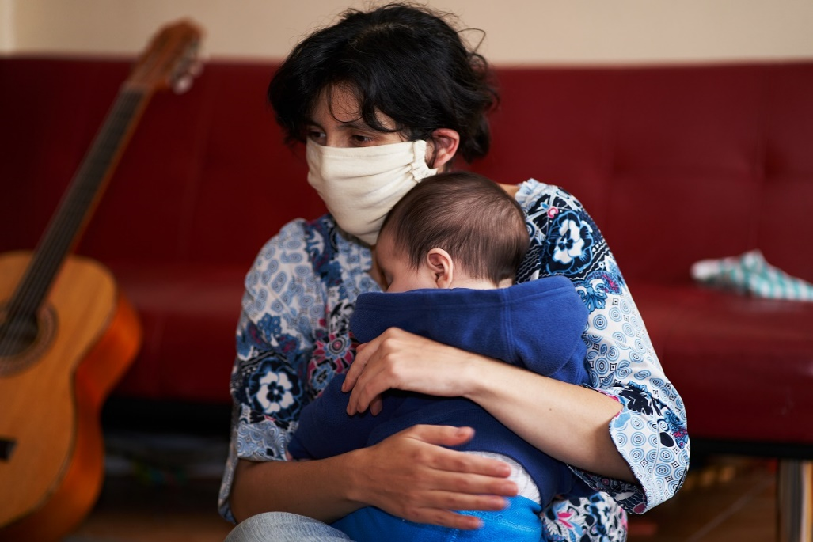
Infant Crying
Caregivers may experience anger or frustration over prolonged crying.
Caregivers need strategies to cope with a crying, fussy, or distraught infant.

Slide 30
Strategies to Cope
Manage your stress and practice self-care. Be aware of feelings of increasing frustration or anger.
Use a calming strategy that works for you. For example, take a few deep breaths or breathe deeply while counting to ten.
If you are unable to bring your frustration under control on your own, then find a way to take a break from the situation (without leaving children unsupervised).
Remember: it is never okay to shake or strike a child.
Notes:
If you need a break from a crying baby, the following are acceptable per California Child Care Licensing Regulations for providers who may be alone in family child care homes:
• The child care provider may designate a qualified substitute provider who can provide relief to a
child care provider who is stressed by a baby’s crying. It is appropriate to ask someone to help
take care of a crying baby while the care provider gets some respite. In licensed child care, the
only acceptable substitutes are those who have been fingerprint-cleared and meet all necessary
requirements established by Title 22 and the Health and Safety Code.
• The parent/guardian may designate an emergency contact, in addition to herself/himself, that can be called if the baby’s crying is alarming.
• If a child care provider realizes that a baby’s crying is a trigger for negative stress reactions, consider not providing care to infants.

Slide 31

For more information see Tips for Child Care Providers to Soothe a Crying Baby https://childcare.extension.org/tips-for-child-care-providers-to-soothe-a-crying-baby

Slide 32
Identifying Shaken Baby Syndrome
Watch for:
Changes in mood, behavior, appetite, breathing, head or eye movement
Bruising (around the head, neck or chest), bleeding (around the eyes), swelling of the head, forehead, or soft spot
Changes in muscle tone, ability to lift head, tremors, seizures
Notes:
A child care provider might be the first to notice if an infant has experienced abusive head trauma. In many cases there are no symptoms at all, but it’s important to be aware and respond so that the child can receive medical attention. Provide first aid, and call 9-1-1 for signs of severe abusive head trauma.

Slide 33
Traumatic Brain Injury (TBI) and Concussion
TBI is a type of brain injury that changes the way the brain normally works.
A bump, blow, or jolt to the head can cause a TBI.
A blow to the body that causes the head and brain to move rapidly back and forth can also cause a TBI.
A concussion is the most common type of TBI.
Notes:
Even what seems to be a mild bump to the head can be serious. Children recovering from a concussion may need adjustments to their activities.

Slide 34
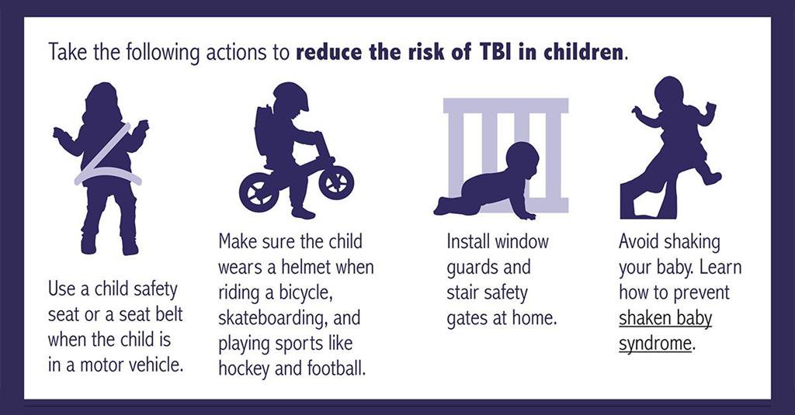
Eunice Kennedy Shriver National Institute of Child Health and Human Development (NICHD), NIH, HHS; http://www.nichd.nih.gov.

Slide 35
Child Abuse Prevention
What is child abuse?
Child abuse is a non-accidental injury or pattern of injuries to a child for which there is no reasonable explanation.
Child abuse is usually a pattern of behavior, not a single act.
Notes:
Refer to the CCHP Health and Safety Note Child Abuse Prevention

Slide 36
Kinds of Child Abuse
Physical
Emotional
Sexual
Neglect
Notes:
Refer to the CCHP Health and Safety Note Child Abuse Prevention

Slide 37
Ways to Prevent Child Abuse
Build trusting relationships with families.
Provide information on child development.
Help families build positive relationships with their children.
Model positive communication and good child care practices.
Host parenting workshops for families.
Notes:
You may be the biggest source of support and information to families and building community with other families provides extra support.

Slide 38
Ways to Prevent Child Abuse (cont.)
Know the signs of family stress and offer support
Refer families to community resources
Educate young children about their right to say “no”.
Inform parents that you are required by law to report suspected child abuse.
Notes:
Community resources include: local First 5, local Health Department, local Social Services (Child Protective Services), warm lines, mental health services, local schools, and libraries.

Slide 39
Mandated Reporter
As a Mandated Reporter, you are required to report known or suspected child abuse to Child Protective Services (CPS).
Call CPS for advice if you are not sure about something you observe.
Call 9-1-1 if the child is in immediate danger or needs urgent medical care.
Notes:
You may be the first person to suspect abuse and neglect. Child care providers are Mandated Reporters and must report known or suspected child abuse in order to protect the child. CPS will investigate the situation and provide help and services to the child and family as needed.

Slide 40
Mandated Reporter Training
Child care providers are required to take Mandated Reporter training about:
How to spot indicators of possible child abuse or neglect
How to talk to children about suspected abuse
How to make a report
What happens after a report is filed
The free online class can be found here: http://childcare.mandatedreporterca.com

Slide 41
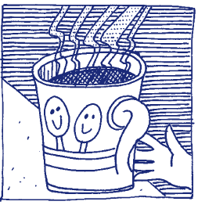
Burns and Fire
Burns can be caused by contact with hot objects or surfaces, hot liquids or steam, fire, electricity, or chemicals.
Hot liquids—not fire—are the most common cause of burns to young children.
Children are curious and don’t recognize danger!

Slide 42
Burn and Fire Prevention: Equipment
Install smoke detectors.
Maintain a working fire extinguisher.
Put barriers around fireplaces, radiators or hot pipes.
Don’t use portable, open flame or space heaters in play areas.
Cover electrical outlets.
Don’t overload electrical wiring.
Keep the temperature of your hot water heater at 120° F or lower. Check the water temperature before bathing a child in a tub.
Notes:
.

Slide 43
Burn and Fire Prevention: Food and Drinks
Keep children out of cooking areas.
Don’t drink hot beverages or carry anything hot near children.
Don’t heat bottles in the microwave.
Test hot food before giving it to a child.
Keep hot foods and drinks away from the edge of tables and counters and off of tables with table cloths.
Use the rear burners for cooking, turn pot handles toward the rear or center.

Slide 44
Burn and Fire Prevention: Practices
Store all chemicals, matches, and lighters out of children’s reach.
Teach children to stay away from hot things and not to play with matches, lighters, chemicals, electrical equipment.
Plan a fire escape route.
Conduct regular fire and evacuation drills using different exits.
Teach children how to stop, drop, and roll.
Notes:
Check with your local Fire Marshal for more information on preventing fires. See the California Child Care Disaster Plan for information on conducting drills in child care programs.

Slide 45
Heat-related Illness
Steps to prevent heat illness:
Plan outdoor activities for cooler times of the day.
Provide shade.
Take regular water breaks.
Wear loose fitting, light weight, light colored clothing.
Watch for signs of heat exhaustion:
Elevated body temperature.
Cool and clammy skin
Goose bumps
Dizziness, weakness, headache, irritability, fainting
Sweating, thirst, cramps
Nausea or vomiting
Notes:
Heat waves are becoming more common in California. Infants and young children are especially vulnerable to heat-related illness.

Slide 46
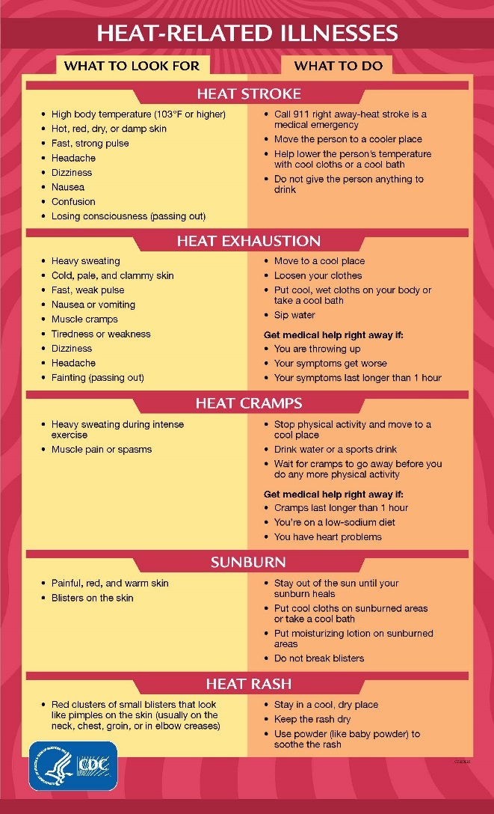
Notes:
Hot Weather Emergencies
Notify families to pick up their children in the event you are unable to maintain a safe temperature inside your child care facility (a maximum of 85 degrees F, in areas of extreme heat, a maximum of 20 degrees F less than the outside temperature). Reference: LIC PIN

Slide 47
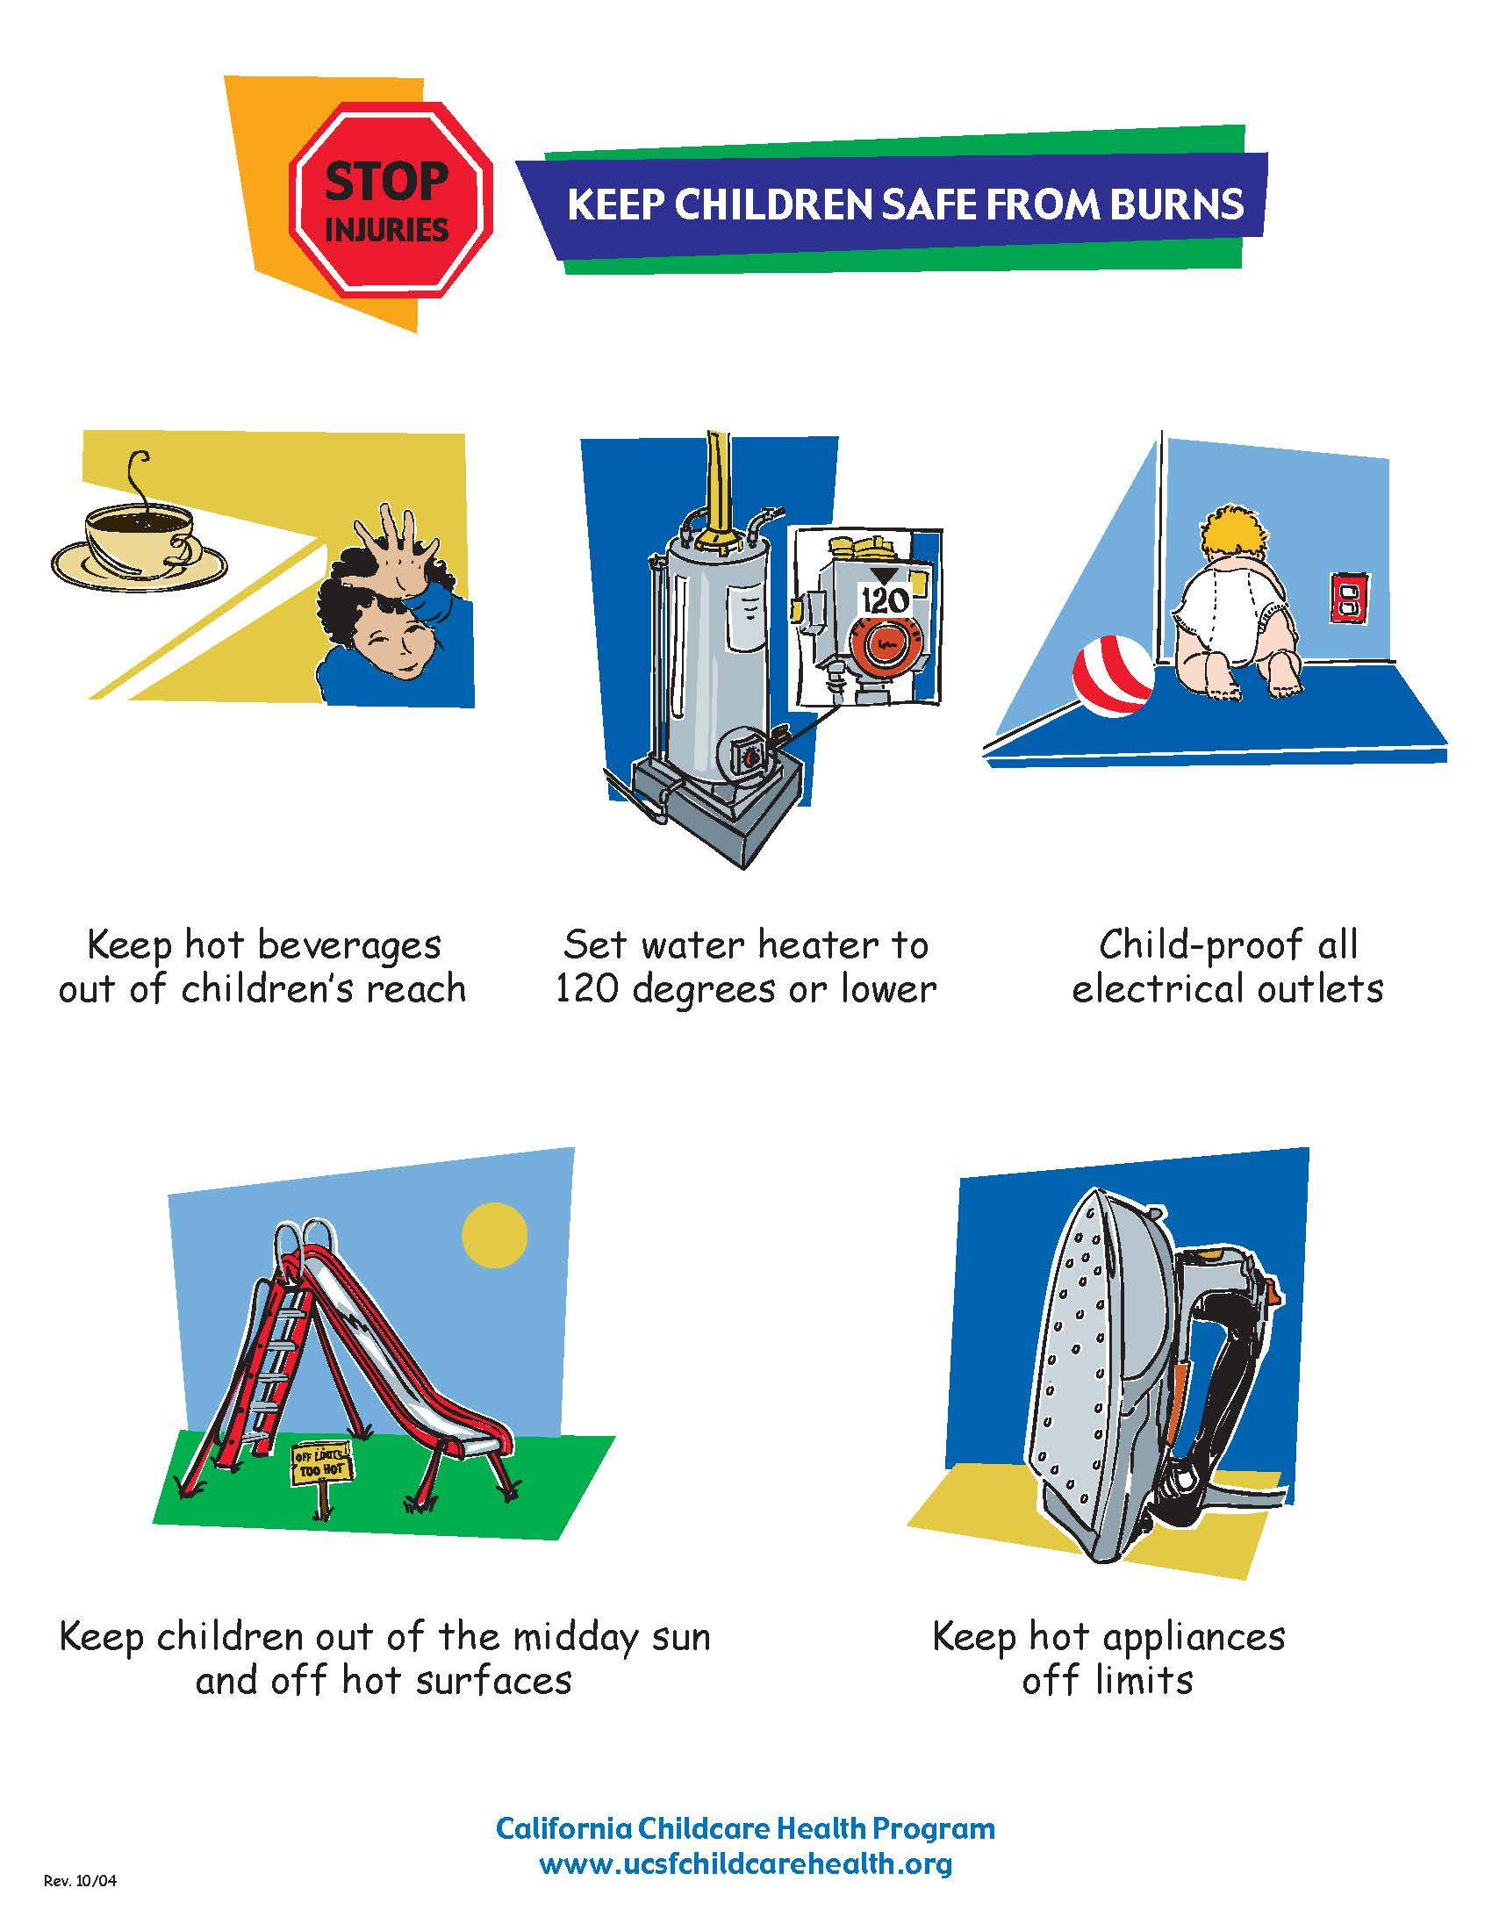

Slide 48
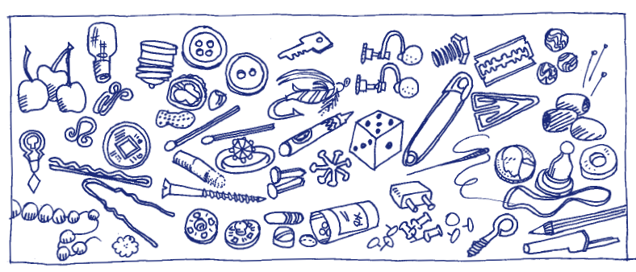
Choking Prevention
Notes:
Foods, toys, and objects can be choking hazards. How many choking hazards can you see in the picture? Keep a watchful eye for choking hazards, and keep them out of children’s reach. Objects smaller than 1 1/4" in diameter should not be accessible to children who put things in their mouths. Demonstrate the use of a “”choke tube”.

Slide 49
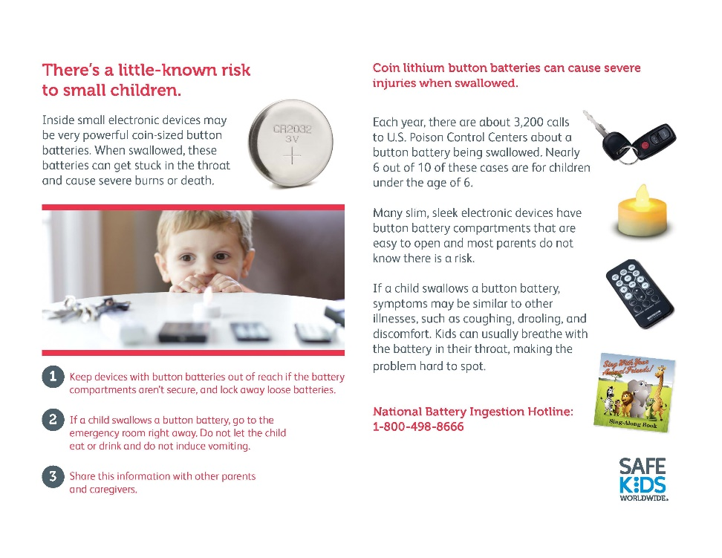
Choking Hazards: Toys and Objects
Pins
Coins
Nails
Toothpicks
Jewelry
Game pieces
Buttons
Small Toys
Jacks, Marbles
Crayons
Batteries
Button Batteries
Notes:
Check toys and equipment regularly for small parts that may break off, such as eyes and noses on stuffed animals, buttons on doll clothes.

Slide 50
Suffocation and Strangulation Hazards
Balloons
Plastic bags
Disposable gloves
Toy chests with no air holes
Cords from window blinds and drapes
Ropes and string
Never place a crib near a window.
Don’t drape blankets over crib rails or attach hanging toys/mobiles to cribs.
Use CSPC approved cribs and play yards.
Notes:
Be aware of the needs and protections for children with developmental delays, swallowing or other disabilities.

Slide 51

Falls
Falls are the single greatest cause of injury in the child care environment.
They are the most common cause of injury requiring medical care.
Children of all ages can fall.
Preventing falls is the greatest challenge to a safe environment.
Notes:
Although many injuries resulting from falls are minor (cuts and scrapes), many others such as heavy bleeding, broken bones, and head and eye injuries will be more severe and could be potentially life-threatening. Ask for examples of different kinds of falls at different ages/developmental stages.

Slide 52

Reducing the Risk of Falls: Equipment
Make sure equipment is in good repair, inspected for safety, and developmentally appropriate.
Use durable, balanced furniture that will not tip over easily.
Place gates at the top and bottom of stairs.
Notes:
(Baby walkers are outlawed in child care.)

Slide 53
Reducing the Risk of Falls: Environment
Install window guards and safety latches.
Pick up toys and other objects from the floor.
Clean up spills right away. Don’t use slippery floor finishes.
Remove loose and slippery rugs.
Adapt your space for children with special mobility needs.
Maintain safe and developmentally appropriate playgrounds.
Notes:
Provide shock absorbent surfaces (rubber, sand, pea gravel, wood chips) and appropriate fall zones for climbing structures.

Slide 54

Reducing the Risk of Falls: Supervision
Don’t allow children to climb on furniture.
Never leave infants or toddlers unattended on a bed, changing table, or other high surface.
Enforce rules for where children can run.
Enforce rules for playground safety consistently (for example, no running up slides, only one person on a swing, etc.).
Notes:
Remember, children are naturally active and playful. You can encourage healthy physical activity while taking steps to reduce the risk of falls.

Slide 55
Poisoning
Poisonings occur from many common items found in and around a home or child care environment.
Poisoning can occur by eating or drinking, contact with skin, getting in the eyes, breathing fumes, puncture wounds, and animal and insect bites.
Notes:
Image used with permission of California Poison Control

Slide 56
Poisoning Prevention: Environment
Keep anything that could poison a child out of children's reach.
Store purses away from children’s play areas.
Create a special place for families and visitors to put their purses and backpacks when they are there for a short time.
Check with your local waste management about how to safely dispose of hazardous/poisonous materials you don’t need.
Notes:
Image used with permission of California Poison Control.

Slide 57
Poisoning Prevention: Practices
Routinely inspect child care areas for health and safety hazards. Remove hazards immediately.
Provide active supervision at all times.
Teach poison prevention to children and staff.
Never call medication candy.
Keep the number of the Poison Control Center near a telephone (800-222-1222).
Notes:
You can order refrigerator magnets with the poison control number from the Poison Control Center free of charge.

Slide 58
Poisoning Prevention: Hazards
medications (prescription and non-prescription)
cosmetics
cleaning, sanitizing, and disinfecting products
arts and crafts materials
batteries
automotive products
gardening products
pesticides
certain plants and mushrooms
lead-containing paint, dust, soil, plumbing fixtures, and pottery

Slide 59
Lead Poisoning Prevention
Lead poisoning is one of the most common and preventable environmental illnesses.
Around 1 in 100 children under age 6 years old in California are found to have elevated blood lead levels. (CDPH 2022)*
Young children are more vulnerable to lead’s toxic effects.
*A blood lead level of 3.5 mcg/dL or higher is considered elevated. However, no safe blood lead level in children has been identified. CDC recommends children with a blood lead level at or above the blood lead reference value of 3.5 μg/dL be referred for follow-up. (2021)

Slide 60
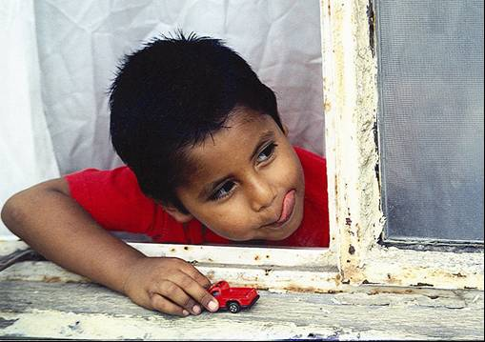
Why are young children at risk?
Children explore the environment using their hands and mouths.
They spend a lot of time on the floor and ground where sources of lead may be found.
Children absorb more ingested lead than adults.

Slide 61
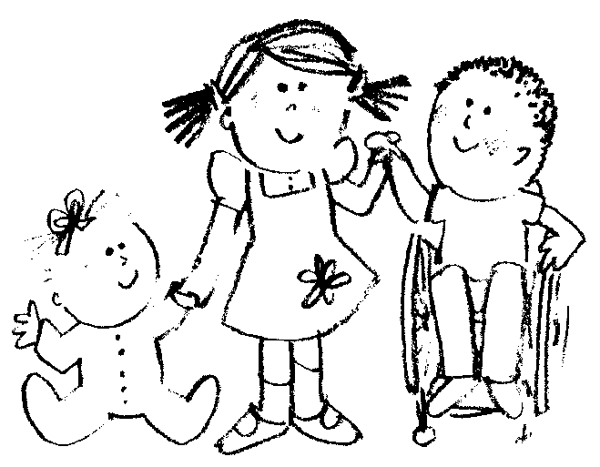
What are the health effects of lead?
Lead can affect a child’s learning, behavior, and physical development.
Anemia and lead poisoning may occur together.
Notes:
Good nutrition with sources of iron and vitamin C protects children from absorbing lead. More information on nutrition can be found in the Nutrition content of this class.

Slide 62
How would I know if a child is lead poisoned?
Most children with lead poisoning don’t look or act sick. Testing is the ONLY way to know.
Health care providers should assess children for risk of lead exposure at every well-child visit up to age 6.
Children with risk factors should have a blood lead level (BLL) test.
Children in publicly funded programs for low-income children (e.g. Head Start, Medi-Cal, Child Health and Disability Program (CHDP), and WIC) are required to have a BLL test at 12 and 24 months of age.
Notes:
Risk factors for lead poisoning include living in a building built before 1978 that has peeling or chipped paint or has recently been remodeled or having recently moved from a country with high levels of environmental lead.

Slide 63
What are possible sources of lead?
Lead-based paint in homes built before 1978.
Paint that peels, cracks, chips, or creates dust* in homes built before 1978.
Vinyl mini-blinds
Bare dirt, old artificial turf, rubber mulch, artificial surfaces
Notes:
*High friction areas like windows and doors are more prone to creating dust.

Slide 64
Possible Sources of Lead (continued)
Water from wells or running through plumbing that contains lead
Toys, particularly those that are old, painted, plastic, vinyl, or imported
Some imported foods, including candy, spices, and seasonings.
Some home remedies, make-up, and jewelry
Some handmade or imported pottery, dishes, and water crocks

Slide 65
Possible Sources of Lead (continued)
Lead brought in on clothes and shoes by parents who may be exposed at work
Some hobbies such as making stained glass (lead solder), hunting or firing ranges (lead bullets), fishing (lead sinkers)
Property near busy highways and some industries

Slide 66
What can child care providers do?
Teach parents about lead poisoning.
Encourage parents to have their children screened for lead.
Reduce lead exposure in your facility.
Remove or wipe off shoes worn indoors.
Promote good nutrition.

Slide 67
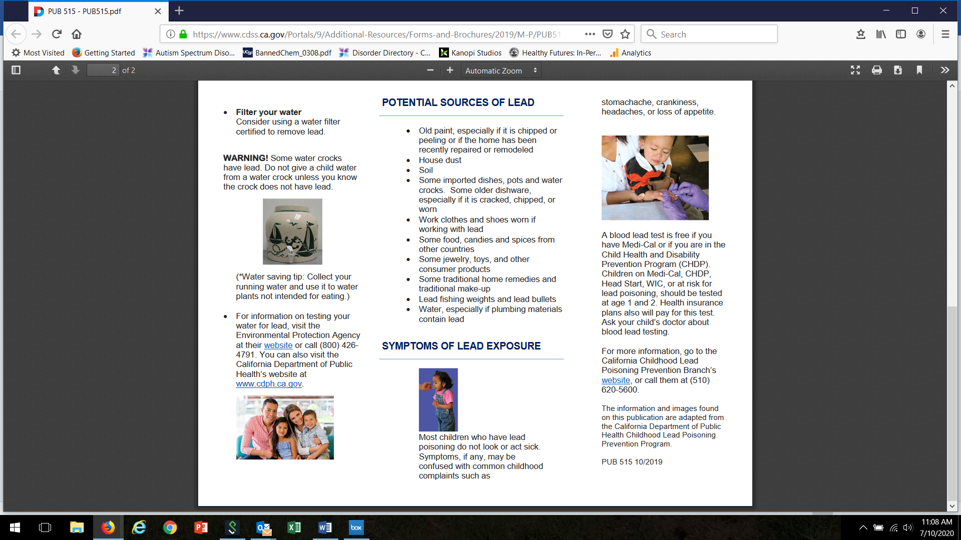
Notes:
Family Child Care Homes and Centers are required to provide lead poisoning prevention information to parents. This handout is available in many languages on the CCL website.

Slide 68
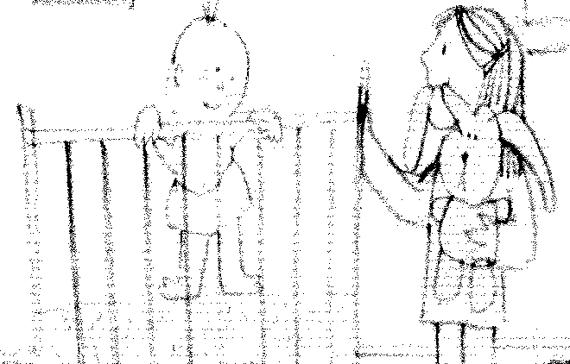
Reducing Environmental Exposure
Check toys, furniture, and equipment for chipping paint.
Do not use supplies, equipment, old toys, or imported toys unless you know they are lead-free.
Check CPSC for toy recalls: www.cpsc.gov/Recalls/
Inspect and address sources of lead monthly, see curriculum booklet for a lead exposure checklist.

Slide 69
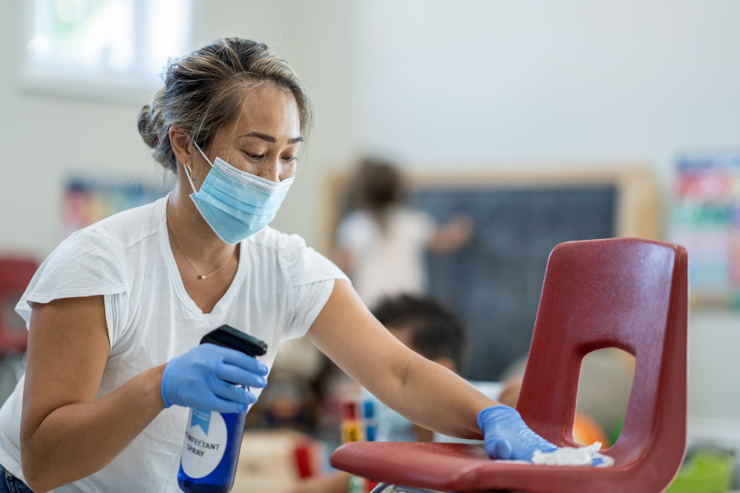
Reducing Environmental Exposure
Wash toys regularly, especially toys and pacifiers that are frequently mouthed.
Clean floors and surfaces regularly by mopping, vacuuming, and washing and rinsing.

Slide 70
Lead in Tap Water
Most tap water in California does not contain lead. BUT the only way to know is to have it tested.
Licensed child care centers in buildings built before 2010 are required to have their tap water tested for lead between January 1, 2020 and January 1, 2023 and every five years thereafter and must inform parents of testing results.
Contact your local public health department or child care licensing program analyst for information about water testing.

Slide 71
Lead in Tap Water
To reduce potential exposure to lead in tap water:
  Flush the pipes by running water until it feels coldest (usually at least 30 seconds and up to a few minutes, longer if taps have been off for 6 or more hours). Clean screens and aerators.
  Use only cold tap water for cooking, drinking and mixing baby formula (if used as an alternative to breastfeeding).
  If using a water filter, be sure to use an NSF-certified filter that removes lead. Change water filter according to manufacturer’s instructions.

Slide 72
Painting, Repairing or Remodeling
Contamination Risks for Your Child Care Environment
  Was it built before 1978?
  Is it exposed to heavy automobile traffic?
  Is it near an industrial area where lead products have been used or produced.
  Does it have old artificial play surfaces?
*Please note: The EPA requires child care facilities built before 1978 to use certified lead-safe professionals for remodels and repairs.
www.epa.gov/lead/renovation-repair-and-painting-program-operators-childcare-facilities
Notes:
*Certified lead professionals have special training in lead-safe practices.

Slide 73
Testing for Lead
  Call your local public health department Childhood Lead Poisoning Prevention Program for testing information.
  Have your facility evaluated by a certified lead inspector. A list of certified assessor/inspectors is available on the CDPH website. https://www.cdph.ca.gov/Programs/CCDPHP/DEODC/CLPPB/Pages/LRCcertlist.aspx
  Test any potential sources of lead, such as paint, soil, water, artificial turf and surfaces, rubber mulch, equipment, toys, and dishes.
Notes:
Test kits for pottery are available in hardware stores. EPA's Lead Renovation, Repair and Painting Rule (RRP Rule) requires that child care facilities and pre-schools built before 1978 use firms certified in lead-safe practices for renovation, repair, or painting projects that disturb lead-based paint. CDPH maintains an up to date list of professionals it certifies for lead-related construction in California.

Slide 74

Lead and Nutrition
Be sure to serve a variety of healthy foods for meals and snacks, especially those rich in iron, calcium, and Vitamin C.
More information on nutrition can be found in Module 3.

Slide 75
Resources:
Your Local Childhood Lead Poisoning Prevention Program (XXX) XXX-XXXX
California Department of Public Health (CDPH) Childhood Lead Poisoning Branch (510) 620-5600 www.cdph.ca.gov/Programs/CLPPB

Slide 76

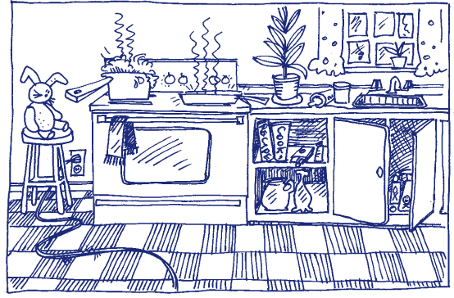

Find the Hazards

Slide 77
Drowning
Children between the ages of one and four years are at greatest risk from drowning.
Even a bucket containing only a few inches of water can be dangerous for a small child.
Notes:
Young children are “top heavy” and can fall into a bucket and drown.

Slide 78
Drowning Prevention
Never leave a child alone in or near any body of water (for example, a tub, toilet, bucket, swimming pool, or wading pool, ).
Empty buckets and other standing water when not in use.
Always provide careful, direct, and constant supervision around bodies of water.
Enclose water hazards with a fence that is at least five feet tall with a self closing gate that is at least 55’ high.

Slide 79
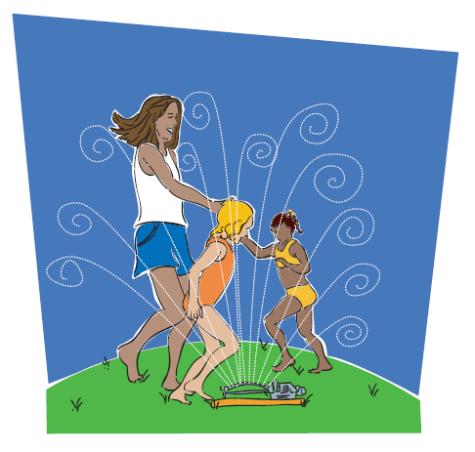
Find Safe Ways to Play with Water
Notes:
Portable wading pools are not recommended for child care programs.

Slide 80
Young Children and Disasters
A disaster or emergency in your child care center or community brings many challenges.
Children may be experiencing trauma in the aftermath of a disaster.
You can lessen the impact if you know what to expect and plan accordingly.
Notes:
After experiencing a disaster—whether it is a flood, earthquake, fire, pandemic, or human caused event, children may react in ways that are difficult to understand.
Refer to the CCHP Health and Safety Note, Young Children and Disasters

Slide 81
After a Disaster…
Keep TV/radio/adult conversations about the disaster at a minimum around young children.
Answer all questions as honestly and simply as possible.
Be prepared to answer the same questions over and over. Be patient, understanding, and reassuring.

Slide 82
After a Disaster…(cont.)
Try to return to a normal routine as soon as possible to restore a sense of normalcy and security.
Don’t promise there won’t be another disaster. Instead, encourage children to talk about their feelings.
Tell children you will do everything you can to keep them safe.

Slide 83
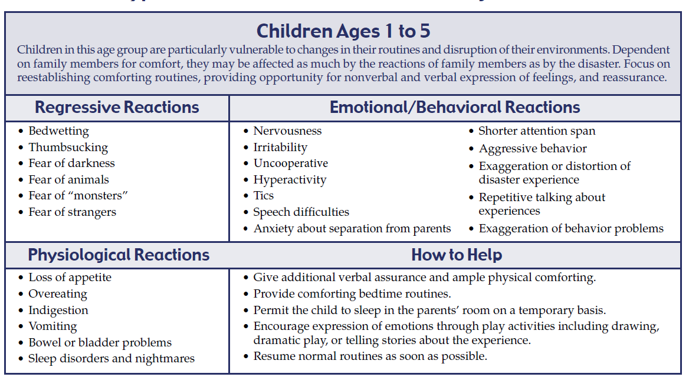
Typical Reactions Following a Disaster

Slide 84
Child Passenger Safety
Children under 2 years of age shall ride in a rear-facing car seat unless the child weighs 40 or more pounds OR is 40 or more inches tall. The child shall be secured in a manner that complies with the height and weight limits specified by the manufacturer of the car seat.
​Children under the age of 8 must be secured in a car seat or booster seat in the back seat.
Children who are 8 years of age OR have reached 4’9” in height must be secured by a safety belt.
Passengers who are 16 years of age and over are subject to California's Mandatory Seat Belt law.

Slide 85
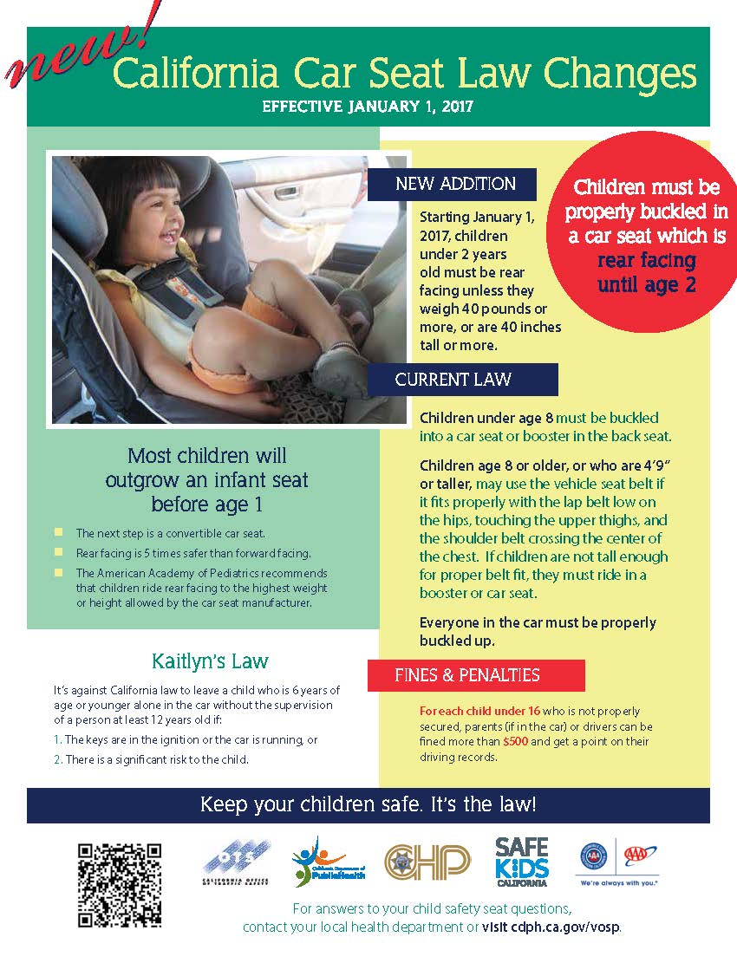
Notes:
Child Passenger Safety Laws must be posted in licensed child care centers.
You can find this poster on the Child Passenger Safety web page of the CDPH website. www.cdph.ca.gov/Programs/CCDPHP/DCDIC/SACB/Pages/ChildPassengerSafety(CPS)InCalifornia.aspx

Slide 86
In and Around Cars
Teach children to never play in, on, or around cars.
Never leave a child unattended in a vehicle, even with the window slightly open
Always lock vehicle doors and trunk, especially at home.
Keep keys and remote entry devices out of children’s reach
Watch children closely around vehicles.
Make sure children leave the vehicle when you reach your destination (especially sleeping infants).
Be careful when dropping off children at a child care provider if it’s not part of your normal routine. Place something you’ll need (for example, a purse or briefcase) on the floor of the back seat.
Child care providers should follow-up if a child is unexpectedly absent.
Notes:
Sadly, every year children die after being left in a car that gets too hot. Some motor vehicle accidents happen when the car is not moving or the child is not even in the car. Follow these safety tips to keep children safe in and around cars.

Slide 87
Prevent Roll Overs
Walk all the way around your parked vehicle to check for children before getting in and starting the car.
Make sure young children are always accompanied by an adult when getting in and out of a vehicle.
Firmly hold the hand of children when walking near moving vehicles, in driveways, or in parking lots.
Identify and use safe areas for children to play away from parked or moving vehicles.
Designate a safe spot for children to go when vehicles are about to move.

Slide 88
Field Trip Safety
Field trips with young children provide wonderful learning opportunities that enrich and extend your curriculum.
With careful planning, adequate supervision and a spirit of adventure, adults and children can safely enjoy outings!
Notes:
Tip: A field trip to your relocation site in the event of a disaster can be fun for children and serves as a good drill.

Slide 89
Field Trip Safety
Research your destination-make sure it’s child friendly.
Obtain written consent--be sure you know how to reach families in an emergency.
Arrange for adequate supervision--you may need volunteers. Make sure volunteer staffing complies with licensing regulations.

Slide 90
Field Trip Safety
Prepare a roster with names of participating children.
Pack a first aid kit, medications (along with special health care plans), water, food, hand sanitizer, sunscreen, walking ropes, and other supplies you might need for the day.
Follow child passenger laws for travel by car or van.

Slide 91

School Bus Safety
Always supervise young children in and around school buses

Slide 92
School Bus Safety Tips
Teach children to:
Stand at least three giant steps back from the curb as the bus approaches.
Board the bus one at a time.
Use handrails when getting on or off the bus.
Wait for the bus to come to a complete stop before getting off.
Never to walk behind the bus.

Slide 93
Injury Prevention Policies and Routines
Topics
Active Supervision
Regular Safety Checks: Inside and Outside
Safe Playground Habits
Safety Routines and Behavior Management
Back Injury Among Providers
Forms and Checklists

Slide 94
Active Supervision: Strategies
Set up your space so that it’s free of clutter and hazards and you have easy access to children.
Position yourself so you can see and hear every child and respond quickly if necessary.
Scan and count so you know where everyone is. Count children regularly, especially during transitions.
Listen for sounds of potential danger or warning.
Anticipate children’s behavior so you’re aware when they might do something dangerous.
Pay attention to when children are unable to solve problems on their own.
Notes:
Active supervision means you are always watching so you can step in quickly in order to prevent harm to a child. Adapted from Head Start Active Supervision.

Slide 95
Regular Safety Checks: Inside and Outside
Examining the indoor and outdoor environments for safety hazards prevents accidents.
Modifying an environment for children’s safety, is sometimes called “childproofing”.
Childproofing does not make the environment 100 percent safe or replace supervision.

Slide 96
Safety Routines and Behavior Management
Establish written safety policies for your child care environment (include guidelines, checklists, and assignments).
Provide active supervision at all times.
Monitor children’s behavior.
Teach children injury-preventive behavior and safety rules.
Adapt your environment to the developmental needs of. children
Notes:
As time allows, this is a good time for small group and/or problems solving scenarios.

Slide 97
Health and Safety Checklists
Use a checklist to conduct safety checks of outdoor areas, indoor areas, first aid kits, etc. on a regularly scheduled basis.
Build safety checks into your daily, weekly and monthly schedules.
Notes:
You can use a series of checklists (for example, one for safety, one for first aid supplies, etc. or one checklist that is more comprehensive, such as the Health and Safety Checklist for ECE based on Caring for Our Children National Health and Safety Performance Standards.

Slide 98
Health and Safety Checklist for ECE
Based on Caring for Our Children (CFOC) http://nrckids.org
Online version
Checklist: https://cchp.ucsf.edu/content/resources/cchp-health-and-safety-checklist
User Manual: https://cchp.ucsf.edu/content/resources/cchp-health-and-safety-checklist-users-manual
Notes:
Share local resources, use the resource table for reference.

Slide 99
Back Injury Prevention for Staff
Back injuries are the most common injuries among child care providers.
Good body mechanics and proper lifting techniques will help to keep your back healthy!
Notes:
Be sure to take care of your self!

Slide 100
How Back Injuries Can Occur
Lifting of children, toys, equipment, etc.
Height of furniture (e.g., child-sized tables and chairs)
Lowering and lifting children in and out of cribs
Frequent sitting on the floor with back unsupported
Excessive reaching above shoulder height to obtain stored supplies
Frequent lifting of children on and off the diaper changing tables
Awkward positions and forceful motions needed to open windows
Carrying garbage/diaper bags to dumpster

Slide 101
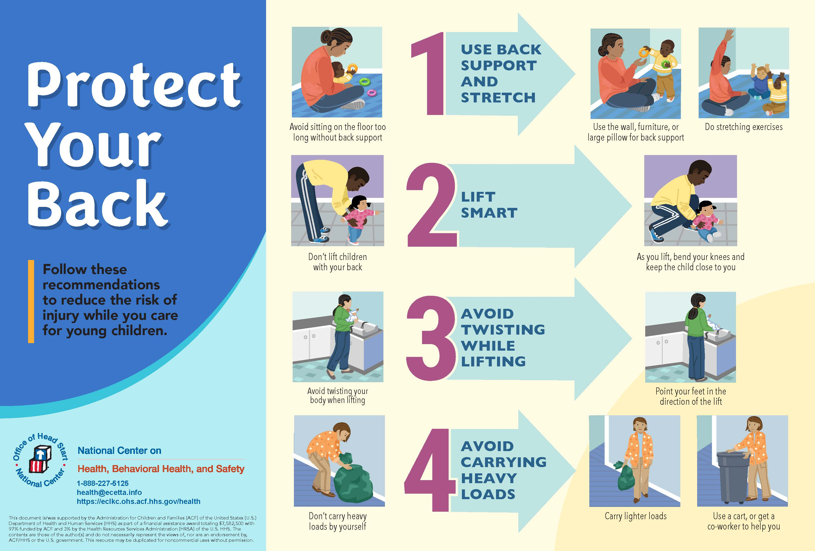
Notes:
Opportunity for demonstration or lifting exercise.

Slide 102
More Lead Poisoning Prevention Resources:
Community Care Licensing Division (CCLD) Website https://www.cdss.ca.gov/inforesources/child-care-licensing
CCLD Lead Poisoning Prevention and Water Testing https://www.cdss.ca.gov/inforesources/child-care-licensing/water-testing-information
Food and Drug Administration (FDA): Lead and Food in Dishware https://www.fda.gov/food/metals/lead-food-foodwares-and-dietary-supplements
CDPH maintains a list of lead-safe certified professionals in California. https://www.cdph.ca.gov/Programs/CCDPHP/DEODC/CLPPB/Pages/LRCcertlist.aspx

Slide 103
More Lead Poisoning Prevention Resources:
Centers for Disease Control (CDC): Childhood Lead Poisoning Prevention Program https://www.cdc.gov/nceh/lead/
Environmental Protection Agency (EPA) Brochure: Protect Your Family from Lead in your Home https://www.epa.gov/sites/production/files/2017-06/documents/pyf_color_landscape_format_2017_508.pdf
EPA Toolkit: Reducing Lead in Drinking Water https://www.epa.gov/ground-water-and-drinking-water/3ts-reducing-lead-drinking-water-toolkit

