Slide 1
Managing Rodents in Child Care Settings
University of California, San Francisco / California Childcare Health Program
HEALTHY SCHOOLS ACT APPROVED COURSE, 2023
Notes:
Introduce yourself & project

Slide 2
Acknowledgements
Funding for this program was provided through a grant awarded by the California Department of Pesticide Regulation (DPR). The contents of this document do not necessarily reflect the views and policies of DPR nor does mention of trade names or commercial products constitute endorsement or recommendation for use.
https://www.cdpr.ca.gov/docs/schoolipm
https://cchp.ucsf.edu
Notes:
This Integrated Pest Management (IPM) workshop was funded by the California Department of Pesticide Regulation (DPR) and originally developed by the University of California (UC), San Francisco School of Nursing’s California Childcare Health Program, in collaboration with the UC Berkeley Center for Environmental Research and Children’s Health, the UC Statewide IPM Program, and DPR. The contents of this document do not necessarily reflect the views and policies of DPR, nor does mention of trade names or commercial products constitute endorsement or recommendation for use.

Slide 3
Icebreaker Questions
What is your name?
Have you ever seen rodents in your home or child care center?
How do you feel about rodents?
What would you like to learn from today’s workshop?

Slide 4
Goals
To prevent and get rid of rodents safely
To protect the health of children and staff in child care facilities
To protect the environment
To make sure your staff is following the Healthy Schools Act requirements
Notes:
What are the five things we hope you’ll take away from this presentation?
This presentation will teach you how to prevent and get rid of rodents inside your center.
Integrated pest management methods are designed to control pests while also protecting the health of people…
and the environment.
In addition to this information being about best practices, it’s also about the law. Today we’ll also learn more about the Healthy Schools Act and what your responsibilities are in order to be compliant with it.

Slide 5
Agenda
Rodents as pests
The Healthy Schools Act and Integrated Pest Management
Integrated Pest Management (IPM) of rodents

Slide 6
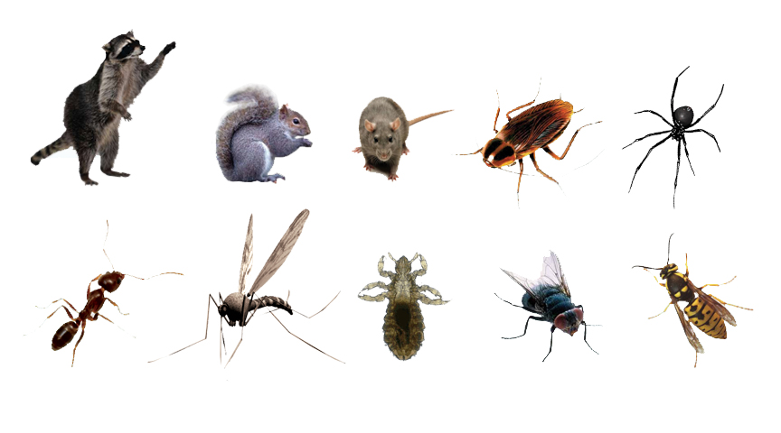
What is a pest?
A pest can be described as any living organism that causes damage or discomfort, or transmits or produces disease.
Notes:
What pests do you see here?
A pest can also be something that is simply where it is not wanted, such as clover in a grass play area. It’s important to remember: something that is a pest in one situation can play an important role in the environment in other settings. For example, ants are actually beneficial when they’re outdoors. They add oxygen to the soil and attack insects such as fleas, caterpillars, and termites.

Slide 7
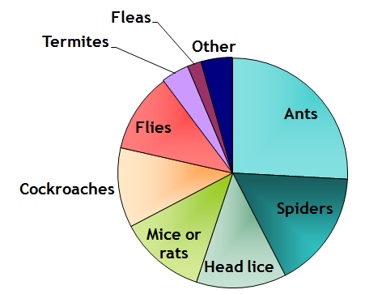
What are the most common INDOOR pests in California childcare centers?
Bradman, A. , Dobson, C., Leonard, V. & Messenger, B. (2010). Pest Management and Pesticide Use in California Child Care Centers, Center for Children’s Environmental Health Research, School of Public Health, UC Berkeley at apps.cdpr.ca.gov/schoolipm/childcare/pest_mgt_childcare.pdf.
Notes:
In a survey a California’s child care centers, rodents like mice or rats are less common than other indoor pests (ants, spiders, head lice).

Slide 8
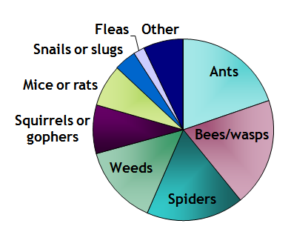
What are the most common OUTDOOR pests in California childcare centers?
Bradman, A. , Dobson, C., Leonard, V. & Messenger, B. (2010). Pest Management and Pesticide Use in California Child Care Centers, Center for Children’s Environmental Health Research, School of Public Health, UC Berkeley at apps.cdpr.ca.gov/schoolipm/childcare/pest_mgt_childcare.pdf.
Notes:
Outdoors, child care center staff report seeing not only mice and rats, but also squirrels and gophers (which are also rodents).

Slide 9
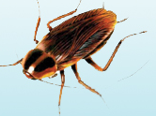
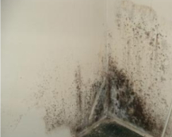
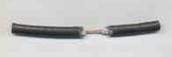
What problems can pests cause?
Health Problems
Spread Disease, Contaminants
Allergies
Trigger Asthma
Building Damage
Mold & Termites Damage Building
Rats Eat Wires
Parents and staff are upset when they see pests
Notes:
There are three major categories of concern with pests in child care.
The first one is health problems. Pests such as cockroaches or mice can spread germs that can cause disease. For instance, a roach can walk across the toilet or in the trash on uncooked meat or rotting food and then across plates and tables where we eat. Pests can also cause allergies or asthma. Roaches can trigger asthma because when they shed their skin to grow, they release a “dander” much like a cat. This has been shown to be an asthma trigger. Mice have also been shown to trigger asthma because of their fur and urine smells.
The second category of problem is building damage. Mold and termites can damage the structural integrity of a building. Rats can through wires, which can be an electrical danger.
The third category of problem is that parents and staff are upset when they see pests, and often want to get rid of them as quickly as possible.

Slide 10
SMALL GROUP DISCUSSION:
Are rodents pests?
Health Problems
Do they cause:
Damage or discomfort?
Health problems?
Building damage?
Parents and staff to be upset?
Does the location of the rodents change your answer?
Building Damage
Parents and staff are upset when they see pests
Notes:
Definition of a pest: causes damage or discomfort, or transmit or produce disease?
Do they cause health problems? Building damage? Are parents upset when they see rodents?
Does the location of the rodents (indoors vs outdoors, etc) change the answer?
Discuss in groups, come back to give your group’s answer(s)
Possible harms: rodents can bite. They may trigger asthma attacks. Deer mice (which are sometimes in cabins/outbuildings) can spread hantavirus.
How you think about rodents affects whether or not you use pesticides. Using pesticides can trigger requirements of the Healthy Schools Act.

Slide 11
What Is the Healthy Schools Act (HSA)
A right-to-know law that informs parents and staff about pesticide use at public schools and child care centers.
Assures healthy, safe learning and care environments for California children.
Applies to public K–12 schools and public and private licensed child care centers.
Does not apply to family child care homes.
Notes:
Has anyone heard of the Healthy Schools Act? What can you tell me about it?
In 2007, California Law AB 2865 extended the Healthy Schools Act to child care centers. Many ECE providers are unaware of their responsibilities under the HSA.
Even though the HSA does not apply to family child care homes, there is great value in protecting children’s health using IPM strategies in this setting. Guidance for safer pest management and IPM specific to family child care homes is available on the CCHP website: https://cchp.ucsf.edu/content/integrated-pest-management-toolkit-family-child-care-homes

Slide 12
What Is the Healthy Schools Act (HSA)
The California Department of Pesticide Regulation (DPR) is responsible for helping implement the Healthy Schools Act
Contact DPR’s Child Care IPM Program:
https://www.cdpr.ca.gov/docs/schoolipm/
Email ccipmlist@cdpr.ca.gov with questions
Notes:
Who is responsible for helping to implement the Healthy Schools Act? The California Department of Pesticide Regulation (DPR) is responsible for helping schools and child care centers implement IPM practices.
You may request information from the California DPR about starting an IPM program in an ECE facility by contacting The California Department of Pesticide Regulation’s Child Care IPM Program. Resources at https://www.cdpr.ca.gov/docs/schoolipm/
Or email ccipmlist@cdpr.ca.gov with any questions.

Slide 13
HSA Requirements for Child Care Centers
Notes:
You may be familiar with these requirements (next 4 slides):
1. Identify a person at the center to make sure the requirements are met, AKA the Integrated Pest Management Coordinator
2. Develop an IPM plan
Use the template provided by the Department of Pesticide Regulation (DPR); or write your own that includes: name of IPM Coordinator, list of all pesticides expected to be applied even by PMPs, and the date when the plan will be revised.
Post the IPM plan on your program’s Web site; if you do not have a Web site send the IPM plan to all parents, guardians, and staff with the annual written notification
Post a paper copy of the plan in your center or school office

Slide 14
HSA Requirements for Child Care Centers
Notes:
Complete IPM training
This training is required for the IPM coordinator and anyone who will apply pesticides (including disinfectrodents) at the child care program
Training must be repeated every year
Post signs
Notify parents and staff before pesticides are applied
Post warning signs around each area where nonexempt pesticides will be applied (sprays, foggers, or uncontained pellets or powder) .
These signs should be posted 24 hours before and stay in place 72 hours after pesticides are used.

Slide 15
HSA Requirements for Child Care Centers
Notes:
Notify
Every year, let everyone know in writing which pesticides are expected to be applied by center staff or pest management professionals in the upcoming year.
Record
Keep records about nonexempt pesticides (sprays, foggers, or uncontained pellets or powder) used by staff and contractors in the past 4 years

Slide 16
HSA Requirements for Child Care Centers
Notes:
Register
Maintain a list of parents and staff who want to be told when non exempt pesticides (sprays, foggers, pellets or powder if uncontained) are going to be used
Notify everyone on the register early--at least 72 hours before they are used
Make sure to report non exempt (sprays, foggers, or uncontained pellets or powder) pesticide use each year.
send pesticide use reports for pesticide applications made by schoolsite employees to DPR annually or more frequently
DO NOT submit pesticide use reports for pesticides applied by contractors; they will submit their own reports to DPR
submit reports no later than January 30 for the previous year (for example, submit your 2023 reports no later than January 30, 2022)
use the DPR form HSA-118 (Pesticide Use Reporting For School And Child Care Employees) which is available on the DPR School IPM Web site https://www.cdpr.ca.gov/docs/schoolipm/

Slide 17
Be sure to communicate with…
Property Owners
Pest Management Professionals
Custodians/Janitorial Service
Volunteers
Photo from UCSF
The Healthy Schools Act has specific requirements for property owners and pest management professionals. More information can be found on the DPR website.
Notes:
It’s important to be aware of everyone who might be using pesticides in your center. They need to be informed of the Healthy Schools Act requirements.
The Healthy Schools Act has very specific requirements for:
property owners—you may need to inform your landlord if you rent that they have responsibilities under the Healthy Schools Act.
pest management professionals—if you use a service you may need to inform them of the requirements of the Healthy Schools Act.
Other people may be using pesticides in your center:
Custodians/janitorial
Any volunteers

Slide 18
Exempt Products
These products are exempt from reporting and posting requirements:
Pesticides in self-contained baits
Pesticides in gels or pastes used as crack-and-crevice treatments
Products used to kill germs (antimicrobials), such as sanitizers and disinfectants
Minimum risk pesticides or FIFRA 25(b) containing minimum risk products like cinnamon, peppermint, citronella
Annual training is required even when using exempt products!
Notes:
Some pesticides are exempt from the Healthy Schools Act. This means that parents and staff do not need to be notified when these pesticide products are used, and records do not have to be kept of their application.
Products that use pesticides in a bait, trap, or gel , are exempt. That is because they are contained—so they can’t be inhaled or easily touched by children.
Products that are used to kill germs (antimicrobials), such as sanitizers and disinfectants are also exempt.
Certain pesticides that pose little to no risk to people or the environment are considered minimum risk pesticides under the Federal Insecticide, Fungicide, and Rodenticide Act (FIFRA). These pesticides are also known as FIFRA 25(b) products. This may include products with minimum risk active ingredients such as: rosemary oil, cinnamon, peppermint, citronella
Full List of minimum risk pesticides: https://www.epa.gov/sites/default/files/2018-01/documents/minrisk-active-ingredients-tolerances-jan-2018.pdf
These are also exempt.
HOWEVER, if you apply any type of pesticide, exempt or not, you still have to take the IPM training.

Slide 19
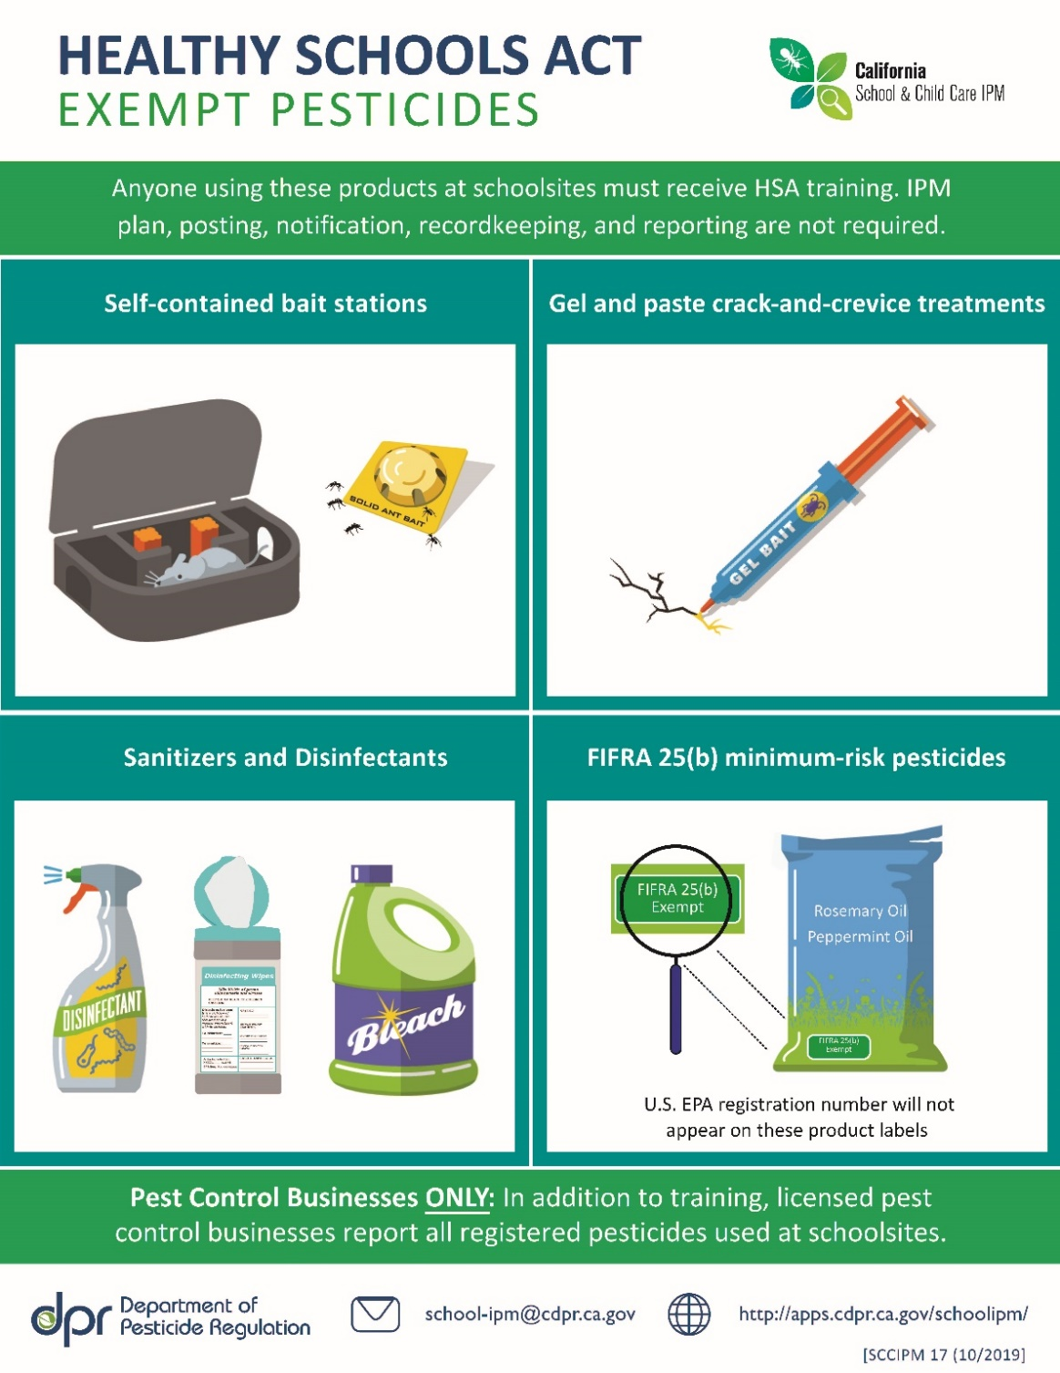
Notes:
Here are some pictures of pesticides that are exempt.
--self-contained bait stations
--gels and pastes
--sanitizers and disinfectants
--FIFRA 25(b) minimum risk pesticides:
Again, This includes products with minimum risk active ingredients such as: rosemary, cinnamon, peppermint, citronella
List: https://www.epa.gov/sites/default/files/2018-01/documents/minrisk-active-ingredients-tolerances-jan-2018.pdf
If you use these you do not have to post notifications to parents or fill out reports. You do have to still take the annual IPM/IGM training.

Slide 20
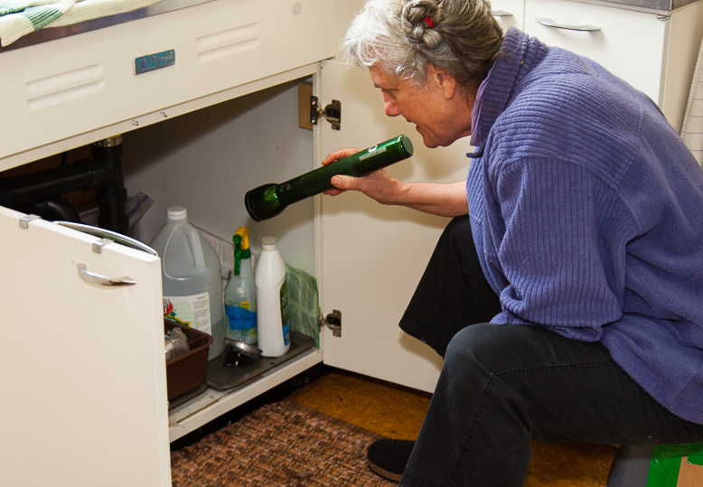
What is Integrated Pest Management (IPM)?
A safer, more sustainable approach that uses the least toxic, effective method to solve pest problems and focuses on:
Preventing infestations
Monitoring pests
Reducing the use of pesticides
Minimizing health risks to people and the environment.
Notes:
IPM keeps pests out while reducing the use of pesticides
Integrated Pest Management (IPM) is an approach to controlling pests in safer, more effective, and longer-lasting ways.
Manages pest problems by
Using non-chemical approaches.
Using least-toxic pesticides
IPM works because combined approaches for pest management are more effective in the end than a single approach, like spraying pesticides.
Less need for reporting, paperwork, etc required by Healthy Schools Act.

Slide 21
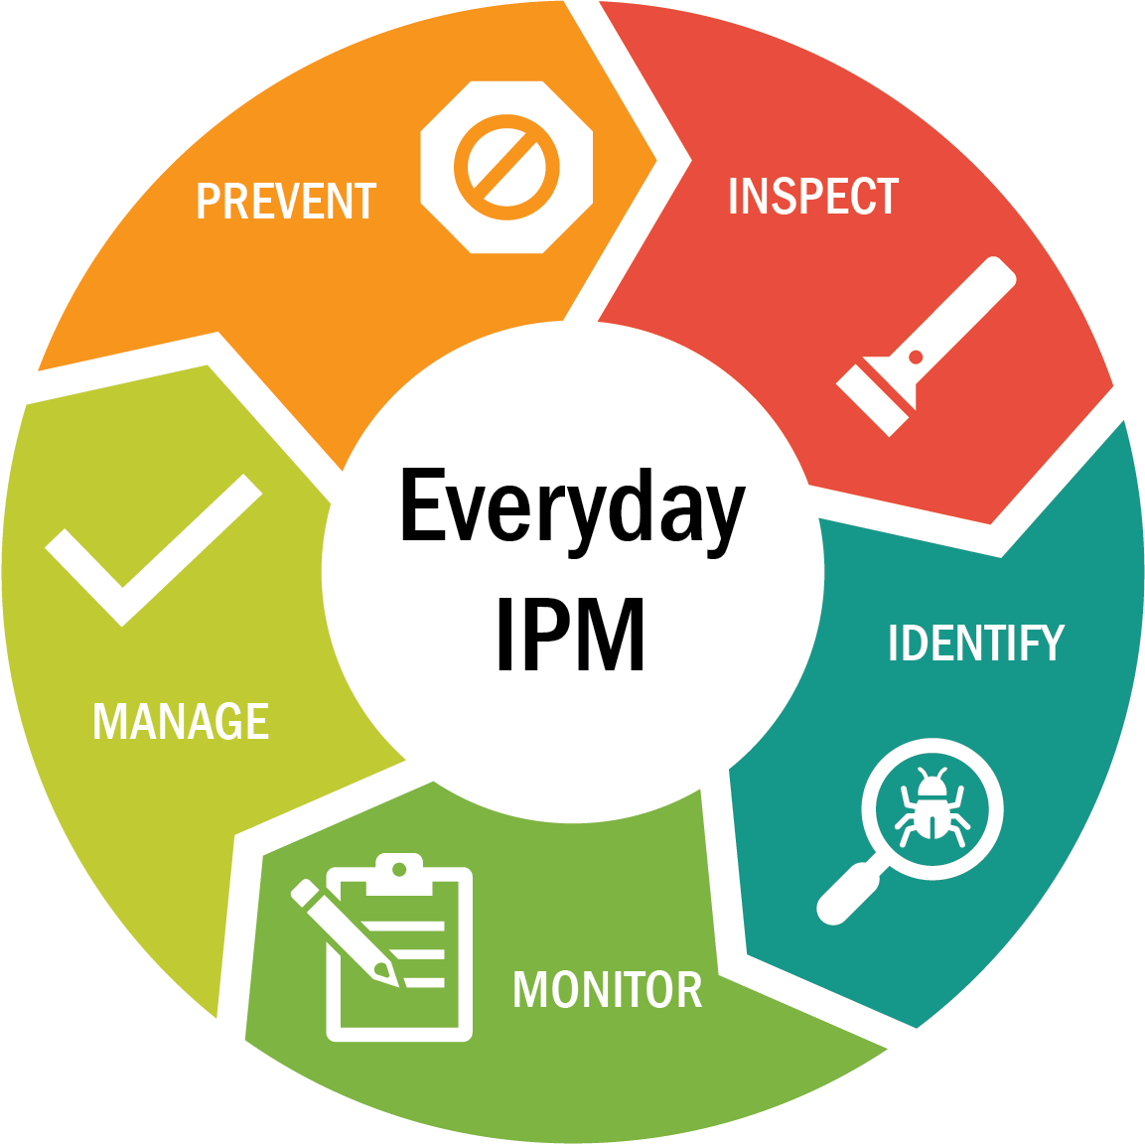
The Integrated Pest Management Cycle
Notes:
Prevent: Keep pests out; Remove pests' food, water, and shelter
Inspect - Look for signs of pests; Evidence, Damage, The pests themselves; Where and how are they coming in?
Identify Pests - What kind of pests are you finding? Where do they live? What do they eat? What is their life cycle?
Monitor - Continue inspecting and evaluating; Use the IPM Checklist
Manage - Manage existing pest problems: Clean thoroughly ; Vacuum and trap; If pesticide use is necessary, use baits and gels, not sprays
Out of all of the strategies, prevention is the key to IPM. In practice, many of the strategies we describe in these categories are used in more than one category of IPM. For example, keeping rodents out of your building is an important prevention strategy, but it is also a strategy used when managing a rodent infestation.

Slide 22
Fun facts about rodents!
Mice are great climbers and can run up the insides of walls.
Rodents can breed 5-10 times per year. That’s a lot of baby mice and rats!
Rodents are mostly active at night.

Slide 23
PREVENTING RODENTS:
Keep them outside.
Mice can squeeze through holes ¼-inch across.
That is smaller than your pinky finger
Seal any small gaps around doors, windows, or in the foundation
Install door sweeps under doors
Seal gaps around pipes
Seal cracks in foundations
Notes:
We’ll go through the steps of the IPM Cycle specifically talking about rodents.
Step 1: Prevention—best way to prevent rodents is to keep them from coming in to your building.

Slide 24
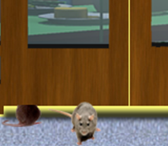
PREVENTING RODENTS:
Keep them outside.
Use metal to seal gaps in walls and around pipes
Rodents gnaw through softer materials
Thin out vegetation near the building
Prune branches that hang over or touch the building.
Prune ivy or vines away from the building’s walls
Notes:
Use stainless steel scouring pads, sheet metal, or wire mesh to plug holes or gaps. Rodents will chew through plastic sheeting, wood, caulking, rubber, and other materials.
Roof rats can cross from trees and shrubs to the roof of the building. Keep trees, bushes, and vines pruned so that they are at lest 2 feet away from the building.

Slide 25
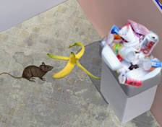
PREVENTING RODENTS: Remove sources of food and shelter.
Keep kitchen and eating areas clean between meals
Store food in sealed containers
Use garbage cans with tight lids
Empty garbage frequently
Do not leave uneaten pet food out between feedings
Notes:
You also want to discourage rodents from sheltering and finding food inside your building.

Slide 26
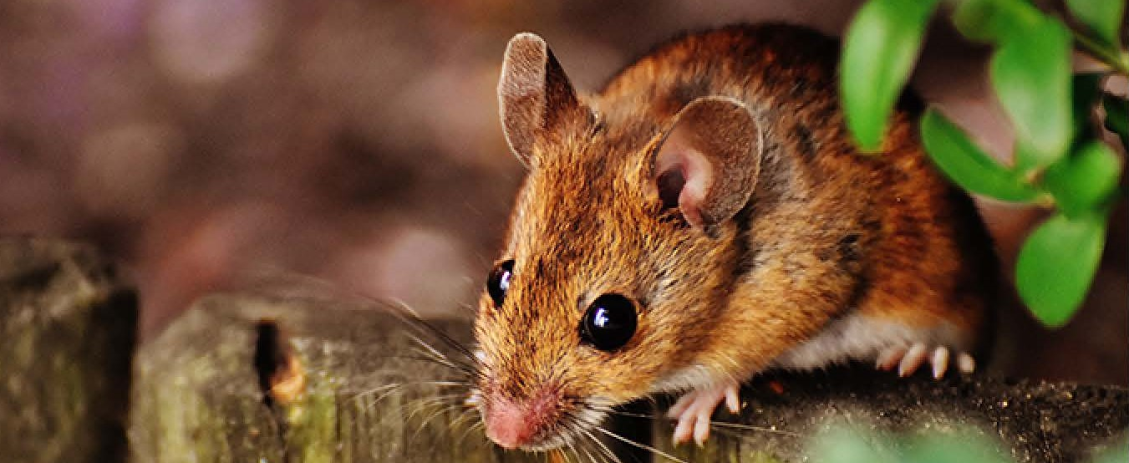
Inspecting for Rodents
Look for the following signs:
Droppings…
around pet food bowls or bags
where you store your food
in your recycling bins
Noises from the attic, especially in the evening
Dead rodents
in your pool or hot tub
brought home by your cat or dog
Photos from the California Department of Pesticide Regulation

Slide 27
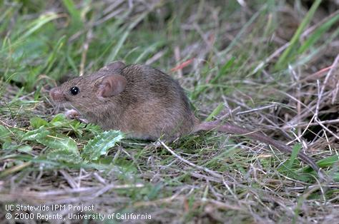
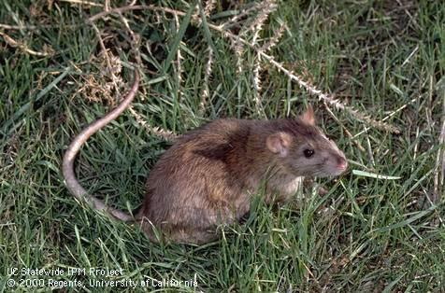
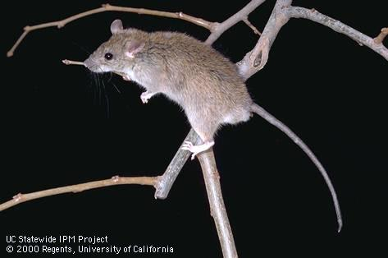
Identifying Rodents
Most common types of rodents seen indoors:
House mouse
Norway rat
Roof rat
Photos from University of California Statewide Integrated Pest Management Program
Notes:
Most common types seen indoors in California: House mouse:
Norway rat: Large and stocky, mostly gray. Tail is shorter than its body.
Roof rat: Smaller than a Norway rat, sleeker and gray to white. Tail is almost as long as its body.
These photos are from the University of California Statewide Integrated Pest Management Program.

Slide 28
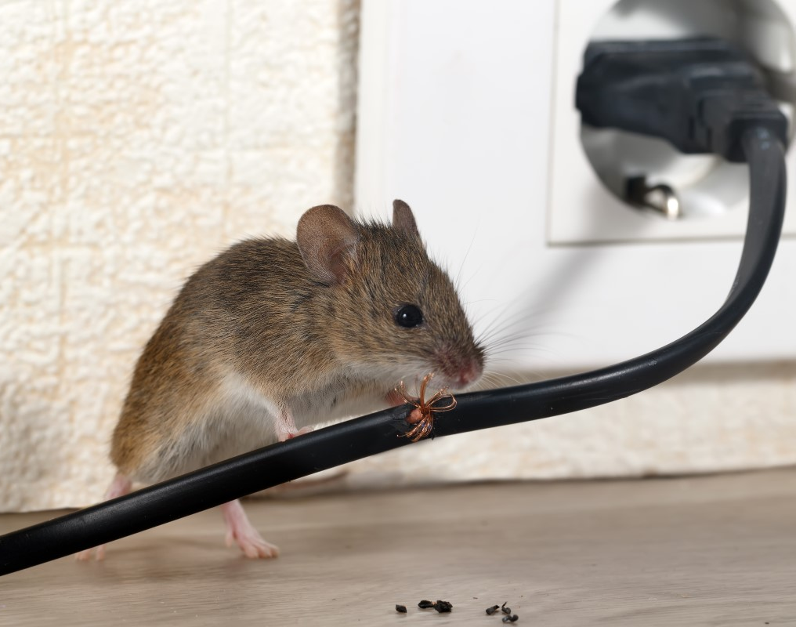
House Mice
Very small bodies, only a few inches long
Tail is as long or longer than body
Prefer to eat grains but will also eat other foods
Can cause fires by chewing through electrical wire

Slide 29
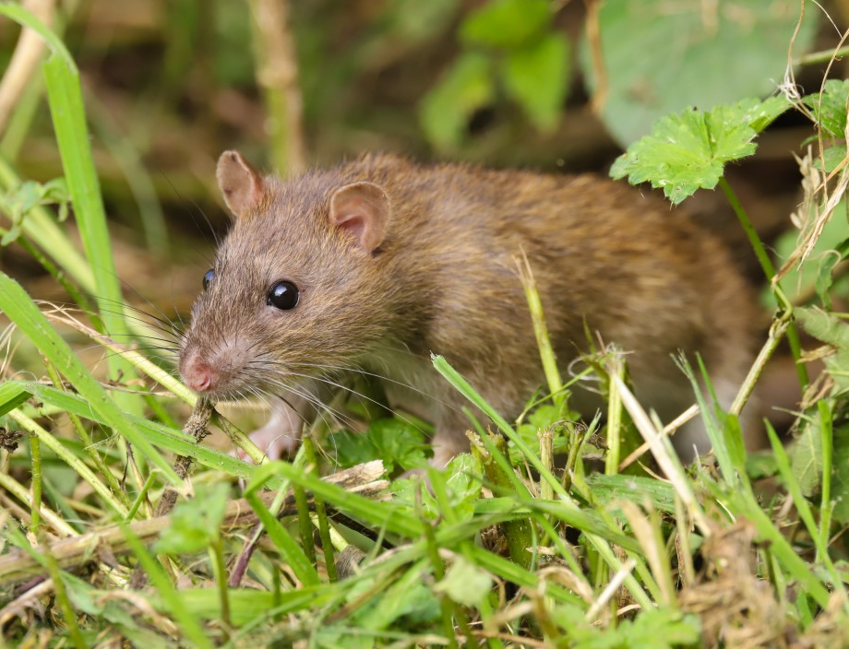
Norway Rats
Tail is shorter than body
Make burrows underground
Indoors, they prefer low places like the basement or ground floor
Rats are much larger than mice

Slide 30
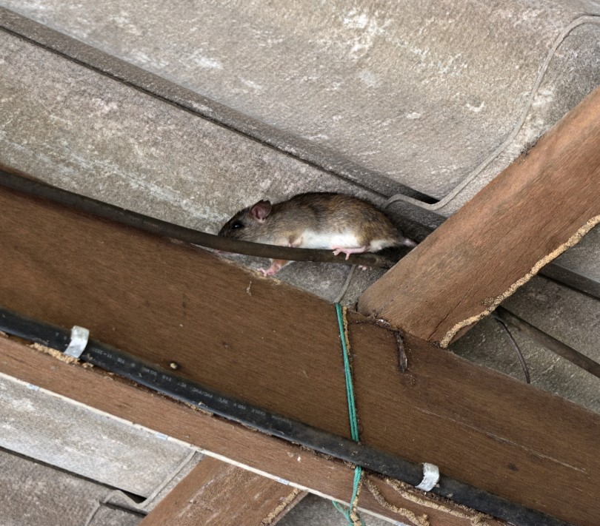
Roof Rats
Roof rats are slightly smaller than Norway rats
Tail is longer than their body and head
Outdoors: nest in trees, shrubs, and ivy
Indoors, they prefer high places like roofs, attics, walls, false ceilings, or cabinets

Slide 31
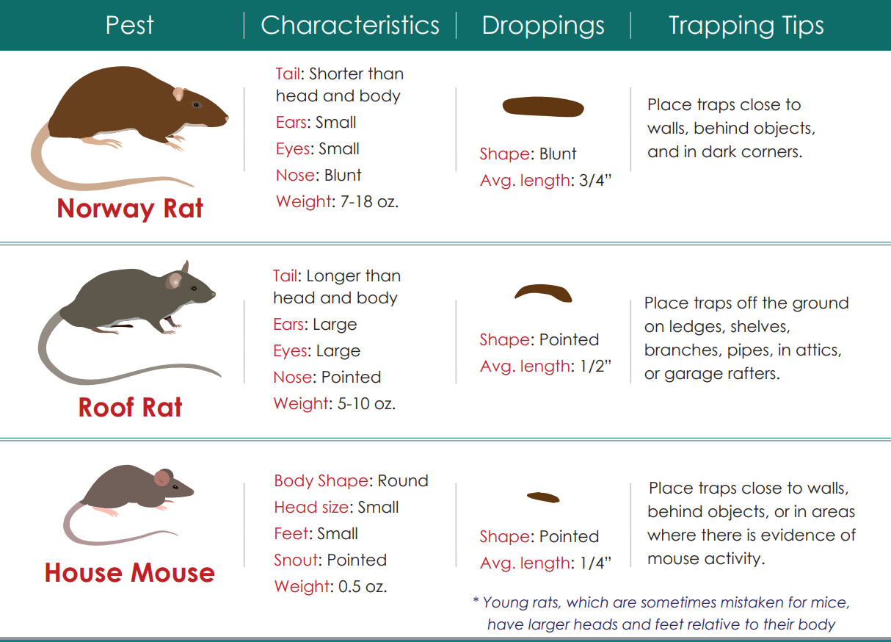
Identifying
Rodents
Graphic from the California Department of Pesticide Regulation
Notes:
Here is another comparison chart, from the California Department of Pesticide Regulation’s Integrated Pest Management Trapping Commensal Rodents handout https://www.cdpr.ca.gov/docs/schoolipm/school_ipm_law/trapping_commensal_rodents.pdf
The droppings are usually easier to see than the rodents themselves, and you can use them for identification too.
FYI: “Commensal” is used to describe rodents that are generally found living in close associations with humans and very often dependent upon human habitat for food, water, shelter and space

Slide 32
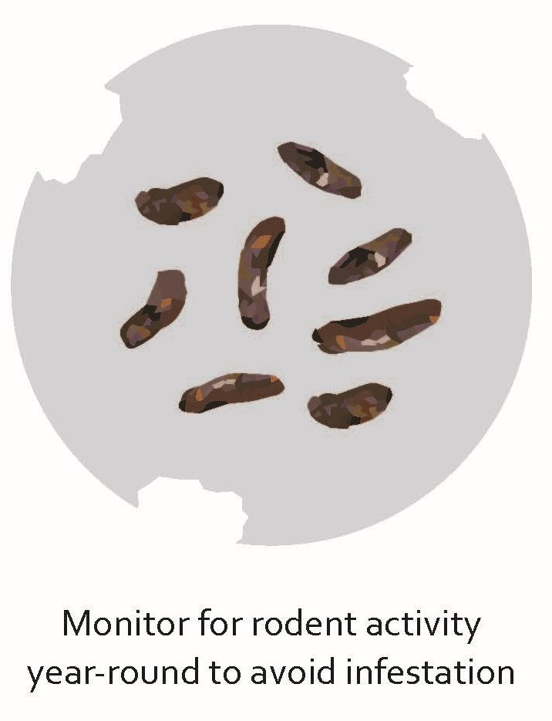
Monitoring Rodents
Be on the lookout for droppings
Investigate if you hear any sounds at night
Scratching or scurrying in the ceiling or walls
Pay special attention if you have had rodents before

Slide 33
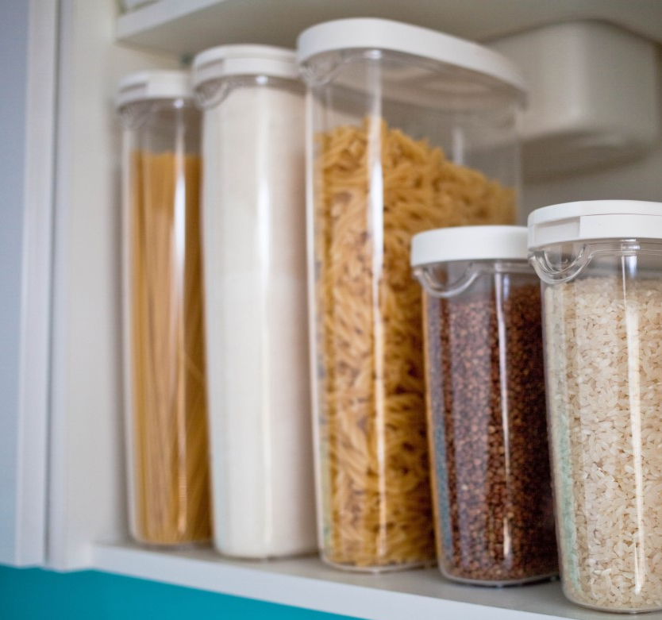
MANAGING RODENTS:
First Steps
Dispose of any food that has droppings around it.
Store any nearby untouched food in rodent-proof containers.
Wear gloves and clean any droppings up with disinfectant. Do not sweep or vacuum droppings.
Notes:
Be very careful when cleaning up droppings or urine left by rodents. Wear gloves. To avoid inhaling the residue from the droppings, use a disinfectant spray to wet the droppings before you wipe them up and throw them away. Then disinfect the area where you found them.

Slide 34
MANAGING RODENTS:
Garbage Cans
Make sure garbage cans have tight-fitting lids.
Dispose of garbage before it piles up.
Make sure garbage cans are on a concrete surface away from the building.
Notes:
Rodents can get in to your garbage and recycling bins outside. Make sure the lids fit tightly and do not pile garbage up next to the cans.
Keep your cans on a hard surface like concrete.

Slide 35
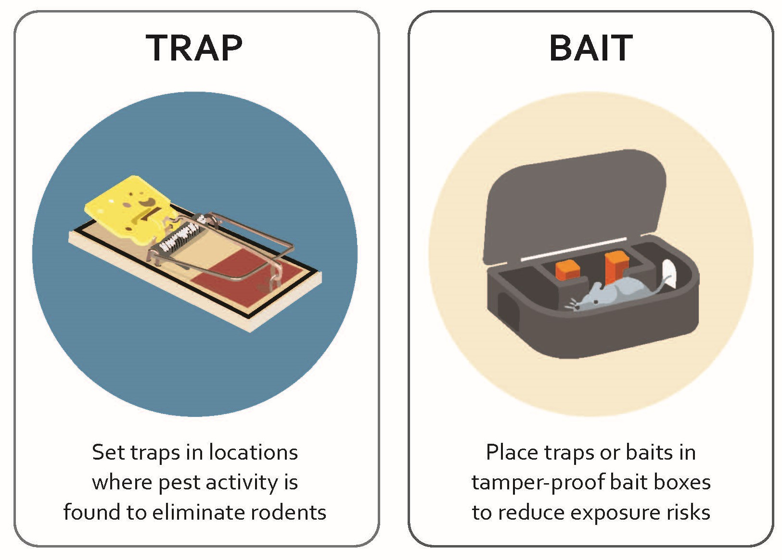
MANAGING RODENTS:
Trap or Bait
Place traps in bait boxes, where children can not reach them.
Notes:
Be sure to use tamper-proof bait boxes for your traps. That way, children can not be hurt by the trap.
For roof rats, place traps off the ground where rats might be coming down to find food (in the rafters, on top of shelves, etc.).
For Norway rats, place traps close to walls, in dark corners, and wherever you have seen droppings. Place them perpendicular with the trigger end touching the wall.

Slide 36
MANAGING RODENTS:
Trap or bait
Pre-bait the traps
Place the bait without setting the trap
After a few times that bait is eaten, then set the trap
Use chocolate syrup, dried food, nuts, or bacon
Put traps out of reach of children
Use tamper-resistant bait boxes
Do not use spring traps where children can reach them
Notes:
A rat will avoid an unfamiliar object. Pre-baiting the traps lets the rat get used to the trap before you set it.
Set up multiple traps along the bottom of a wall—this makes it more likely a rat will find a trap and spring it.

Slide 37
MANAGING RODENTS:
Avoid Poison
Traps can be reused many times
Poison kills rodents’ natural predators like hawks and owls
Your pet can be poisoned if it finds the trap and eats the bait
Taking away food, shelter, and water is more effective long term.
Notes:
Traps can use a spring snap or electric current to catch rodents. Traps are less expensive than poison because you can reuse them. You do not have to buy special bait, just use nuts, dried fruit, bacon, or pet food.
Outdoor predators like birds of prey can keep your rodent population down so there are fewer in the area.
If it is easy for rodents to get inside your building and find food/shelter/water there, then even if you kill some, more will come in and settle. In the long run, it’s better to focus on making your building difficult for rodents to enter and unattractive for nesting.

Slide 38
Managing Rodents Outdoors
Remove sources of food that are near house
Store garbage securely and have it picked up regularly
Pick up fruit or nuts that have fallen from trees
Remove shelter near building
Store lumber, firewood, crates, boxes, and gardening equipment up off the ground.
Notes:
If you see signs that rodents have been in your outdoor trash bins, be sure to take action. You do not want your garbage to become a source of food and shelter.
If you see signs that rodents have been sheltering around your building, be sure to remove the items they were using as shelter, such as cardboard boxes or piles of equipment.

Slide 39
SMALL GROUP DISCUSSION:
Rodents and the HSA
Discuss the relative costs and benefits of using IPM vs. conventional rodent control.
Consider:
Time
Money
Chemical exposure
HSA requirements
Notes:
Possible costs of IPM:
Money cost of materials
Time cost of implementing IPM
HSA training every year if using exempt pesticides
Possible costs of conventional methods:
Exposing staff, children to harmful chemicals
Money cost of materials
Time cost of posting signs, filling out and sending in pesticide use reports to follow HSA law
HSA training every year
Benefits of IPM:
Focus on prevention, means less likely to have rodents in the first place
Healthier environment in the classroom
Cost lower if do not have to apply pesticides regularly
Less time spent on following HSA reporting and record-keeping requirements
Benefits of conventional methods:
HSA=Healthy Schools Act
Requirements = posting signs, sending in pesticide use reports

Slide 40
MANAGEMENT:
Hiring a pest management professional (PMP)
Must be licensed
with DPR, and
with Structural Pest Control Board
Must be trained in IPM for schools and child care
Free DPR online Advanced course for PMPs: www.cdpr.ca.gov/schoolipm
Request UC IPM free online training: www.ipm.ucdavis.edu/training/school-and-child-care-ipm.html
Notes:
If you have tried all of the IPM steps and still have rodents entering your building, contact a Pest Management Professional. Remember:
All pest management professionals (PMPs) must be licensed by the State of California. You can verify whether a company or an individual has a license issued by the Structural Pest Control Board at www.pestboard.ca.gov. Having a structural pest control board license means you have passed the exam and you have completed your live scan finger print process.
2. PMPs should be trained in IPM for schools and child care. The UC Statewide IPM Program offers a free online course for PMPs titled Providing IPM Services in Schools and Child Care Settings. Ask for proof that your PMP has taken the course
3. Some PMPs may have a third-party certification demonstrating extra skills in IPM and environmentally sensitive practices. Review each certification type before choosing a PMP.​

Slide 41
MANAGEMENT:
Hiring a PMP
Examples of third-party certification:
EcoWise: https://www.ecowisecertified.com/ecowise_find.html
GreenPro: https://www.qualitypro.org/certified-services/greenpro/
GreenShield: https://greenshieldcertified.org/
Notes:
Some PMPs may have a third-party certification demonstrating extra skills in IPM and environmentally sensitive practices.
Review each certification type before choosing a PMP. Here are links with more information.

Slide 42
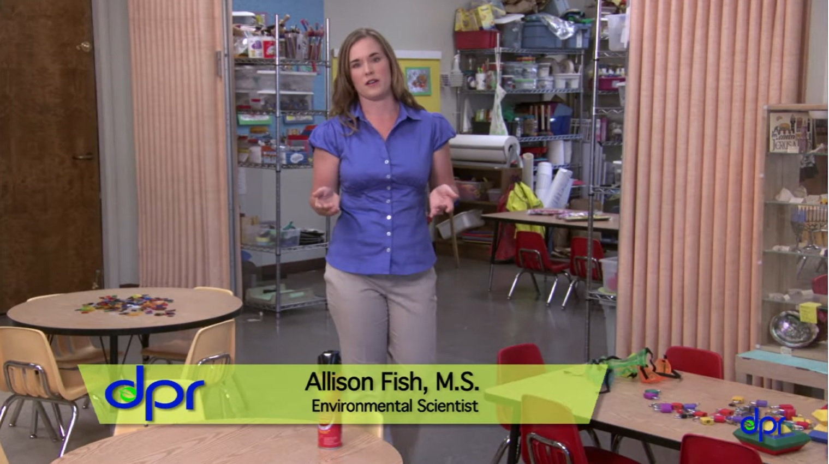
VIDEOS:
Keeping Pests Out of Your Child Care Center
Getting Rid of Mice and Rats in Your Child Care Center
https://youtu.be/YybRGNEObX0
Cómo deshacerse de los ratones y las ratas en su centro de cuidado infantil
https://youtu.be/shf_7KsdT2E

