Slide 1
Managing Roaches in Child Care Settings
University of California, San Francisco / California Childcare Health Program
HEALTHY SCHOOLS ACT APPROVED COURSE, 2023
Notes:
Image purchased from iStock.
Introduce yourself & your role as a health and safety advocate.

Slide 2
Acknowledgements
Funding for this program was provided through a grant awarded by the California Department of Pesticide Regulation (DPR). The contents of this document do not necessarily reflect the views and policies of DPR nor does mention of trade names or commercial products constitute endorsement or recommendation for use.
https://www.cdpr.ca.gov/docs/schoolipm
https://cchp.ucsf.edu
Notes:
The development of Managing Cockroaches in Child Care Settings was funded by the California Department of Pesticide Regulation (DPR) and the University of California (UC), San Francisco School of Nursing’s California Childcare Health Program. The contents of this document do not necessarily reflect the views and policies of DPR, nor does mention of trade names or commercial products constitute endorsement or recommendation for use.

Slide 3
Icebreaker Questions
What’s your name?
Have you ever hired a pest management professional?
What would you like to learn from today’s workshop?
Notes:
Talking points:
Sometimes people have a strong emotional reaction to the presence of cockroaches and that’s okay.
Some people may also have strong feelings about wanting to keep children and the environment safe from pesticides.
Some things attendees might want to learn:
Why cockroaches are a problem
Effective methods for managing cockroaches
How to manage cockroaches safely
Overview of IPM
How to comply with the Healthy Schools Act

Slide 4
Goals
To prevent and get rid of cockroaches safely.
To protect the health of children and staff in child care facilities.
To protect our environment.
To make sure your staff is following the Health Schools Act requirements.
Notes:
Here are the four things we hope you’ll take away from this presentation:
How to prevent and get rid of cockroaches inside your center.
How to use pest control methods that are designed to control pests while also protecting the health of people.
How to use pest control methods that protect the environment.
To understand the Healthy Schools Act and what your responsibilities are in order to follow the law.

Slide 5
Agenda
Cockroaches as pests
The Healthy Schools Act and Integrated Pest Management (IPM)
IPM of cockroaches

Slide 6
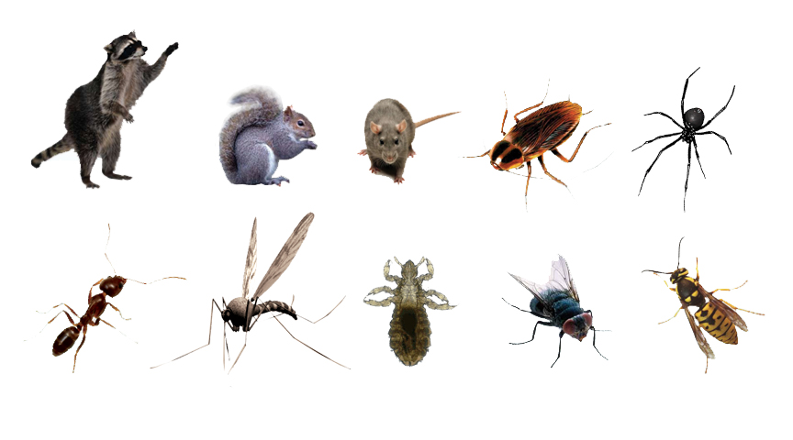
What is a pest?
A pest can be described as any living organism that causes damage or discomfort, or transmits or produces disease.
Notes:
What pests do you see here?
A pest can also be described as something that is simply where it is not wanted, such as weeds in a grassy play area. It’s important to remember: something that is a pest in one situation can play an important role in the environment in other settings. For example, ants are actually beneficial when they’re outdoors. They add oxygen to the soil and attack insects such as fleas, caterpillars, and termites. Today we are focusing on cockroaches.

Slide 7
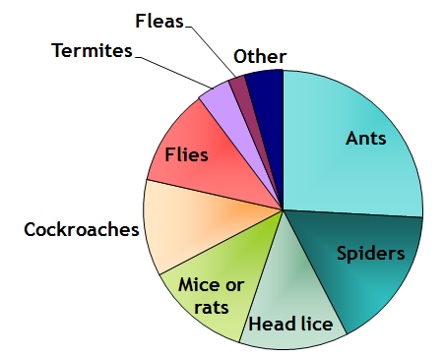
What are the most common INDOOR pests in California childcare centers?
Bradman, A. , Dobson, C., Leonard, V. & Messenger, B. (2010). Pest Management and Pesticide Use in California Child Care Centers, Center for Children’s Environmental Health Research, School of Public Health, UC Berkeley at apps.cdpr.ca.gov/schoolipm/childcare/pest_mgt_childcare.pdf.
Notes:
As you can see from this pie chart of a survey of child care centers, the cockroach is one of the most common indoor pests.

Slide 8
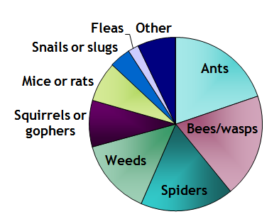
What are the most common OUTDOOR pests in California childcare centers?
Bradman, A. , Dobson, C., Leonard, V. & Messenger, B. (2010). Pest Management and Pesticide Use in California Child Care Centers, Center for Children’s Environmental Health Research, School of Public Health, UC Berkeley at apps.cdpr.ca.gov/schoolipm/childcare/pest_mgt_childcare.pdf.
Notes:
As you saw in the previous pie chart of a survey of child care centers, the cockroach is one of the most common indoor pests. But they are not seen as outdoors as much. However, outdoor cockroaches sometime come indoors, so it’s good to keep an eye out.

Slide 9
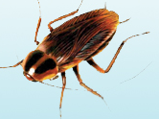
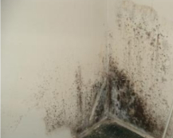
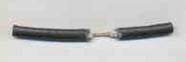
What problems can pests cause?
Health Problems
Spread Disease/Contaminants
Allergies
Trigger Asthma
Building Damage
Mold & Termites Damage Building
Rats Eat Wires
Parents and staff are upset when they see pests
Notes:
There are three major categories of concern with pests in child care.
The first one is health problems. Pests such as cockroaches or mice can spread germs that can cause disease. For instance, a roach can walk across the toilet or in the trash on uncooked meat or rotting food and then across plates and tables where we eat. Pests can also cause allergies or asthma. Roaches can trigger asthma because when they shed their skin to grow, they release a “dander” much like a cat. This has been shown to be an asthma trigger. Mice have also been shown to trigger asthma because of their fur and urine smells.
The second category of problem is building damage. Rats can through wires, which can be an electrical danger. Mold and termites can damage the structural integrity of a building.
The third category of problem is that parents and staff are upset when they see pests, and often want to get rid of them as quickly as possible.

Slide 10
SMALL GROUP DISCUSSION:
Are cockroaches pests?
Health Problems
Do they cause:
Health problems?
Building damage?
Parents and staff to be upset?
Building Damage
Parents and staff are upset when they see pests
Notes:
Definition of a pest: causes damage or discomfort, or transmit or produce disease?
Do they cause health problems? Building damage? Are parents upset when they see ants?
Does the location of the ants (indoors vs outdoors, etc) change the answer?
Discuss in groups, come back to give your group’s answer(s)
Using pesticides can trigger requirements of the Healthy Schools Act.

Slide 11
What Is the Healthy Schools Act (HSA)
A right-to-know law that informs parents and staff about pesticide use at public schools and child care centers.
Assures healthy, safe learning and care environments for California children.
Applies to public K–12 schools and public and private licensed child care centers.
Does not apply to family child care homes.
Notes:
Has anyone heard of the Healthy Schools Act? What can you tell me about it?
In 2007, California Law AB 2865 extended the Healthy Schools Act to child care centers. Many ECE providers are unaware of their responsibilities under the HSA.
Even though the HSA does not apply to family child care homes, there is great value in protecting children’s health using IPM strategies in this setting. Guidance for safer pest management and IPM specific to family child care homes is available on the CCHP website: https://cchp.ucsf.edu/content/integrated-pest-management-toolkit-family-child-care-homes

Slide 12
Healthy Schools Act (HSA)
The California Department of Pesticide Regulation (DPR) is responsible for helping implement the Healthy Schools Act
Contact DPR’s Child Care IPM Program:
https://www.cdpr.ca.gov/docs/schoolipm/
Email ccipmlist@cdpr.ca.gov with questions
Notes:
Who is responsible for helping to implement the Healthy Schools Act? The California Department of Pesticide Regulation (DPR) is responsible for helping schools and child care centers implement IPM practices.
You may request information from the California DPR about starting an IPM program in an ECE facility by contacting The California Department of Pesticide Regulation’s Child Care IPM Program. Resources at https://www.cdpr.ca.gov/docs/schoolipm/
Or email ccipmlist@cdpr.ca.gov with any questions.

Slide 13
HSA Requirements for Child Care Centers
Notes:
You may be familiar with these requirements (next 4 slides):
1. Identify a person at the center to make sure the requirements are met, AKA the Integrated Pest Management Coordinator
2. Develop an IPM plan
Use the template provided by the Department of Pesticide Regulation (DPR); or write your own that includes: name of IPM Coordinator, list of all pesticides expected to be applied even by PMPs, and the date when the plan will be revised.
Post the IPM plan on your program’s Web site; if you do not have a Web site send the IPM plan to all parents, guardians, and staff with the annual written notification.
Post a paper copy of the plan in your center or school office.

Slide 14
HSA Requirements for Child Care Centers
Notes:
Complete IPM training
This training is required for the IPM coordinator and anyone who will apply pesticides (including disinfectants and other exempt pesticides) at the child care program
Training must be repeated every year
Post signs
Notify parents and staff before pesticides are applied
Post warning signs around each area where nonexempt pesticides will be applied (sprays, foggers, or uncontained pellets or powder) .
These signs should be posted 24 hours before and stay in place 72 hours after pesticides are used.

Slide 15
HSA Requirements for Child Care Centers
Notes:
Notify
Every year, let parents and staff know in writing which pesticides (nonexempt) are expected to be applied by center staff or pest management professionals in the upcoming year.
Record
Keep records about nonexempt pesticides (sprays, foggers, or uncontained pellets or powder) used by staff and contractors in the past 4 years

Slide 16
HSA Requirements for Child Care Centers
Notes:
Register
Maintain a list of parents and staff who want to be told when non exempt pesticides (sprays, foggers, pellets or powder if uncontained) are going to be used
Notify everyone on the register early--at least 72 hours before they are used
Make sure to report non exempt (sprays, foggers, or uncontained pellets or powder) pesticide use each year.
send pesticide use reports for pesticide applications made by school site employees to DPR annually or more frequently
DO NOT submit pesticide use reports for pesticides applied by contractors; they will submit their own reports to DPR
submit reports no later than January 30 for the previous year (for example, submit your 2023 reports no later than January 30, 2022)
use the DPR form HSA-118 (Pesticide Use Reporting For School And Child Care Employees) which is available on the DPR School IPM Web site https://www.cdpr.ca.gov/docs/schoolipm/

Slide 17
Be sure to communicate with…
Property Owners
Pest Management Professionals
Custodians/Janitorial Service
Volunteers
Photo from UCSF
The Healthy Schools Act has specific requirements for property owners and pest management professionals. More information can be found on the DPR website.
Notes:
The Healthy Schools Act has very specific requirements for:
property owners—you may need to inform your landlord if you rent your facility.
pest management professionals—if you use a service you may need to inform them of the Healthy Schools Act requirements.
Be sure to share this information to protect children and staff in your center. It’s important to be aware of everyone who might be using pesticides in your center:
Custodians/janitorial
Any volunteers

Slide 18
Exempt Products
These products are exempt from reporting and posting requirements:
Pesticides in self-contained baits
Pesticides in gels or pastes used as crack-and-crevice treatments
Products used to kill germs (antimicrobials), such as sanitizers and disinfectants
Minimum risk pesticides or FIFRA 25(b) products containing minimum risk active ingredients like cinnamon, peppermint, citronella
Annual training is required even when using exempt products!
Notes:
Some pesticides are exempt from the Healthy Schools Act. This means that parents and staff do not need to be notified when these pesticide products are used, and records do not have to be kept of their application.
Products that use pesticides in a bait, trap, or gel , are exempt. That is because they are contained—so they can’t be inhaled or easily touched by children.
Products that are used to kill germs (antimicrobials), such as sanitizers and disinfectants are also exempt.
Certain pesticides that pose little to no risk to people or the environment are considered minimum risk, pesticides under the Federal Insecticide, Fungicide, and Rodenticide Act (FIFRA). These pesticides are also known as FIFRA 25(b) products. This may include products with minimum risk active ingredients such as rosemary oil.
Full List of minimum risk pesticides: https://www.epa.gov/sites/default/files/2018-01/documents/minrisk-active-ingredients-tolerances-jan-2018.pdf
These are also exempt.
HOWEVER, if you apply any type of pesticide, exempt or not, you still have to take the IPM training.

Slide 19
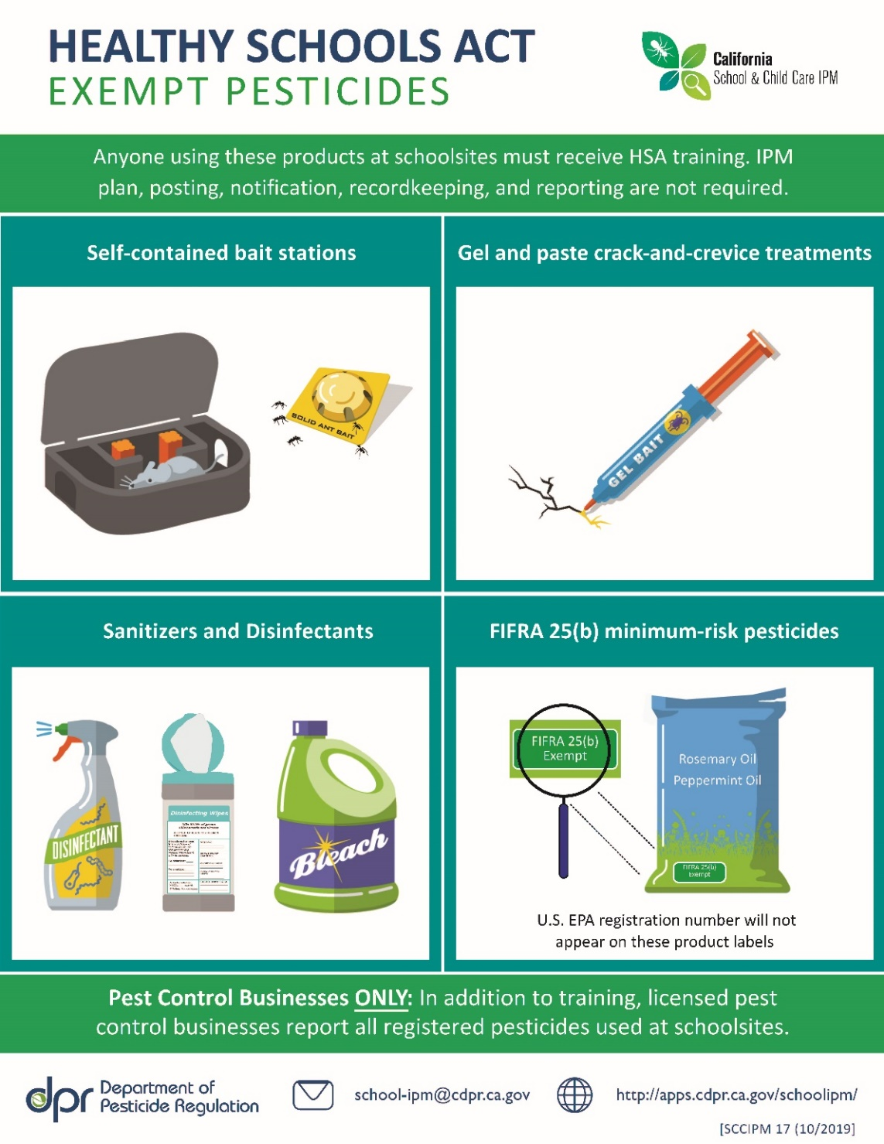
Notes:
Here are some pictures of pesticides that are exempt. If you use these you do not have to post notifications to parents or fill out reports. However, you are still required to take annual IPM/IGM training.

Slide 20
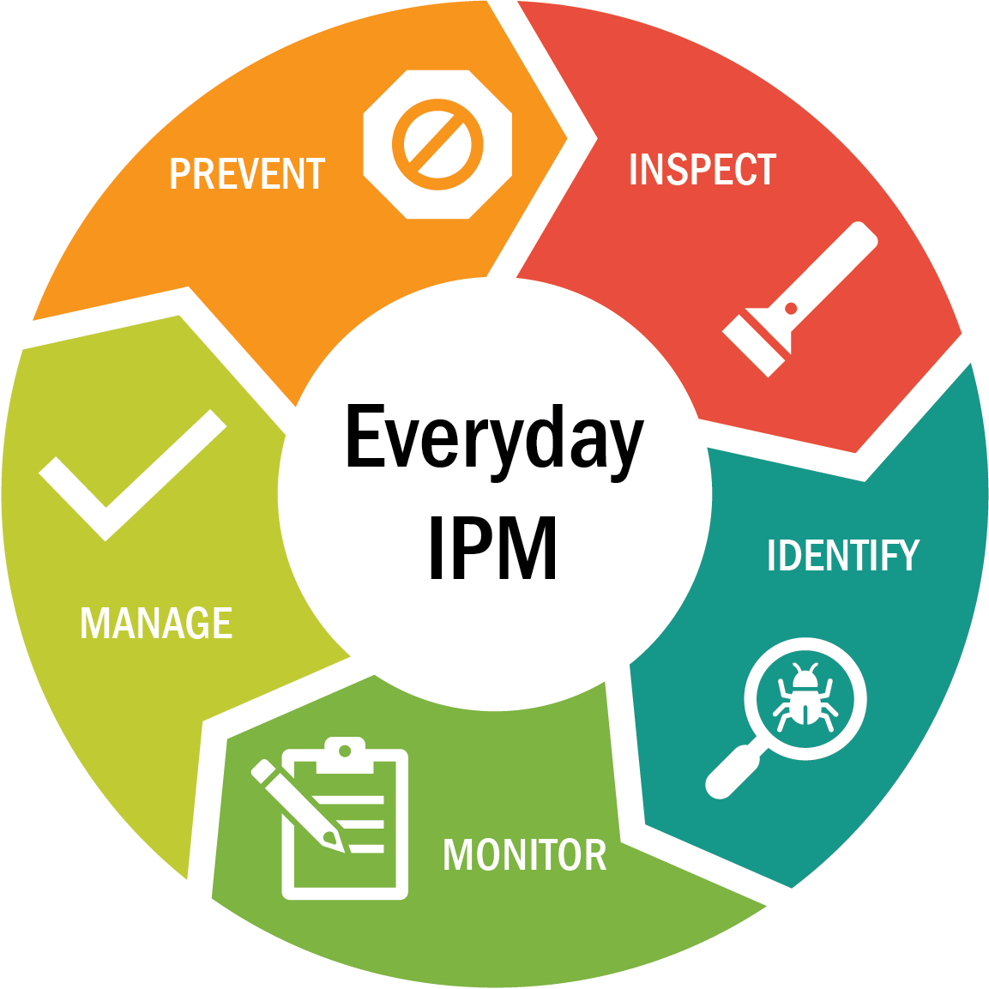
The Integrated Pest Management Cycle
Notes:
Prevention: Keep pests out; Remove pests' food, water, and shelter
Inspect - Look for signs of pests; Evidence, Damage, The pests themselves; Where and how are they coming in?
Identify Pests - What kind of pests are you finding? Where do they live? What do they eat? What is their life cycle?
Monitor - Continue inspecting and evaluating; Use the IPM Checklist for FCCHs
Manage existing pest problems: Clean thoroughly ; Vacuum and trap; If pesticide use is necessary, use baits and gels, not sprays
Out of all of the strategies, prevention is the key to IPM. In practice, many of the strategies we describe in these categories are used in more than one category of IPM. For example, keeping pests out of your building is an important prevention strategy, but it is also a strategy used when managing an infestation.

Slide 21
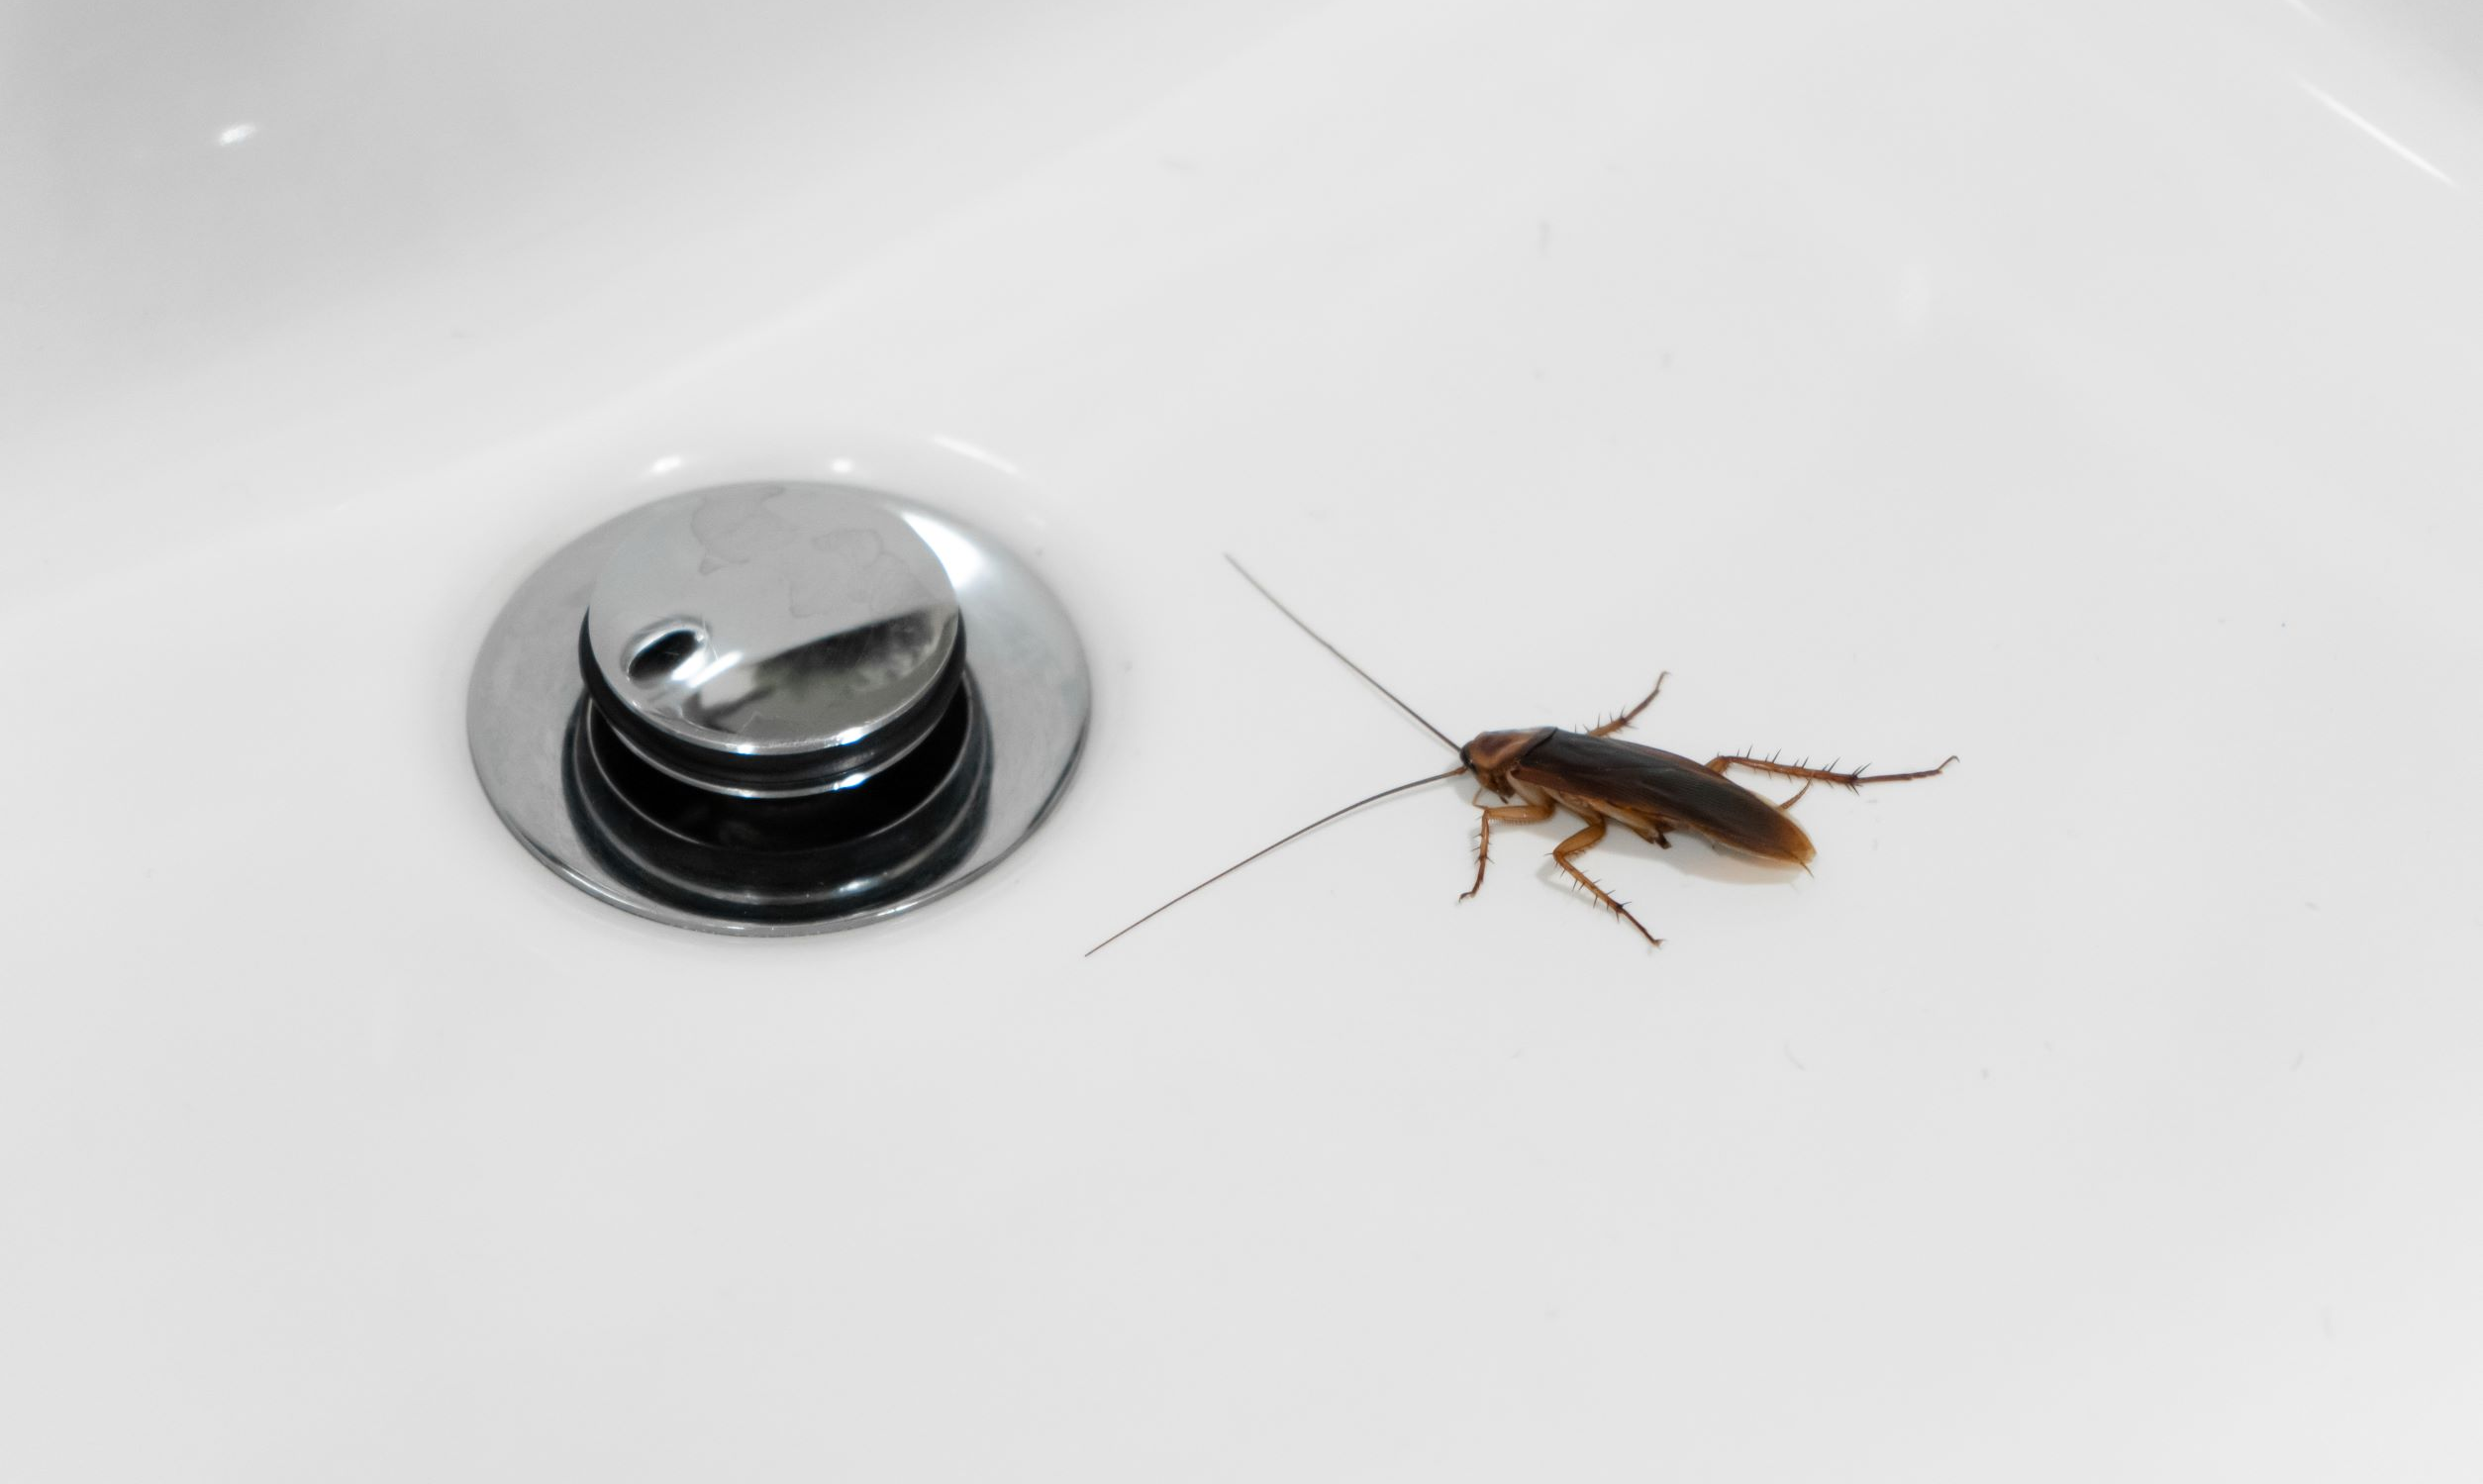
IPM for cockroaches

Slide 22
Fun facts about cockroaches!
Cockroaches are active at night, so if you see one during the day you probably have a lot more!
Cockroaches avoid open spaces and scurry into hiding places when they sense noise, movement, and light. They can flatten their bodies to fit into narrow spaces and hide beneath rubber mats, behind wallpaper, and within wall cracks.
Some cockroaches live indoors and some cockroaches live outdoors. Sometimes an outdoor cockroach will come indoors in search of food.
The German cockroach is the most common indoor species in California. It has the fastest reproductive cycle: a single female and her offspring can produce over 30,000 cockroaches in a year! Yikes, that’s a lot of cockroaches!
Notes:
The brownbanded cockroach is not as common as the German cockroach in California and accounts for only about 1% of all indoor infestations.
German Cockroaches are drawn to warm, dark, humid areas that are close to food and water.

Slide 23
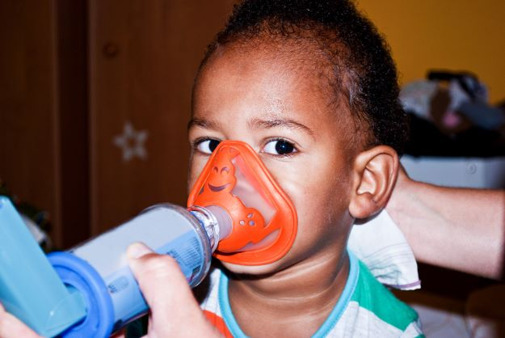
Potential health concerns
German cockroaches (indoor) are believed to be capable of transmitting Staph, Strep, hepatitis, coliform, typhoid, and dysentery. And they produce allergens that can trigger asthma attacks, especially in children.
American cockroaches (outdoor) may come into contact with human excrement in sewers or with pet droppings outdoors. They are capable of transmitting bacteria that cause food poisoning like Salmonella and Shigella.
Notes:
Image purchased from iStock.

Slide 24
PREVENTING COCKROACHES:
Keep them outside
How can cockroaches get in?
German cockroaches can enter buildings hidden in grocery bags, lunch bags, back packs, diaper bags, and cardboard boxes.
In apartment buildings, cockroaches sometimes slip under doors or through wall voids.
Outdoor cockroaches can sneak in through drainpipes and narrow gaps around windows and doorways.
Notes:
We’ll go through the steps of the IPM Cycle specifically talking about cockroaches.
During the day, roaches hide in dark, moist areas like cracks, water meter boxes, sewers, and crawl spaces. They come out at night to feed.
Step 1: Prevention—outside your building. Take away places that cockroaches like to nest or find food near your building. They are less likely to find their way inside.

Slide 25
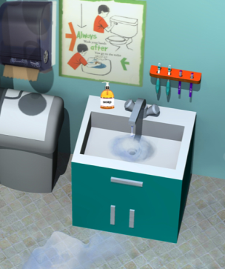
PREVENTING COCKROACHES:
Remove their food and water
Keep kitchen and eating areas clean between meals.
Store food in sealed containers.
Wipe up spills right away.
Remove garbage every day.
Repair leaky sinks and pipes.
Notes:
Continuing Step 1, Preventing cockroaches from finding food and water inside your building

Slide 26
PREVENTING COCKROACHES:
Remove their shelter
Seal cracks and crevices where outdoor cockroaches can come in.
Install brush door sweeps.
Get rid of clutter.
Store supplies in containers with tight fitting lids instead of cardboard boxes.
Notes:
Corrugated cardboard boxes are a favorite hiding place for cockroaches. They eat the glue and lay their eggs in the corrugation.

Slide 27
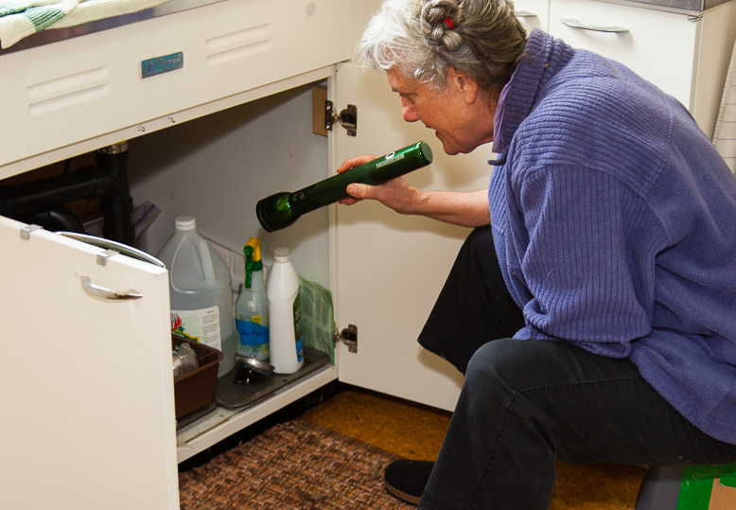
Inspecting for Cockroaches
Use a flashlight and/or a small mirror to check behind/under cabinets and appliances.
Put sticky traps on the ﬂoor next to walls and under refrigerators, dishwashers, sinks, and ranges.
If you see one cockroach, there are probably many more hiding.
Notes:
Cockroaches thrive in both indoor and outdoor environments that provide food, water, and shelter. Seal cracks and crevices that are allowing them inside.

Slide 28
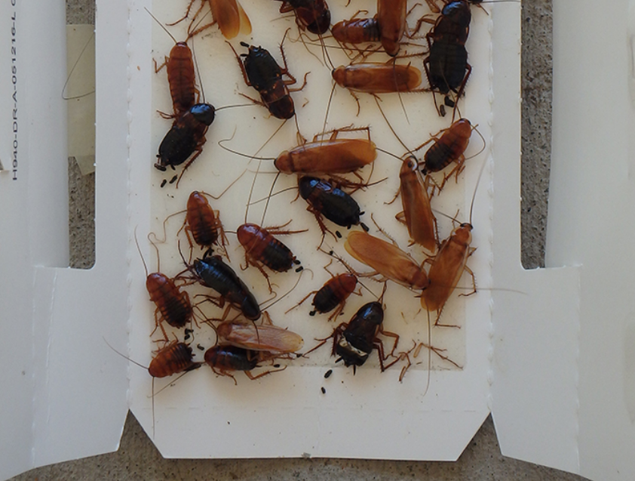
Identifying Cockroaches
Sticky Traps help to identify what kind of cockroaches they are, where they are hiding, and how many generations you may have.
Photo Credit: Andrew Southerland, UC IPM
https://www2.ipm.ucanr.edu/highlights/2018/School_outdoor_baiting_program_to_manage_cockroaches/
Notes:
During the day, roaches hide in dark, moist areas like cracks, water meter boxes, sewers, and crawl spaces. Cockroaches leave stains and foul odors. Locate hiding places by putting sticky traps (such as a roach motel) on the floor next to walls and under refrigerators, dishwashers, sinks, and ranges. A lot of young cockroaches (smaller and wingless) indicate you have an active infestation. Glue traps are usually for indoor use and work best when used with other strategies for insect control. Glue traps alone will catch some cockroaches but will not take care of your cockroach problem.

Slide 29
Identifying Cockroaches
Types of indoor cockroaches (smaller)
Most common:
German cockroaches
Less common:
Broadbanded cockroaches
Types of cockroaches seen outdoors (larger)
Turkestan
Oriental
American
Smokey brown
Field
Learn more:
http://ipm.ucanr.edu/PMG/PESTNOTES/pn7467.html
Notes:
German cockroaches can enter buildings hidden in grocery bags, lunch bags, back packs, diaper bags, and cardboard boxes.
In apartment buildings, cockroaches sometimes slip under doors or through wall voids.
Outdoor cockroaches can sneak in through drain pipes and narrow gaps around windows and doorways.

Slide 30
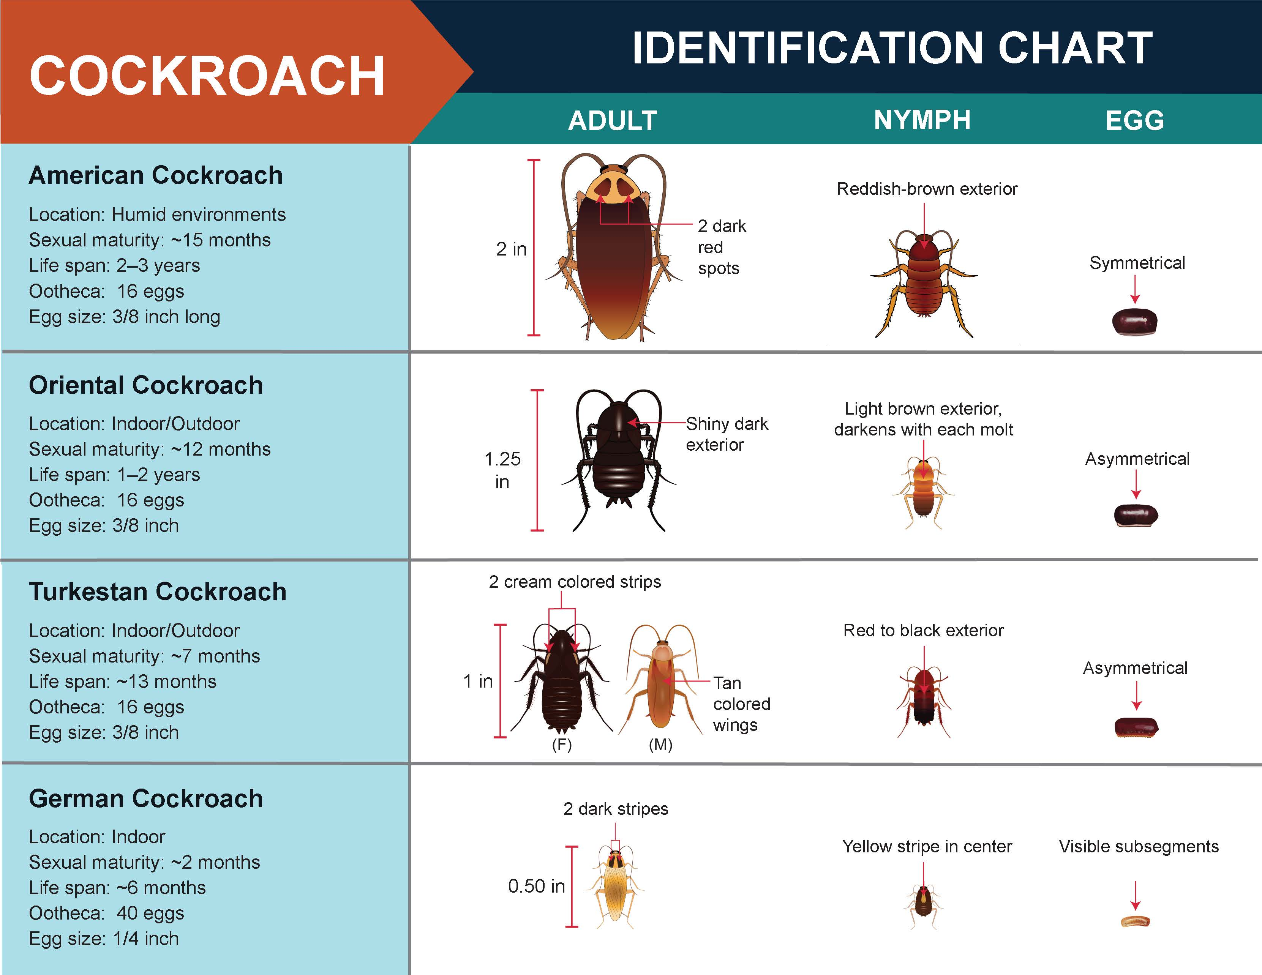
Graphic from the California Department of Pesticide Regulation
Notes:
Identification Chart

Slide 31
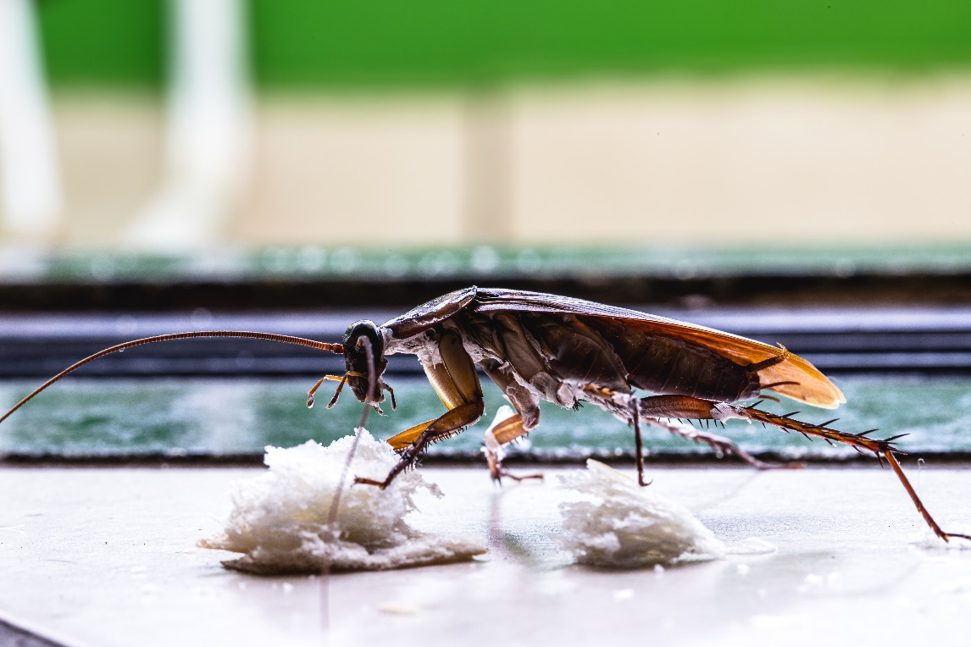
Why do outdoor cockroaches come indoors?
They are searching for food and water!

Slide 32
Monitoring for Cockroaches
Look for signs of cockroaches: droppings, egg casings, cast-off skins, stains, unpleasant odor.
Use an IPM checklist regularly. https://cchp.ucsf.edu/content/ipm-checklist-0
Notes:
Cockroaches usually hide during the day, but you might see the following signs of cockroaches: droppings, egg casings, stains, unpleasant odor.

Slide 33
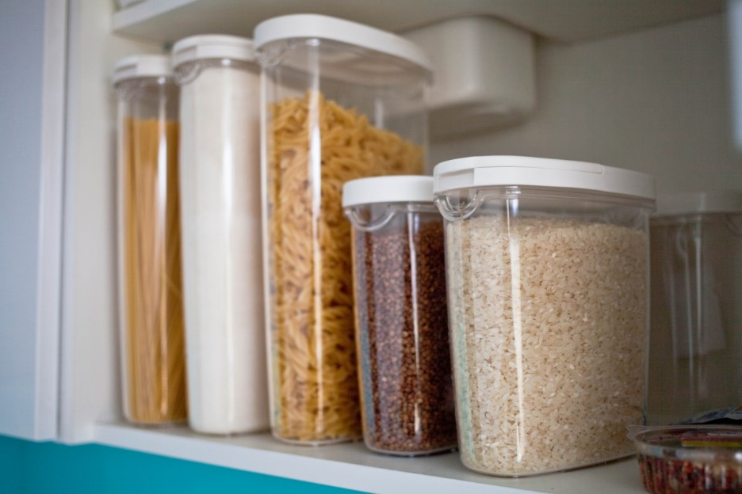
MANAGING COCKROACHES: First Steps
Vacuum cockroach hiding places thoroughly using a HEPA filter vacuum with a crevice attachment.
Take away the food and water they are attracted to.
Wipe up sticky spills.
Store food in sealed containers.
Fix leaks.
Notes:
Use an integrated approach to managing cockroaches. Cockroaches are hard to get rid of. Cleaning up and fixing leaks are only the first steps of cockroach control.

Slide 34
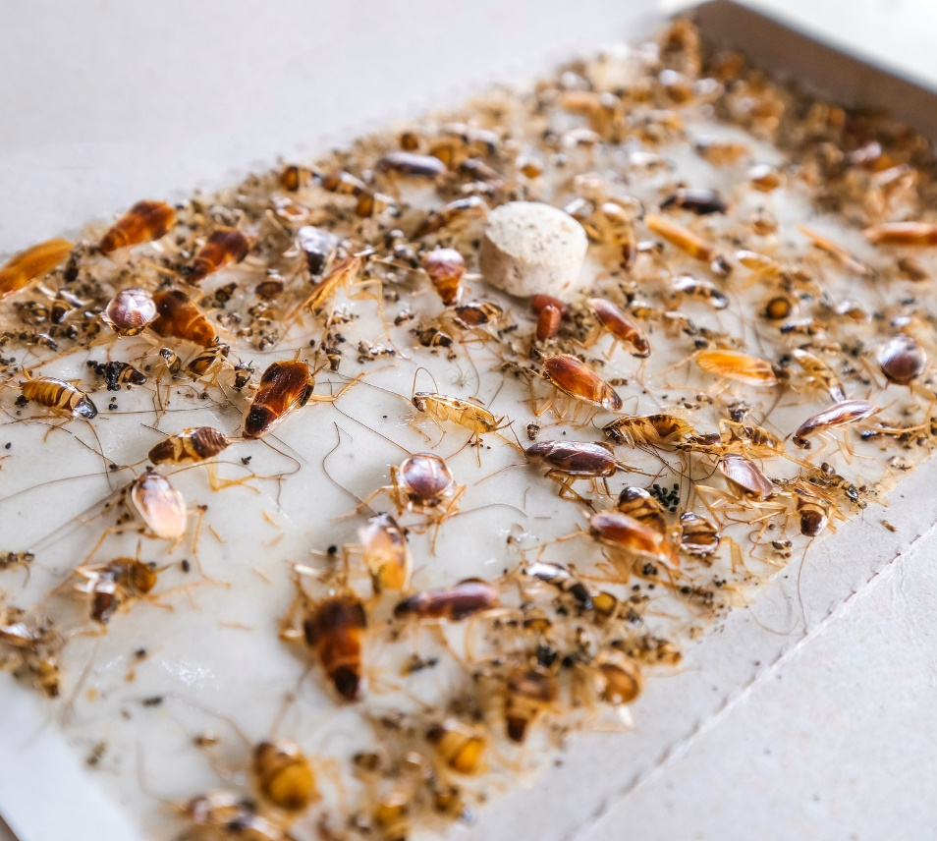
MANAGING COCKROACHES: Traps
Place cockroach traps glue-side up.
Place them under sinks, on the floor next to walls and appliances, or in any other inside location where you have seen roach activity (out of children’s reach).
If traps become clogged with cockroaches, throw them away and put out new traps.
Notes:
Traps catch roaches with a sticky substance. You can get low lying traps that fit under appliances or in other tight spaces.

Slide 35
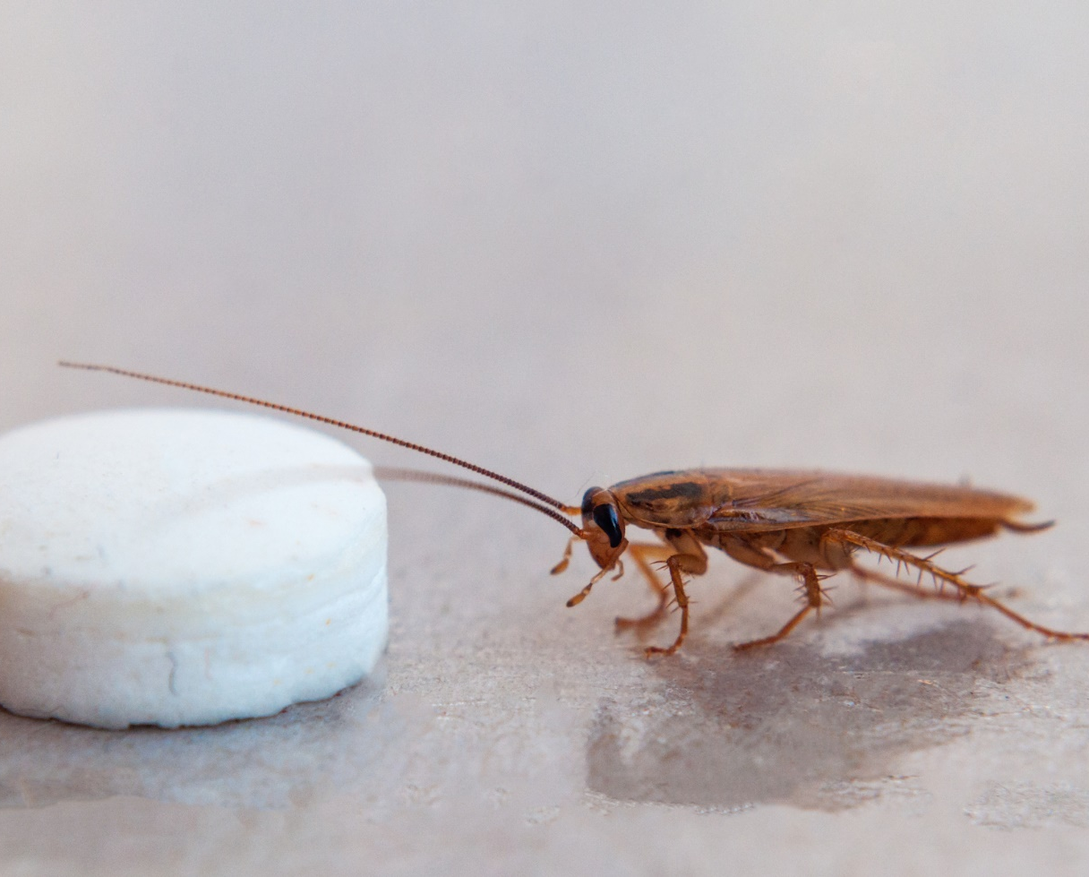
MANAGING COCKROACHES: Baits
Contained bait stations or gels are safer than sprays.
The pesticide in the bait can move through the cockroach population and cause the numbers to fall significantly.
Baits work best when placed near areas where cockroaches breed and hide.
Bait pesticides act slowly. So be patient.
Notes:
Contained bait stations or gels are safer than sprays because the pesticide does not spread to people in the building.
Cockroach gel baits are available with a variety of insecticide formulations that control these pests. The method works by enticing the pests to eat gel bait, which it thinks is a source of food, so it consumes the pesticide contained within.

Slide 36
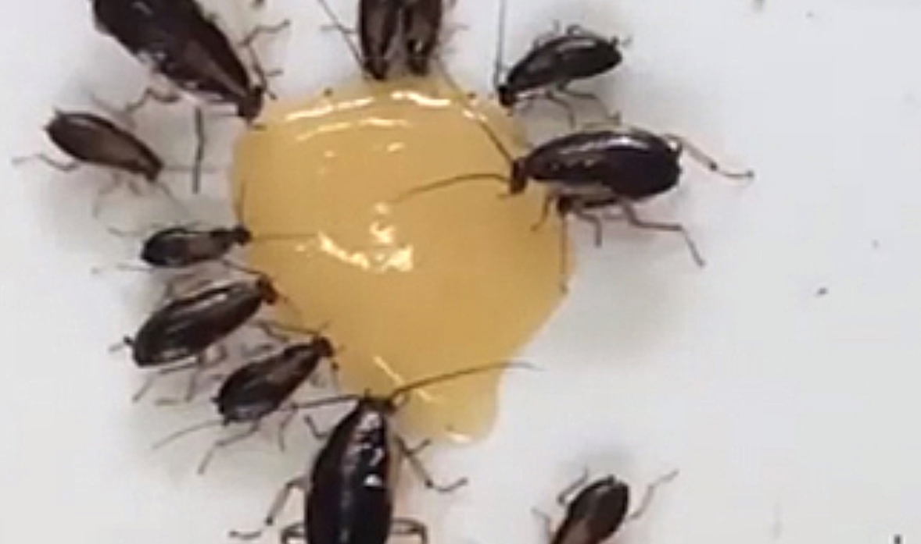
MANAGING COCKROACHES: Baits
Place baits out of children’s reach.
For serious infestations, hiring a professional pest management may the best option to safely get rid of cockroaches.
Baits can be used indoors and outdoors.
Notes:
Self-contained bait stations (or crack-and-crevice gels) are safer than sprays because the pesticide does not spread to people in the building. Be sure to place self-contained bait stations out reach of children and animals. Gels are meant to be used in wall cracks-and-crevices away from people, especially children.
Cockroach gel baits are available with a variety of insecticide formulations that control these pests. The method works by enticing the pests to eat gel bait, which it thinks is a source of food, so it consumes the pesticide contained within.

Slide 37
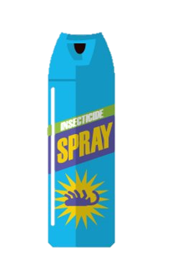
MANAGING COCKROACHES: Avoid using sprays
Sprays only kill the cockroaches you can see and don’t reach their hiding places or kill their eggs. Sprays tend to scatter cockroaches.
Sprays can leave residues or drift into the air and harm people (especially children), pets, and the environment.
Don’t spray pesticides when you use baits because you’ll kill the pest before it can share the pesticide.
Notes:
Don’t spray or use bug bombs because the cockroaches will scatter and return later. Instead, use bait stations and gels.

Slide 38
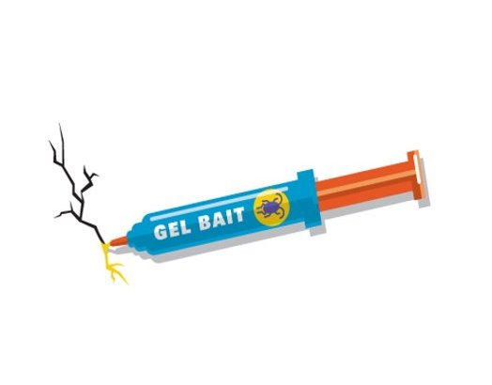
ACTIVITY: Which have you used to get rid of cockroaches?
Notes:
A vacuum cleaner with a HEPA filter? Insecticide spray? Crevice-and-crack gel bait?

Slide 39
MANAGING COCKROACHES: Outdoors
1. Keep them from coming indoors.
2. Remove their source of food and water.
3. Eliminate their hiding spots (They can be found hiding in mulch, rotting leaf litter, decaying logs, woodpiles, stumps, ground cover plantings, around garbage, storm drains, or sewer lines.)
4. Place bait stations out of children’s reach.
Notes:
When traps become clogged with cockroaches, throw them away and replace with new ones. Note: it is illegal to use/discharge pesticides in storm drains or sewer systems.

Slide 40
MANAGING COCKROACHES: Best practices
Graphic from the California Department of Pesticide Regulation

Slide 41
MANAGEMENT:
Hiring a pest management professional (PMP)
Must be licensed
with DPR, and
with Structural Pest Control Board
Must be trained in IPM for schools and child care
Free DPR online Advanced course for PMPs: www.cdpr.ca.gov/schoolipm
Request UC IPM free online training: www.ipm.ucdavis.edu/training/school-and-child-care-ipm.html
Notes:
If you have tried all of the IPM steps and still have rodents entering your building, contact a Pest Management Professional. Remember:
All pest management professionals (PMPs) must be licensed by the State of California. You can verify whether a company or an individual has a license issued by the Structural Pest Control Board at www.pestboard.ca.gov. Having a structural pest control board license means you have passed the exam and you have completed your live scan finger print process.
2. PMPs should be trained in IPM for schools and child care. The UC Statewide IPM Program offers a free online course for PMPs titled Providing IPM Services in Schools and Child Care Settings. Ask for proof that your PMP has taken the course
3. Some PMPs may have a third-party certification demonstrating extra skills in IPM and environmentally sensitive practices. Review each certification type before choosing a PMP.​

Slide 42
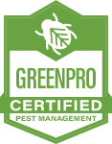
MANAGEMENT:
Hiring a PMP
Examples of third-party certification:
EcoWise: https://www.ecowisecertified.com/ecowise_find.html
GreenPro: https://greenshieldcertified.org/
GreenShield: https://www.qualitypro.org/certified-services/greenpro/
Notes:
Some PMPs may have a third-party certification demonstrating extra skills in IPM and environmentally sensitive practices.
Review each certification type before choosing a PMP. Here are links with more information.

Slide 43
VIDEOS:
Keeping pests our of your child care center
Getting Rid of Cockroaches in Your Child Care Center
https://www.youtube.com/watch?v=IdIjwCHQiCM&t=55s
Cómo deshacerse de las cucarachas en su centro de cuidado infantil
https://www.youtube.com/watch?v=rhulBiAHCW4&t=1s

