Slide 1


Funded through the California Department of Education, Early Education Support Division

Slide 2
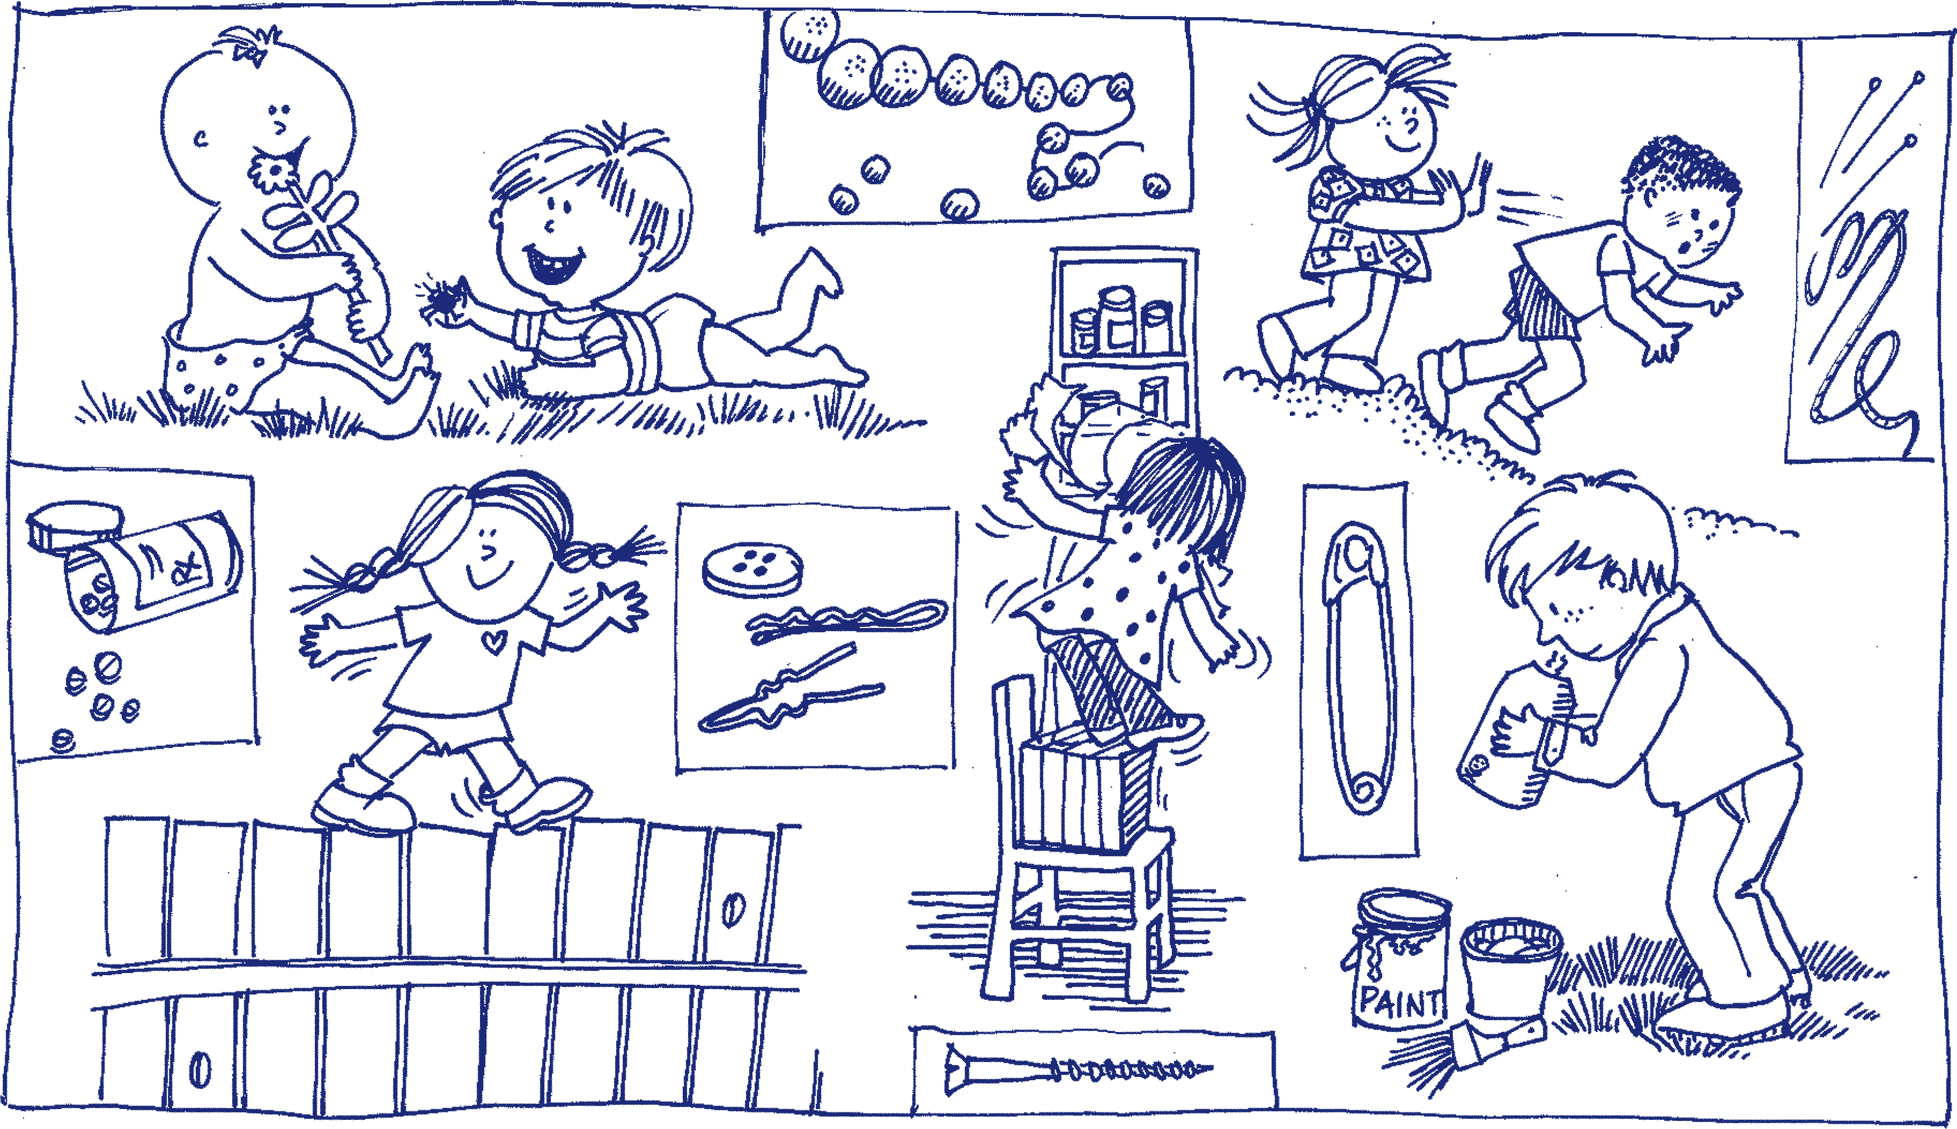
Understanding Childhood Injuries
Notes:
Injuries usually occur because of some combination of unsafe conditions and supervision and children’s participation in activities which are not developmentally appropriate. Strategies to prevention injuries include:
• Conducting regular safety checks to identify hazards
• Modifying the environment to reduce hazards
• Supervising children
• Setting and enforcing rules for activities (indoors and outdoors)
• Educating children, parents, and staff members about injury prevention

Slide 3
Where are children injured?
Most injuries occur on the playground, accounting for 50 to 60 percent of all injuries child care settings.
Furniture, stairs, windows, or slipping and tripping hazards are often involved.
Injuries occur in and around cars and other vehicles.

Slide 4
How are children injured?
Falls are the leading cause of serious injuries.
A child may injure another child (for example, they might fight, push, collide, throw objects, or bite).
Children may collide with objects such as moving playground equipment (swings), furniture, part of the building, plants, toys, a fence, gate, etc.
Children may be cut by a sharp edge; burned by a hot surface, hot tap water or heater; or poisoned by toxic materials.
Notes:
Most injuries in child care settings are minor resulting in cuts, scrapes and bruises. But severe injuries such as head injuries, broken bones, internal injuries,
dislocations, burns, or dental injuries can also occur. Injuries like poisoning, drowning, choking, and suffocation are of special concern because they are life threatening.

Slide 5
Risk of Injury and
Developmental Stages
Injury rates are low for infants and increase with the age of the child.
Children ages two to five years old get injured most frequently.
Notes:
Growing children are at risk for injuries as they develop new physical, mental, and emotional abilities. They grow quickly and want to test and master their
skills and environment. Their curiosity, fearlessness and lack of safety knowledge put them at risk of attempting actions for which they may lack the skills and physical capabilities. The type of injuries that may occur are related to their development.

Slide 6
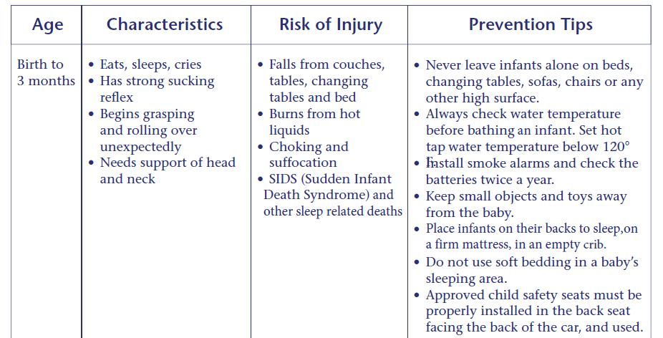
Birth to 3 months old
Notes:
Have participants work in small groups or pairs to predict what the prevention tips on the next slide for each developmental/age group. Then compare as a large group. Are there any ideas not mentioned on the slide?

Slide 7
Birth to 3 months old

Slide 8
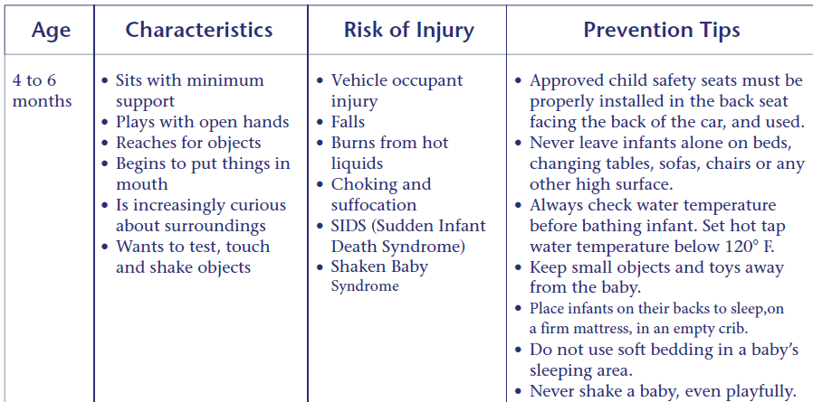
4 to 6 months old

Slide 9
4 to 6 months old

Slide 10
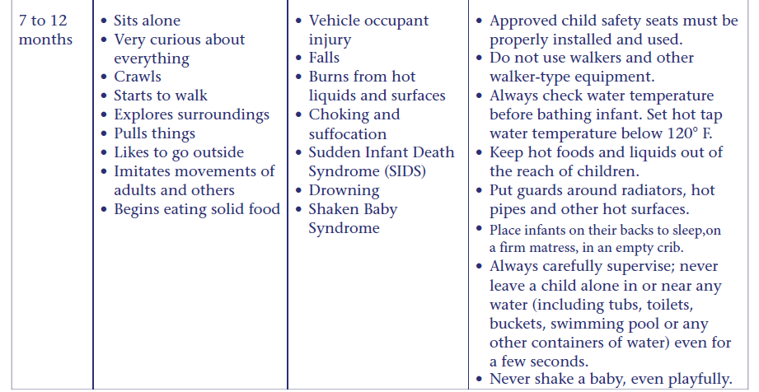
7 to 12 months old

Slide 11
7 to 12 months old

Slide 12
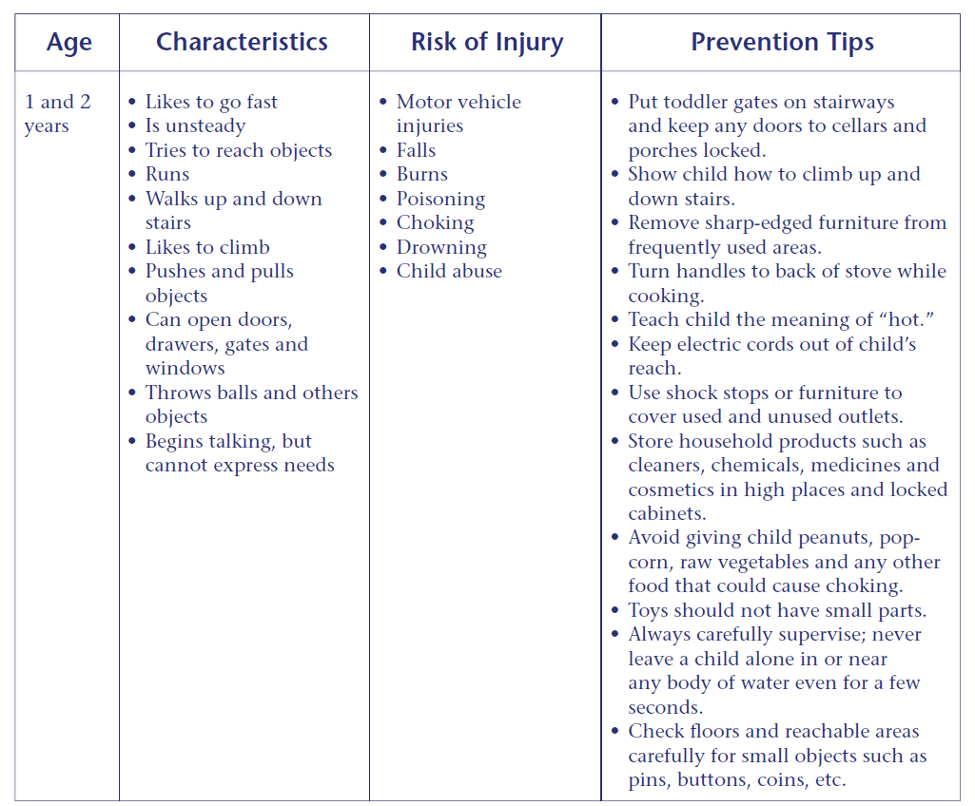

Slide 14
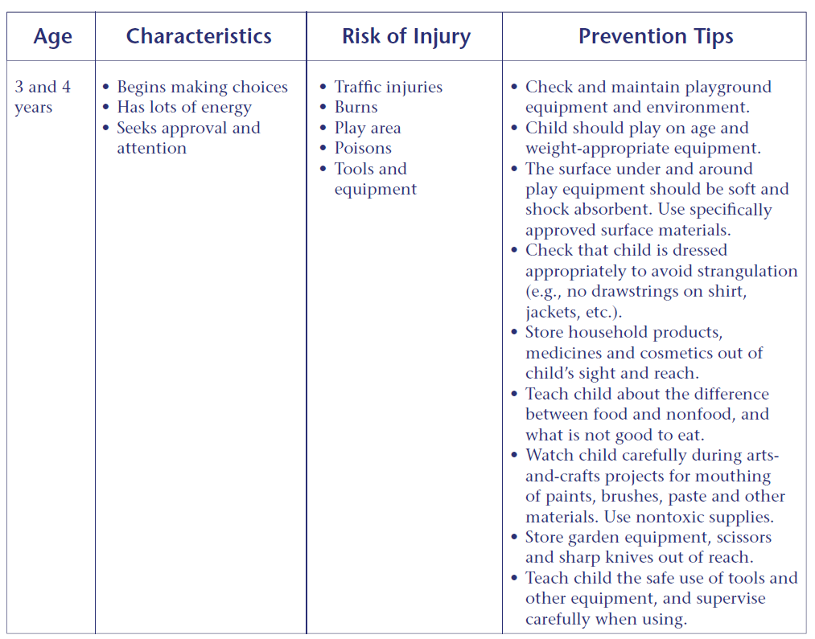

Slide 16
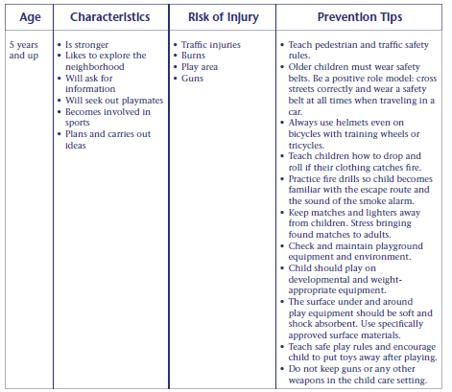

Slide 17
Notes:
Children with developmental delays may have unique risks for injury. For more information on developmental milestones and developmental delay go to the CDC website Learn the Signs. Act Early.

Slide 18
Developmental Delay
Children with developmental delays may have unique risks for injury.
For more information on developmental milestones and developmental delay go to the CDC website Learn the Signs. Act Early.
www.cdc.gov/ncbddd/actearly/index.html

Slide 19
Preventing Childhood Injuries
Topics
SIDS and Other Sleep-Related Infant Deaths
Shaken Baby Syndrome
Brain Injury and Concussion
Child Abuse Prevention
Burns and Fire
Choking, Strangulation, Suffocation
Falls
Poisoning
Drowning
Young Children and Disasters
Child Passenger Safety
Field Trip Safety
School Bus Safety
Notes:
Now we will talk about each of these topics in more detail.

Slide 20
Sudden Infant Death Syndrome(SIDS) &
Other Sleep-Related Infant Deaths
SIDS is the death of an infant younger than 1 year of age that is unexplained after a thorough scene investigation, autopsy, and review of the clinical history.
Ninety percent of SIDS deaths occur before an infant reaches 6 months of age, and peak between 1 and 4 months of age.
Other sleep-related infant deaths include suffocation, asphyxia, entrapment, and strangulation.
Notes:
It is a truly tragic event when a seemingly healthy infant dies suddenly and unexpectedly. And when the death
happens in a child care program, it can be devastating; not only for the family of the child, but also for the child
care provider and other families in the program. Safe infant sleep practices and environments reduce the risk
of Sudden Infant Death Syndrome (SIDS) and other sleep-related infant deaths.

Slide 21
SIDS and Child Care
Research shows that unexpected infant deaths in child care were more likely to happen during the first week. Infants are at greater risk when they are:
used to sleeping on their backs at home and are placed on their stomachs for sleep in child care
allowed to sleep in an unsafe sleep environment in child care (for example: a car seat, stroller, futon, pillow, or bean bag)

Slide 22

Eunice Kennedy Shriver National Institute of Child Health and Human Development (NICHD), NIH, HHS; http://www.nichd.nih.gov.
Notes:
This is what a safe sleep environment looks like.

Slide 23
How to Reduce the Risk of SIDS in Child Care
Always put to sleep on their backs until 1 year of age.
Place infants on a firm mattress, with a fitted crib sheet, in a crib or play yard that meets the Consumer Product Safety Commission (CPSC) safety standards.
Keep the crib free of toys, mobiles, soft objects, stuffed animals, pillows, bumper pads, blankets, positioning devices and extra bedding.
Notes:
The next slides provide details for the recommendations for safe sleep in child care settings.

Slide 24
How to Reduce the Risk of SIDS in Child Care
Do not overdress infants – no more than one extra layer than an adult. Keep the infant’s head uncovered for sleep. Remove bibs and clothing with hoods.
If additional warmth is needed for sleep, a one-piece blanket sleeper or sleep sack may be used
Ventilate the sleeping area. Keep the temperature comfortable for a lightly clothed adult.
Actively observe sleeping infants by sight and sound.

Slide 25
How to Reduce the Risk of SIDS in Child Care
Do not allow infants to sleep on a sofa/couch, chair cushion, bed, pillow, or in a car seat, stroller, swing or bouncy chair.
If an infant falls asleep anyplace other than a crib, move the infant to a crib right away.
If an infant arrives asleep in a car seat, move the infant to a crib right away.
Space cribs three feet apart with one infant per crib.

Slide 26
How to Reduce the Risk of SIDS in Child Care
If provided by the parent, offer a pacifier for sleep.
Do not attach pacifiers to an infants clothing.
When able to roll back and forth from back to front, place infants to sleep on their backs and allow them to assume a preferred sleep position.

Slide 27

How to Reduce the Risk of SIDS in Child Care
Keep your child care program smoke-free.
Support breastfeeding families.
Provide supervised “Tummy Time”.

Slide 28

Tummy Time
Eunice Kennedy Shriver National Institute of Child Health and Human Development (NICHD), NIH, HHS; http://www.nichd.nih.gov.
Notes:
Infants spending all their time on their backs or in car seats, swings, and high chairs are at risk for developing motor delays. Make sure that infants have supervised tummy time when they are awake so they can grow strong.

Slide 29
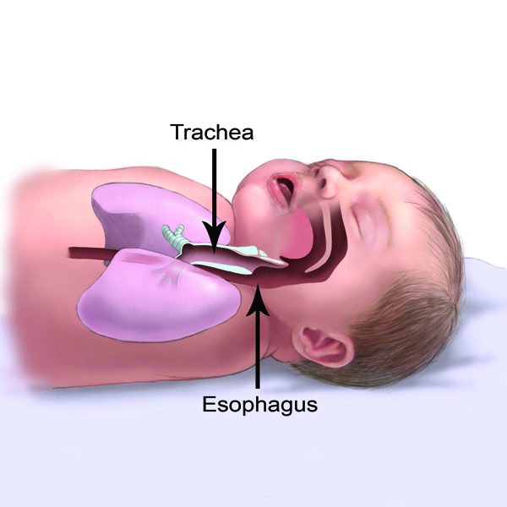
Eunice Kennedy Shriver National Institute of Child Health and Human Development (NICHD), NIH, HHS; http://www.nichd.nih.gov.
Notes:
Some people are concerned that baby will choke if put to sleep on their back. This picture shows how the trachea (wind pipe) is on top the esophagus when babies on their backs. This makes it unlikely for the baby to choke on spit up.

Slide 30
What about swaddling?
Although some newborns and young infants may be swaddled for sleep at home, swaddling of infants is not necessary or recommended in child care programs.
The risk of death is high if swaddled infants are placed on, or roll onto, their stomachs.
In a child’s home, swaddling should not be used once an infant shows signs of trying to roll over (usually before an infant is three months old).
Notes:
Use baby model to show a baby in a sleep sack positioned on their back.

Slide 31
Shaken Baby Syndrome
The term “shaken baby syndrome” describes a set of symptoms seen in infants who have sustained a head injury from shaking.
The term “abusive head trauma” may also be used. Abusive Head Trauma includes the various ways a child could suffer a head injury as a result of abuse such as: shaking; dropping; throwing; hitting; or hitting child’s head against a surface or object while shaking.
Notes:
Definitions. Abusive Head Trauma can be mild to severe and have serious long term consequences.
Demonstrate using the baby model. Show how the brain can knock against the skull when a baby is shaken.

Slide 32
Abusive Head Trauma/Shaken Baby Syndrome
May result in:
partial or total blindness;
hearing loss;
paralysis;
problems with motor development;
seizure disorders;
cerebral palsy;
sucking and swallowing disorders;
intellectual disabilities;
speech and language delay;
problems with executive function;
attention, memory, and behavior problems.
Notes:
Infants are especially vulnerable to abusive head trauma. Their fragile brains and skulls are rapidly
developing and a sudden impact can cause irreversible injury..

Slide 33
Infant Crying
Infants are unable to express their needs and feelings using words. Instead, they cry.
Infants may have colic or other kinds of pain and discomfort leading to crying.
A phase of alarming crying is considered a normal phase in infant development.
Strategies for soothing a crying infant include gently rocking, carrying, singing, providing white noise, and offering a pacifier.

Slide 34
Infant Crying
Caregivers may experience anger or frustration over prolonged crying.
Caregivers need strategies to cope with a crying, fussy, or distraught infant.

Slide 35
Strategies to Cope
Manage your stress and practice self-care. Be aware of feelings of increasing frustration or anger.
Use a calming strategy that works for you. For example, take a few deep breaths or breathe deeply while counting to ten.
If you are unable to bring your frustration under control on your own, then find a way to take a break from the situation (without leaving children unsupervised).
Notes:
If you need a break from a crying baby, the following are acceptable per California Child Care Licensing Regulations for providers who may be alone in family child care homes:
• The child care provider may designate a qualified substitute provider who can provide relief to a
child care provider who is stressed by a baby’s crying. It is appropriate to ask someone to help
take care of a crying baby while the care provider gets some respite. In licensed child care, the
only acceptable substitutes are those who have been fingerprint-cleared and meet all necessary
requirements established by Title 22 and the Health and Safety Code.
• The parent/guardian may designate an emergency contact, in addition to herself/himself, that can be called if the baby’s crying is alarming.
• If a child care provider realizes that a baby’s crying is a trigger for negative stress reactions, consider not providing care to infants.

Slide 36
Strategies for Coping (cont.)
For more information about typical infant development, how to manage infant crying, and techniques for soothing crying infants:
See Period of PURPLE Crying® www.purplecrying.info
Remember: it is never okay to shake or strike a child.
Notes:
Share Period of Purple Crying resources with parents.

Slide 37
Identifying Shaken Baby Syndrome
Watch for:
Changes in mood, behavior, appetite, breathing, head or eye movement
Bruising (around the head, neck or chest), bleeding (around the eyes), swelling of the head, forehead, or soft spot
Changes in muscle tone, ability to lift head, tremors, seizures
Notes:
A child care provider might be the first to notice if an infant has experienced abusive head trauma. In many cases there are no symptoms at all, but it’s important to be aware and respond so that the child can receive medical attention.

Slide 38
Traumatic Brain Injury (TBI) and Concussion
TBI is a type of brain injury that changes the way the brain normally works.
A bump, blow, or jolt to the head can cause a TBI.
A blow to the body that causes the head and brain to move rapidly back and forth can also cause a TBI.
A concussion is the most common type of TBI.
Notes:
Even what seems to be a mild bump to the head can be serious. Children recovering from a concussion may need adjustments to their activities.

Slide 39
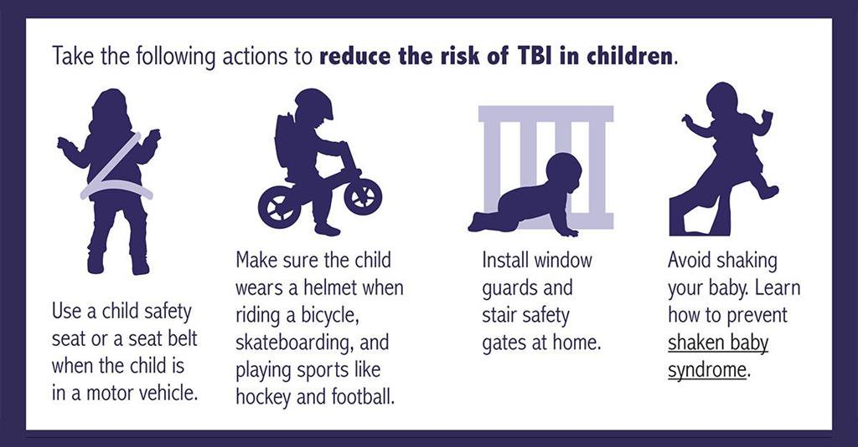
Eunice Kennedy Shriver National Institute of Child Health and Human Development (NICHD), NIH, HHS; http://www.nichd.nih.gov.

Slide 40
Child Abuse Prevention
What is child abuse?
Child abuse is a non-accidental injury or pattern of injuries to a child for which there is no reasonable explanation.
Child abuse is usually a pattern of behavior, not a single act.
Notes:
Refer to the CCHP Health and Safety Note Child Abuse Prevention

Slide 41
Kinds of Child Abuse
Physical
Emotional
Sexual
Neglect
Notes:
In physical abuse, children are slapped, hit, kicked or pushed, or have objects thrown at them, causing wounds, broken bones or other injuries. Severe physical abuse can cause major injury, permanent physical or emotional damage, or even death. Sexual abuse includes a wide range of sexual behavior, including fondling, masturbation, intercourse or involving children in pornography. Emotional abuse involves humiliation, dishonoring or other acts carried out over time that terrorize or frighten the child. Neglect means not feeding or caring for a child’s basic needs or not adequately supervising a child.

Slide 42
Ways to Prevent Child Abuse
Build trusting relationships with families
Provide information on child development
Help families build positive relationships with their children
Model positive communication and good child care practices
Host parenting workshops for families
Notes:
You may be the biggest source of support and information to families and building community with other families provides extra support.

Slide 43
Ways to Prevent Child Abuse (cont.)
Know the signs of family stress and offer support
Refer families to community resources
Educate young children about their right to say “no”.
Inform parents that you are required by law to report suspected child abuse.
Notes:
Community resources include: local First 5, local Health Department, local Social Services (Child Protective Services), warm lines, mental health services, local schools, and libraries.

Slide 44
Mandated Reporter
As a Mandated Reporter, you are required to report known or suspected child abuse to Child Protective Services (CPS).
Call CPS for advice if you are not sure about something you observe.
Call 9-1-1 if the child is in immediate danger or needs urgent medical care.
Notes:
You may be the first person to suspect abuse and neglect. Child care providers are Mandated Reporters and must report known or suspected child abuse in order to protect the child. CPS will investigate the situation and provide help and services to the child and family as needed.

Slide 45
Mandated Reporter Training
Child care providers are required to take Mandated Reporter training about:
How to spot indicators of possible child abuse or neglect
How to talk to children about suspected abuse
How to make a report
What happens after a report is filed
The free online class can be found here: http://childcare.mandatedreporterca.com

Slide 46
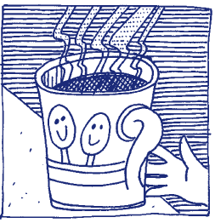
Burns and Fire
Burns can be caused by contact with hot objects or surfaces, hot liquids or steam, fire, electricity, or chemicals.
Hot liquids—not fire—are the most common cause of burns to young children.
Children are curious and don’t recognize danger!

Slide 47
Burn and Fire Prevention: Equipment
Install smoke detectors.
Maintain a working fire extinguisher.
Put barriers around fireplaces, radiators or hot pipes.
Don’t use portable, open flame or space heaters in play areas.
Cover electrical outlets.
Don’t overload electrical wiring.
Keep the temperature of your hot water heater at 120° F or lower. Check the water temperature before bathing a child in a tub.
Notes:
.

Slide 48
Burn and Fire Prevention: Food and Drinks
Keep children out of cooking areas.
Don’t drink hot beverages or carry anything hot near children.
Don’t heat bottles in the microwave.
Test hot food before giving it to a child.
Keep hot foods and drinks away from the edge of tables and counters and off of tables with table cloths.
Use the rear burners for cooking, turn pot handles toward the rear or center.

Slide 49
Fire and Burn Prevention: Practices
Store all chemicals, matches, and lighters out of children’s reach.
Teach children to stay away from hot things and not to play with matches, lighters, chemicals, electrical equipment.
Plan a fire escape route.
Conduct regular fire and evacuation drills using different exits.
Teach children how to stop, drop, and roll.
Notes:
Check with your local Fire Marshal for more information on preventing fires. See the California Child Care Disaster Plan for information on conducting drills in child care programs.

Slide 50
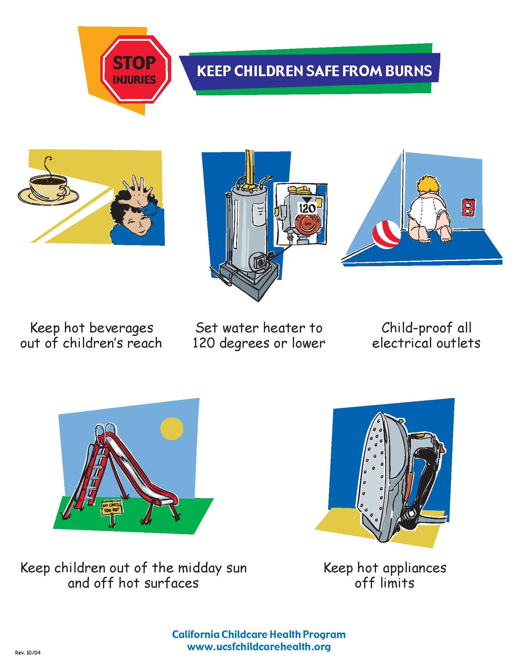

Slide 51
Choking
Young children are at greater risk of choking because:
They explore the world by putting objects in their mouths
They are just learning how to chew and eat solid food

Slide 52
Signs of choking and suffocation in children:
difficulty speaking or breathing,
the inability to cough,
wheezing sounds,
clutching of throat or gesturing,
a bluish face,
confusion and unexplained loss of consciousness (this is a very late sign).
Notes:
Keep your CPR and First aid certification up to date so you know how to respond to choking and suffocation emergencies.

Slide 53
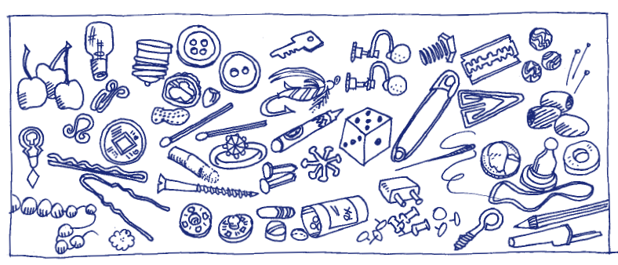
Choking Prevention
Notes:
Foods, toys, and objects can be choking hazards. How many choking hazards can you see in the picture? Keep a watchful eye for choking hazards, and keep them out of children’s reach. Objects smaller than 1 1/4" in diameter should not be accessible to children who put things in their mouths. Demonstrate the use of a “”choke tube”.

Slide 54
Choking Hazards: Foods
Chunks of meat
Whole olives
Whole grapes and raisins
Peanuts/nuts
Gum
Popcorn
Dried fruit
Hard candy, cough drops, lollypops
Raw vegetables (carrots, etc.)
Hot dogs and sausages (cut in rounds or whole)
Watermelon seeds
Spoons full of peanut butter
Notes:
Do not offer foods that are round, hard, small, thick, sticky, smooth or slippery to children younger than four years of age. For infants, foods should
be cut in small pieces no longer than 1/4"; for toddlers, pieces no longer than 1/2". Make sure children are sitting for meals and snacks.

Slide 55
Choking Hazards: Toys and Objects
Pins
Coins
Nails
Toothpicks
Jewelry
Game pieces
Buttons
Small toys
Marbles
Jacks
Crayons
Batteries
Notes:
Check toys and equipment regularly for small parts that may break off, such as eyes and noses on stuffed animals, buttons on doll clothes.

Slide 56
Suffocation and Strangulation Hazards
Balloons
Plastic bags
Disposable gloves
Toy chests with no air holes
Cords from window blinds and drapes
Ropes and string
Never place a crib near a window.
Don’t drape blankets over crib rails or attach hanging toys/mobiles to cribs.
Use CSPC approved cribs and play yards.
Notes:
Be aware of the needs and protections for children with developmental delays, swallowing or other disabilities.

Slide 57
Falls
Falls are the single greatest cause of injury in the child care environment.
They are the most common injury requiring medical care.
Children of all ages can fall.
Preventing falls is the greatest challenge to a safe environment.
Notes:
Although many injuries resulting from falls are minor (cuts and scrapes), many others such as heavy bleeding, broken bones, and head and eye injuries will be more severe and could be potentially life-threatening. Ask for examples of different kinds of falls at different ages/developmental stages.

Slide 58
Reducing the Risk of Falls: Equipment
Make sure equipment is in good repair, inspected for safety, and developmentally appropriate.
Use durable, balanced furniture that will not tip over easily.
Place gates at the top and bottom of stairs.
Notes:
(Baby walkers are outlawed in child care.)

Slide 59
Reducing the Risk of Falls: Environment
Install window guards and safety latches.
Pick up toys and other objects from the floor.
Clean up spills right away. Don’t use slippery floor finishes.
Remove loose and slippery rugs.
Adapt your space for children with special mobility needs.
Maintain safe and developmentally appropriate playgrounds.
Notes:
Provide shock absorbent surfaces (rubber, sand, pea gravel, wood chips) and appropriate fall zones for climbing structures.

Slide 60
Reducing the Risk of Falls: Supervision
Don’t allow children to climb on furniture.
Never leave infants or toddlers unattended on a bed, changing table, or other high surface.
Enforce rules for where children can run.
Enforce rules for playground safety consistently (for example, no running up slides).
Notes:
Remember, children are naturally active and playful. You can encourage healthy physical activity while taking steps to reduce the risk of falls.

Slide 61
Poisoning
Poisonings occur from many common items found in and around a home or child care environment.
Poisoning can occur by eating or drinking, contact with skin, getting in the eyes, breathing fumes, puncture wounds, and animal and insect bites.

Slide 62
Poisoning Hazards
medications (prescription and non-prescription)
cosmetics
cleaning, sanitizing, and disinfecting products
arts and crafts materials
batteries
lead-containing paint, dust, soil, plumbing fixtures, and pottery
automotive products
gardening products
pesticides
certain plants and mushrooms

Slide 63
Poisoning Prevention: Environment
Keep anything that could poison a child out of children's reach.
Store purses away from children’s play areas.
Create a special place for families and visitors to put their purses and backpacks when they are there for a short time.
Check with your local waste management about how to safely dispose of hazardous/poisonous materials you don’t need.

Slide 64
Poisoning Prevention: Practices
Routinely inspect child care areas for health and safety hazards. Remove hazards immediately.
Provide active supervision at all times.
Teach poison prevention to children and staff.
Never call medication candy.
Keep the number of the Poison Control Center near a telephone (800-222-1222).
Notes:
You can order refrigerator magnets with the poison control number from the Poison Control Center free of charge.

Slide 65
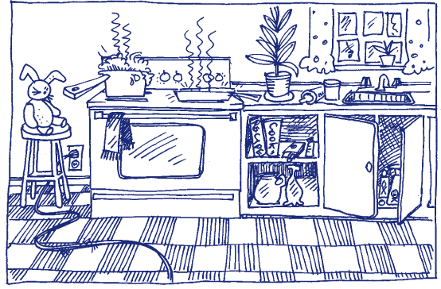
Find the Hazards

Slide 66
Drowning
Children between the ages of one and four years are at greatest risk from drowning.
Even a bucket containing only a few inches of water can be dangerous for a small child.
Notes:
Young children are “top heavy” and can fall into a bucket and drown.

Slide 67
Drowning Prevention
Never leave a child alone in or near any body of water (for example, a tub, toilet, bucket, swimming pool, or wading pool, ).
Empty buckets and other standing water when not in use.
Always provide careful, direct, and constant supervision around bodies of water.
Enclose water hazards with a fence that is at least five feet tall with a self closing gate that is at least 55’ high.

Slide 68
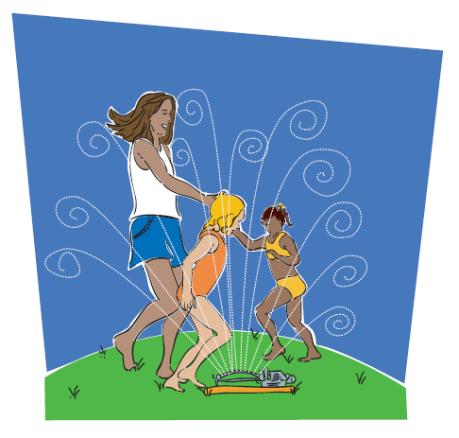
Find Safe Ways to Play with Water
Notes:
Portable wading pools are not recommended for child care programs.

Slide 69
Child Passenger Safety
Children under 2 years of age shall ride in a rear-facing car seat unless the child weighs 40 or more pounds OR is 40 or more inches tall. The child shall be secured in a manner that complies with the height and weight limits specified by the manufacturer of the car seat.
​Children under the age of 8 must be secured in a car seat or booster seat in the back seat.
Children who are 8 years of age OR have reached 4’9” in height must be secured by a safety belt.
Passengers who are 16 years of age and over are subject to California's Mandatory Seat Belt law.

Slide 70
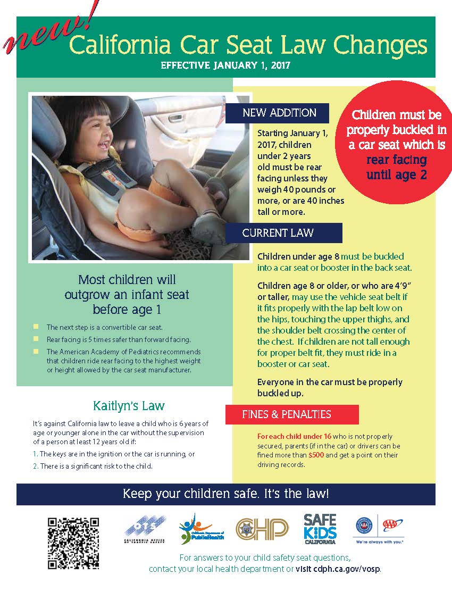
Notes:
Child Passenger Safety Laws must be posted in licensed child care centers.
You can find this poster on the Child Passenger Safety web page of the CDPH website. www.cdph.ca.gov/Programs/CCDPHP/DCDIC/SACB/Pages/ChildPassengerSafety(CPS)InCalifornia.aspx

Slide 71
In and Around Cars
Teach children to never play in, on, or around cars.
Never leave a child unattended in a vehicle, even with the window slightly open
Always lock vehicle doors and trunk, especially at home.
Keep keys and remote entry devices out of children’s reach
Watch children closely around vehicles.
Make sure children leave the vehicle when you reach your destination (especially sleeping infants).
Be careful when dropping off children at a child care provider if it’s not part of your normal routine. Place something you’ll need (for example, a purse or briefcase) on the floor of the back seat.
Child care providers should follow-up if a child is unexpectedly absent.
Notes:
Sadly, every year children die after being left in a car that gets too hot. Some motor vehicle accidents happen when the car is not moving or the child is not even in the car. Follow these safety tips to keep children safe in and around cars.

Slide 72
Prevent Roll Over Accidents
Walk all the way around your parked vehicle to check for children before getting in and starting the car.
Make sure young children are always accompanied by an adult when getting in and out of a vehicle.
Firmly hold the hand of children when walking near moving vehicles, in driveways, or in parking lots.
Identify and use safe areas for children to play away from parked or moving vehicles.
Designate a safe spot for children to go when vehicles are about to move.

Slide 73
Field Trip Safety
Field trips with young children provide wonderful learning opportunities that enrich and extend your curriculum.
With careful planning, adequate supervision and a spirit of adventure, adults and children can safely enjoy outings!
Notes:
Tip: A field trip to your relocation site in the event of a disaster can be fun for children and serves as a good drill.

Slide 74
Field Trip Safety
Research your destination-make sure it’s child friendly.
Obtain written consent--be sure you know how to reach families in an emergency.
Arrange for adequate supervision--you may need volunteers. Make sure volunteer staffing complies with licensing regulations.

Slide 75
Field Trip Safety
Prepare a roster with names of participating children.
Pack a first aid kit, medications (along with special health care plans), water, food, hand sanitizer, sunscreen, walking ropes, and other supplies you might need for the day.
Follow child passenger laws for travel by car or van.

Slide 76

School Bus Safety
Always supervise young children in and around school buses

Slide 77
School Bus Safety Tips
Teach children to:
Stand at least three giant steps back from the curb as the bus approaches.
Board the bus one at a time.
Use handrails when getting on or off the bus.
Wait for the bus to come to a complete stop before getting off.
Never to walk behind the bus.

Slide 78
Young Children and Disasters
A disaster or emergency in your child care center or community brings many challenges.
Children may be experiencing trauma in the aftermath of a disaster.
You can lessen the impact if you know what to expect and plan accordingly.
https://cchp.ucsf.edu/content/resources/young-children-and-disasters-health-and-safety-note
Notes:
After experiencing a disaster—whether it is a flood, earthquake, fire, or human caused event, children may react in ways that are difficult to understand.
Refer to the CCHP Health and Safety Note, Young Children and Disasters

Slide 79
After a Disaster…
Keep TV/radio/adult conversations about the disaster at a minimum around young children.
Answer all questions as honestly and simply as possible.
Be prepared to answer the same questions over and over. Be patient, understanding, and reassuring.

Slide 80
After a Disaster…(cont.)
Try to return to a normal routine as soon as possible to restore a sense of normalcy and security.
Don’t promise there won’t be another disaster. Instead, encourage children to talk about their feelings.
Tell them you will do everything you can to keep them safe.

Slide 81
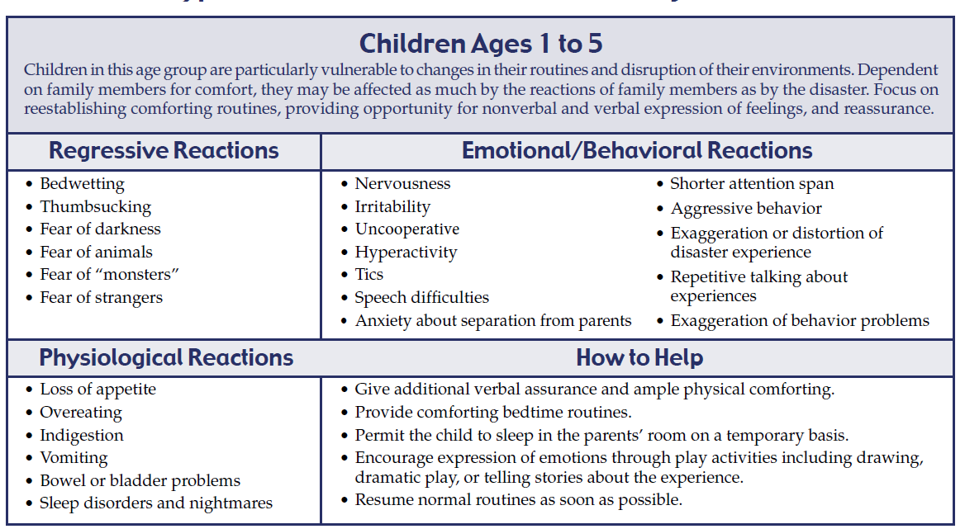
Typical Reactions Following a Disaster

Slide 82
Injury Prevention Policies
Topics
Back Injury Prevention for Staff
Regular Safety Checks: Inside and Outside
Safe Playground Habits
Safety Routines and Behavior Management
Resources

Slide 83
Back Injury Prevention for Staff
Back injuries are the most common injuries among child care providers.
Good body mechanics and proper lifting techniques will help to keep your back healthy!
Notes:
Be sure to take care of your self!

Slide 84
How Back Injuries Can Occur:
1. Incorrect lifting of children, toys, equipment, etc.
2. Inadequate work heights (e.g., child-sized tables and chairs)
3. Lowering and lifting children in and out of cribs
4. Frequent sitting on the floor with back unsupported

Slide 85
How Back Injuries Can Occur: (cont.)
5. Excessive reaching above shoulder height to obtain stored supplies
6. Frequent lifting of children on and off the diaper changing tables
7. Awkward positions and forceful motions needed to open windows
8. Carrying garbage diaper bags to dumpster

Slide 86
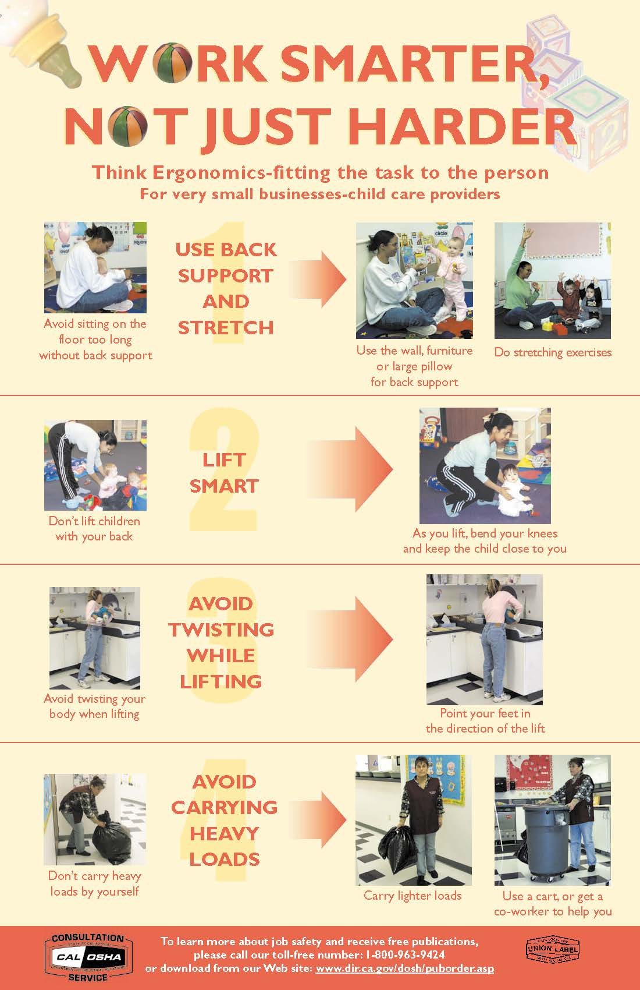
Notes:
Opportunity for demonstration or lifting exercise.

Slide 87
Safe Playground Habits

Slide 88
Swings
Sit in the center of the swing. Never stand or kneel.
Hold on with both hands.
Stop the swing before getting off.
Stay far away from moving swings.
Be sure only one person is in on a swing at a time. Do not swing empty swings or twist unoccupied rings.
Keep head and feet out of the exercise rings.

Slide 89
Slides
Wait your turn. Give the person ahead lots of room. Hold on with both hands when climbing up.
Before sliding down, make sure no one is in front.
Slide down feet first, sitting up, one at a time, (unless the slide is double or triple width).
After sliding down, get away from the front of the slide.
Don’t use slides that are too hot.

Slide 90
Horizontal Ladders and Bars
• Only ___ people at a time. (Fill in your limit.)
• Everybody starts at the same end and goes in the same direction.
• Use lock grips (fingers and thumbs).
• Keep a big space between you and the person in front.
• Do not use when wet or hot.
• Drop down with knees bent. Try to land on both feet.

Slide 91
Climbing Structures
• Only ___ people at a time. (Fill in your limit.)
• Use both hands and use the lock grips (fingers and thumbs).
• Stay away from other climbers.
• Do not use when wet or hot.
Place all pieces of playground equipment over a shock-absorbing surface with a six foot surrounding fall zone.

Slide 92
Safety Routines and Behavior Management
Establish written safety policies for your child care environment (include guidelines, checklists, and assignments)
Provide active supervision at all times
Monitor children’s behavior
Teach children injury-preventive behavior and safety rules
Adapt your environment to the developmental needs of children
Notes:
As time allows, this is a good time for small group and/or problems solving scenarios.

Slide 93
Regular Safety Checks: Inside and Outside
Examining the indoor and outdoor environments for safety hazards prevents accidents.
Modifying an environment for children’s safety, is sometimes called “childproofing”.
Childproofing does not make the environment 100 percent safe or replace supervision.

Slide 94
Health and Safety Checklists
Use a checklist to conduct safety checks of outdoor areas, indoor areas, first aid kits, etc. on a regularly scheduled basis.
Build safety checks into your daily, weekly and monthly schedules.
Notes:
You can use a series of checklists (for example, one for safety, one for first aid supplies, etc. or one checklist that is more comprehensive, such as the Health and Safety Checklist for ECE based on Caring for Our Children National Health and Safety Performance Standards.

Slide 95
https://cchp.ucsf.edu/content/forms#hscr
http://cfoc.nrckids.org
Notes:
The ECE Health and Safety Checklist is comprehensive. It has live links to the Caring for Our Children National Health and Safety Performance Standards that could cause the most harm if not followed in ECE programs. It can be found on the CCHP website.

Slide 96
Health and Safety Checklist for ECE
Based on CFOC http://nrckids.org/
Online version
Checklist: https://cchp.ucsf.edu/content/resources/cchp-health-and-safety-checklist
Manual: https://cchp.ucsf.edu/content/resources/cchp-health-and-safety-checklist-users-manual
Notes:
Share local resources, use the resource table for reference.

