Slide 1

Preventive Health and Safety in the Child Care Setting
A Curriculum for the Training of Child Care Providers
SIXTH EDITION
MODULE 3: Nutrition
Funded through the California Department of Social Services

Slide 2

Why is good nutrition important for children?
Good nutrition is crucial to brain growth and development, especially in a child’s first few years.
Children need nutrients found in healthy food and drinks to grow.
Obesity, heart disease, liver disease, tooth decay, some kinds of cancer and other diseases are linked to an unhealthy diet. It’s easier and less costly to prevent these diseases.
So let’s start when children are young!
Notes:
This presentation includes basic nutrition information for children ages birth to 12 years old.

Slide 3
Nutrition Laws and Regulations for Child Care
California Child Care Centers must meet the Child and Adult Care Food Program (CACFP) Requirements for Meals (Title 7, Code of Federal Regulations, Part 226.20)
AB 290, 16 hour Preventive Health and Safety Training (extra hour for nutrition is now required)
AB 2084, Healthy Beverages in Child Care Act
Notes:
First, California Child Care Centers must meet the Federal CACFP meal plan requirements. These requirements, based on USDA standards, have recently been updated. The new updates went into effect in October, 2017.
Second, all licensed child care providers (centers and homes) must complete 16 hour Preventive Health and Safety Training, including one hour for nutrition. This is required for all new licensees.
And third, AB 2084, known as the Healthy Beverages in Child Care Act, applies to centers and Family Child Care Homes. It has four key messages…

Slide 4
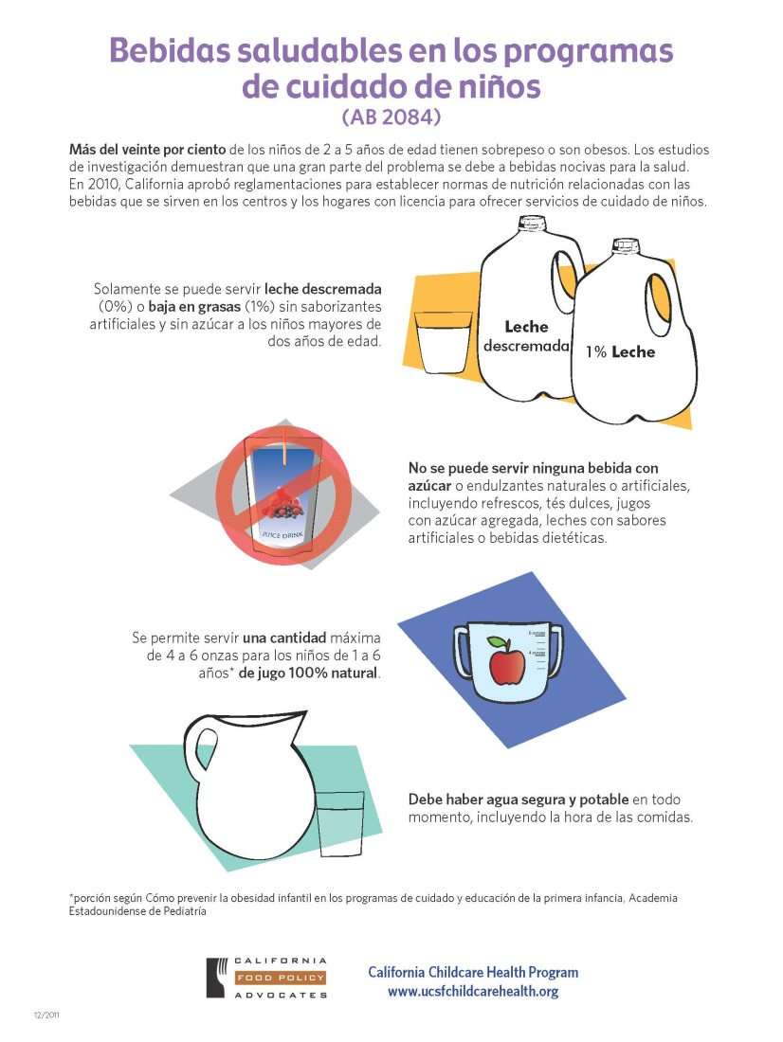
Four Key Messages of the Healthy Beverages in Child Care Act
Notes:
The key messages in the Healthy Beverages in Child Care Act:
Only unflavored, unsweetened, non-fat (fat free, skim, 0%) or low fat (1%) milk can be served to children two years of age or older.
No beverages with added sweeteners, natural or artificial, can be served, including sports drinks, sweet teas, juice drinks with added sugars, flavored milk, soda and diet drinks.
A maximum of one serving (4-6 ounces for 1-6 year olds, AAP) of 100% juice is allowed per day.
Clean and safe drinking water must be readily available at all times; indoors and outdoors and with meals and snacks.

Slide 5

Infant Feeding
Breastmilk is the healthiest source of milk for infants.
Contains all of the nutrients infants need and is easiest to digest.
Protects infants from common illnesses, allergies, and, obesity
Promotes good health for mothers
Notes:
Script:
Breast milk provides the most easily digested food for infants. It has the right amount of fat, sugar, water, and protein that is needed for an infant’s growth and development. Breast milk is the best source of nutrition for infants for at least the first twelve months, and, thereafter, for as long as both mother and child desire. Breastmilk contains antibodies that protect infants against common illnesses and allergies. Also, infants who are fed breastmilk experience less spit up, constipation and illness. Supporting a mother when she wants to breast-feed demonstrates your commitment to the best nutrition for infants. There are many benefits for breastfeeding moms for example, breastfeeding helps mothers to bond with their infants, saves money, and is protective at lowering their risk of developing diabetes, breast cancer, and heart disease.

Slide 6
Supporting Breastfeeding in Child Care
Let parents know you support breastfeeding.
Provide a quiet, comfortable, private place for mothers to breastfeed.
Learn how to safely handle and store breastmilk.
Notes:
Script:
Breast milk provides the most easily digested food for infants. It has the right amount of fat, sugar, water, and protein that is needed for an infant’s growth and development. Breast milk is the best source of nutrition for infants for at least the first twelve months, and, thereafter, for as long as both mother and child desire. Breastmilk contains antibodies that protect infants against common illnesses and allergies. Also, infants who are fed breastmilk experience less spit up, constipation and illness. Supporting a mother when she wants to breast-feed demonstrates your commitment to the best nutrition for infants. There are many benefits for breastfeeding moms for example, breastfeeding helps mothers to bond with their infants, saves money, and is protective at lowering their risk of developing diabetes, breast cancer, and heart disease.

Slide 7
Formula Feeding
Iron-fortified formula is the best substitute for breast milk. (Don’t give infants cows milk.)
Never use a microwave oven to heat the bottles.
Follow the instructions given by the manufacturer when mixing the formula with water.
Notes:
Script:
Iron-fortified infant formula is recommended for infants who are not fed breastmilk. It contains balanced nutrition that growing infants need. Infants under six months do not need any other beverages besides either breastmilk or iron fortified formula. A medical statement is required in order to serve infants under six months anything other than breastmilk or iron fortified formula. Do not use a microwave to heat infant formula or breastmilk. Microwave ovens do not heat liquids evenly and uneven heating could easily burn the infant when they are eating. In addition, bottles can explode if left in the microwave too long. Liquid may become very hot when microwaved even though the bottle feels cool. Also, heating damages special substances in breastmilk that protect infant’s health. Warm bottles under warm running water or in a warm water bath. Follow the instructions given by the manufacturer when mixing the formula with water and ensure that the water used is from a clean and safe source. Goat milk, soy milk, evaporated or whole cow’s milk, rice milk and other milk products are not recommended for infants that are less than 12 months of age, because they cannot digest it and does not provide the balanced nutrition growing infants need.

Slide 8
Feed Infants on Demand
(When They are Hungry)
Signs of Hunger
Fussing and tossing
Sucking their hands
Crying
Looking like they are going to cry
Rooting (sucking motion with the mouth)
Signs of Fullness
Sealing their lips together
A decrease in sucking
Spitting out the nipple
Turning away from the nipple
Pushing the bottle away
Notes:
Script:
Discuss with families the infant’s feeding patterns and look for infant feeding cues letting you know the infant is hungry. Infants should be fed when they are hungry. Some signs/cues that infants are hungry include: rooting, sucking their hand, or fidgeting. Responsive feeding, where the providers recognize and respond to infant feeding cues, helps foster trust and reduces overfeeding. Responding to the infant’s early signs of hunger can reduce their need to cry when hungry. Continue to feed a baby until they indicate fullness. Never force a baby to finish what is in the bottle. Babies are the best judge of how much they need. Babies may want to eat less if they are not feeling well and more if they are going through a growth spurt.

Slide 9

Infants: Other Beverages
Infants from birth to 6 months old drink only breastmilk or formula.
For infants 6 to 12 months, use a cup for water.
Avoid juice or sweetened drinks for infants.
Notes:
Script:
Sugary, sweetened drinks such as fruit juice should not be given to infants. They take the place of the more nutritious breast milk or formula that infants need for growth and good health. Offering fruit juice in the diet may lead to the risk of replacing the nutrient they need to grow. Do not put juice or sweetened beverages in a bottle.

Slide 10
Introducing Solid Food
Before introducing solid food, communicate with the infant’s family to make sure the infant is ready for solid food. Ask the family what foods have been tried at home.
At about 6 months, begin to introduce ground or pureed food, one food at a time. Work with the family to decide what foods to provide. It’s best to have the family try feeding their baby a new food at home first.
Wait for at least 3 to 5 days before introducing a another new food.
Notes:
Signs that an infant is ready to start solid foods
Infant can hold head steady,
Infant can sit with minimal support,
Infant swallows when presented with a spoon,
Infant shown interest in food watching it intently if he sees it.

Slide 11
Solid Food (Table Food)
Start with iron-fortified infant cereal or pureed meats.
Next, pureed vegetables and fruits, and
Then other protein rich foods.
Videos from 1000 Days on YouTube
https://www.youtube.com/playlist?list=PLNEN4w93BoO3zAE0xADCe8ij03N7ewPel
Notes:
Videos from 1000 Days on YouTube
https://www.youtube.com/playlist?list=PLNEN4w93BoO3zAE0xADCe8ij03N7ewPel

Slide 12
Age-appropriate Meals and Snacks for Children in Child Care Settings
*based on standards from Dietary Guidelines for Americans,
2020-2025.
Notes:
Offer a variety of healthy foods at meals and snacks. Plan your menu around what’s in season—seasonal foods are
often the most delicious and usually cost less. Colorful foods with varying textures are attractive and appealing to children.

Slide 13

Grains
Grains provide many important nutrients, vitamins, and minerals for growing children.
Eating whole grains reduces the risk of heart disease and helps children of all ages grow at a healthy weight and avoid constipation.
Pasta, cereal, bread, tortillas, and other baked goods are made using grains.
Rice, oats, corn, wheat, barley, quinoa, millet, and kamut are examples of grains.
Notes:
Script:
Food made from rice, oats, cornmeal, wheat, barley or another cereal grain is a grain product. Grains are an important food group that provide many important nutrients, vitamins, and minerals. Whole grain products contain all the parts of the dietary fiber, meaning they have no nutritious parts removed. Whole grains help children with digestion and helps them feel fuller longer helping children grow at a healthy weight. Whole grains also contain B Vitamins which are essential for healthy growth and development and maintaining a healthy nervous system and metabolism. And whole grains contain magnesium which the body uses to build bones and release energy from muscles.

Slide 14
Grains
Serve Whole Grains
Serve
Whole Grain or multi-grain bread
Brown rice, barley
Whole wheat or corn tortillas
Whole wheat pasta
Oatmeal
Quinoa
Avoid or Limit
White or enriched bread
White rice
Flour tortillas
Pasta or noodles made from white flour

Slide 15

Healthy Choices for Fats
Oils in seafood, nuts
Vegetable oils like olive oil, canola oil, corn oil
Avoid solid fats like butter and lard

Slide 16

Vegetables
Provide minerals, vitamins, and other nutrients to support children’s rapid growth and development.
Diets rich in vegetables have been shown to reduce the risks of heart disease, stroke, and certain cancers.
Notes:
Vegetables are a plant or part of a plant used as food. Vegetables provide many nutrients such as fiber, folic acid, and other vitamins and minerals that nurture the growing children. For example, folic acid helps the body make red blood cells, fiber helps with bowel function and helps children feel full when eating, and vitamins such as Vitamin A from carrots can help strengthen the immune system. Vegetables are also low in calories which help children grow at a healthy weight. Introducing a variety of vegetables helps to develop healthy eating patterns that benefit children their entire life.

Slide 17
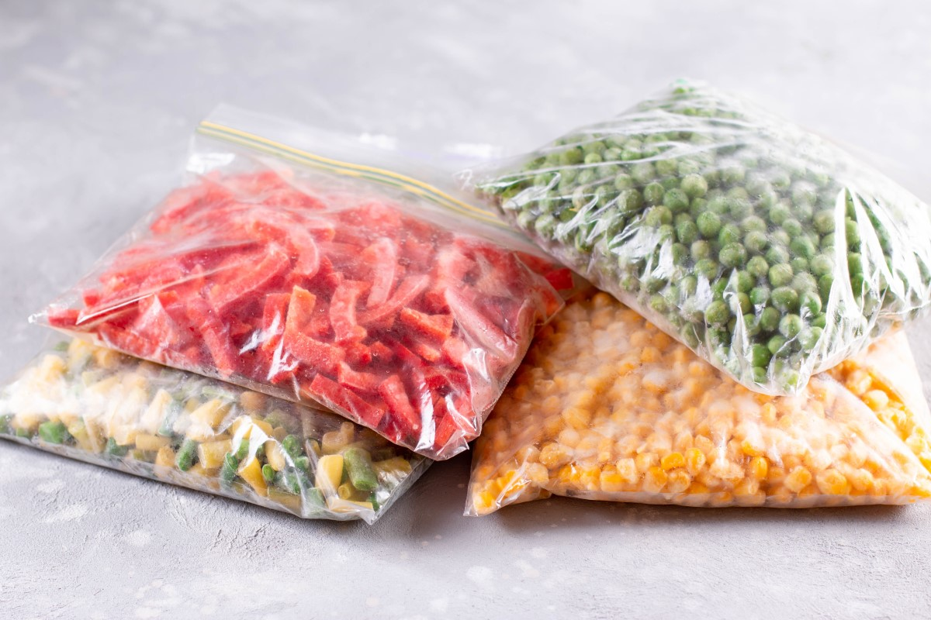
Vegetables
Vegetables can be served fresh, frozen, or canned (all with no added salt, fat, or sugar)
For commercially prepared vegetables, the first ingredient should be the vegetable
Notes:
Each vegetable has different levels of nutrients, so including a variety of vegetables will help make sure children getting the nutrition they need while they are rapidly growing. Many processed food products contain added unhealthy salt, fat, or sugar. Offering children plain vegetables is the healthiest. If serving commercially prepared vegetables such as spinach, green beans, carrots, etc, read the label carefully making sure that the vegetable is the first ingredient listed on the label.

Slide 18
Quiz
Question: Why is it important to eat vegetables?
A.) Vegetables are important because they contain many nutrients, vitamins, and minerals that will help children grow.
B.) Eating vegetables in the diet can help children develop healthy eating patterns that can last a lifetime.
C.) Trying a wide variety of vegetables, textures, and colors can help develop sensory skills.
D.) All the above

Slide 19
Quiz
Question: Why is it important to eat vegetables?
A.) Vegetables are important because they contain many nutrients, vitamins, and minerals that will help children grow.
B.) Eating vegetables in the diet can help children develop healthy eating patterns that can last a lifetime.
C.) Trying a wide variety of vegetables, textures, and colors can help develop sensory skills.
D.) All the above

Slide 20
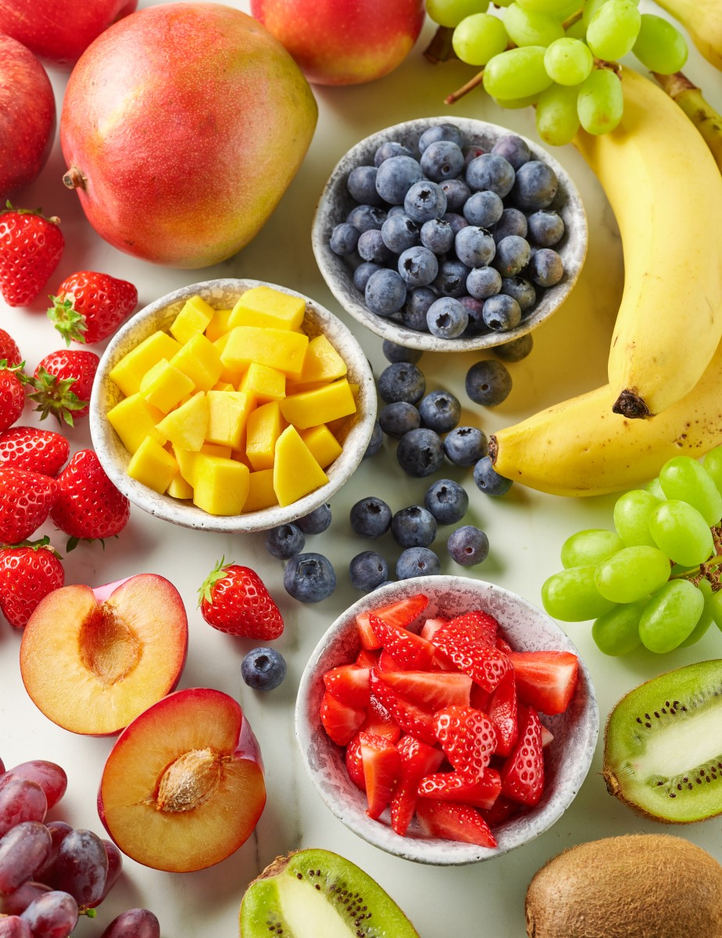
Fruit
Fruits
Fruit provides minerals, vitamins, and other nutrients that support children’s growth and development.
Include a variety of colors: try a rainbow of fruits.
The different fruit colors and textures help develop sensory skills.
Notes:
A fruit is the part of a plant that has seeds in it. Fruits are an important source of food for growing children. Fruits provide many nutrients such as folic acid, fiber, and vitamins. For example, Vitamin C from oranges helps in the growth and repair of all body tissues, keeps teeth and gums healthy, and can strengthen the immune system. Diets rich in fruits, such as bananas with potassium, have been shown to reduce the risks of high blood pressure and other illnesses. Create a positive eating experience. Don’t force or pressure children to eat all the food that is offered.

Slide 21
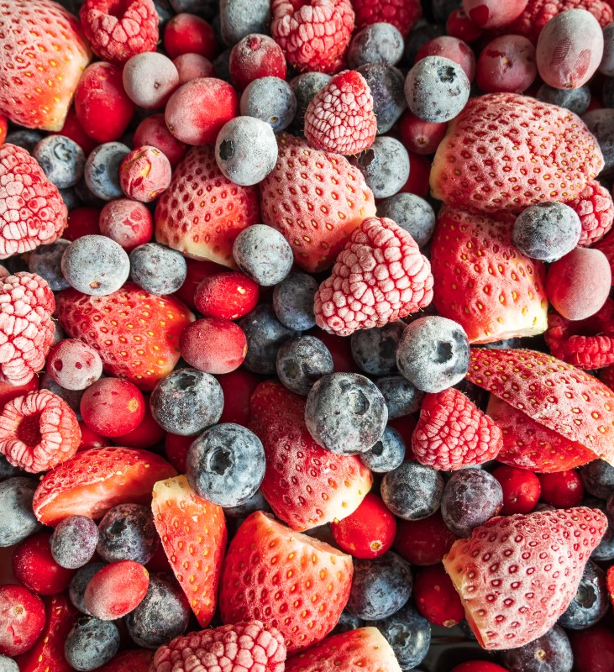
Fruit
Fruits
Offer unsweetened whole, mashed, or pureed fruits, as developmentally appropriate.
Fruit can be fresh, frozen, or canned (all with no added sugars).
Do not add sugar or sweeteners.
For commercially prepared fruits, the fruit should be the first ingredient.
Notes:
Include a variety of fruits. If feeding commercially prepared fruits such as applesauce, peaches, or pears, read the label carefully to check for added sweeteners.

Slide 22
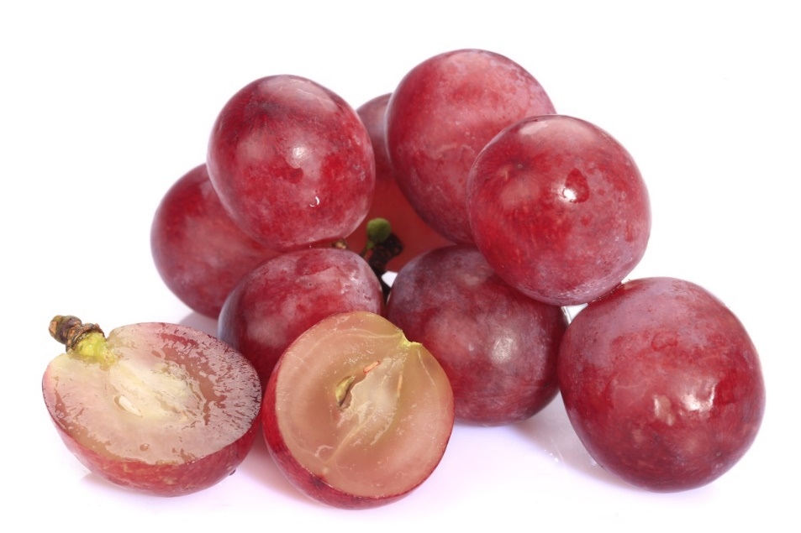
Choking Safety for Young Children
Serve fruits and vegetables ground, mashed, pureed, chopped, cut into small pieces, or shredded.
Remove pits and seeds for children under age 4 years.
Don’t serve whole grapes to young children.
Notes:
Due to the risk of choking, do not feed infants and toddlers whole pieces or hard pieces of fruit such as apple, pear, melon; uncooked, dried fruit (including raisins), whole grapes, berries, cherries, melon balls, or cherry and grape tomatoes. Instead, cut these foods into smaller pieces, quarters, with pits and seeds removed.

Slide 23
Quiz
Choose the most appropriate fruit to feed a toddler:
A.) Pureed applesauce sweetened with sugar
B.) Washed whole grapes
C.) Strawberries cut into small pieces
D.) A raw pear cut in half

Slide 24
Quiz
Choose the most appropriate fruit to feed a toddler:
A.) Pureed applesauce sweetened with sugar
B.) Washed whole grapes
C.) Strawberries cut into small pieces
D.) A raw pear cut in half

Slide 25

Protein
Protein helps build bones, muscles, cartilage, skin and blood. Protein also helps your body make hormones and vitamins.
Meat, poultry, fish without bones, yogurt, cottage cheese, cheese, nut butters, tofu, beans, legumes, and cooked eggs are all examples of protein-rich foods.
Notes:
Protein in foods such as meat, milk, eggs, and beans is needed for healthy growth.

Slide 26
Iron
Dietary iron is important so children don’t become anemic.
Sources of iron include meat, poultry, seafood, legumes, dark green vegetables, and foods enriched with iron such as fortified breads and cereals.
Vitamin C helps the body absorb iron. Vitamin C is found in many fruits and vegetables.
Note: Anemia and lead poisoning may occur together.
Notes:
A healthy balanced diet with a variety of food choices will help children meet their nutritional needs.

Slide 27
Avoid
Meat high in fat, salt, and additives such as bacon, sausage, and hot dogs (hot dogs are also a choking hazard)
Fried and pre-fried baked foods such as fish sticks and chicken nuggets.
Notes:
Avoid serving hot dogs, sausage, chicken nuggets, because they are high in salt and fat. Hotdogs or meat products shaped like hotdogs, when served whole or cut into round slices, are a leading cause of choking in children.

Slide 28
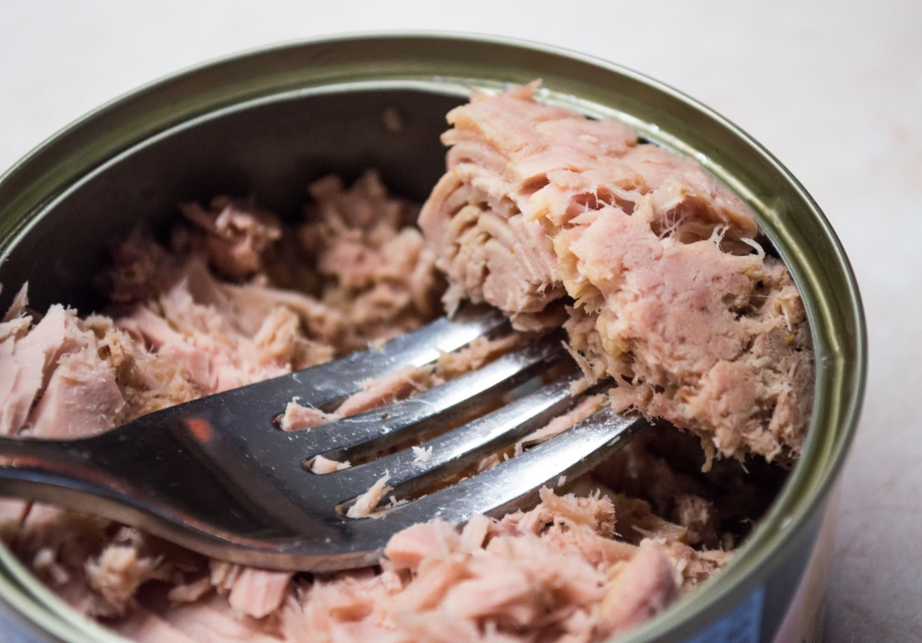
Safety
Ask parents to try common allergen foods at home first: nuts and nut butter, fish and shell fish, and soy products like tofu.
Do not serve fish with bones, chunks of meat, whole nuts or seeds, or spoons-full of nut butter to young children since these food can cause choking.

Slide 29
Preventing Food Borne Illness: Food Safety
Check your refrigerator to make sure the temperature is 41 degrees or lower.
Fully cook eggs, meat, and fish.
Wash your hands before preparing, serving, and eating food and after handling raw fish, eggs, and meat.
Pay careful attention to sanitizing surfaces and utensils after handling raw meat and fish.

Slide 30
Food Allergies and Food Safety Reminders
Watch for allergic reactions such as: vomiting, diarrhea, rash, swelling of the lips or eyes, nasal congestion, coughing, wheezing, asthma-like symptoms, or trouble breathing.
Eggs, milk, and peanuts are the most common causes of food allergies in children. Wheat, soy, tree nuts, fish, shellfish, and sesame also are common food allergies.
Peanuts, tree nuts, fish, and shellfish commonly cause the most severe reactions.
Nearly 5 percent of children under the age of five years have food allergies.
Always have children sit when they eat or drink!
Notes:
For more information on allergies and food safety visit the EMSA Child Care Nutrition Training webpage.

Slide 31
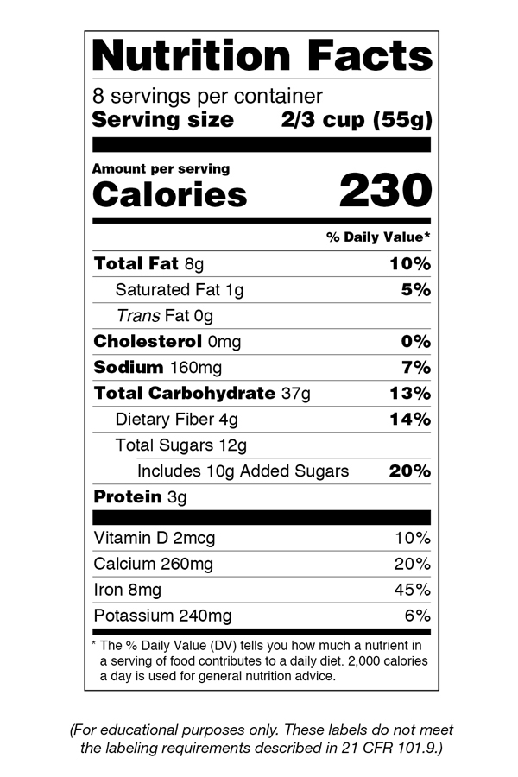
Read the Nutrition Facts Label
Notes:
The Nutrition Facts panel can help you choose foods lower in total fat, saturated fat, trans fat. Choose foods with the lower total fat, and saturated fat. Avoid serving children food with trans fats. Also, to know how much salt is in a product, look for “Sodium” on the label. Choose foods that have less Sodium to reduce the amount of salt you are serving children. The label on the right is the new FDA label scheduled to be in effect by July 2018. It is designed to make it easier for consumers to make healthy choices and includes clearer information about added sugars and serving size.

Slide 32
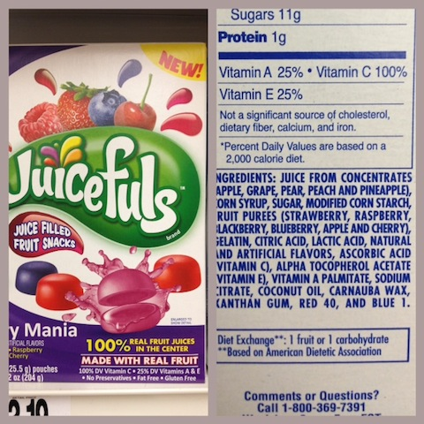
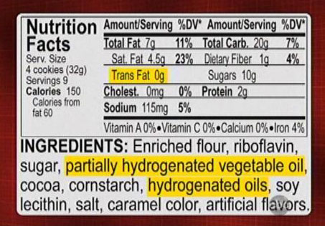
Read the Ingredients List
Notes:
Script
The U.S. Food and Drug Administration (FDA) requires food producers to list all ingredients in their foods. Added sugar and fat comes in many forms – which is why it's so hard to find on the ingredients label. There are many different names for sugar listed on food labels, some of the more common names, are sucrose, cane sugar, sugar, corn syrup, fruit juice concentrate, barley malt, dextrose, maltose, and rice syrup. Avoid foods with transfats (partially-hydrogenated and hydrogenated oils).

Slide 33

Read the Label
Notes:
Juices that are not 100% fruit have names like juice drink, juice cocktail, fruit punch, and lemonade. It will say on the label that these drinks have added sweeteners such as sugar, corn syrup, sugar cane juice.

Slide 34
Avoid foods with added sugar or these sugar equivalents on Ingredient Lists:
High fructose corn syrup
Fructose
Corn syrup
Honey
Cane sugar
Evaporated cane juice
Sucrose
Sucralose

Slide 35
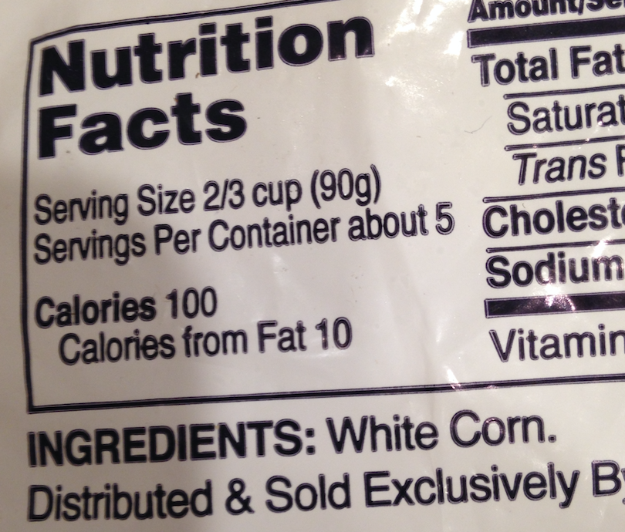
Notes:
Contents on the Ingredients List are listed from most to least. This Ingredients List has just one ingredient: White Corn. That tells you there are no added sugars, salt, or fats.

Slide 36

Children with Special Needs
Consult with the child’s family on any special dietary needs.
Follow the written instructions from the child’s primary care provider.
Develop a special health care needs plan in partnership with the family and primary care provider.
Notes:
Some children have cultural, religious, medical or developmental concerns which may impact their dietary needs. Work closely with families to develop a feeding plan to promote the healthy growth of the infant. For families from different cultures, it is important to learn about their needs and special dietary considerations. For medical and behavioral concerns, get instructions from the child’s family and health care provider. Develop a written feeding plan. Under the Americans with Disabilities Act (ADA), licensed child-care centers are expected to provide care for a child who has special dietary needs.

Slide 37
Healthy Feeding, Eating Behaviors, and Habits
The parent/caregiver is responsible for: | The child is responsible for:
What food is offered Where it is served and eaten When it is offered | How much to eat Whether or not to eat
Notes:
Encourage children to taste a new food, but do not force or reward children to eat or insist that children eat everything on their plates. It is normal for children to dislike some foods and favor others. You may need to offer a new food as many as 10 to 20 times before a child is willing to try it.
Research shows that dietary habits are fairly established at a young age. Creating a positive experience with feeding such as having a positive attitude towards food and during the mealtime experience will encourage healthy eating patterns. One method created to teach heathy eating behaviors and habits was developed by Ellyn Satter. It is called the Division of Responsibility in Feeding Method. Children have a natural ability with eating. This feeding method builds on their natural abilities to regulate how much to eat.
The Division of Responsibility:
The child care provider or parent is responsible for what.
The child is responsible for how much, or whether or not to eat.

Slide 38
Family Style Meals
Learning about Healthy Foods
As a child care provider, every day you are a role model for children.
Eating at the same table with children provides an opportunity to role model healthy eating and how to have a pleasant conversation at mealtime.
Family style dining gives teachers an opportunity to talk about the food with children.
Notes:
What are Family Style Meals?
Family style meal service describes when teachers and children sit at the table and eat a meal or snack together. Foods are placed on serving platters, bowls, and drinks are served in child-sized pitchers and passed and/or placed on the table so children can serve themselves. The adults eat the same food and encourage, but don’t force, children to help themselves to all food offered at the meal. One goal of Family Style eating is to make eating an enjoyable experience. Children who cannot self-serve (such as very young children and children with special needs) may need accommodations in order to join the group.
Food safety tips for Family Style meals:
Use separate utensils for serving. Children should not handle foods that they will not be eating.

Slide 39
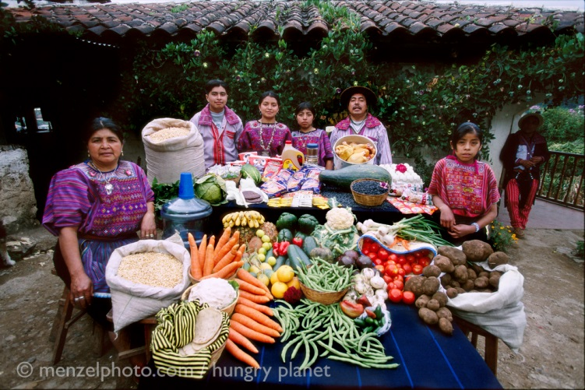
Individual and Cultural Preferences
Notes:
California is home to many cultures full of a variety of food traditions. Celebrate the rich culinary customs of the children and families in your program. Respect individual preferences and be sensitive to cultural and family traditions. Photo used with permission from Peter Menzel for use in this presentation.

Slide 40

Individual and Cultural Preferences
Notes:
California is home to many cultures full of a variety of food traditions. Celebrate the rich culinary customs of the children and families in your program. Respect individual preferences and be sensitive to cultural and family traditions. Photo used with permission from Peter Menzel for use in this presentation.

Slide 41
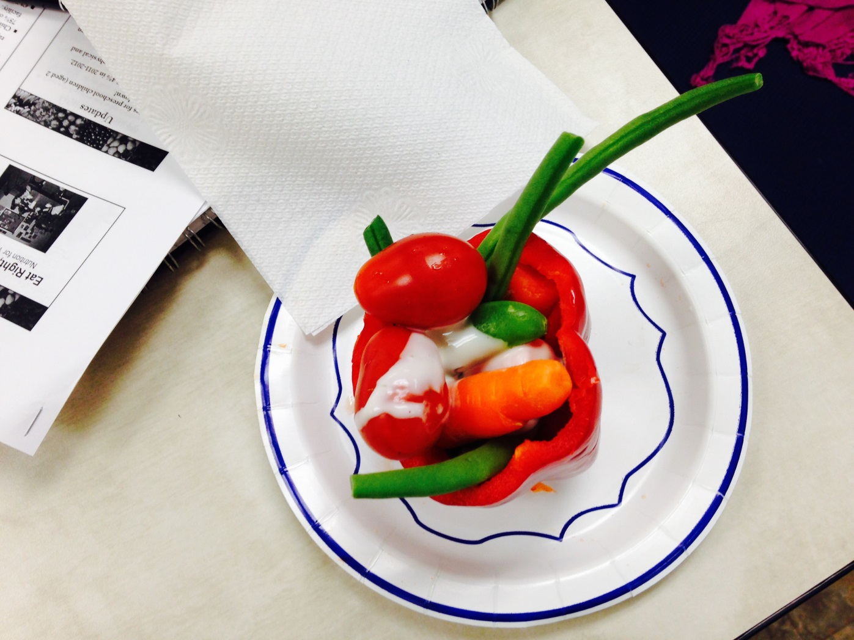
Child Engagement
Notes:
Keep it fun! There are lots of good ways to include messages about healthy eating in your lessons with children. Take the opportunity to help children understand that healthy food helps them grow strong and healthy!

Slide 42
Policies for Feeding Children in Child Care
Written Policies
Staff training
Family Engagement
Children with Special Dietary Needs, for example, food allergies
Notes:
Written policies help child care providers and families understand what will be served and how it will be served in a child care program. Writing policies is the first step for child care providers to provide healthier meals and snacks to the children in their care. Share written policies with staff and families to send a message that nutrition is a priority in your child care program. Clear policies prevent misunderstanding about what food and drinks will be served or brought into a child care program for meals, snacks and celebrations. Make sure that new staff receive training on your nutrition policies, and that parents receive information about your nutrition policies upon enrollment. Consistent practices for feeding children at child care and at home support children to grow strong and healthy with good habits for eating and drinking.
Make sure you have policies for how you will keep children with food allergies and special dietary needs safe in your child care setting. Work closely with parents and the child’s health care provider for all children with special dietary needs. Develop a written special nutrition plan with clear instructions about which foods cause a child to have an allergic reaction and what actions to take in case a child has an allergic reaction.

Slide 43
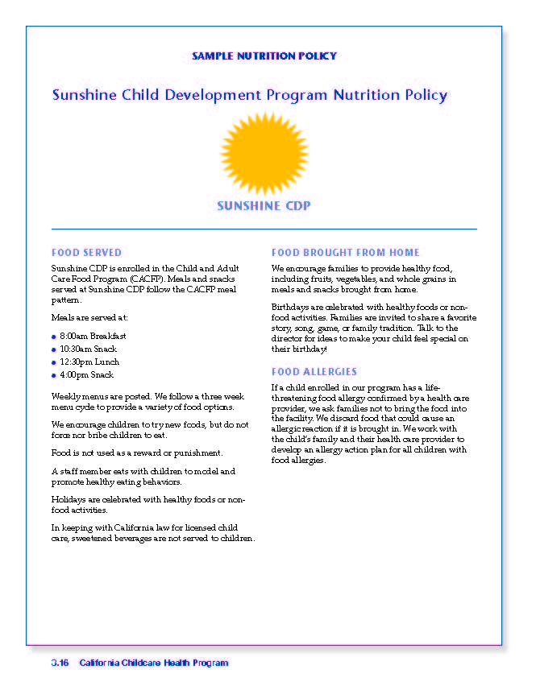
Sample Policy
Notes:
Consider a group activity asking participants to develop a nutrition policy for their child care program.
This policy is on page 3.16 of the Trainer Guide, page 3.14 of the Student Handbook, and in the student handouts

Slide 44
What is the USDA's Child and Adult Care Food Program (CACFP)?
Meal Patterns for infants and for children of different ages:
https://www.fns.usda.gov/cacfp/meals-and-snacks
Best Practices for Nutrition: https://www.fns.usda.gov/tn/child-care-organization
Sample Menus for Child Care: https://theicn.org/cacfp/
Notes:
CACFP is a federally funded food program administered through the California Department of Social Services, Nutrition Services Division.
CACFP provides money and informational resources to help child care providers provide high quality meals for children in child care. CACFP can provide ideas for recipes, menu planning, food preparation, and nutrition education.
New meal patterns went into effect on October 1, 2017.
If you are not currently participating; consider enrolling!
https://www.fns.usda.gov/cacfp/child-day-care-centers

Slide 45
What is the USDA's Child and Adult Care Food Program (CACFP)?
Contact your local CACFP sponsor for information about eligibility, enrollment, reimbursement rates, contact information for local sponsors can at:
https://www.cdss.ca.gov/child-care-and-nutrition/data-statistics/student-health-support/food-programs/cacfp-day-care-home-sponsors-food-programs
Your local CACFP Sponsor:
______________________________________
Notes:
Visit
https://www.cdss.ca.gov/child-care-and-nutrition/data-statistics/student-health-support/food-programs/cacfp-day-care-home-sponsors-food-programs
to find out more about eligibility and how to sign up for CACFP
Provide the referral telephone number and link to contact information for local CACFP sponsors.

Slide 46
Resources
Visit the California Emergency Medical Services Authority (EMSA) Child Care Nutrition Training webpage for samples, resources, and additional information about children's nutrition. www.emsa.ca.gov/childcare-nutrition
Find Ellyn Satter's Division of Responsibility in Feeding at: https://www.ellynsatterinstitute.org/how-to-feed/the-division-of-responsibility-in-feeding/
Find NAP SACC Sample Nutrition Polices at: https://healthyapple.arewehealthy.com/documents/Nutrtion_PA_PolicyExamples.pdf
Find Dietary Guidelines for Americans 2020-2025 at: https://www.dietaryguidelines.gov/resources/2020-2025-dietary-guidelines-online-materials
Supporting Breastfeeding Families: A Toolkit for Child Care Providers
  https://www.cdc.gov/obesity/strategies/early-care-education/pdf/breastfeed-ece-082022-508.pdf
Notes:
Information in this 1 hour class is consistent with the Dietary Guidelines for Americans. There are lots of resources available for the child care community that can be found on the EMSA website.

