Slide 1

Preventive Health and Safety in the Child Care Setting
A Curriculum for the Training of Child Care Providers
SIXTH EDITION
MODULE 1: Prevention of Infectious Disease
Funded through the California Department of Social Services
Notes:
Welcome! This course was EMSA approved in [date, 2024]. The curriculum is based on best practice evidence and expert opinion in Caring for Our Children National Health and Safety Standards for Early Care and Education (CFOC), Managing Infectious Diseases in Child Care and Schools, the Centers for Disease Control and Prevention (CDC), California Department of Public Health (CDPH), United States Department of Agriculture (USDA), and the Environmental Protection Agency (EPA). Content in the training is in agreement with California Title 22 child care licensing regulations but may exceed licensing requirements.

Slide 2
In Module I, You Will learn:
How illnesses spread in child care settings.
How to reduce the spread of illness for children and staff.
How to write health policies for your child care program and how to help parents understand your policies.
How to access local health and safety resources.
Notes:
Presenter notes:
Module I should take about four hours. Time for interactive and hands on activities is included. Interactive activities promote student learning and retention.

Slide 3
Understanding Infectious Illness in
Child Care Settings
Module 1, Section 1

Slide 4
What is an infectious illness?
Specific germs such as viruses, bacteria, fungi, and parasites cause infectious illness in people.
Infectious illnesses can spread from one person to another before their signs and symptoms appear.
People may pass the germs without having symptoms of illness or continue to spread germs once symptoms have gone.
Notes:
Notes to presenter: “disease” or “illness” “sickness” can be interchanged. The term “contagious” can be used for spread or pass.

Slide 5

What infectious illnesses would you expect to see in your child care program?
Notes:
Ask participants to think of illnesses they would expect to see in their child care program. Write the names of the illnesses on the white board/flip chart/chalk board.

Slide 6
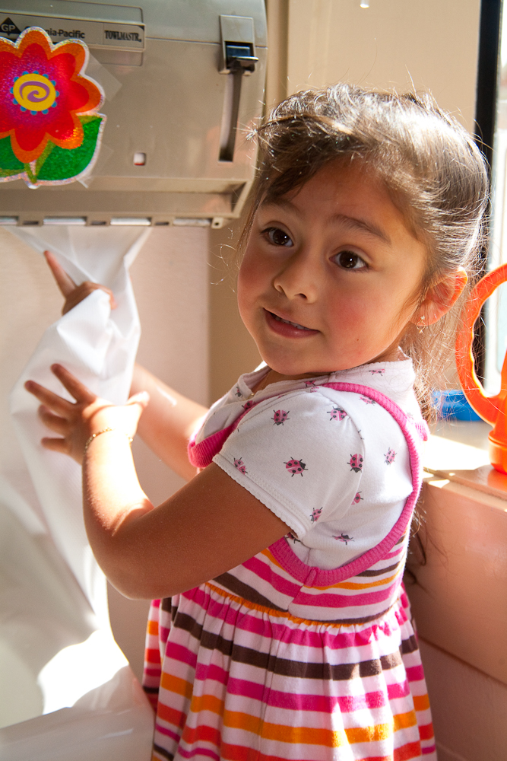
Infectious Illness and Child Care
Infectious illnesses spread easily among young children.
Children in child care settings are at higher risk of getting an infectious disease.
You can reduce the risk of spreading illness with healthy environments and healthy practices.
Notes:
Notes: Prevention of infectious disease help families and child care providers improve their quality of life and save time, health care costs, and lost work

Slide 7
Why Do Children in Child Care Settings Have More Illnesses?
They have not yet been exposed to many of the most common germs and have no “immunity”.
They have habits that promote the spread of germs.
They have not yet learned practices to reduce the spread of illness.
They have close contact with other children and adults.
Notes:
Children develop immunity by being exposed to germs and illnesses and through vaccination (immunization).
Explain that normal childhood behaviors such as playing on the floor; self-soothing by putting fingers in their mouths; exploring the world by putting toys and other objects in their mouths; and having close contact with other children and adults promotes the spread of disease. Children are just learning the habits the reduce the spread of diseases like handwashing and coughing in your sleeve.

Slide 8


How Do Illnesses Spread?
There must be a source of germs.
There must be a way for germs to move from one person to another.
A host or vulnerable person who is not immune to the germ must come in contact with the germs.
Notes:
“Route of transmission” means the way germs move from one person to another.

Slide 9
Routes of Transmission:
Major Ways for Illnesses to Spread
Direct Contact
Air
Fecal-Oral
Blood and Body Fluids

Slide 10
Routes of Transmission:
Major Ways for Illnesses to Spread
Through direct contact with other people or objects
Through the air (passing from the lungs, throat or nose of one person to another person through the air)
Through stool or “fecal-oral” transmission (transfer of a germ from an infected person’s stool into another person’s mouth)
Through contact with blood and body fluids

Slide 11
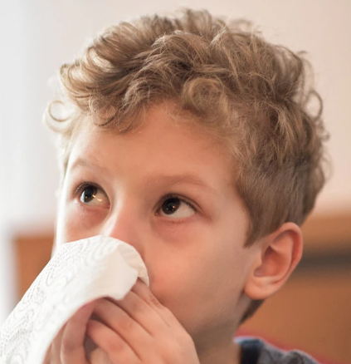
Illnesses Can Spread through Direct Contact by
Sneezing and coughing onto people and objects
Wiping noses and drooling onto people and surfaces
Wiping noses with a tissue without washing hands
Kissing (especially on the mouth)
Sharing mouthed toys, bedding, towels and clothing
Notes:
Do these things happen in child care settings?? Why? Young children are constantly touching and exploring their surroundings and the people around them. Infections can spread easily among children and their caregivers in the child care setting.
Discuss children’s immature habits for cleanliness (they haven't learned to wash their hands, blow their noses etc., their natural curiosity, and young children’s need for touching and affection.)

Slide 12
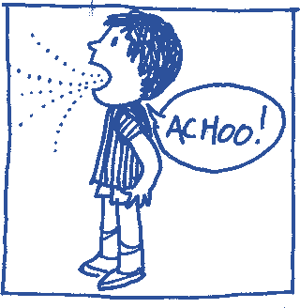
Illnesses Can Spread through the
Air by
GESUNDHEIT!
Breathing, singing, sneezing and coughing into the air
Poor ventilation
Limited opportunities for outdoor play
Notes:
When an infected person talks, sings, coughs, sneezes or blows his/her nose, infectious droplets get into the air where they can be breathed in by another person. Droplets can also land on hands or objects such as toys or food, and can be touched, mouthed or eaten by other persons. Fun Fact: Fun fact: Who knows what gesundheit means?
It is borrowed from German meaning: “To your health” Does anyone know how to say “to your health” in other languages?
Improving your building’s ventilation can reduce the build up of germs that are spread by the air.

Slide 13

Illnesses Can
Spread through Stool by
Unsafe diapering procedures
Unsafe food preparation
Toileting without washing hands
Serving food without washing hands
Mouthing toys and other surfaces
Notes:
In most situations this happens when hands or objects have become contaminated with a very small amount of stool (usually too small to be seen) are placed in the mouth. Or when food or water is contaminated with a very small amount of human or animal stool and then is eaten or drunk.

Slide 14
Examples of How Diseases Can Spread through Contact with Blood and Other Body Fluids
Providing first aid without gloves
Attending to a bloody nose without gloves
  Getting infected blood or body fluids into broken skin, eyes, or mouth
  Changing a diaper with blood without gloves
  A serious biting incident (the skin is broken, blood flows and is exchanged)
  Touching open wounds and rashes
Notes:
Viruses can be spread when blood or body fluids containing the virus enters the blood stream of another person or enter through skin that has open sores. A person can carry blood borne pathogens without signs of illness. (Sexual transmission can also occur, but this does not apply to the child care setting.)

Slide 15
Examples of Illnesses and How they Spread
Hepatitis B and C, and HIV/AIDS are serious viral infections spread by contact with infected blood.
Cytomegalovirus (CMV) is an example of a disease that spreads by contact with urine or saliva.
MRSA is spread by direct contact with the bacteria.
Salmonella is spread by the fecal-oral route or by contaminated food/water.
COVID-19 spreads mainly through the air.
Notes:
See page 1.9 in the curriculum booklet for more examples.

Slide 16
Knowledge Check-in
Name four “routes of transmission” for infectious illnesses to spread:
?
?
?
?

Slide 17
Knowledge Check-in
Direct contact with germs on people and surfaces
Breathing in germs in the air
Transfer of germs from an infected person’s stool into another person’s mouth (fecal-oral)
Contact with germs in blood and body fluids

Slide 18
Knowledge Check-in
You should wait until you know a child is ill before worrying about spreading illness.
True
False

Slide 19
Knowledge Check-in
You should wait until you know a child is ill before worrying about spreading illness.
True
False

Slide 20
Knowledge Check-in
Why are young children in child care settings more vulnerable to infectious diseases?
1.
2.
3.
Notes:
Write answers on white board as participants list them.
Example answers:
They have not yet been exposed to many of the most common germs and have no “immunity”.
They have habits that promote the spread of germs.
They have not yet learned practices to reduce the spread of illness.
They have close contact with other children and adults.

Slide 21

Sneezing 101 Video
Notes:
Sneezing 101 video from Virginia Department of Health
https://www.youtube.com/watch?v=SWSodEXC2bk

Slide 22
Preventing the Spread of Infectious Illnesses
Module 1, Section 2

Slide 23
Topics
The Daily Health Check
Standard Precautions
Hand Washing
When to Wash Hands
Use of Disposable Gloves
Cleaning, Sanitizing, and Disinfecting
Green Cleaning
Disposal of Garbage
Diapering and Toileting
Food Safety
Oral Hygiene
Air Quality
Water Supply
Pets, Pests, and Integrated Pest Management (IPM)
Keeping Sand Boxes and Sand Play Areas Safe
Notes:
These are the topics we will discuss next.

Slide 24
Daily Health Check
Helps you better understand each child
Helps children feel more comfortable
Fosters communication with parents
Reduces the spread of disease by excluding children with obvious signs of illness

Slide 25
Notes:
Use All Your Senses to Check for Signs of Illness
Look at the child from her level. Observe for signs of crankiness, pain, discomfort or being tired. Does the child look pale, have a rash or sores, a runny nose or eyes?
Listen to what the child and parents tell you about how the child is feeling. Is the child’s voice hoarse, is he having trouble breathing, or is he coughing?
Feel the child for warmth, clamminess or bumps as a casual way of greeting.
Smell the child for unusual odor in their breath, diaper or stool.
Daily Health Check poster is on page 1.11 of trainer handbook, page 1.9 of student handbook, or in the handout packet

Slide 26
What am I checking for?
General mood/behavior (sad, cranky, sluggish, sleepy, unusual behavior)
Signs of fever (warmth, flushed face, change in behavior)
Skin rashes, itchy skin, or itchy scalp, unusual spots, swelling or bruises
Complaints of pain or just not feeling well
Other signs and symptoms of illness
  severe coughing or breathing difficulties (wheezing)
  discharge from nose, ears or eyes
  diarrhea or vomiting
Ask about illness in child or family members since last date of attendance
Notes:
Role-play: Have participants get in pairs to role-play a daily health check. Practice making a decision on whether to include or exclude a child from care that day. Have one participant role-play a parent who is eager to leave his or her child and get to work. The other participant should role-play the child care provider. Only a few illnesses require sick children to stay home to ensure protection of other children and staff. We will talk more about when to keep a child out due to illness when we discuss policies in the next section.

Slide 27

Mildly Ill Children
When mildly ill children are in your program:
Maintain an area (or special room) where they can spend quiet time and rest while being supervised.
Do not leave children unsupervised.
Notes:
It’s usually okay for a mildly ill child (for example, a child with a cold) to be in a child care program. They may need a little extra rest, but as long as they are able to participate in activities and don’t take more care than you can provide while caring for other children, it’s okay.

Slide 28
Standard Precautions:
If you have contact with blood and body fluids, (whether or not a child is ill) always use:
Proper hand washing
Proper use of non-permeable gloves
Proper disposal of garbage
Proper cleaning, sanitizing, and disinfection of surfaces in the environment
Notes:
Following Standard Precautions means treating blood and body fluids as if everyone is potentially infected.
Refer to Health and Safety Note on Standard Precautions.

Slide 29
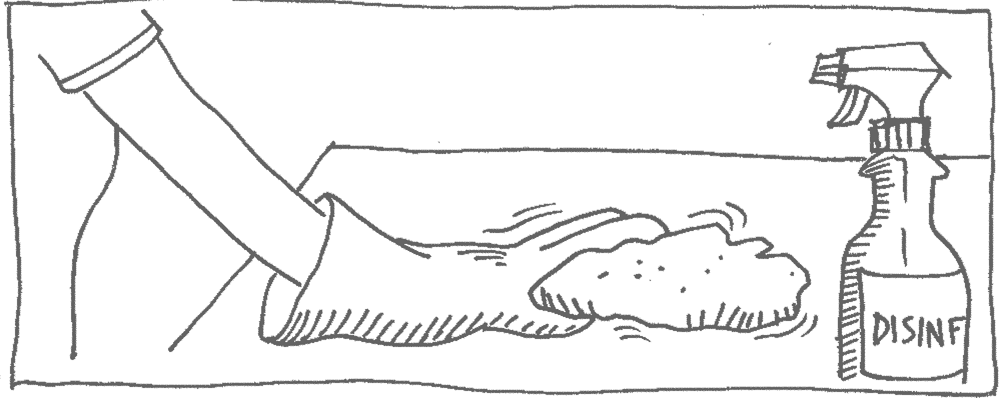

Clean up and disinfect any surfaces soiled with blood, feces, nasal or eye discharge, saliva, urine, or vomit immediately.

Slide 30
Hand Washing
Hand washing is the most important infection control measure to prevent illness.
When caregivers, children, and families wash their hands at the proper times and with the proper technique, the amount of illness in child care can be drastically reduced.

Slide 31
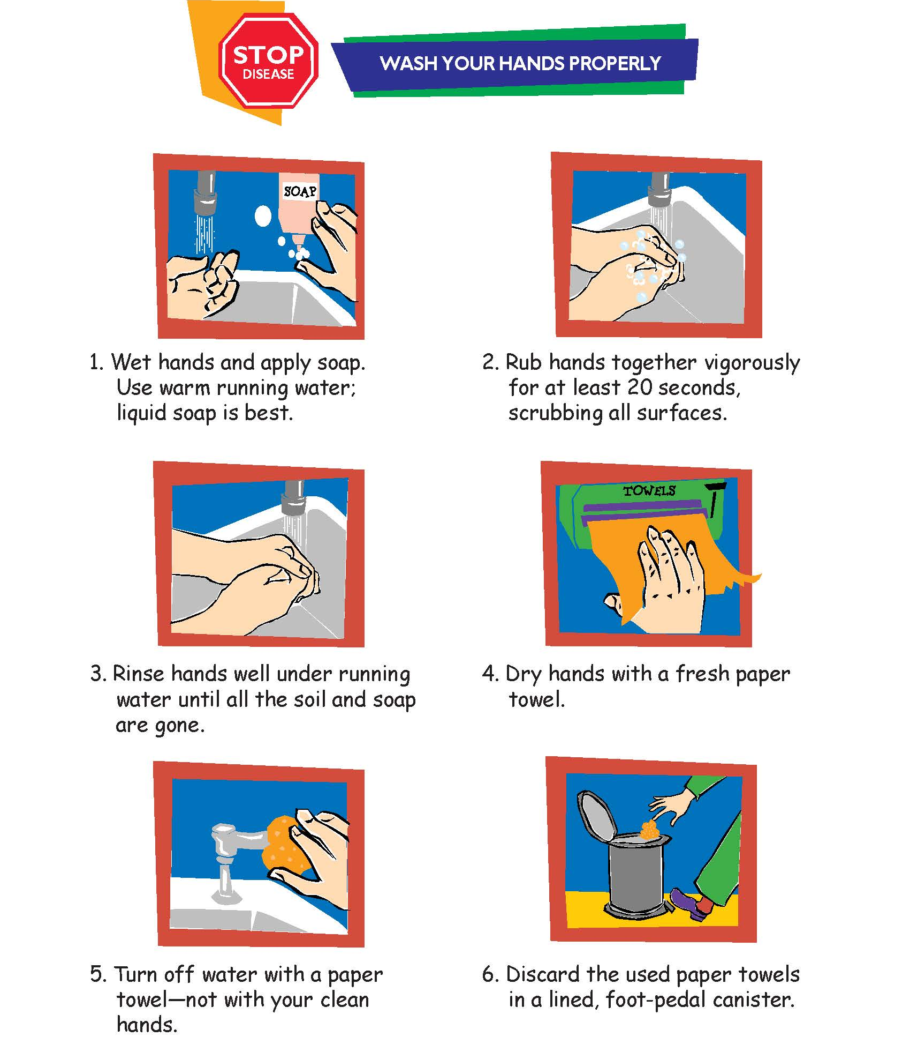
Hand Washing Demonstration
Notes:
Refer to Handout. Poster is on page 1.19 of trainer handbook, page 1.15 of student handbook, and in student handouts.
For the demonstration, us a small bucket or bowl, a pitcher of water, liquid soap, and paper towels. For extra effect you can apply poppy seeds to a film of Vaseline on the hands to act as germs. Demonstrate how and when to use hand sanitizer. (only when soap and running water are not available.) Adults and children over age two may use an alcohol based hand sanitizer for visibly clean hands when there is no access to hand washing facilities (for example, when on a field trip). Keep hand sanitizers out of children’s reach. Carefully supervise children using hand sanitizers and monitor for skin reactions.
Locate your diapering area next to a sink whenever possible.
Teach children to wash their hands for 20 seconds using a handwashing song.

Slide 32
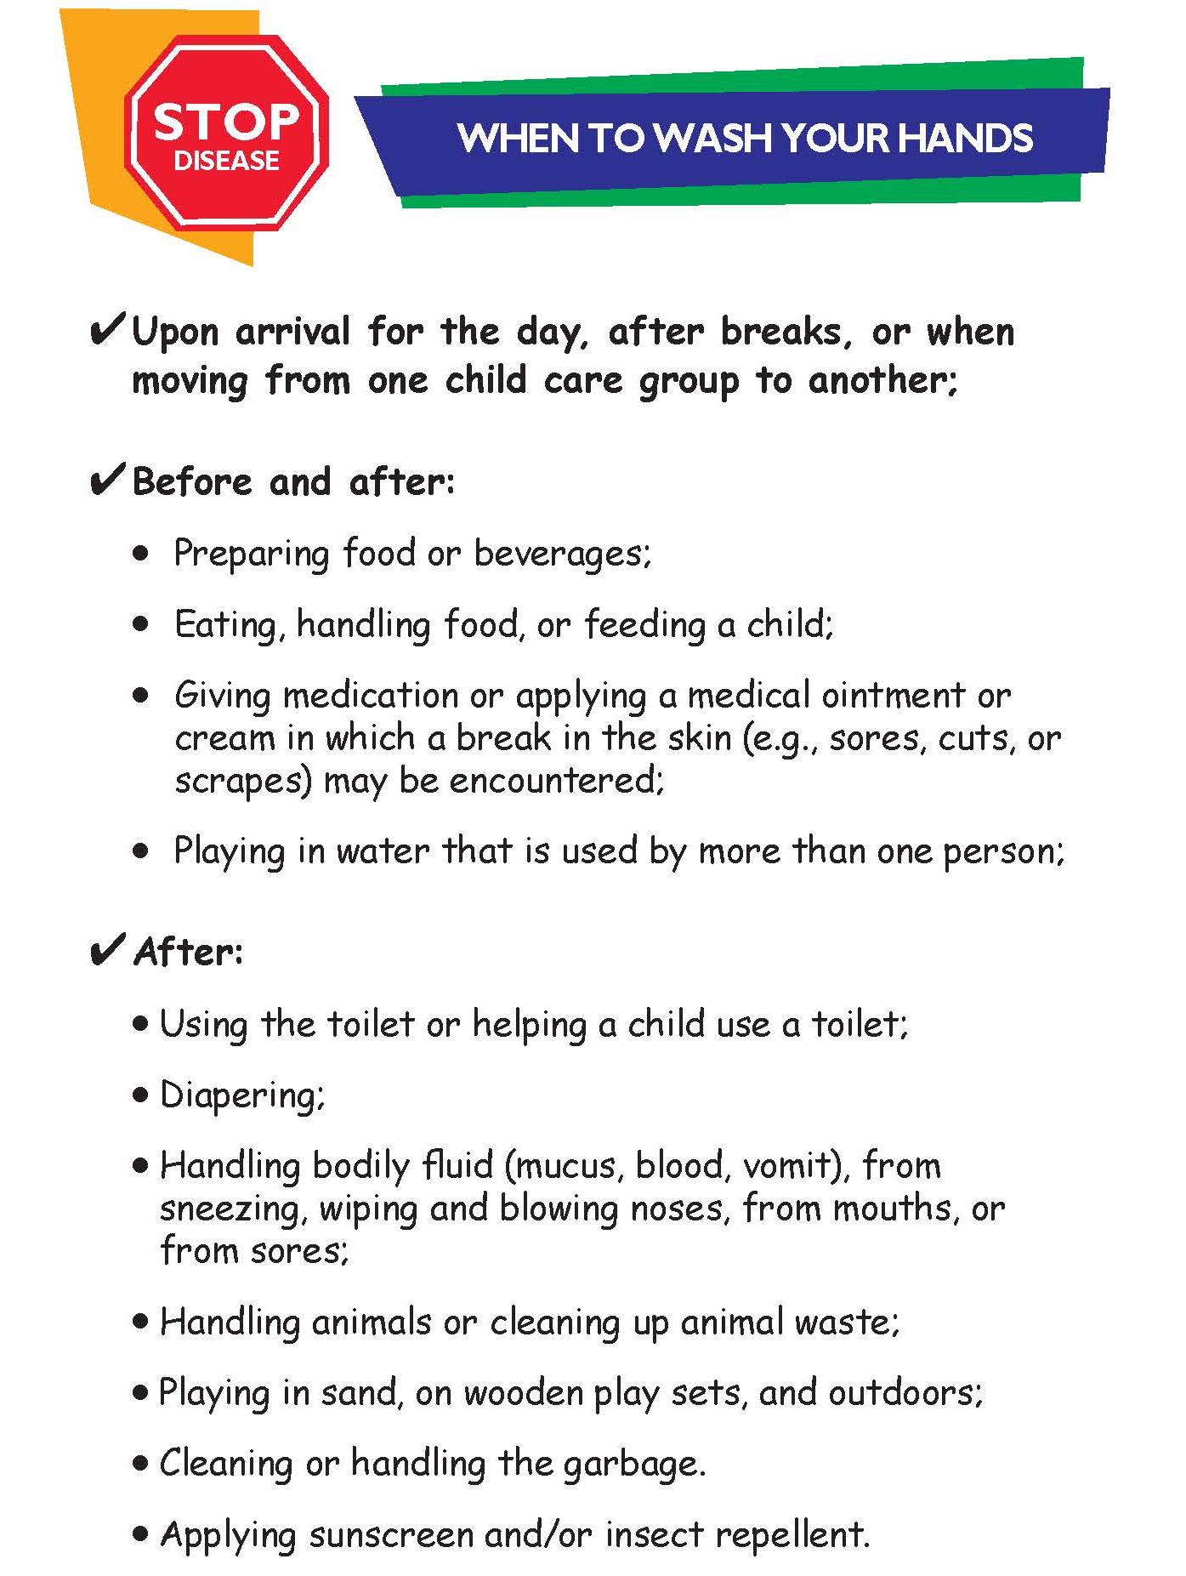
What about Hand Sanitizer?
Hand sanitizer may be used on visibly clean hands when there is no access to soap and running water.
Use hand sanitizer with 60-95% alcohol according to label instructions.
Keep hand sanitizer out of children’s reach.
Please note: using hand sanitizer does not remove allergens or toxins from hands.
Notes:
Poster is on page 1.20 of trainer handbook, page 1.16 of student handbook, and in student handouts

Slide 33
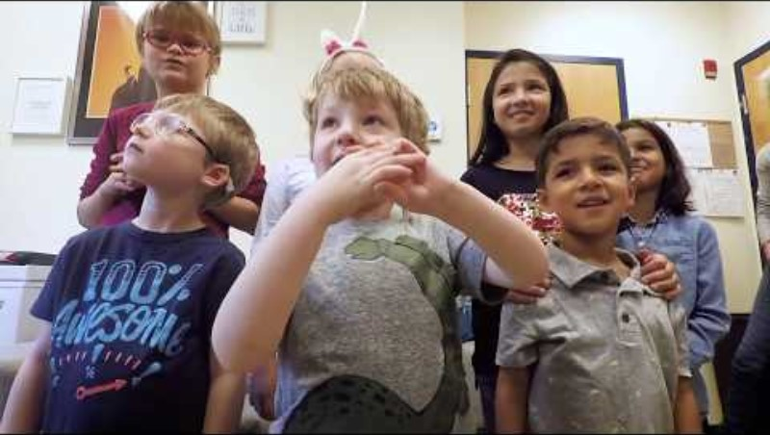
Children’s Handwashing Video
Notes:
Video: Wash Your Hands, Brother John! https://www.youtube.com/watch?v=GAP8HZdV5Qo

Slide 34
When to Use Disposable Gloves
  When in contact with blood or body fluids from a child (first aid, bloody noses, changing a diaper with bloody diarrhea)
  When cleaning surfaces or handling clothes and supplies that have blood or body fluids (vomit, urine, or stool)
  When caring for skin rashes or oozing lesions
  When providing mouth care, eye care, and special medical procedures such as finger prick for a blood glucose test.

Slide 35
What kind of gloves should I use for handling blood and body fluids?
Non-permeable, single-use, disposable gloves provide protection from blood-borne pathogens and infectious body fluids.
Do not use food service or housekeeping gloves when handling blood or infectious body fluids because they might leak or tear.
Avoid latex gloves as they can cause allergy, especially if you use them often. Nitrile gloves can be used with less risk of allergy.
Gloves should never be used as a substitute for hand washing.

Slide 36
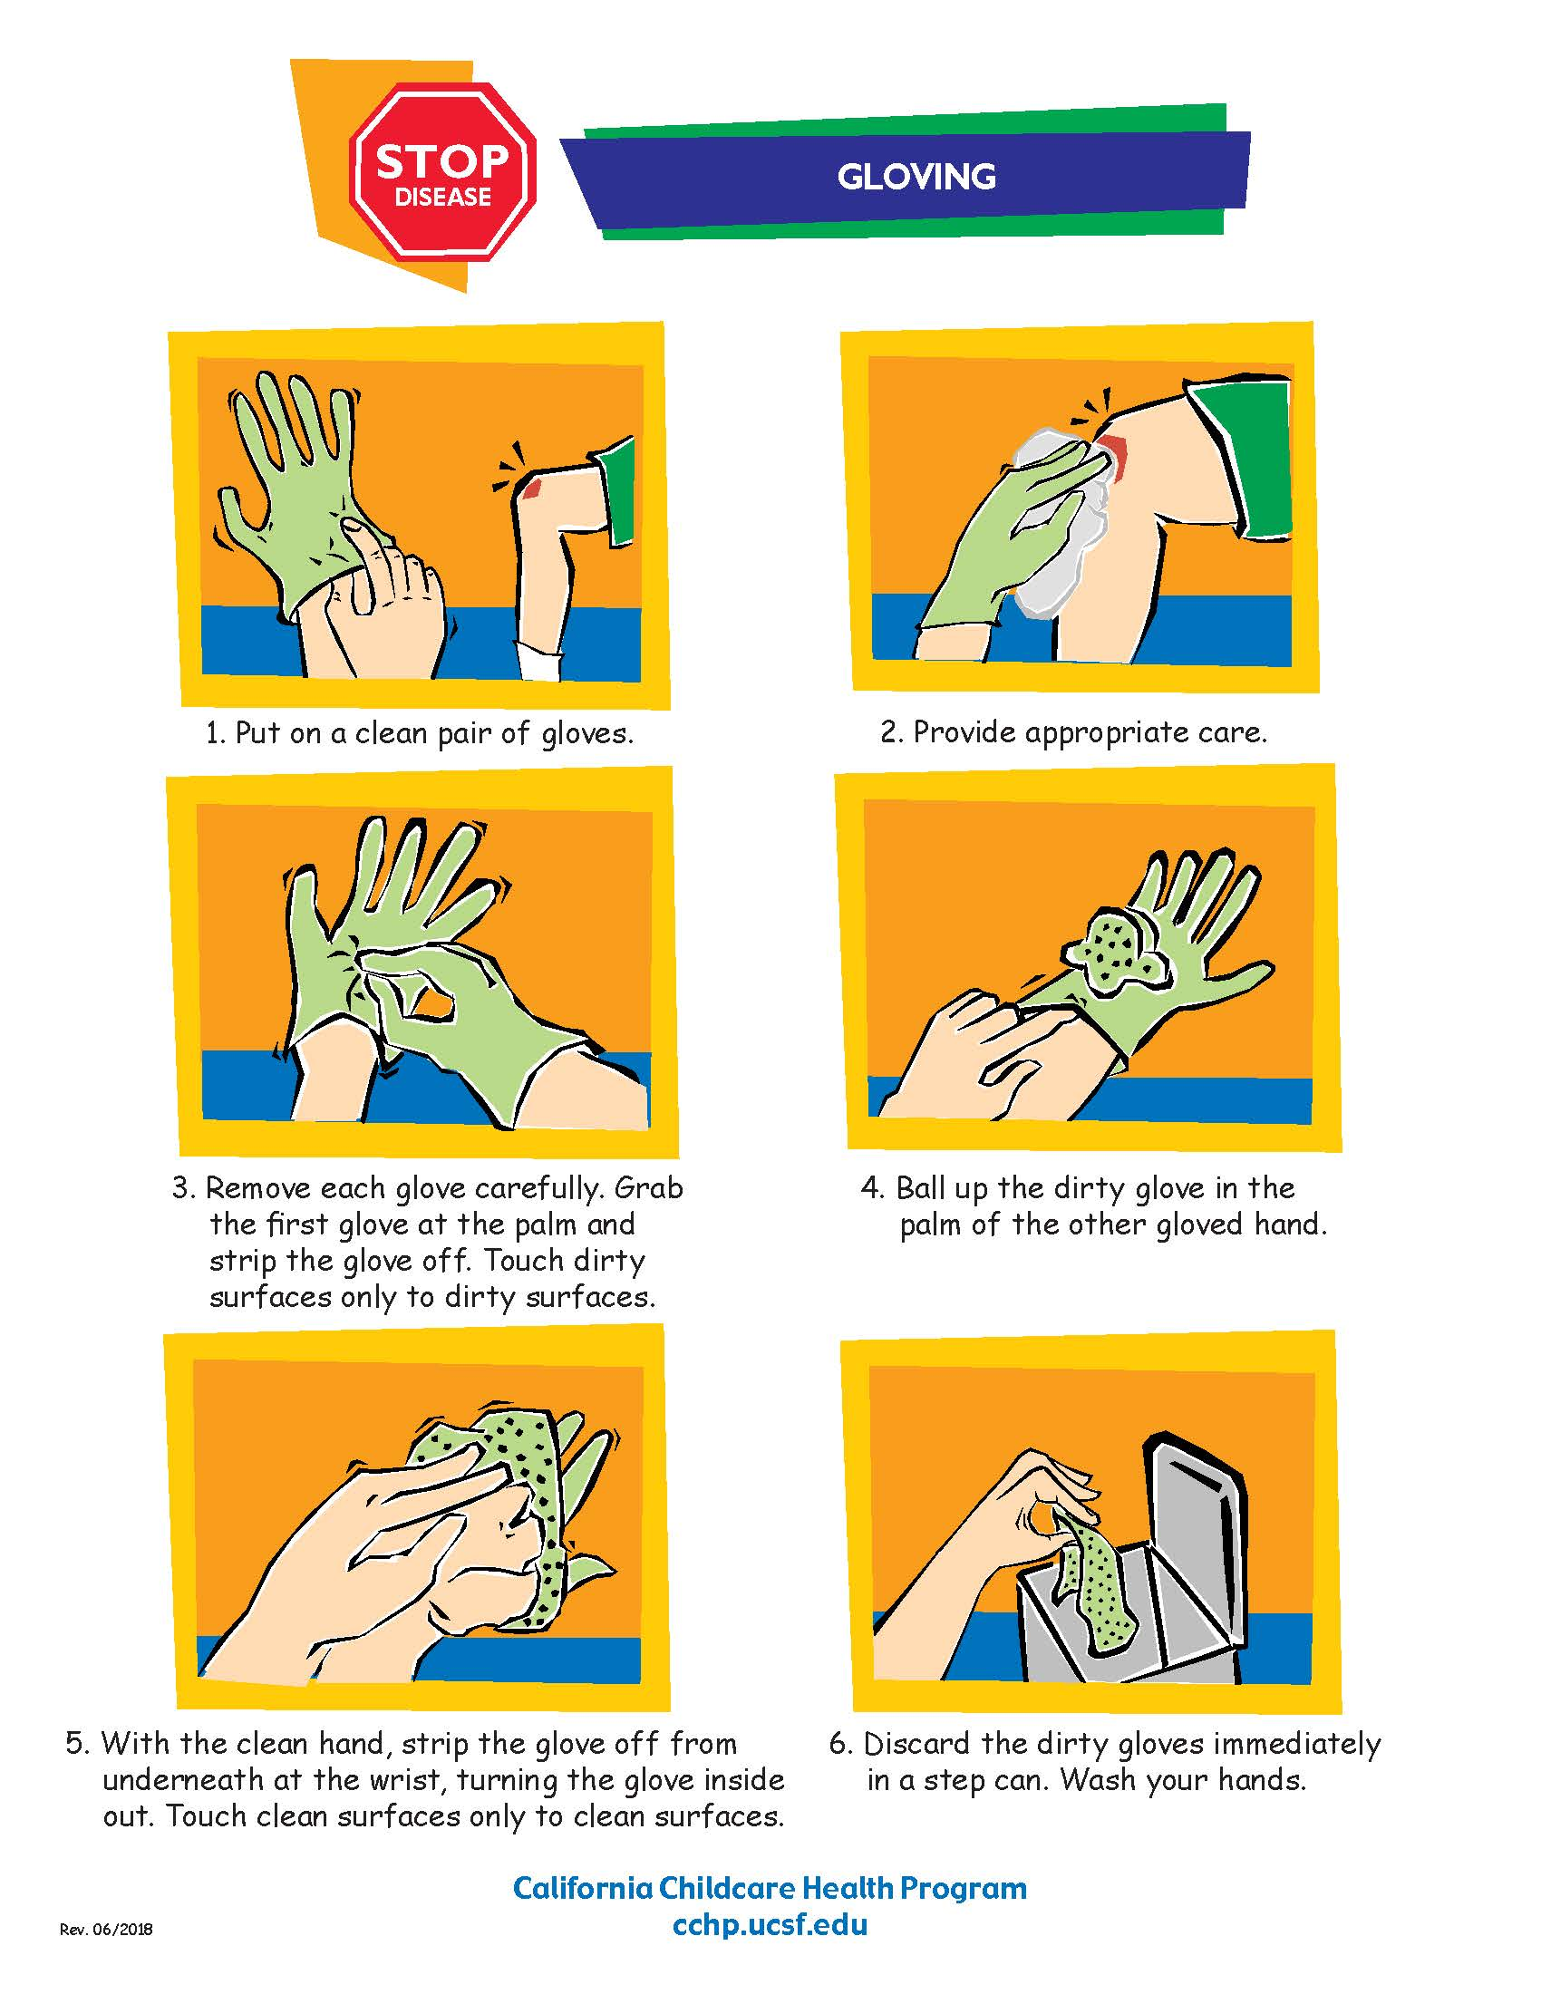
Notes:
Hand out gloves so students can try them, or demonstrate correct use.
Poster is on page 1.22 of Trainer Guide, page 1.18 of Student Handbook, and in student handouts.

Slide 37
Cleaning, Sanitizing, and Disinfecting
Clean: To physically remove dirt, debris, and sticky film by washing, wiping, and rinsing. You can clean with a mild soap, detergent, and water.
Sanitize: To apply a product that reduces germs to safer levels. Sanitizing reduces the risk of becoming ill from contact with the surface.
Disinfect: To apply a product that destroys nearly all germs, including viruses, on a hard, non-porous surface.
Notes:
Sometimes these terms are used interchangeably, but they are not the same. Products used to kill germs are called antimicrobials. Antimicrobials kill bacteria, viruses, and fungi.
Sanitizing and disinfecting products are antimicrobial pesticides.

Slide 38

What surfaces should be cleaned?
Toys
Bedding
Floors
Clothing (including hats)
Cribs, cots, and mats
Play equipment
Refrigerators
All surfaces before sanitizing or disinfecting!
Notes:
Washing with soap and rinsing with water will clean these surfaces.

Slide 39

What should I use to clean?
Use a mild, unscented, non-antibacterial soap or detergent and rinse with water.

Slide 40
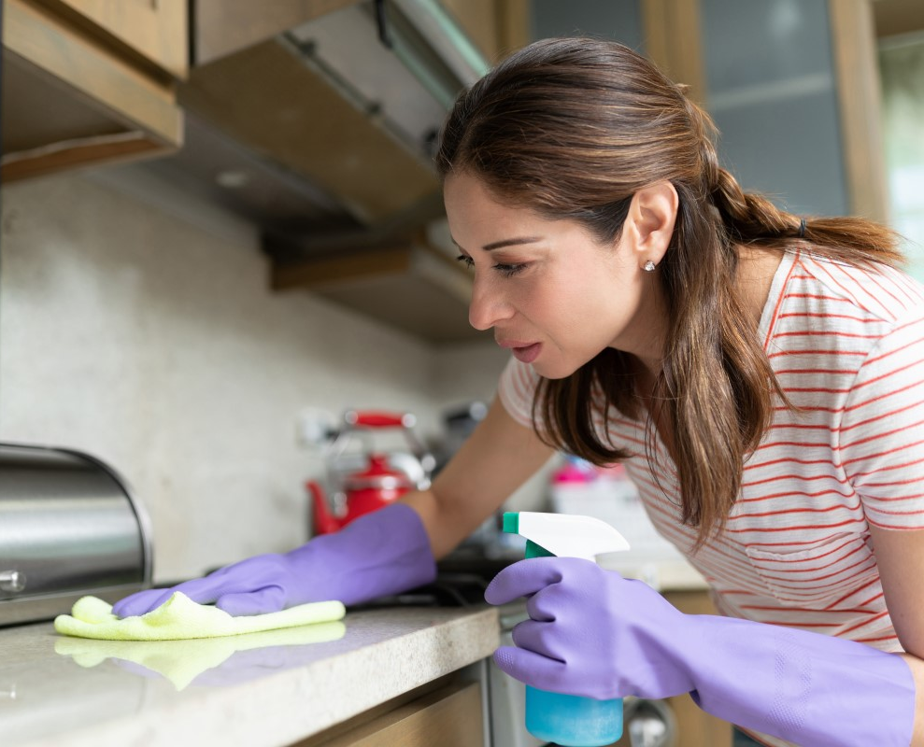
What surfaces should be sanitized?
Food preparation surfaces and appliances
Kitchen counter tops
Eating utensils and dishes
Eating tables and high chair trays
Mixed use tables (before using them for meals and snacks)
Plastic mouthed toys, pacifiers
Notes:
Sanitizing is recommended for food surfaces (dishes, utensils, cutting boards, high chair trays) and other objects intended for the mouth like pacifiers and teething toys.

Slide 41
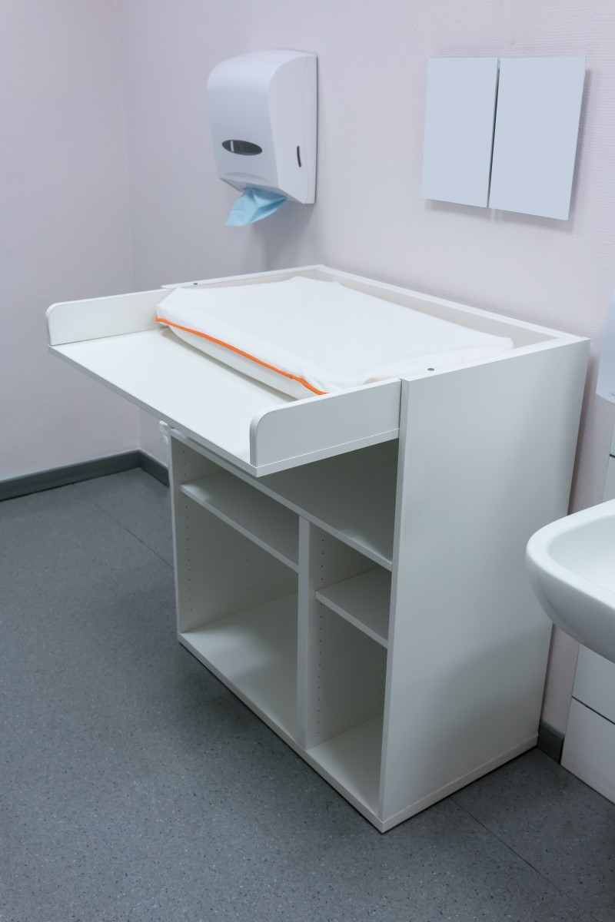
What surfaces should be disinfected?
Toilets and other bathroom surfaces (sinks, faucets, counters, floors)
Diaper changing tables and diapering areas (diaper pails, potty seats)
Surfaces soiled with blood or body fluids (vomit, urine, feces)
Notes:
Disinfecting is recommended for hard non-porous surfaces such as toilets, changing tables, and other bathroom surfaces; blood spills and other potentially infectious body fluids like vomit, urine, and feces.

Slide 42
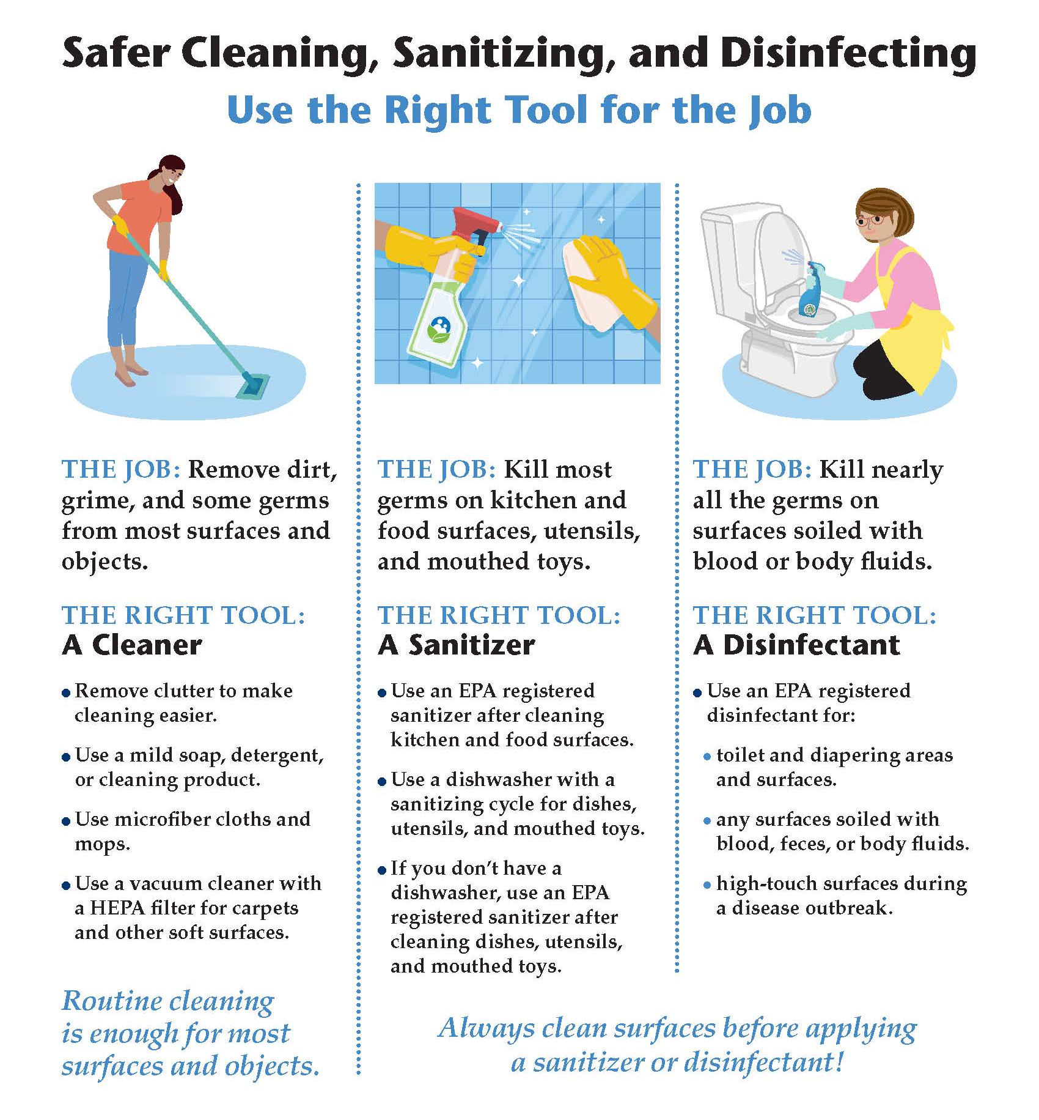
Notes:
Poster on page 1.26 of Trainer Guide, page 1.22 of Student Handbook, and in student handouts
See on poster: Always clean surfaces before applying a sanitizer or a disinfectant!

Slide 43
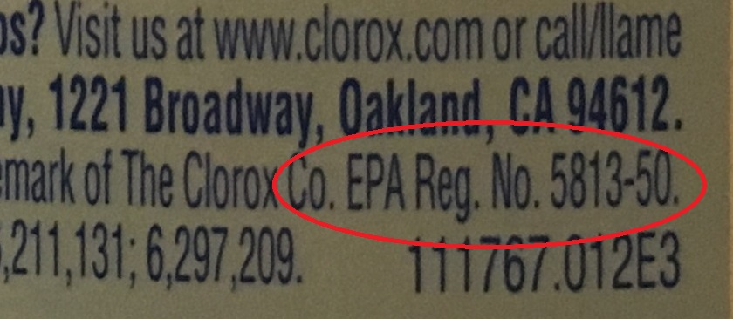
What products should I use for sanitizing and disinfecting?
Environmental Protection Agency (EPA) registered antimicrobial products
Check the product label for an EPA registration number
Notes:
Antimicrobial means the product kills germs. A dishwasher set at 165 degrees F will sanitize (dishes, toys)
A washing machine set to hot can sanitize cloth toys.

Slide 44
The Label is the Law
Always follow the instructions on the label for sanitizing and disinfecting.
Do you need to mix the product with water?
How long must the product be wet on the surface? (dwell time)
Is it okay to use the product on food surfaces?
Do you need to rinse the product off?
Notes:
Poster on page 1.28 of Trainer Guide, page 1.24 of Student Handbook, and in student handouts

Slide 45
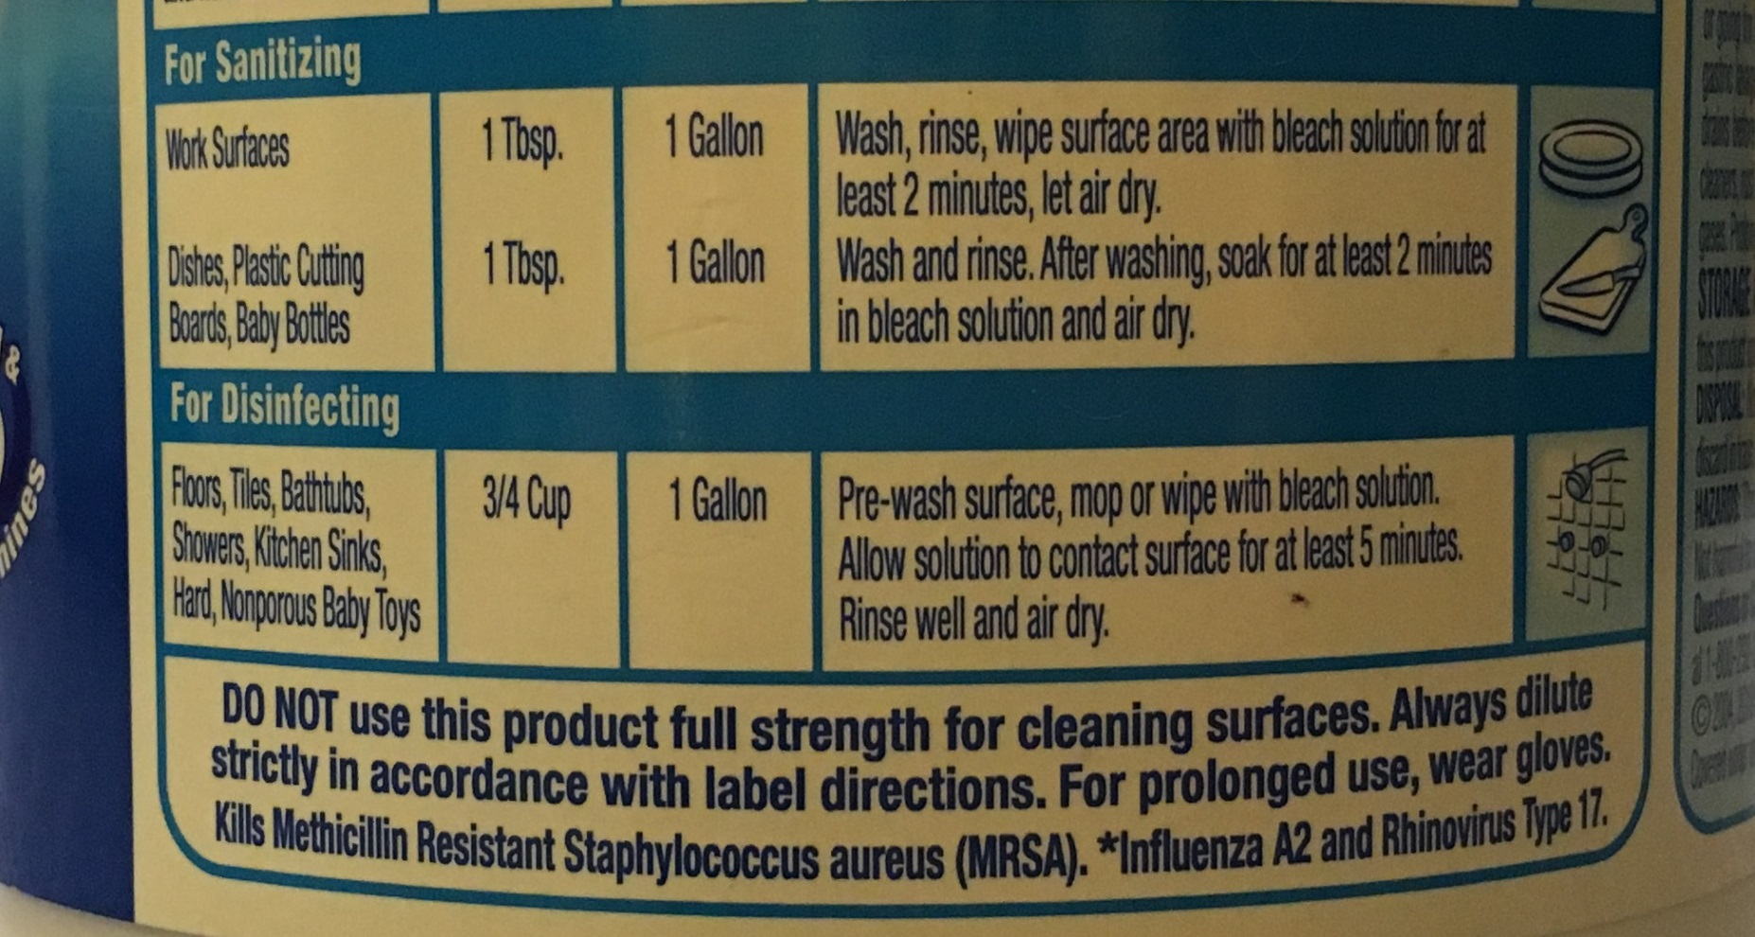

Slide 46
Tips for Safe and Effective
Cleaning
Decrease clutter to make cleaning easier.
Clean regularly to keep dirt, dust, and other particles out of your environment.
Use a vacuum cleaner with a high efficiency particulate air (HEPA) filter.
Use microfiber mops and cloths.
Place floor mats at your building’s entryways.
Notes:
These are basic cleaning practices that are good for children’s environments.

Slide 47
Tips for Safe and Effective
Cleaning (continued)
Do not use sanitizers or disinfectants with children nearby.
Encourage frequent hand washing with gentle soap and running water.
Provide ventilation by opening windows.
Change your heating/cooling system filters regularly.
Choose cleaning products that are less toxic.

Slide 48
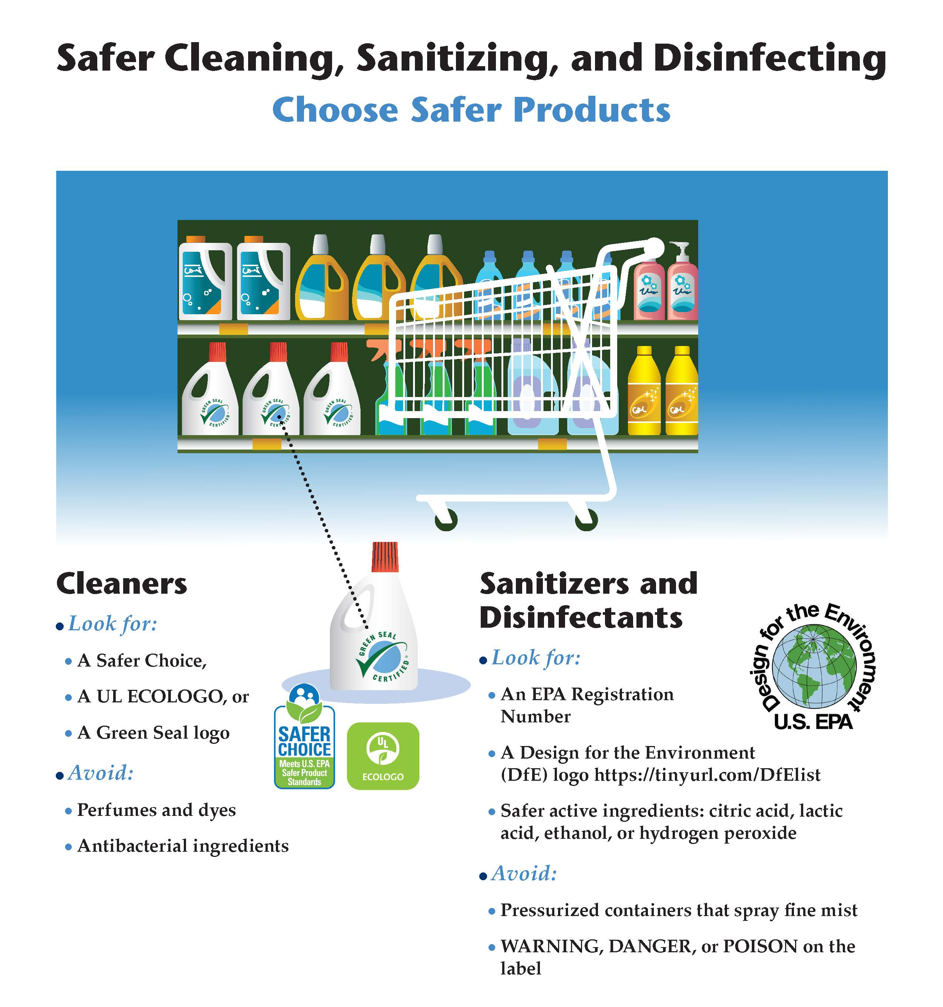
Notes:
Poster is on page 1.27 of Trainer Guide, page 1.23 of Student Handbook, and in student handouts

Slide 49
Using Bleach to
Sanitize and Disinfect
Pros: low cost, effective (if used according to label instructions), and readily available.
Cons: corrosive, harmful fumes (can trigger an asthma attack), has to be freshly mixed each day, can ruin clothing.
Notes:
If you are using bleach to sanitize and disinfect, be sure to follow label instructions.

Slide 50
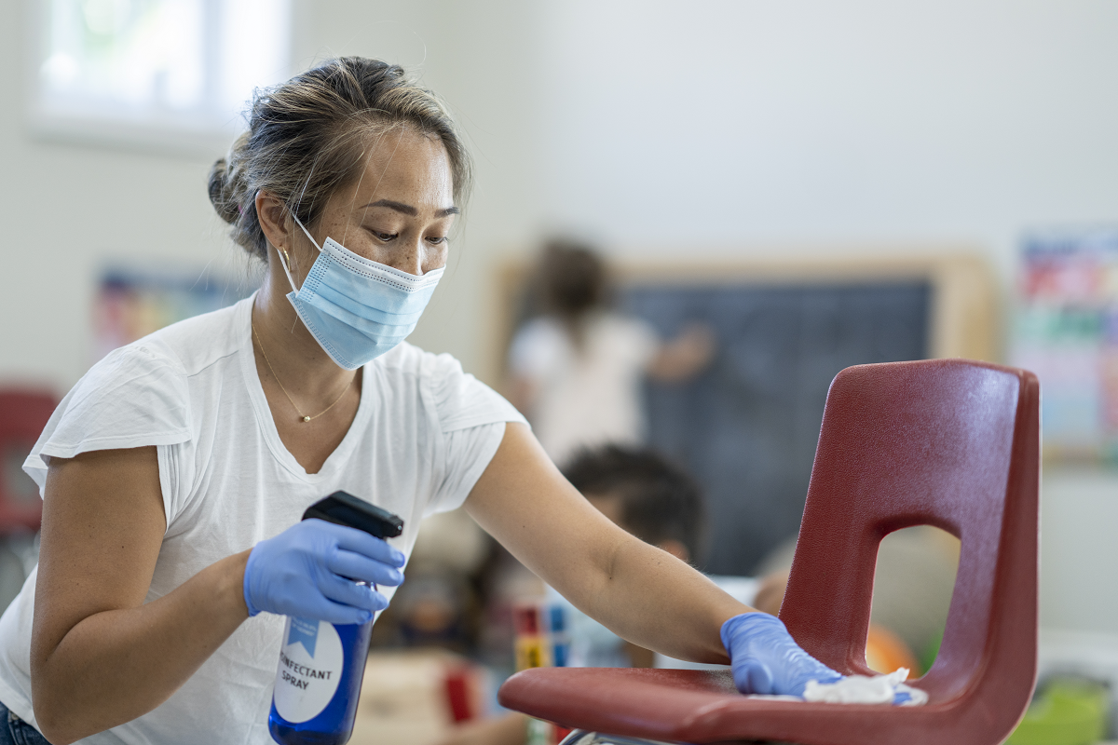
Demonstration
Clean surface: use soap and rinse with water
Apply sanitizer or disinfectant.
Allow to stand for required time (per label instruction)
Provide ventilation
Notes:
For discussion:
Label instructions
Do not use sanitizers or disinfectants with children nearby.

Slide 51
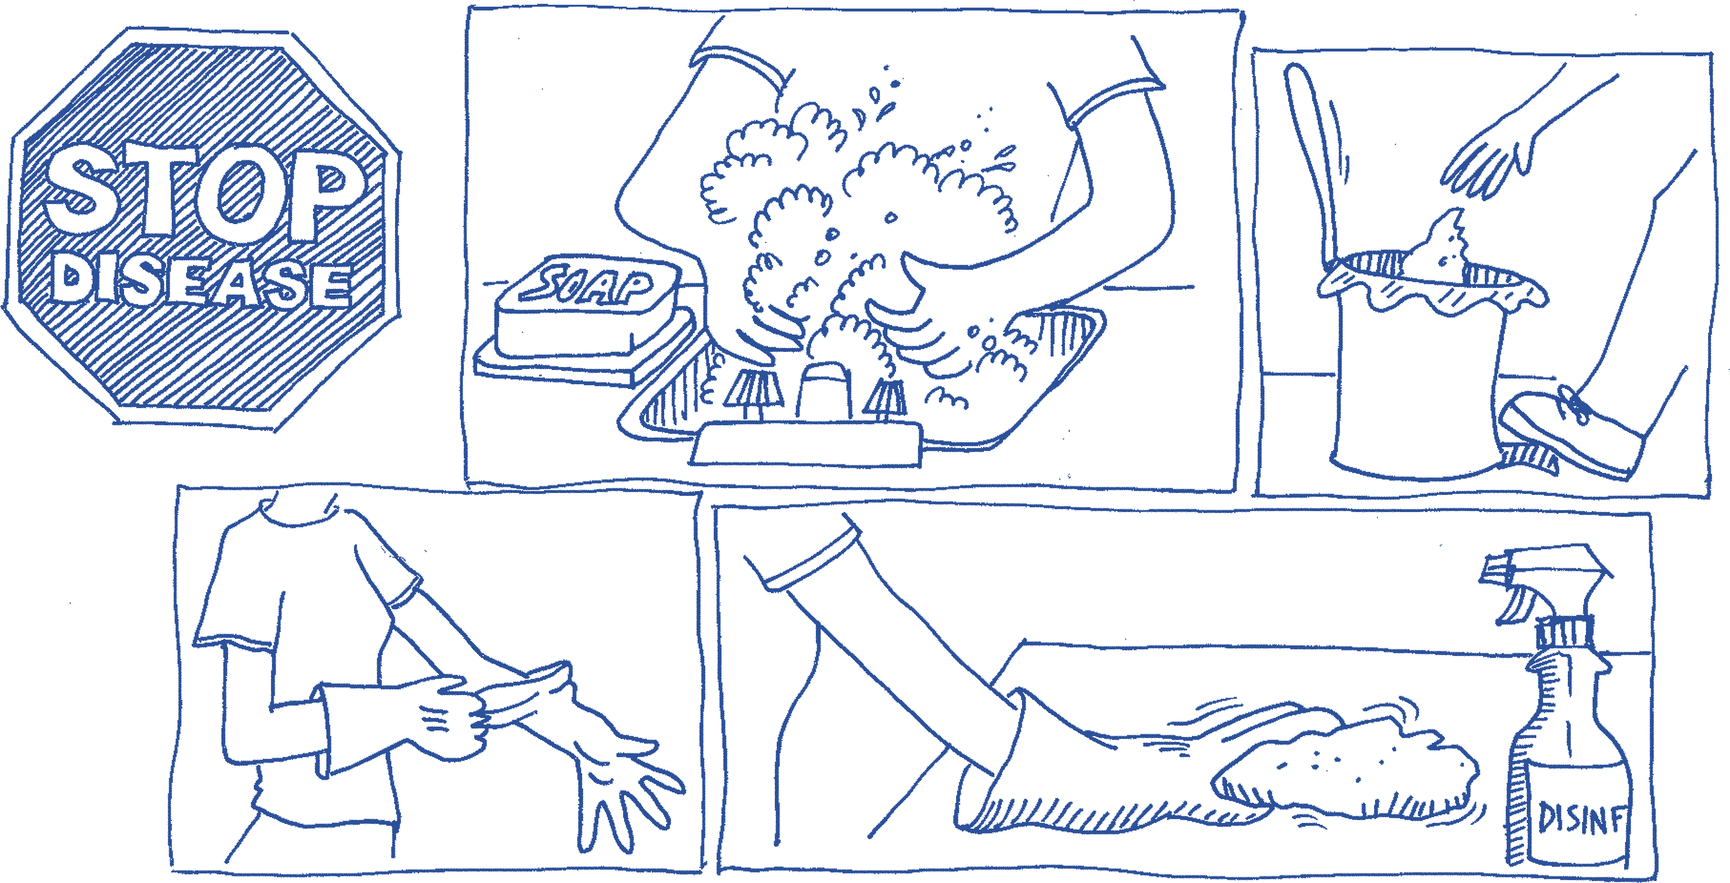
Disposal of Garbage
Use garbage containers with a foot pedal, especially for diaper disposal.
Put the containers within reach of the diaper changing area, hand washing sink, and food preparation area.
Clean and disinfect diaper containers at the end of the day.
Use a plastic bag to line garbage containers.
Make sure infants and toddlers cannot knock over or reach into the containers.
Empty indoor garbage containers daily.
Notes:
Participate in your community recycling program. Foot pedal containers are not needed for classroom recyclables.

Slide 52
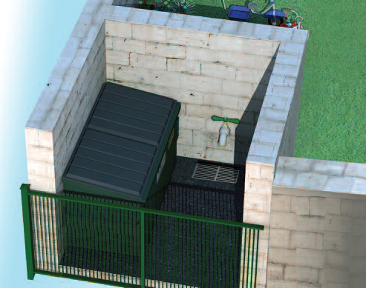
Disposal of Garbage
Dispose of sharps from glucose testing or needle injections in bio-hazard containers.
Use water-proof and rodent-proof containers
with tight fitting lids to collect garbage outdoors.
Proper storage and disposal of garbage:
prevents the spread of disease,
contains unpleasant odors,
prevents pest problems.
Notes:
Throw away soiled disposable diapers, gloves, paper towels, tissues in an appropriate trash or diaper container immediately.

Slide 53
The Diapering Station
Set up a diapering station in an area away from food, near a handwashing sink.
Protect your back with a changing table at a comfortable height.
Use a clean, flat, waterproof surface/pad that is free of cracks and crevices. Cover it with a disposable cover.
Store creams, lotions, and cleaning supplies out of children's reach. Baby powder is not recommended because of risks of inhaling small talc particles.
Use the diapering station for diapering only.
Notes:
Many changing tables will have a strap and a guard rail for extra safety. Always keep on hand on the child, never leave the child unattended. Protect your back by having the table at a comfortable height and using proper lifting techniques.

Slide 54
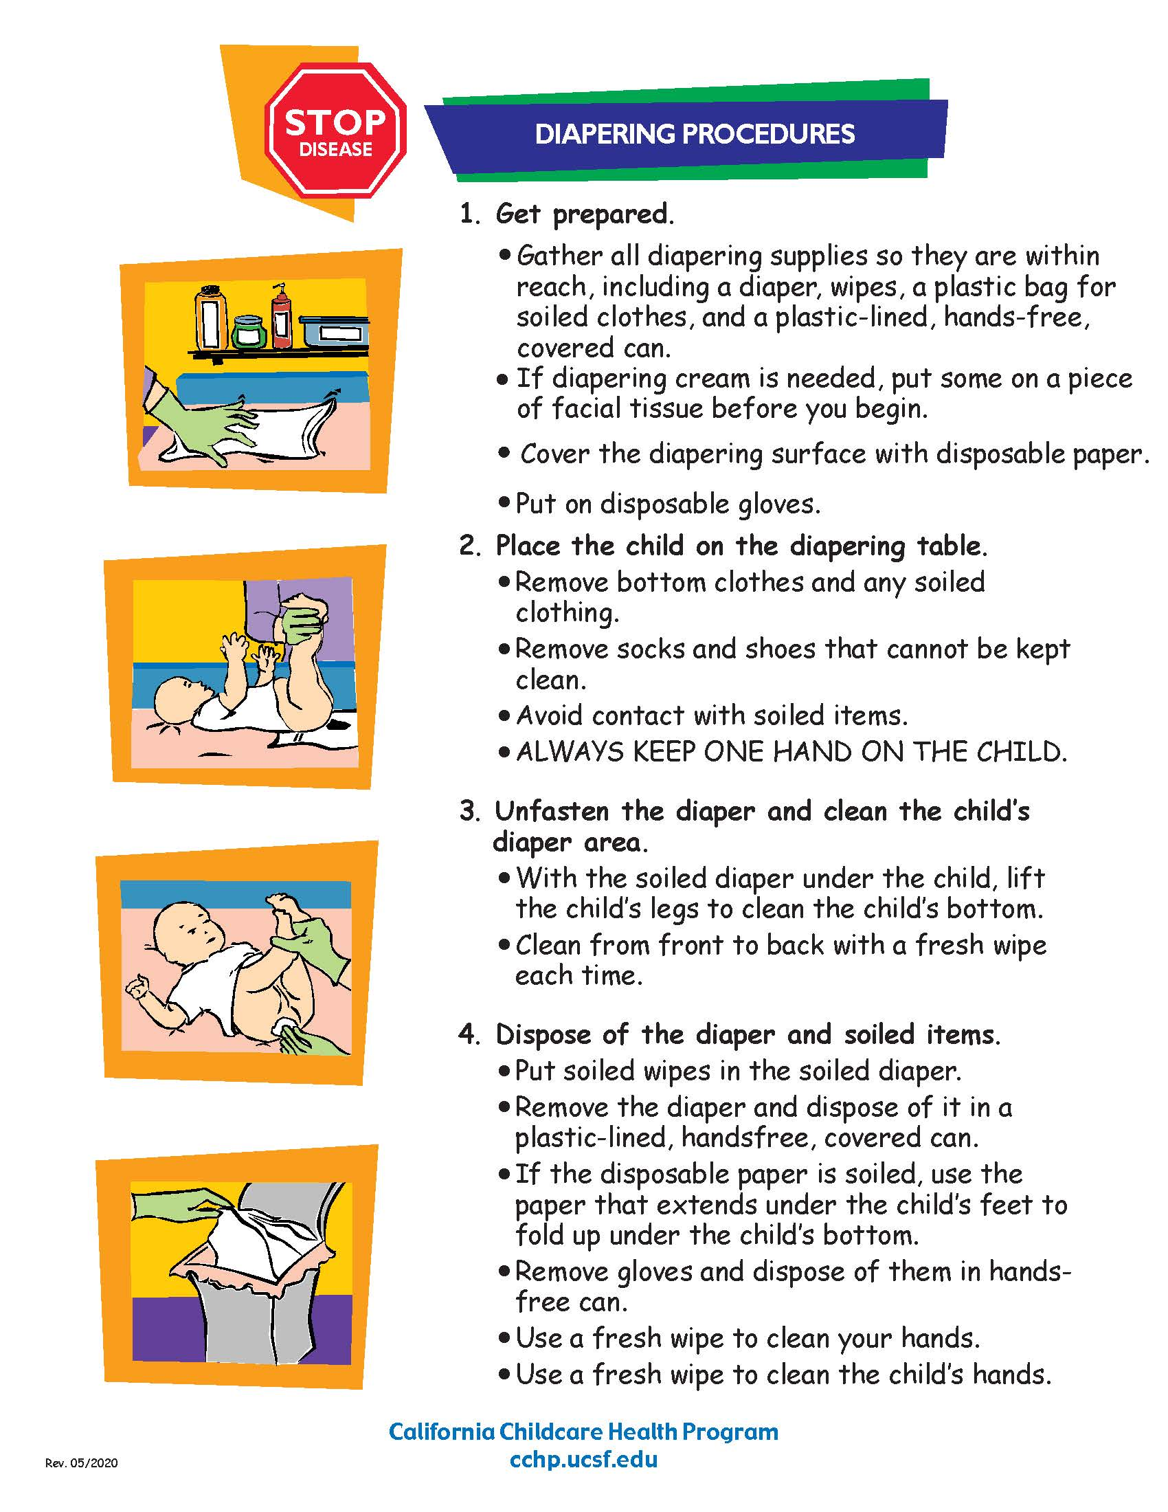
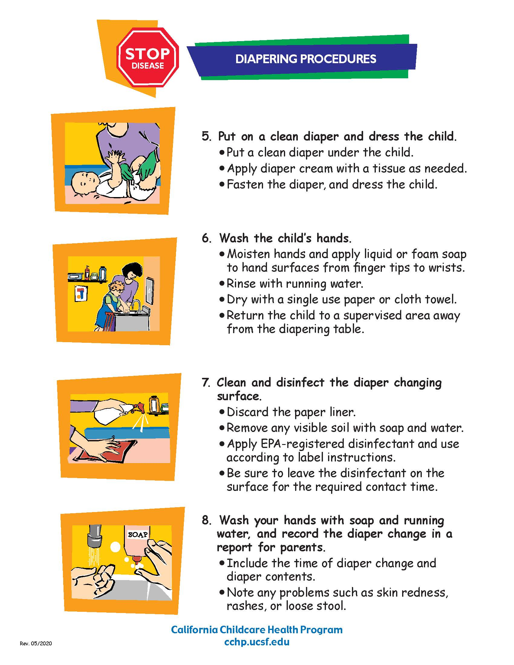
Notes:
This Diapering poster is on page 1.32-1.33 of the Trainer Guide, pages 1.27-1.28 of the Student Handbook, and in the student handout packet.
Don’t wash or rinse diapers or clothes soiled with stool in the child care setting. The risk of splashing and contamination of hands, sinks, and bathroom surfaces, increases the risk of spreading germs that could cause infection. All soiled clothing should be put in a plastic bag, securely closed, and sent home with the child without rinsing. Tell parents about this procedure and why it is important because they may request that diapers and training pants be rinsed out to avoid staining.

Slide 55
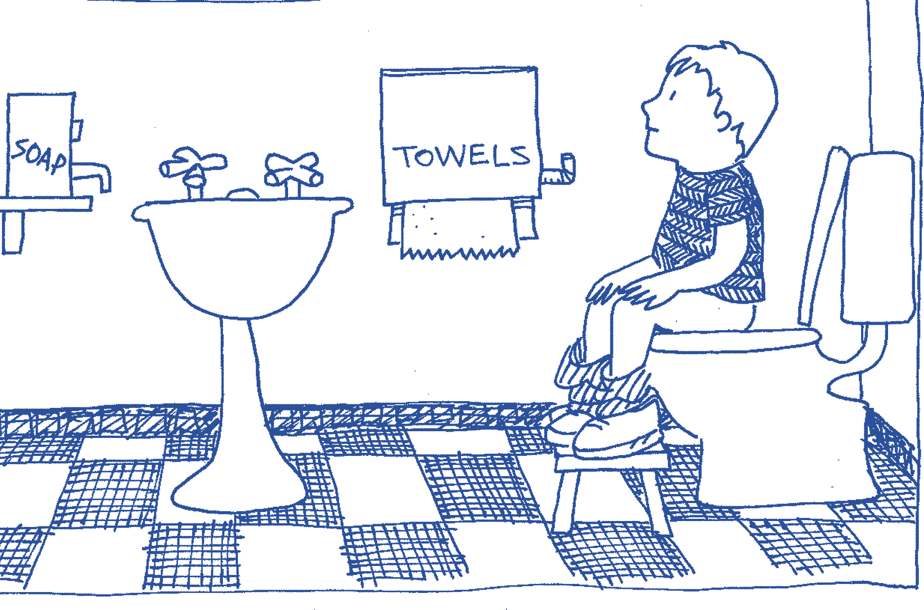
Toileting
  Child-sized toilets or a step stool to a standard toilet are preferred.
Notes:
Child sized toilets or a step stool to a standard sized toilet are best for children's toileting needs.

Slide 56
Toileting with Potty Chairs
  Use only in a bathroom area out of reach of toilets or other potty chairs
  After each potty chair use:
    Help child wash their hands.
    Move child to a supervised location away from cleaning and disinfecting activities.
    Immediately empty the potty contents into a toilet, being careful not to splash or touch the water in the toilet.
    Rinse the potty chair with water and empty into toilet.
    Wash the chair with soap and water. (Consider using paper towels.)
    Empty soapy water into toilet.
    Rinse again.
    Empty into toilet and flush.
    Spray with disinfectant according to label instructions. Wash hands. Allow potty chair to air dry.

Slide 57
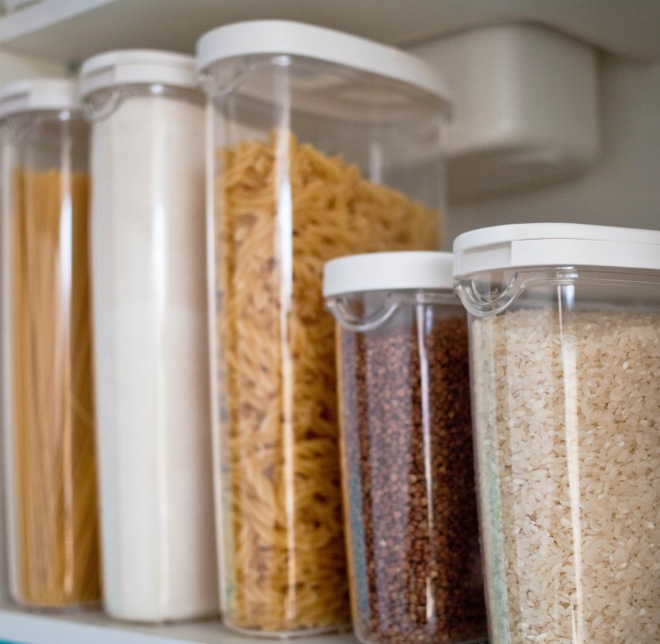
Food Safety
Purchase food safely:
Check “use by,” “sell by,” or “expiration date”
Refrigerated food is cold, frozen food is rock-solid
Cans free of dents, cracks, or bulging lids
Pasteurized milk, milk products, and fruit juice
Store food safely:
Take food straight home, don’t leave food in a hot car
Refrigerate perishable foods
Store dry foods in clean metal, glass or hard plastic containers with tight fitting lids
Notes:
Prevent food-borne illness by purchasing and storing food safely
More tips for food purchasing:
Only purchase meat and poultry that has been inspected. USDA ensures meat and poultry products are safe, wholesome, and correctly labeled and packaged.
Shop for meat, fish, poultry, and cold food last, and keep separate from other foods
More safe food storage tips:
Store containers of food above the floor (at least 6") on racks or other clean slotted surfaces that permit air circulation.
Keep storerooms free of moisture. Repair all holes and cracks in storerooms to prevent pest infestation.
Store food items separately from non-food items.
Pay attention to expiration dates and rotate stored food.

Slide 58

Food Safety
Prepare food safely:
Heat hot foods to 140 degrees F
Do not prepare or serve food while sick
Wash all raw fruits and vegetables
Prepare meat, poultry, and fish separately from other foods
Refrigerate leftovers right away
Clean and sanitize:
Wash hands before preparing and serving food
Serve food on a table that was cleaned and sanitized.
Clean and sanitize utensils and surfaces properly after preparing and serving food
Notes:
Prevent food-borne illness by preparing food safely and cleaning and sanitizing properly.
More food prep tips:
Wash tops of cans before opening.

Slide 59
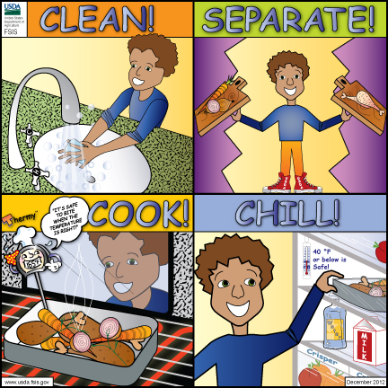

Slide 60
Oral Hygiene

Slide 61
Tips for Preventing Cavities
Brush teeth twice a day: after breakfast, and before bedtime at night.
Use a smear of fluoride toothpaste the size of a grain of rice for toddlers. Use a pea sized amount for preschoolers.
Don’t leave infants sleeping with a bottle, and never put juice or sugary drinks in a bottle.
Serve healthy food. Stay away from sugary drinks and sticky snacks.
Encourage children to drink plenty of water. Check if your drinking water has fluoride.
Help families find a dental care provider in their area for regular dental check-ups starting when children get their first tooth.

Slide 62
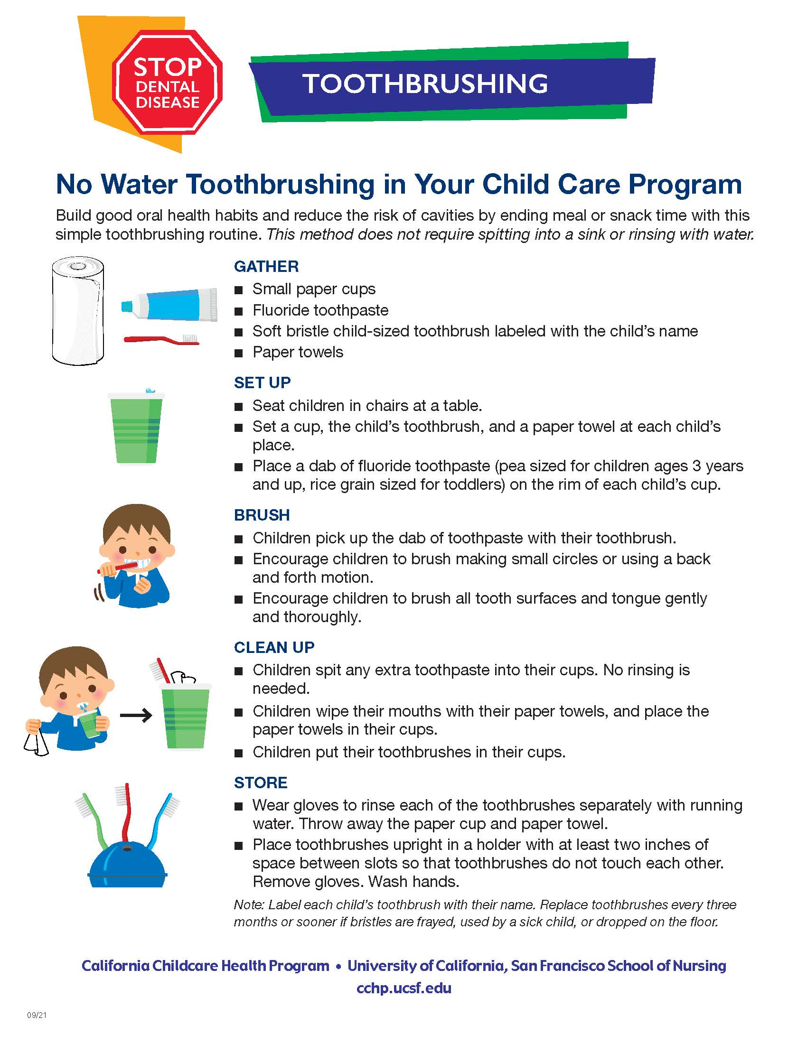
Notes:
This poster can be found on page 1.40 of the Trainer Guide, page 1.36 of the Student Handbook, and in the student handouts.
There are 2 other toothbrushing posters, one for children with special needs and one for infants and toddlers.

Slide 63
Indoor Air Quality
Identify and manage sources of odors and unhealthy air!
Indoor air pollutants include:
Bacteria, viruses, and mold
Dust, pet dander, pollen, and pest debris
Fumes from stoves and heaters, cleaning/sanitizing/disinfecting products, perfumes, air fresheners, pesticides, art supplies, second hand and third hand smoke
VOCs from carpeting, wood finishes, new furniture, and paints
Notes:
Many health problems can be triggered by polluted air. Smoking is not allowed in licensed child care settings per licensing regulations.
VOCs are Volatile Organic Compounds

Slide 64
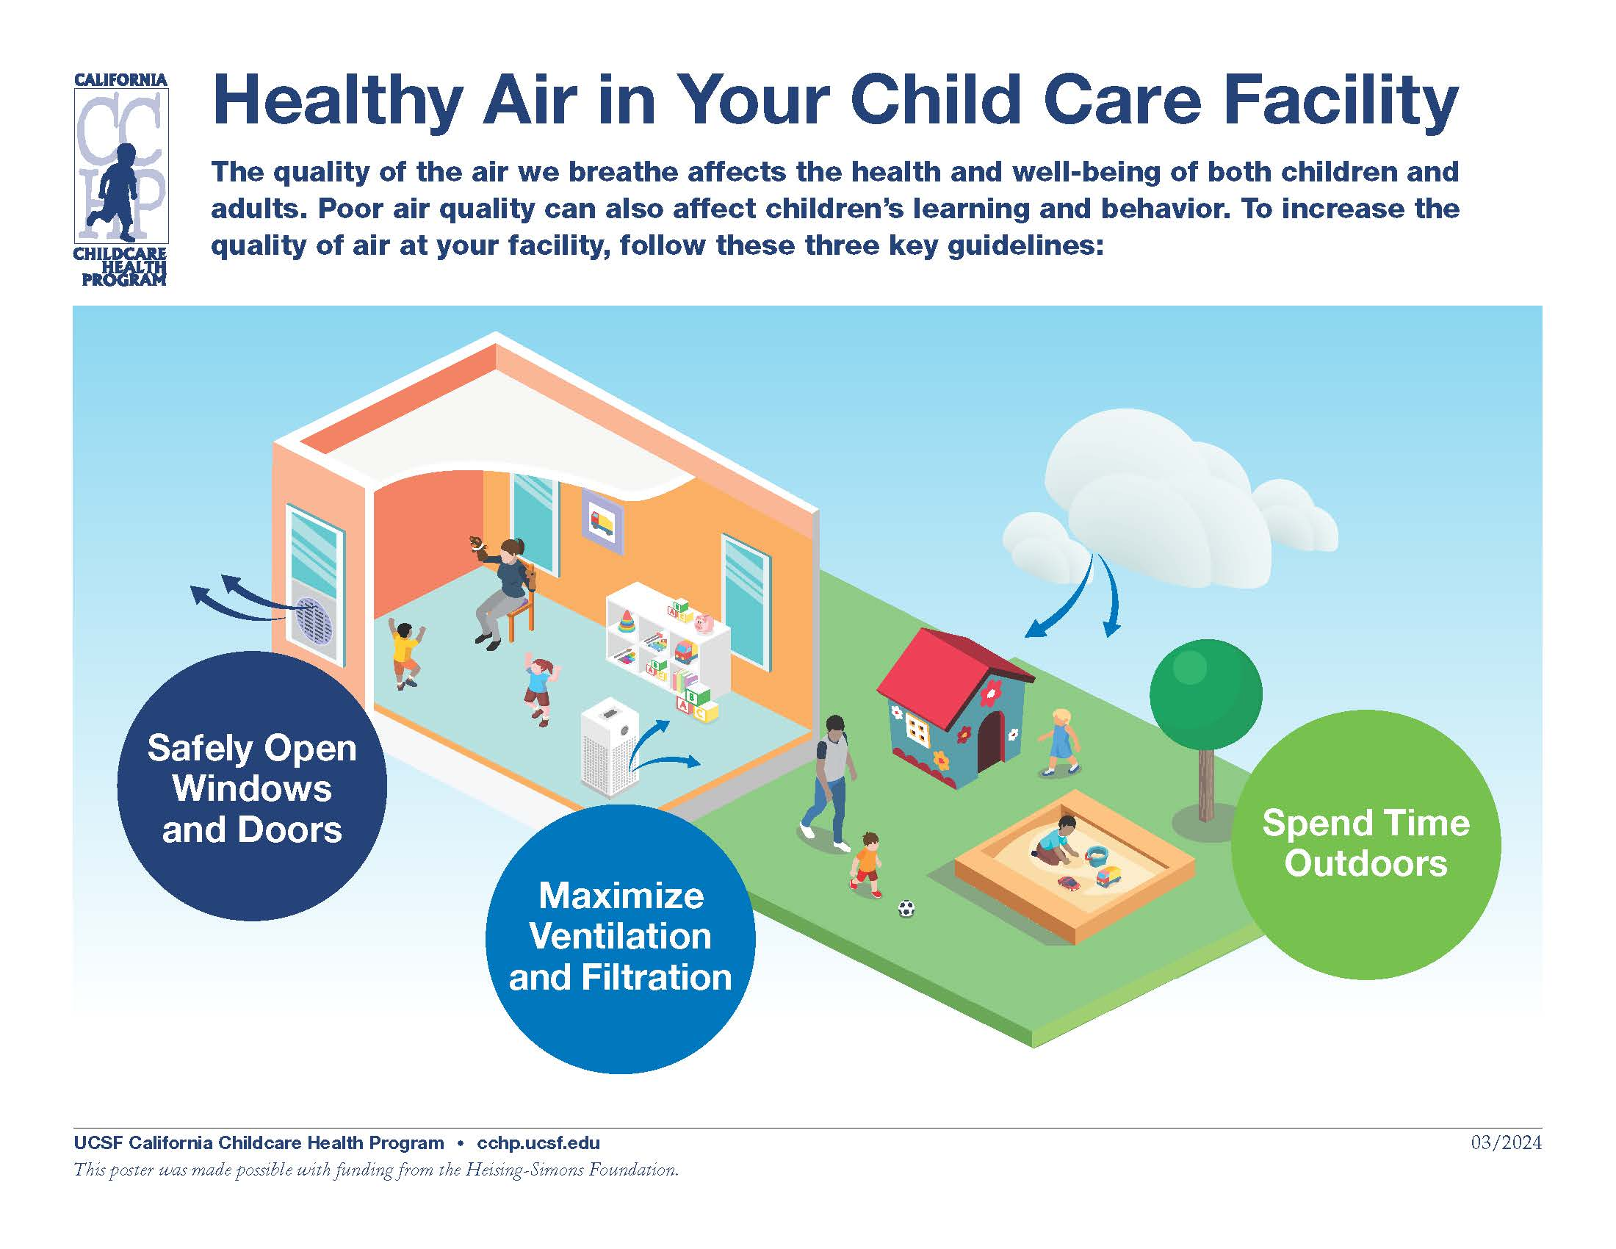
Notes:
In general, improving ventilation in your building and spending time outdoors will help get rid of those indoor air pollutants. It will also reduce the spread of airborne infectious diseases.
What if outdoor air is polluted with wildfire smoke or pesticides? Next slide…

Slide 65
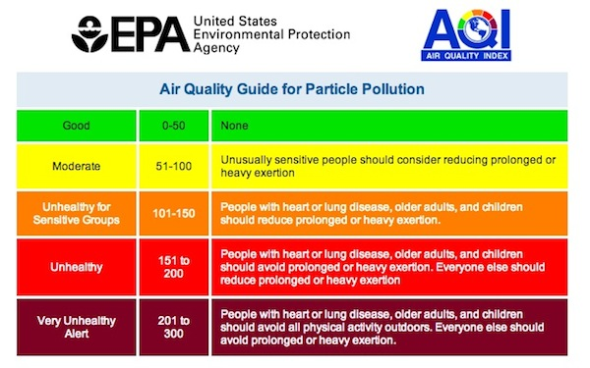
Outdoor Air Quality
Notes:
Smoke, smog, pesticide spray, manufacturing fumes, and auto exhaust can all pollute the air outdoors. Pay attention to the air quality index from the EPA.
Generally, it’s healthier for children to play outdoors, but there are times when children should stay indoors. Adjust your indoor space to allow for active play opportunities when children need to stay indoors.
Activity: check your local AQI score using airnow.gov

Slide 66
Wildfires and Air Quality
Follow instructions of local officials before, during, and after a wildfire emergency
If you are not in a wildfire area but your air quality is smoky:
  Close all doors and windows
  Use your HVAC (heating, venting, and cooling) system and portable air cleaners
  Bring children indoors or limit outdoor play
  Consider wearing a mask (not for children under 2 years)
Notes:
Be prepared to respond to smoky air that occurs because of wildfires. Children with chronic health conditions like asthma, allergies, and other conditions can have even more trouble breathing.

Slide 67
Water Supply
Notes:
Tap water in the United States is generally safe. The Safe Drinking Water Act is a federal law that requires public water companies to test water regularly and meet strict federal standards. Water quality standards in California are even more rigorous than federal standards. Testing for water quality is done annually, and the results are sent to every customer in a Consumer Confidence Report (CCR). You can check the website of your local public water system for a current CCR.

Slide 68
Water Supply
Does your child care center get water from ground-water wells, springs, or surface water instead of a public water system?
If so, California Community Care Licensing (CCL) regulations require an on-site inspection of privately-owned water sources and a laboratory report that shows the water is safe to drink.
Notes:
If you get your water from a private sources, contact your local public health department, the California Department of Public Health, or a licensed commercial laboratory for information about testing your water. Contact your regional child care licensing office for more information about child care regulations and water testing.

Slide 69
How can water get contaminated?
Water treatment removes contaminants and makes the water less corrosive to pipes. When water leaves a public water system it is considered safe to drink.
Water can be contaminated after it leaves the public water system. As water flows through older plumbing, small pieces of lead can flake off of pipes and lead can leach into the water. water standing in pipes or fixtures with lead solder can absorb lead. Homes and buildings built before 1986 are more likely to have pipes, solder, or fixtures that contain lead
Notes:
Most likely your water is safe to drink. However, drinking water in your building can be tested by a certified laboratory. The laboratory will send a technician to collect samples.

Slide 70
Testing Drinking Water for Lead
Licensed child care centers in facilities built before 2010 are required to have their tap water tested for lead by January 2023 and every five years thereafter. This requirement does not apply to Family Child Care Homes.
Funding for water testing and fixture replacement is available for qualified child care centers from a State Water Board grant.
Contact your local Child Care Resource and Referral program or Regional Child Care Licensing office for more information.
Notes:
Visit the Child Care Licensing website: https://www.cdss.ca.gov/inforesources/child-care-licensing/water-testing-information
Contact your local community water system, or
For a list of Certified Laboratories visit: http://www.epa.gov/dwlabcert/ contact-information-certification-programs-and- certified-laboratories-drinking-water

Slide 71
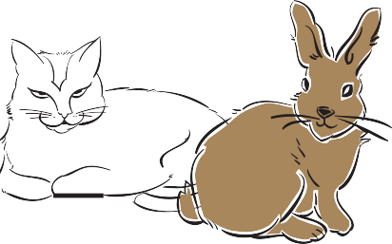
Pets in the Child Care Setting
Notes:
Pets are excellent companions and provide many opportunities for children to learn. However, animals can pass some diseases to people. Follow these guidelines to reduce the risk of spreading disease.

Slide 72
Pets in the Child Care Setting
Pets should be in good health and friendly toward children.
Dogs and cats should be immunized and on flea, tick, and worm control programs.
Keep pet cages clean; keep pet waste out of children’s reach.
Directly supervise children playing with pets.
If you have a pet, let parents know before they enroll. (Some children have allergies.)
Wash your hands (and children's hands) after handling pets or pet items.

Slide 73
Reptiles and Exotic Pets
Reptiles, turtles and iguanas carry salmonella and are not appropriate for child care settings.
Venomous or aggressive snakes, spiders, or tropical fish are a safety risk in child care settings.
*Check with a veterinarian if you are unsure whether a pet is safe to have around children.

Slide 74
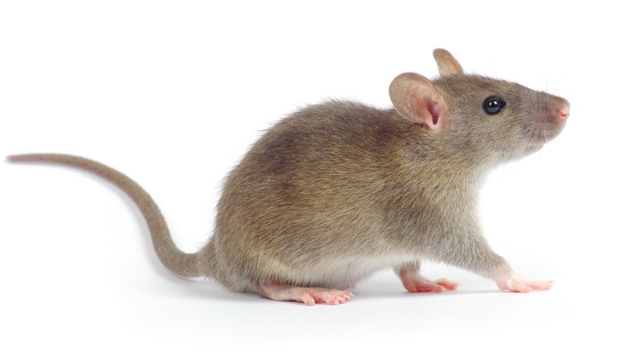
Pests
Examples of health problems pests can cause:
Flies can spread germs,
Mosquito stings can spread disease,
Yellow jacket stings are painful and some people are allergic,
Spider bites are painful and can be harmful,
Mice and rats can spread disease,
Cockroaches can trigger asthma attacks.
Notes:
Pests can cause injury or spread disease in child care environments.

Slide 75
Integrated Pest Management (IPM)
IPM is a pest control approach that minimizes the use of pesticides-there are many ways to control pests without using harmful chemicals.
IPM provides a least toxic alternative to spraying pesticides.
With IPM, pesticides are only used as a last resort.
IPM training for child care providers is available for free on the DPR website: https://apps.cdpr.ca.gov/schoolipm/

Slide 76
Notes:
Training is required once a year for anyone applying pesticides in child care centers by the Healthy Schools Act (HSA). This includes antimicrobial pesticides (sanitizers and disinfectants).
This poster is on page 1.53 of the Trainer Guide, page 1.49 of the Student Handbook, and in the student handouts.

Slide 77

Sand Boxes and Sand Play Areas
Place sandboxes away from prevailing winds or provide windbreaks using bushes, trees, or fences.
Separate the sandbox from other play equipment such as slides or swings.
Make sure the sandbox has adequate drainage so water does not puddle or pool.
Use smooth-surfaced, fine pea gravel or washed sand that is labeled for sandbox use.
Keep surrounding pavement free of sand. Sweep pavement regularly to reduce the risk of sliding and slipping.
Make sure sand play area is free of pests, sharp objects, and feces from cats or other animals.
Do not use chemicals to disinfect sand in the sandbox. Instead, remove the soiled sand.
Replace sand as often as necessary to keep the sand clean.
Keep the sand play area clear of food, garbage, and standing water.
Keep the sandboxes covered when not in use.
Notes:
Children enjoy and learn from sand play. Yet a sand box can be a health and safety hazard.

Slide 78
Policies to
Prevent the Spread of
Infectious Disease
Module I, Section 3
Notes:
What is a policy? A way to improve communication, provide guidance, and ensure fairness. Sometimes policies are the law, as in licensing regulations, and sometimes policies are based on “best practices.” All policies need to be communicated at the time of enrollment and as needed thereafter.
Ask attendees to list some of the preventive health topics needing clear, written policies.

Slide 79
Topics for Policies
Health History
Emergency Information
Immunization (children and staff)
Keeping Health Records and Confidentiality
Exclusion for Illness Policy in the Child Care Setting
Staff Health
Pandemic Preparedness
Communication about Illness (reporting requirements)
Caring for Children with Mild Illness
Medication Administration Children with Special Needs
Emergency Illness Procedures
No Smoking or Use of Alcohol or Illegal Drugs

Slide 80
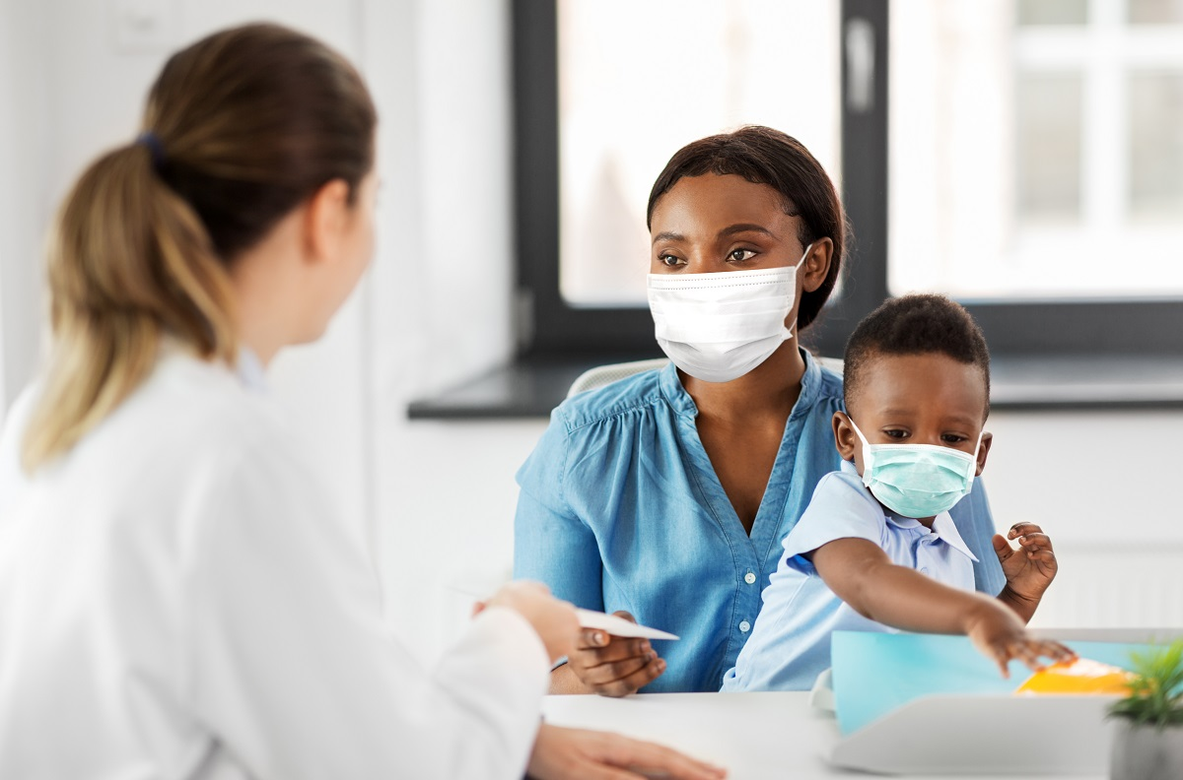
To develop a policy ask:
What will be done?
Why will it be done?
Who’s responsible?
When and how will it be done?
How will it be communicated, enforced, and monitored?

Slide 81
Health History and Emergency Information Policy
LIC 700 (Identification and Emergency Information-Child Care Centers)
LIC 702 (Child’s Preadmission Health History-Parent Report)
LIC 701(Physician’s Report-Child Care Centers)
LIC 627 (Consent for Medical Treatment-Child Care Centers or Family Child Care Homes)
Child Emergency Information Form (Child Care Disaster Plan)* more detailed
Notes:
It’s important to have a health history and emergency information for each child. You will need to have information on immunization, health insurance, any and any other special health needs a child might have, such as allergies, asthma, or medications. Licensing forms will help you collect the information.
If a child has special health needs, you will need to work with the family and health care provider to develop a written care plan.
And be sure emergency contact information is kept up to date.

Slide 82
Immunization Policy
The law requires written proof of each child’s up-to-date immunizations.
Parents must submit their child’s Immunization Record prior to enrollment.
Licensed Child Care Programs are required to copy the information onto the California School Immunization Card (“Blue Card”)
Every fall, you must submit an Immunization Assessment Report to your Local Health Department
Blue Cards, helpful tools, and assistance are available from your Local Health Department.
Notes:
Immunization is an important way to decrease the risk of spreading serious illnesses among children. Immunization is required for entry into licensed children care by law. Parents or guardians of students in any school or child care facility, whether public or private, are no longer allowed to submit a personal beliefs exemption to a currently-required vaccine.

Slide 83
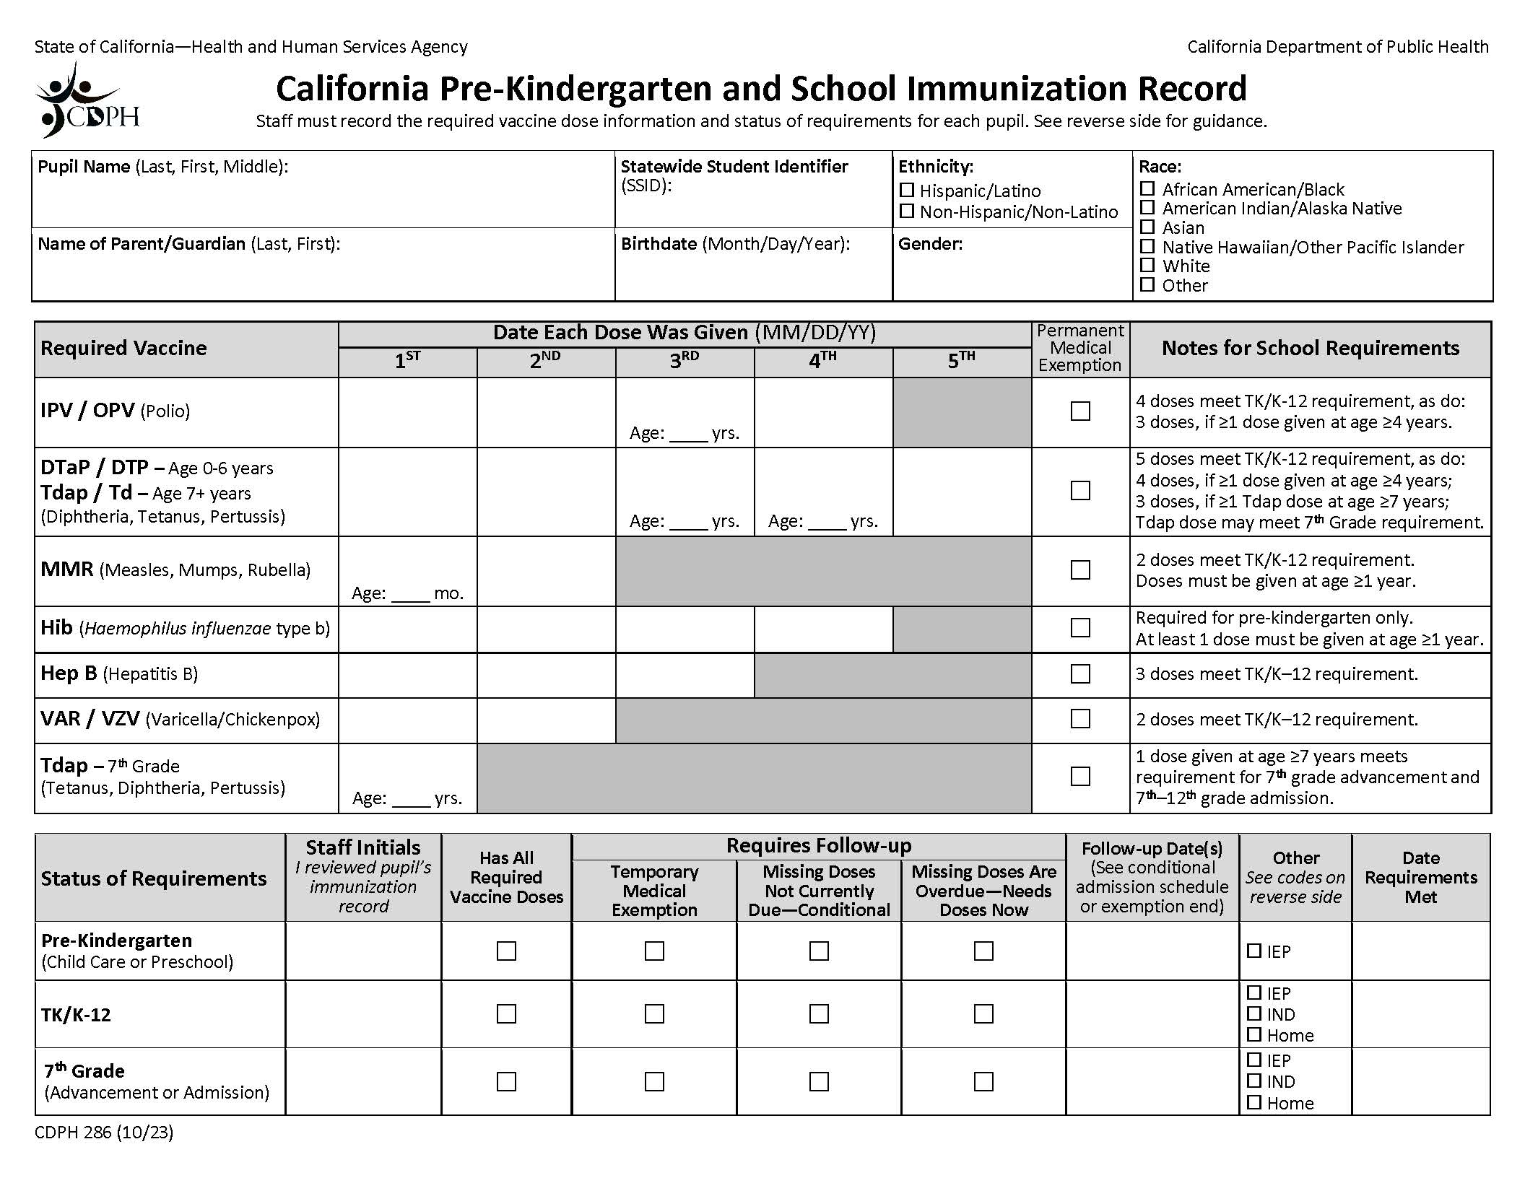
Notes:
This form is on page 1.72 of Trainer Guide, page 1.66 of Student handbook

Slide 84
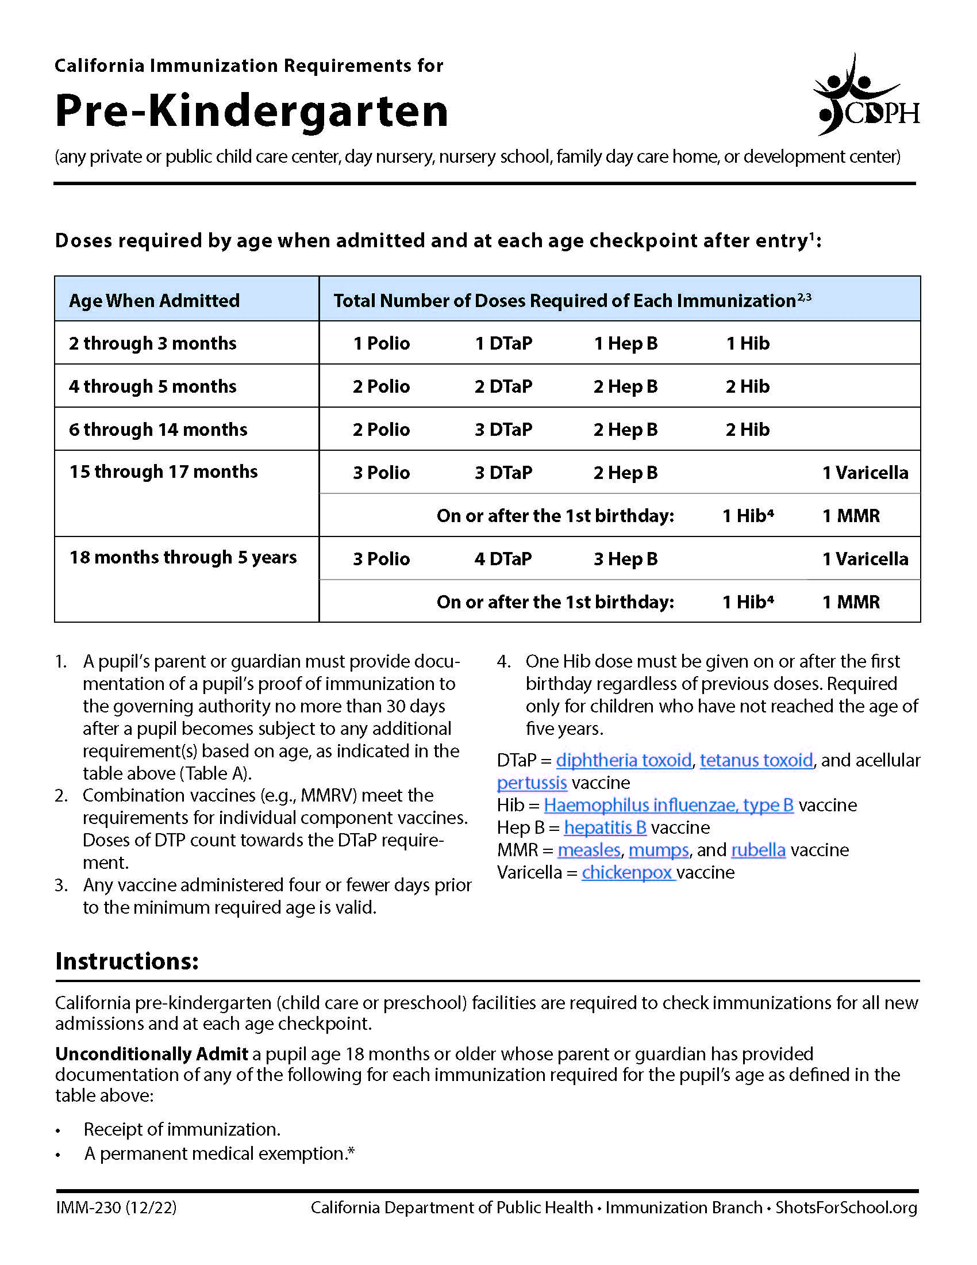
Notes:
This form is on page 1.70-1.71 of Trainer Guide, page 1.64-1.65 of Student handbook

Slide 85
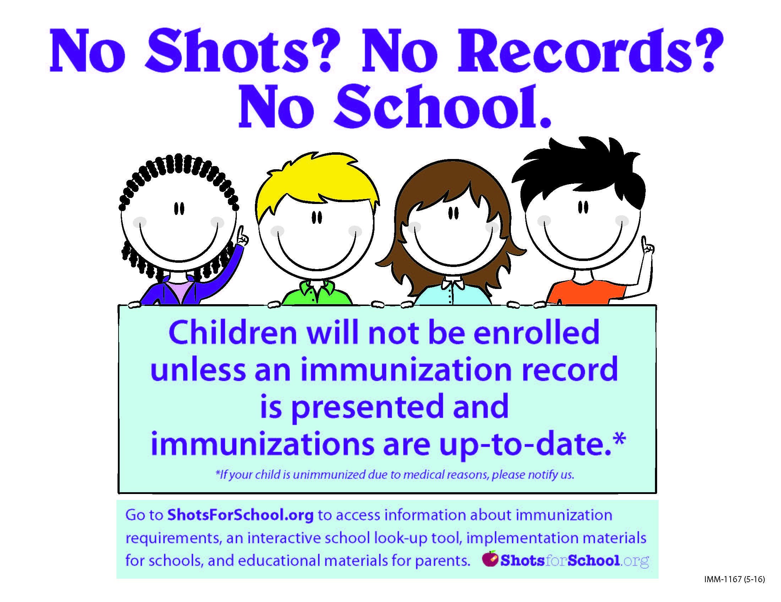

Slide 86
Medical Exemptions:
Some children cannot get vaccinated for medical reasons.
A child who cannot be vaccinated needs a letter from their doctor stating they have a medical exemption. The doctor will upload the letter to the California Immunization Registry.
As of January 1, 2021, child care providers must go to the California Immunization Registry to find the doctor’s letter.
A temporary medical exemption will expire within a year. After it expires, the child must either get the vaccine or get a new medical exemption letter.

Slide 87

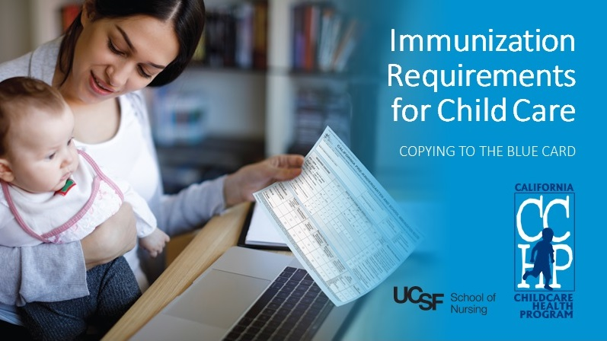
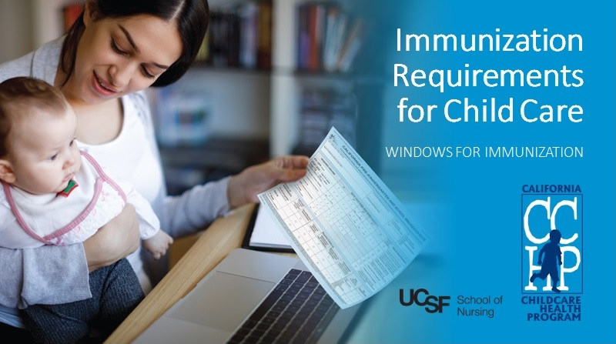
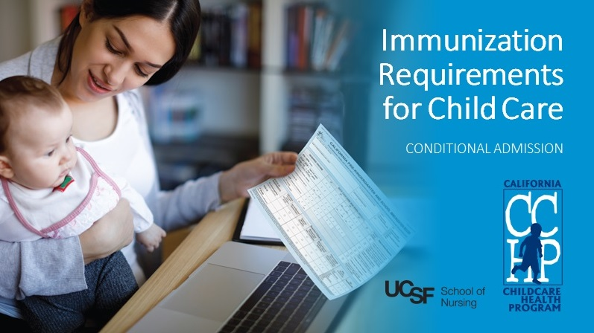
Immunization Resources
https://www.cdph.ca.gov/Programs/CID/DCDC/Pages/Immunization/School/shotsforschool.aspx
Your local Public Health Department
CCHP Immunization Requirements for Child Care Videos
www.youtube.com/playlist?list=PL0P9O6XrDoM0O-YzzC9jlUzjuYdaWRH0N
Notes:
There are three CCHP Immunization Requirements videos:
Copying to the Blue Card
Windows for Immunization
Conditional Admission

Slide 88
Keeping Health Records
Keep a file for each child’s health records with:
Immunization records,
Special health needs and care plans, (for example, asthma or diabetes)
Health history
Health screening (vision, hearing, lab results, height and weight, developmental, Tb)

Slide 89
Confidentiality
Health records are “confidential” to protect the privacy of children and families.
If you need to notify families and program staff about a infectious illness so they can watch for symptoms, do not give the name or identify the child with the illness.
You may need to share certain information for the child’s safety, for example: if a child has a severe allergy or when reporting known or suspected child abuse to Child Protective Services.
Notes:
By law these records can only be shared with staff who need the information in order to do their job. See the handout Maintaining Confidentiality in Child Care Settings.

Slide 90

Exclusion for Illness Policy
Establish a clear policy for when children cannot attend child care because of illness.
Share your written policy with parents.
Make sure staff understand how to apply and enforce your policy.
Enforce your exclusion policy fairly and consistently.

Slide 91
Reasons for Exclusion
The child does not feel well enough to participate in routine activities. (for example, cranky, low energy, fussy, crying)
The ill child requires more care than the staff is able to provide without compromising the health and safety of other children.
The illness poses a risk of spreading a harmful disease to others.
Notes:
Refer to Health and Safety Note: Excluding Children Due to Illness.
Any child who does not feel well enough to participate, no matter what the cause, should stay home.

Slide 92
Keep a child home if…
Fever along with behavior change or other signs of illness such as sore throat, rash, vomiting, diarrhea, ear ache etc.)
Unusual tiredness, uncontrolled cough or wheezing, continuous crying, difficulty breathing, or severe abdominal pain.
Diarrhea (runny stool that cannot be contained in a diaper or is causing accidents.)
Vomiting (more than two times in the last 24 hours)
As determined by the local health department as a risk for spreading illness during an outbreak, epidemic, or pandemic.
Notes:
Or if they meet other exclusion criteria on previous slide.

Slide 93
Keep a child home until evaluated by a health care provider
Strep throat (and for 24 hours after treatment has started)
Impetigo (and for 24 hours after treatment has started)
Scabies (and for 24 hours after treatment has started)
Mouth sores with drooling

Slide 94

Examples of when it’s okay for a child to attend…
Common colds, runny noses, mild cough
Fever if there are no other signs or symptoms
Watery eyes with clear watery discharge or pink eye (unless the child meets other exclusion criteria.)
Rash without fever or behavior changes
Notes:
Discuss how this might be different in a pandemic.

Slide 95

Staff Health
Immunization Requirements
Influenza (annual)
Pertussis
Measles
Your primary health care provider may recommend additional vaccines based on your health and immunization history.
Notes:
A person may not be employed or volunteer at a child care center or a family child care home unless he or she has been immunized. In order to qualify for an exemption, a person must submit one of the following to the child care center or family child care home: a determination by a licensed physician, in writing, that immunization is not safe for them because of their physical condition or medical circumstances; or a determination by a licensed physician, in writing, that they have evidence of current immunity; or in regard to the influenza vaccine only, a signed declaration that he or she has declined the vaccine. Check with you local public health department for more details and information about how to get immunized.

Slide 96
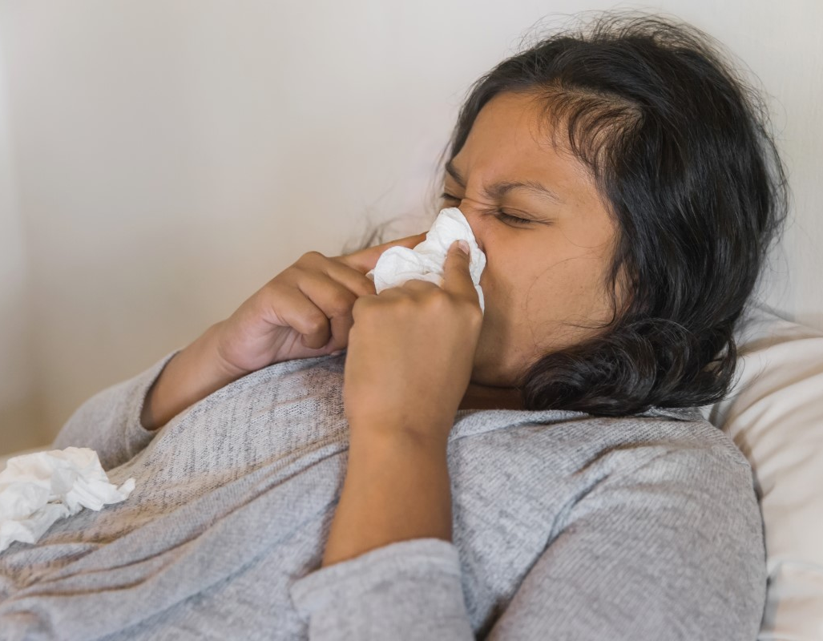
Staff Health
Establish policies for:
Pre-employment screenings and regular check-ups
Exclusion for illness
Following Standard Precautions
Safe lifting practices
Notes:
Unfortunately, many caregivers neglect their own health in order to focus on the needs of children. Make staff health a priority.

Slide 97
Pregnant Child Care Providers
Some childhood infectious illnesses can be harmful to a fetus or newborn (Chickenpox, CMV, Slapped Cheek Fever, Rubella, Influenza).
If you are pregnant, get regular pre-natal care. Tell you health care provider about your occupation.
Immunization and following Standard Precautions protect pregnant women from getting an infectious illness.

Slide 98
Communication About Illness
Review all health and safety policies prior to enrolling a child.
Communicate any changes in health and safety policies:
  at parent meetings
  in your parent handbook
  by newsletters, handouts, bulletin board postings
  verbally as you greet the parents at the beginning and end of the day.
Notes:
Assure parents that are working in the best interest of the children. Communicate in the primary language of the parent (when possible) and without judgement.

Slide 99
Communicating with Health Care Providers
Usually you will communicate with the health care provider through the parent.
Use an “Information Exchange with the Health Care Provider Form” to write down your concerns. Or just write a simple note.
You won’t be able to talk directly to a doctor or clinic without written permission from the parent. (see “Consent for Release of Medical Information Form”).
Notes:
The purpose of your communication is to share your specific observations about a child (and perhaps some information about your program) and to get an opinion about the child’s condition, as well as recommendations on when a child can return to care. Because of confidentiality laws, health care providers will not be able to discuss a child’s health with you unless they have a signed consent form from the parent.

Slide 100

Parent Communication
Ask parents to report illness to the child care program within 24 hours of diagnosis, even if they keep their child home.
Alert other parents to watch for signs of that illness in their children and seek medical advice when necessary.
You can use the “Notice of Exposure to Contagious Disease Form”. (Do not share the name of the child who is ill.)
Notes:
Let the parents know you will be sending home exposure notices to parents but will not mention any names.

Slide 101
Reporting Illnesses to Your Local Health Department
Some infectious diseases and illness outbreaks must be reported to your local health department.
COVID-19 is on the list of illnesses to be reported.
Epidemic outbreaks must be reported to Child Care Licensing.
Contact your local health department Communicable Disease department if you have questions about specific diseases.
Notes:
If you make a report, inform the parents of the child that you are required to report the disease to the health department. The child’s health care provider is required to make reports of individual cases of specific diseases.

Slide 102
Caring for Children with Mild Illness
Young children enrolled in child care have a high incidence of illness.
Make decisions about whether a child should stay or go home on a case-by-case basis.
If a child needs to go home because of illness, you may need to at least provide temporary care until a family member or designated adult arrives.
Notes:
Provide a quiet area where the child care rest or play quietly until a family member arrives. Make sure the child is comfortable and supervised.

Slide 103
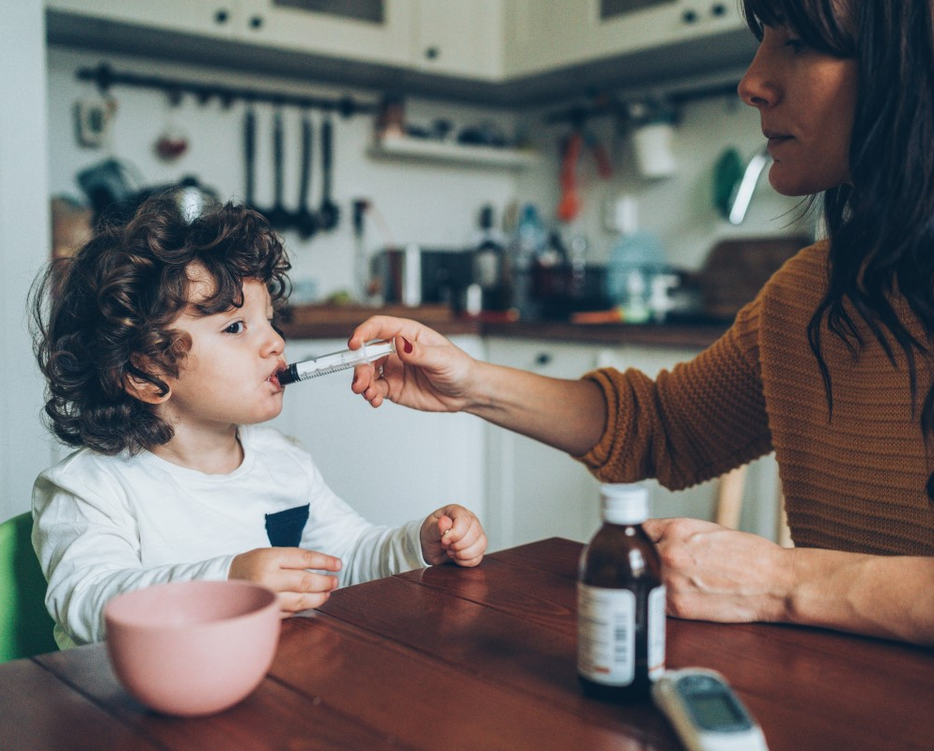
Medication Administration Policy
Include your procedures for safely:
  receiving
  storing
  administering
  documenting
any medication given in your child care setting.
Notes:
Mildly ill and children with chronic illnesses may need to take medication while attending your child care program. The Americans with Disabilities Act (ADA) requires you to make reasonable accommodations when caring for children with special health needs. Include written procedures for how you safely give medication in your plan of operation. Make sure staff who will be giving medication have been trained on your procedures for giving medications.

Slide 104
You may be asked to give…
Prescribed medications: ordered by a health care provider for a specific child and illness and filled by a pharmacist.
Nonprescription (“over-the-counter”) medications: recommended by a health care provider for a child and can be purchased without a prescription.
Notes:
Antibiotics and asthma inhalers are examples of prescription medications. Acetaminophen and Ibuprofen are examples of over-the-counter medications. Provide examples of prescription medications and over the counter medications to show the class.

Slide 105
Medication Safety
Must have written instructions and signed consent from parent or legal guardian.
Medication is in the original, safety lock container with prescription label or manufacturer’s instructions.
Check prescription label for:
  first and last name of the child
  name and phone number of the health professional who ordered the medication
  date prescription was filled
  expiration date
  special instructions for how to store the medication.

Slide 106
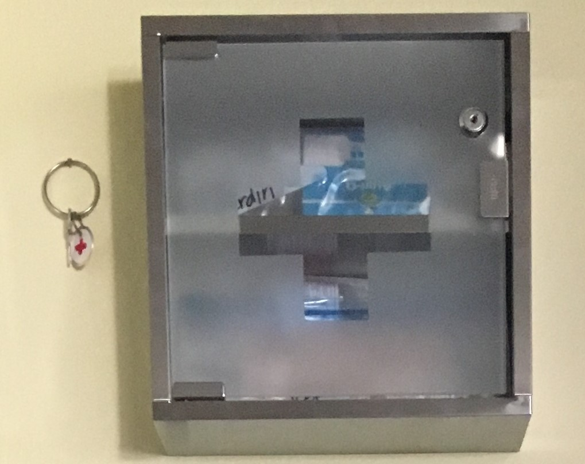
Storing Medication Safely
Make sure all medication is stored safely, out of children's reach.
Store medications according to label instructions. For example, some medications need to be refrigerated and some need to be kept out of light.
Store medications away from food.

Slide 107
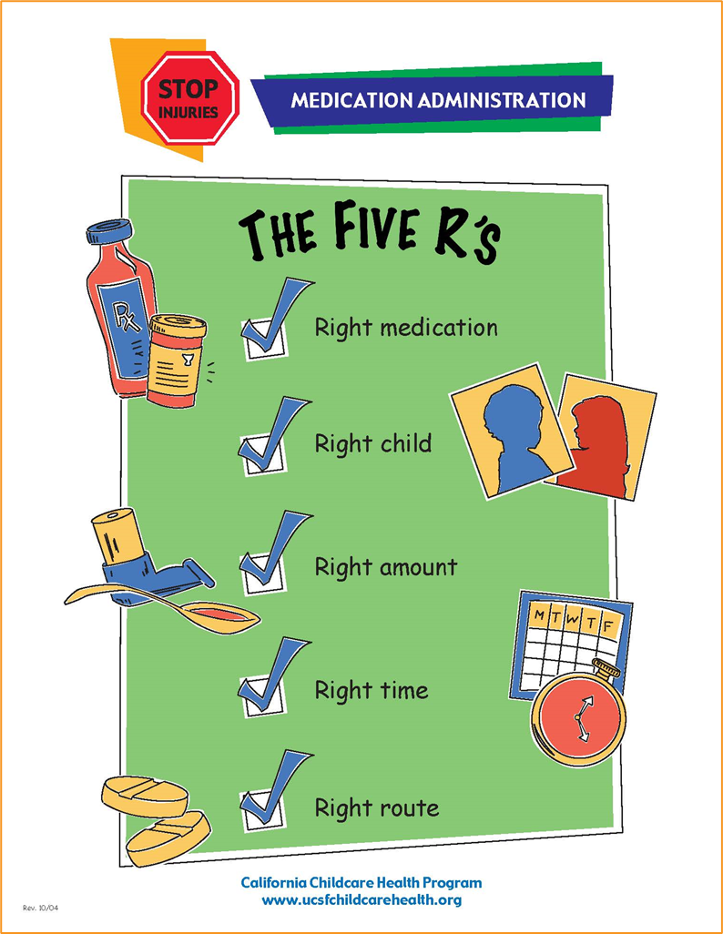
Medication Administration
Staff must be trained in how to give a specific medication to a child.
Always follow the 5 Rights of Medication Administration:
  Right Medication
  Right Child
  Right Dose
  Right Time
  Right Route
Notes:
This poster is on page 1.101 of the Trainer Guide, page 1.95 of the Student Handbook

Slide 108
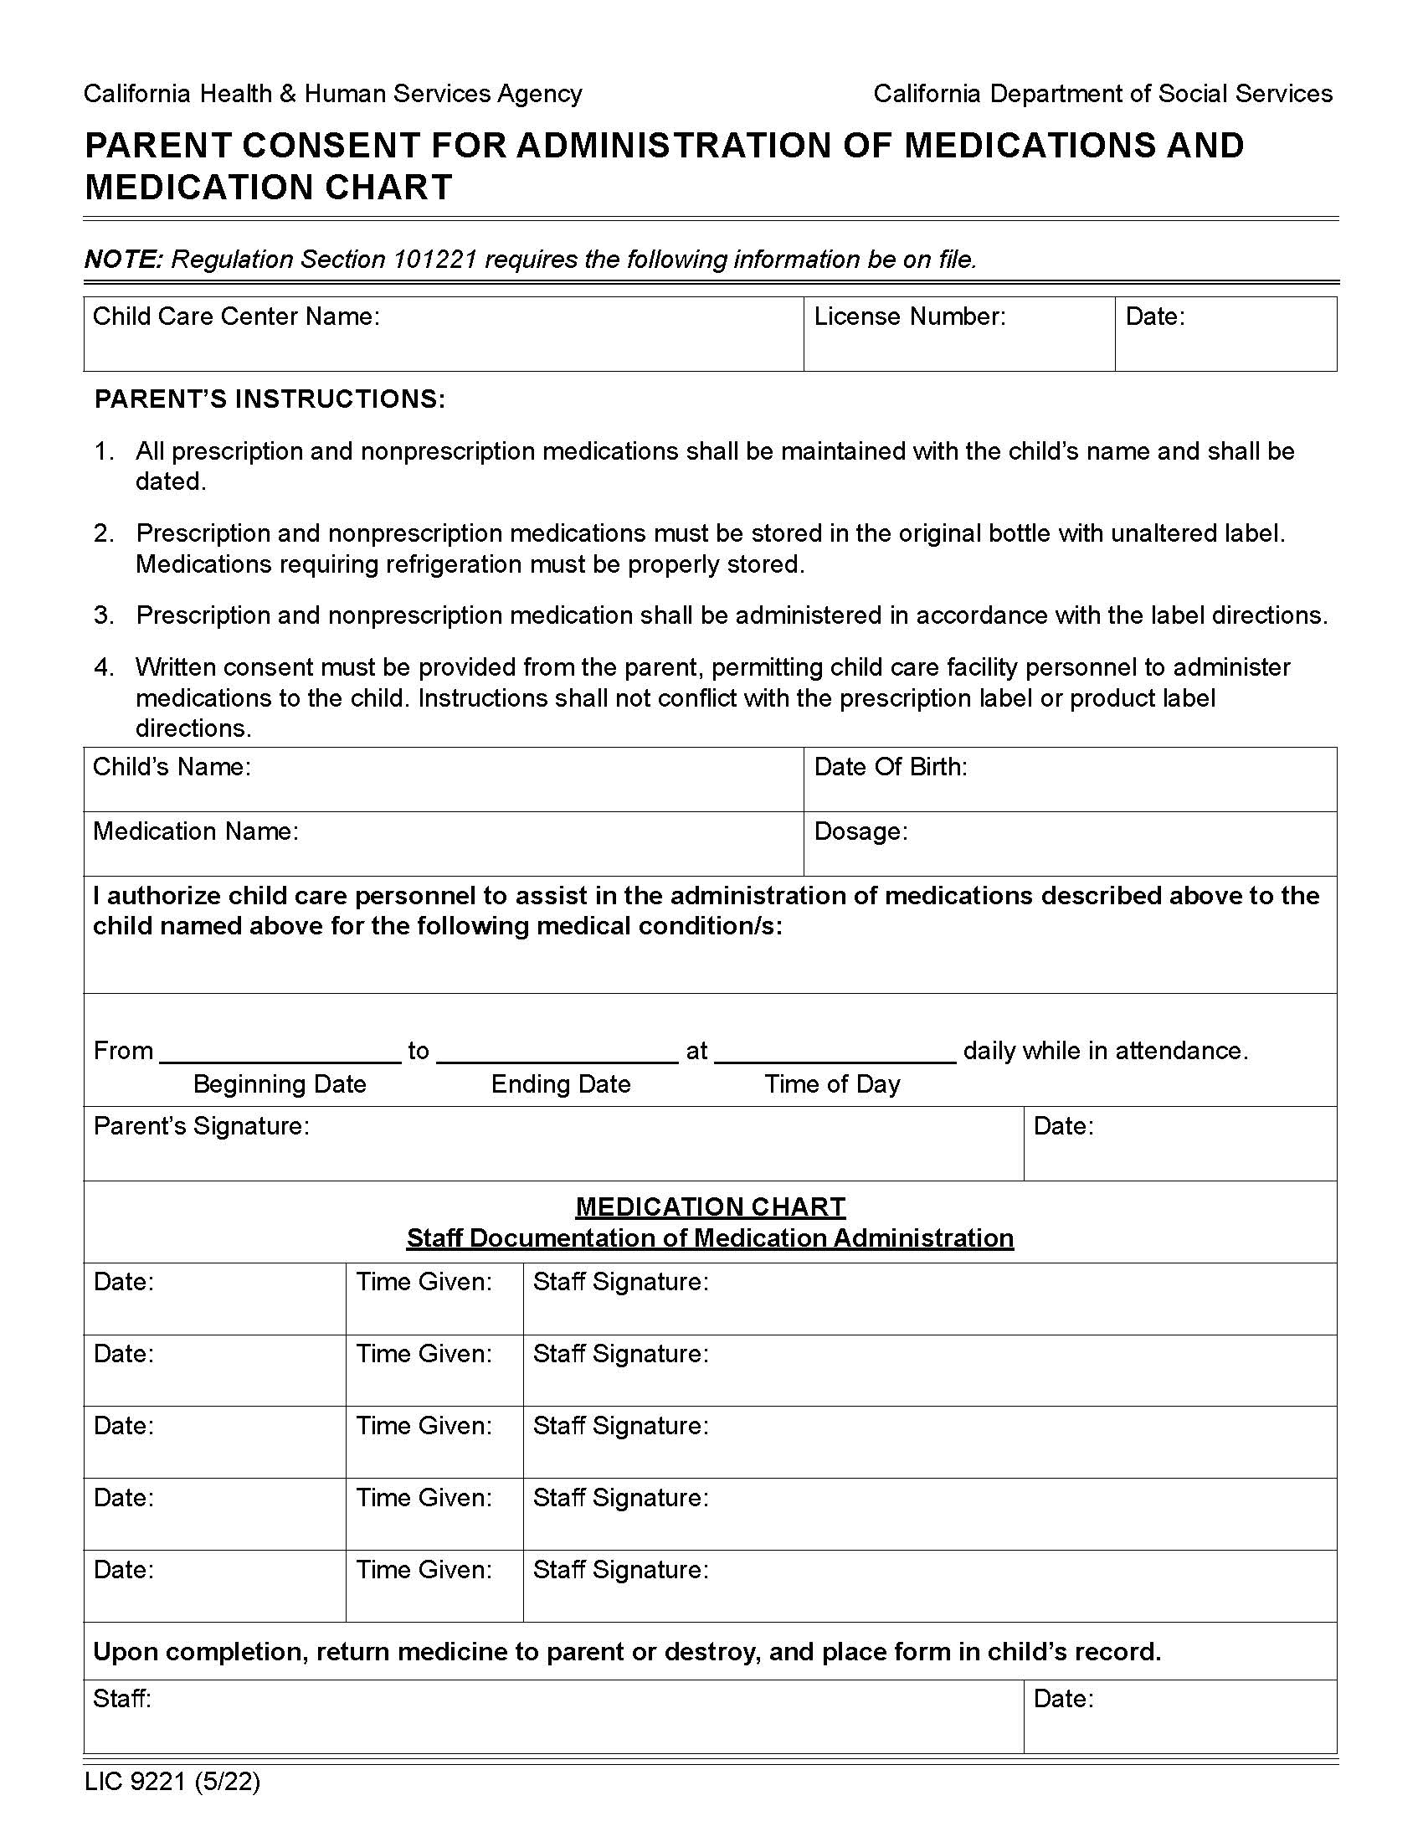
Document Medication Given
Keep a log with:
the name of the medication,
the name of the child receiving the mediation,
the name of the person giving the medication,
dates, time, and dose of the medication given.
Notes:
LIC 9221 is the form to use. Find it on page 1.103 of the Trainer Guide, page 1.97 of the Student Handbook

Slide 109

Children with Special Health Needs
You will need a written care plan for each child with special health needs
See the CCHP “Special Health Care Plan” form.
Notes:
Children with special health care needs and their families benefit from opportunities for socialization that are as normal as possible. With careful planning, most of these children can be safely integrated into child care settings. Work closely with parents and health care providers to establish a safe environment for these children, their peers, and staff members who care for them.
The form is on pages 1.108-1.109 of the Trainer Guide, page 1.102-1.103 of the Student Handbook.

Slide 110

Children with Disabilities
Caring for a child with disabilities may require extra support and resources from:
inclusion experts
mental health consultants
therapists
social workers
the child's parents
health care professionals
Notes:
While you are required by ADA laws to make reasonable accommodation for children with special health needs or disabilites, consider the following questions:
Does the child's disability require more care than you are reasonably able to provide?
Do you have the skills and abilities needed to perform medical or other duties required for the child's care, or can you readily acquire those skills through training or professional development?
Is your child care program equipped to meet the health and safety needs of this child?
Is the extra time you will need to devote to taking care of this child more than you can handle without putting the other children in your care at increased risk for illness or injury, or without causing you to neglect their needs?

Slide 111
Incidental Medical Services (IMS)
Non-medical staff may give medication to children, as long as they follow certain procedures.
Disability laws protect a child’s right to not be excluded from child care because they have a disability (such as needing medication).
Licensing has adopted protocols for safely giving administration.

Slide 112
Add IMS to your Plan of Operation
List:
The type of Incidental Medical Services provided in your program.
The records you will keep and how you will communicate with families.
The plan for safe storage and transport (if needed) of medication/equipment.
The plan for staff training, including a plan for back-up, trained staff to provide IMS (in case of staff absence).
*Talk to your Licensing Program Analyst for more information.

Slide 113
Emergency Illness Policies and Procedures
Let families know that you are trained in first aid and CPR, and in the event of an emergency you will:
Quickly assess the child’s health.
Call 9-1-1 or other appropriate emergency help as needed.
Give first aid and CPR, if necessary.
Contact the family or the person they have listed to call in an emergency.
Call Poison Control if their child is exposed to toxic substances.

Slide 114
Important Emergency Preparedness Policies
Keep emergency numbers posted
  poison control
  local law enforcement
  Child Protective Services
  911
Maintain a current CPR and first aid certificate.
Keep parents’ consent forms for emergency treatment and numbers for emergency contacts on file.
Post first aid procedures where they can be easily seen.
Post an evacuation route.
Keep your first aid supplies fully stocked.
Keep a ready-to-go kit with:
  Emergency supplies
  Medications
  Emergency contact information
  Emergency treatment forms
Notes:
Always keep first aid supplies and medications out of children’s reach.

Slide 115

No Smoking or Use of Alcohol, Recreational, or Illegal Drugs
Notes:
Smoking is prohibited in licensed child care programs in California. A policy that prohibits electronic cigarettes, alcohol, and using or having illegal drugs in your setting should be in place. The use of legal drugs (for example, medical or recreational marijuana and prescribed narcotics) that can diminish the ability to properly supervise and care for children should also be prohibited.
It is important for caregivers/teachers to be aware of the impact marijuana used medicinally and/or recreationally has on their ability to provide safe care. Modeling healthy and safe behavior at all times is essential to the care and education of young children. (Caring for Our Children, 2017)

