Slide 1
Health and Safety in
Child Care Settings during the COVID-19 Pandemic
Developed by the UCSF California Childcare Program with funding from the California Department of Education
August 14, 2020
2020

Slide 2

Check the CCHP homepage for regular updates on COVID-19
https://cchp.ucsf.edu
Notes:
Things are changing all the time.

Slide 3
Guidance based on
California Department of Public Health (CDPH), California Department of Social Services (CDSS), California Department of Industrial Relations (Cal OSHA) COVID-19 Updated Guidance for Child Care Programs and Providers: https://covid19.ca.gov/pdf/guidance-childcare.pdf
Centers for Disease Control (CDC) Supplemental Guidance for Child Care Programs that Remain Open: https://www.cdc.gov/coronavirus/2019-ncov/community/schools-childcare/guidance-for-childcare.html

Slide 4
Communicate with Your Local
Public Health Department
Contact your local public health department, immediately, if you are aware of confirmed COVID-19 cases among staff or children.
Your local health department will provide guidance on when the infected person can return to the facility, testing, contact tracing, and if the facility needs to close.
Notes:
Check local orders for COVID-19 related directives. For example cloth face coverings.

Slide 5
Communicate with Families
Update emergency contact information
Update asthma action plans. Note: Nebulizers are not recommended during the COVID-19 pandemic because they can increase the amount of the virus in the air.
Inform families about your policies during the COVID-19 pandemic.
Require staff and family to inform your program immediately if anyone in the family is diagnosed with COVID-19.
Notes:
Most health care providers are recommending the use of metered dose inhalers with a spacer rather than a nebulizer machine for people with asthma. Use posters, social media, group texts, and/or newsletters.

Slide 6

The best way to prevent COVID-19 is to avoid being exposed to the virus.
Notes:
As we gradually open business and workplaces we need to take measures to avoid exposure to the virus. Like keeping your distance of at least 6 feet, wearing a face mask, and washing your hands.

Slide 7
COVID-19
Some people have mild symptoms or no symptoms at all.
Older people and people with chronic health problems are at risk of getting sicker.

Slide 8
Are California child care programs open?
Yes. Many child care programs are open or are reopening soon. However, some are still closed.
Child care centers and family child care homes that are open or reopening need to follow health and safety guidelines specific to the pandemic (for example, cleaning and disinfecting, daily health screening, physical distancing).

Slide 9

Q: How do we stay healthy and safe?

Slide 10
Understanding how COVID-19 spreads:
Air: The virus is mainly spread person-to-person via respiratory droplets.
The virus may live on surfaces like cardboard for 1 day; plastic and stainless steel 2-3 days; in the refrigerator for over 6 hours.
Notes:
*Feces: The virus has been found in feces. It is unclear whether infection can be spread via body fluids (e.g. blood, stool).

Slide 11
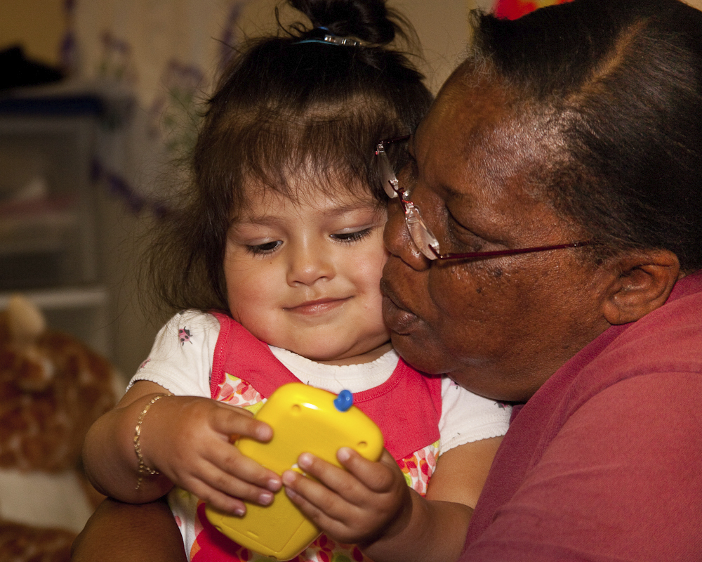
Question: Why are people in child care settings at risk for spreading and catching COVID-19?

Slide 12
Answer:
There is close contact between children and teachers,
Children are curious and touch everything,
Children often put objects and their hands in their mouths,
Children don’t have good personal hygiene skills,
Infants and toddlers wear diapers or are in early stages of toilet learning,
Young children spend more time on the floor where germs collect.

Slide 13
COVID-19 and Children
Recent research shows that children experience lower rates of COVID-19 illness than adults.
The symptoms tend to be milder in children than adults.
Adults make up most of the known COVID-19 cases to date.

Slide 14
Multisystem Inflammatory Syndrome in Children (MIS-C)
A rare inflammatory condition in children associated with COVID-19.
Can require hospitalization and be life threatening. Early diagnosis and treatment is critical to preventing long-term complications.
Signs and symptoms include: fever that does not go away; abdominal pain; vomiting; diarrhea; neck pain; rash; bloodshot eyes; or feeling tired.
As of August 4, 2020 there have been 29 cases of MIS-C reported statewide.

Slide 15
Reduce the Risk of COVID-19
Reducing the risk is different than 100% preventing the spread of COVID-19.
We focus on health practices to reduce the risk of getting COVID-19.
The strategies work together to lower the risk.

Slide 16
Strategies to Reduce the Risk of COVID-19
  Stay home when ill
  Personal hygiene (frequent hand washing, coughing into a sleeve, etc.)
  Cleaning and disinfecting surfaces
  Physical distancing and masking

Slide 17
Strategies to Reduce the Risk of COVID-19
  Stay home when ill
  Personal hygiene (frequent hand washing, coughing into a sleeve, etc.)
  Cleaning and disinfecting surfaces
  Physical distancing and masking

Slide 18
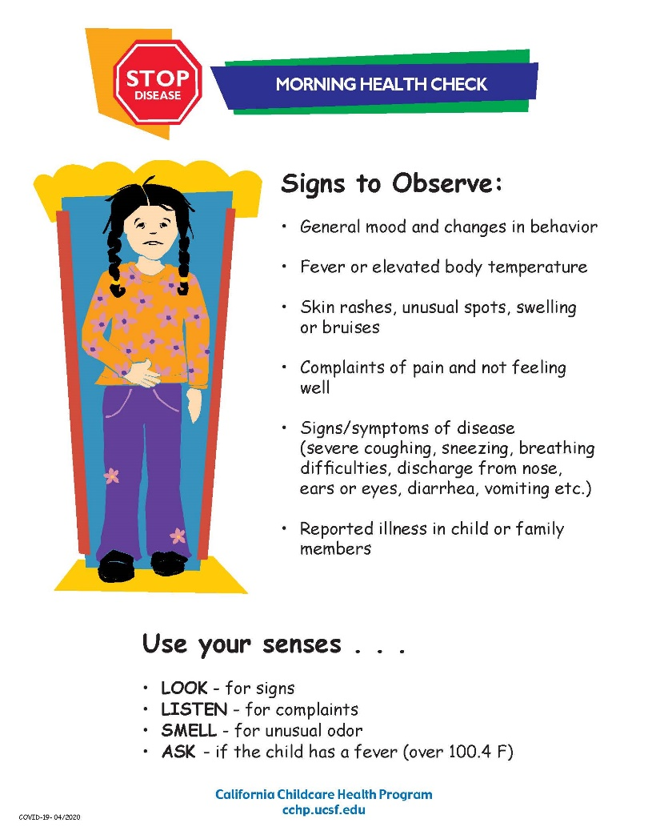
Morning Health Check
This welcome routine can help you to better understand each child, help children feel more comfortable, and foster communication with parents. It will slow the spread of disease by excluding children with signs of illness. Do not admit children with a fever (over 100.4 F) or signs of COVID-19.
Notes:
Note: it’s a best practice to document your health checks.

Slide 19
Checking for Fever
Wear a face mask during the health check. Ask about fever and symptoms of COVID-19 within the last 24 hours.
If you have a touchless thermometer, you can do a temperature screen of all staff and children at the beginning of the day. Otherwise, temperatures should be taken only when a fever is suspected. Wear gloves and use alcohol to disinfect the thermometer after each use.
Keep a record of each child’s daily temperature.
Staff and residing family members in family child care homes should also take their temperatures and check for symptoms of COVID-19 before the child care day begins.
Notes:
Staff and children should take temperatures before arriving to work or beginning care.

Slide 20
Symptoms of COVID-19
People with these symptoms (or combinations of symptoms) may have COVID-19:
  fever,
  cough,
  shortness of breath or difficulty breathing,
  chills, repeated shaking with chills,
  muscle pain,
  headache,
  sore throat,
  congestion or runny nose,
  nausea or vomiting,
  diarrhea,
  and new loss of taste or smell.
Children have similar symptoms to adults and generally have mild illness.
Notes:
Symptoms may appear 2-14 days after exposure to the virus.

Slide 21
Exclusion for Illness Criteria
Symptoms of COVID-19
Symptoms of other illnesses meeting usual exclusion criteria
Consider each child’s health history. For example, a child with documented allergies does not need to be excluded for allergy symptoms.
Isolate a child who develops symptoms of COVID-19 during the day and ask the family to pick up the child right away. If possible, apply a face mask to ill children over two years old.
Notes:
Stricter during COVID-19 pandemic. Requires close communication with families. Isolated children are removed from the group activities but still supervised by an adult. If possible, place a face cloth on ill children over 2 years of age while they wait to be picked up.

Slide 22
Strategies to Reduce the Risk of COVID-19
  Staying home when ill
  Personal hygiene (frequent hand washing, coughing into a sleeve, etc.)
  Cleaning and disinfecting surfaces
  Physical distancing and masking
Notes:
Handwashing is key to decreasing the spread of illness.

Slide 23
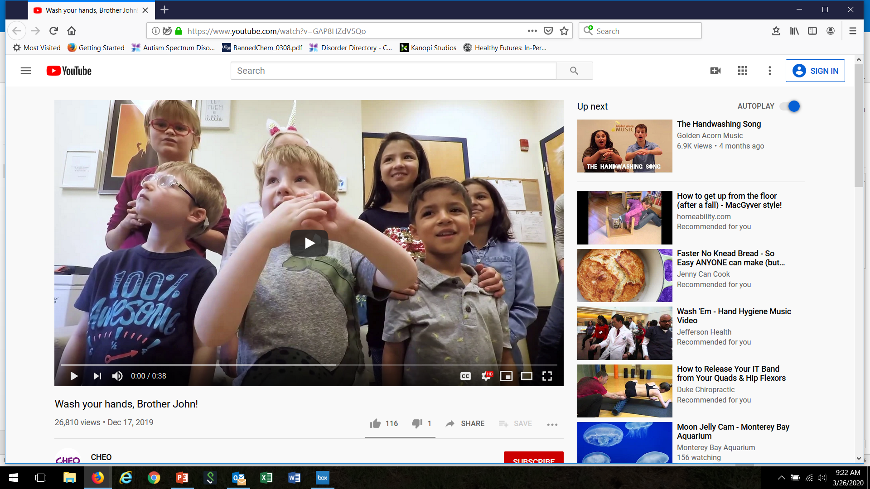
Handwashing Video
https://www.youtube.com/watch?v=GAP8HZdV5Qo

Slide 24
Wash hands upon arrival and frequently throughout the day.
Notes:
Here’s a poster you can put up near sinks and in bathrooms to reinforce proper handwashing technique.

Slide 25
Hand Sanitizer Tips
When soap and water are not available,
For adults and children over 24 months,
With products containing at least 60% alcohol,
On visibly clean hands.
Keep out of children’s reach
FDA Warning: Some hand sanitizer products labeled as having ethanol are contaminated with methanol. Methanol can have life-threatening, toxic effects. Please check the FDA website for a list of hand sanitizers found to have methanol that have been recalled:
https://www.fda.gov/drugs/drug-safety-and-availability/fda-updates-hand-sanitizers-methanol
*Remember: Soap and water are the first choice if available.

Slide 26

Cover your Cough and Sneeze
…with Grover!
https://www.youtube.com/watch?v=dp9z3yaxkSI

Slide 27
Ways to Reduce the Risk of COVID-19
  Staying home when ill
  Personal hygiene (coughing into a sleeve, frequent hand washing, proper diapering procedures etc.)
  Cleaning and disinfecting surfaces
  Physical distancing and masking
Notes:
Antimicrobial pesticides (sanitizers and disinfectants) kill viruses on surfaces.

Slide 28
Disinfecting
Disinfectants (antimicrobial pesticides) are already widely used in child care settings.
Have you taken the Healthy Schools Act training?
https://apps.cdpr.ca.gov/schoolipm/
Notes:
Recommend the IGM training.

Slide 29
What is the difference between cleaning and disinfecting?
Definitions
Clean: To physically remove dirt, debris, and sticky film by washing, wiping, and rinsing.
Disinfect: To kill nearly all of the germs on a hard, non-porous surface.
CFOC Schedule K: https://nrckids.org/files/appendix/AppendixK.pdf
Notes:
These terms are often used interchangeably but they do not mean the same thing. Let’s focus on cleaning and disinfecting.

Slide 30
What surfaces should be cleaned?
Toys
Bedding
Floors
Clothing (including hats)
Cribs, cots, and mats
Play equipment
Refrigerators
Always clean before applying a disinfectant
Notes:
Washing with soap and rinsing with water will clean these surfaces. The friction of cleaning removes most dirt.

Slide 31



Use products that are healthier for people and the environment
fragrance-free
free of dyes
non-antibacterial
non- aerosols (propellant)
third-party certification
*Remember, children are more vulnerable to exposure to chemicals and fumes because they are growing and developing. Their little bodies have a harder time breaking down toxins, and they breath twice as much per body weight as adults. They have softer, more absorbent skin and smaller airways. They also spend more time on the floor where chemical residues can collect.
Notes:
The next step is to choose a safe cleaning product. Many have strong fumes or try to mask odors with perfume leading to poor air quality. Some products may make marketing claims that they are “green”, but they may not be. Look for a third party certification to know if the product you are using is safer for human health and the environment. Some products are ready to use, some need to be diluted with water. Always follow label directions for proper use and use personal protective equipment such as gloves and eye wear as directed.

Slide 32
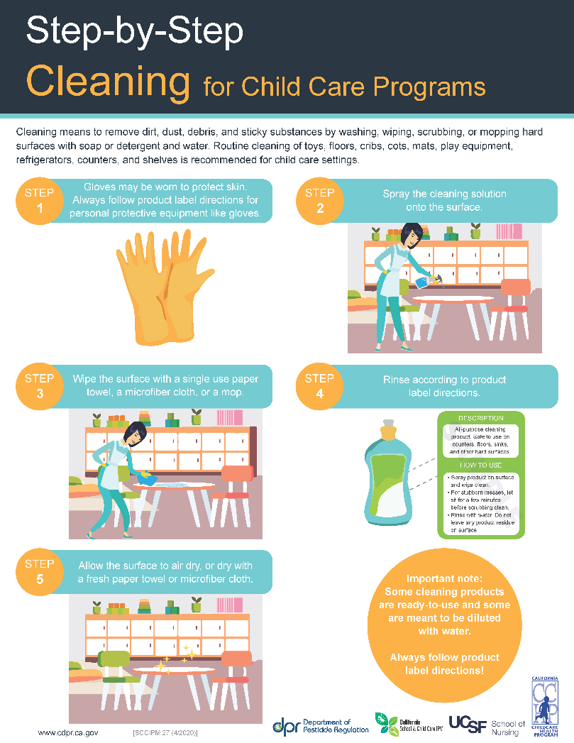

Slide 33
What surfaces should be disinfected?
Drinking fountains
Door and cabinet handles (high-touch)
Surfaces that have been soiled with body fluids
Mouthed objects (collect mouthed toys in a tub)
Toileting and diapering areas:
  Diaper changing tables and diaper pails
  Counter tops in bathrooms
  Potty chairs
  Handwashing sinks and faucets
  Toilets
  Bathroom floors
Notes:
Appropriate for use on non-porous surfaces such as diaper change tables, counter tops, door and cabinet handles, toilets, and sinks used for toileting routines including faucets, door knobs and basins
These are generally toileting areas or High-touch areas that are at high risk for collecting lots of germs, like doorknobs, bathroom faucets, and drinking fountains.

Slide 34
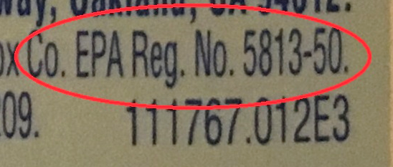
What products should I use for sanitizing and disinfecting?
Environmental Protection Agency (EPA) registered antimicrobial products
Check the product label for an EPA registration number
Notes:
Antimicrobial means the product kills germs.
A dishwasher that reaches 165 degrees F will also sanitize (dishes, toys). Choose a dishwasher that meets NSF International Standards for sanitizing.
A washing machine set to hot can sanitize cloth toys.

Slide 35
The Label Is the Law
Always follow the instructions on the label for sanitizing and disinfecting.
Do you need to mix the product with water?
How long must the product be on the surface? (dwell time)
Is it okay to use the product on food surfaces?
Do you need to rinse the product off?
  CAUTION
  WARNING
  DANGER
Notes:
Check for approved surfaces. Sanitizers must be safe for food contact surfaces
Dwell time (the time the product must be left wet on the surface and in contact with the germs to kill them)

Slide 36
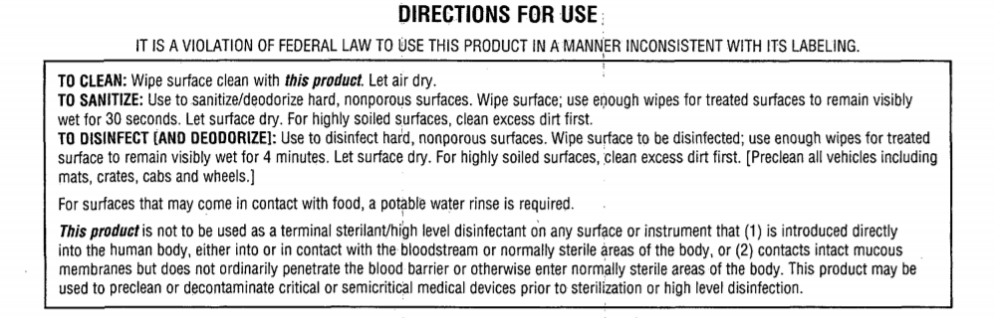
Notes:
Label reading practice
Dwell time?
Food surfaces?

Slide 37
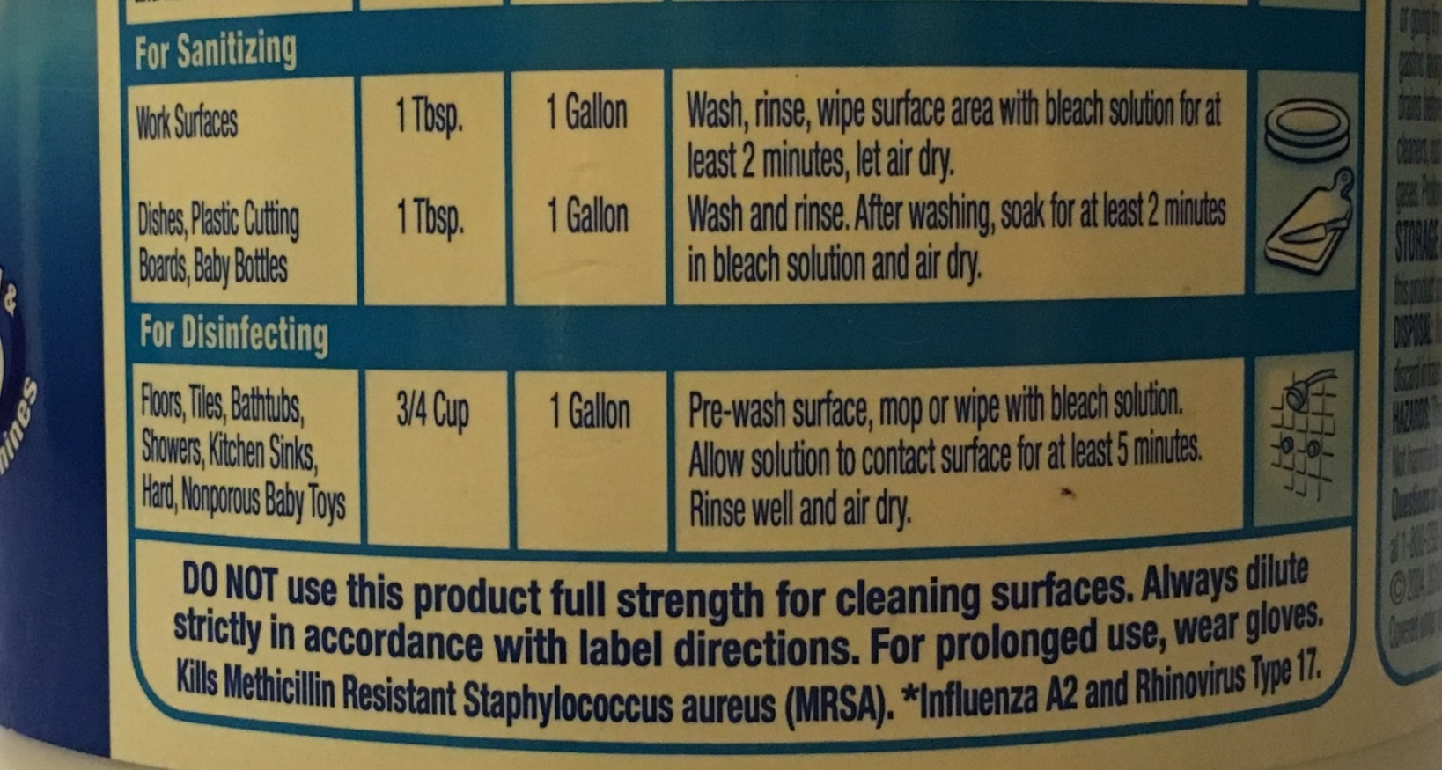
Notes:
Dwell time?
Food surfaces?

Slide 38

Safer Choice Logo
If you see the Safer Choice logo on an EPA-authorized label for a sanitizer or disinfectant, you can be assured that the product uses a least-hazardous active ingredient from this list:
Citric acid
Hydrogen peroxide
L-lactic acid
Ethanol
Isopropanol
Peroxyacetic acid
Sodium Bisulfate
For products that meet the EPA criteria for use against the COVID-19 virus, refer to List N:
www.epa.gov/pesticide-registration/list-n-disinfectants-use-against-sars-cov-2-covid-19
Notes:
EPA’s Safer Choice is the only program that authorizes sanitizers and disinfectants (antimicrobials).
It sets standards for ingredients and evaluates anti-microbial products as safer for human health and the environment.
Remember, safer antimicrobial products will still have an EPA registration number and must be used according to label instructions. All cleaning, sanitizing, and disinfecting products must be stored out of children's reach.

Slide 39
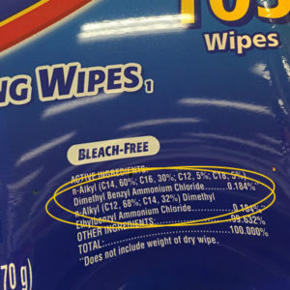
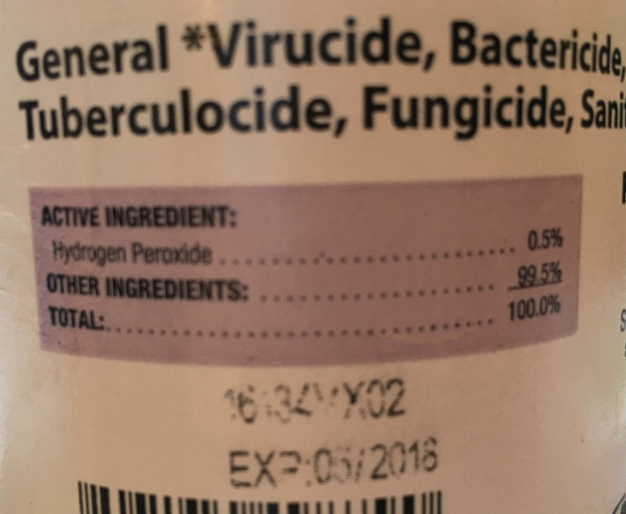
Ingredients Statement

Slide 40
Potential asthmagen active ingredients
Sodium hypochlorite (bleach)
  Mixed daily
  Protection is rarely worn
  Harmful fumes, especially full strength
Quaternary Ammonium Compounds or “Quats”
  Same respiratory risks as bleach
  Potential reproductive toxicity
  Becoming more common as a “bleach-free” product
Notes:
Some products create fumes that could trigger or even cause asthma. If you have children or staff with asthma, best to avoid products with these active ingredients.

Slide 41
Name of disinfecting product: _____________________
EPA-Registration No: __________________
Active Ingredient: ____________________
Signal Word: ________________________
Mixing Required?_____________________
Mixing Instructions____________________
Dwell time: ________
Safe for food-contact surfaces? __________
Safer Choice logo or Safer Choice-approved active ingredient?_________
Is the product on List N?_________________

Slide 42
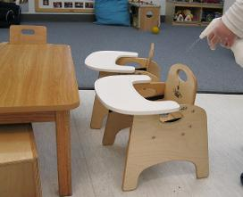
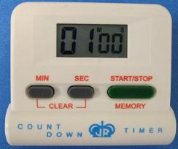
DISINFECTING AND SANITIZING STEPS
Step 1: Ensure that children are in another area
Step 2: Pre-clean using a non-antibacterial soap or detergent and water
Step 3: Apply the disinfectant or sanitizer according to product label
  Spray away from breathing zone
  Provide ventilation
Step 4: Leave the surface wet
Check the product label for the appropriate contact (dwell) time
Set an electronic timer, egg timer, watch, or smart phone to keep track of time
Step 5: Air dry or wipe the surface dry with a fresh paper towel or cloth
Notes:
Apply the sanitizer or disinfectant safely (no matter what product you use).

Slide 44

Always use caution with sanitizers and disinfectants
Provide ventilation
Hold the bottle at a safe distance away from the nose and mouth when spraying
Label spray bottle dilutions with product and date
Keep products out of children’s
reach, in a locked cabinet.
2/7/2020
bleach
Notes:
Label spray bottles with surfaces to use on (date mixed if applicable)
sanitize and disinfect when children are NOT in the area (provide a safe distance);
Never mix vinegar with bleach or ammonia with bleach
Avoid spraying sanitizers and disinfectants on surfaces close to the face (such as windows, mirrors, and partitions)

Slide 45
Continued…
Wear personal protective equipment such as
(gloves, eyewear)
Disinfect while children are not in area
The surface should be dry by the time the children return to the area
Do not mix products or reuse bottles for different products
Never mix ammonia or vinegar with bleach!
Notes:
Label spray bottles with surfaces to use on (date mixed if applicable)
sanitize and disinfect when children are NOT in the area (provide a safe distance);
Never mix vinegar with bleach or ammonia with bleach
Avoid spraying sanitizers and disinfectants on surfaces close to the face (such as windows, mirrors, and partitions)

Slide 46
What about bleach?
Commonly used because it is:
low cost
effective (if used correctly)
readily available
Use caution because it could:
irritate the skin and eyes
trigger asthma
affect breathing (even if you don’t have asthma)
damage clothing
be corrosive
Notes:
  *bleach has a short shelf life, it needs to be mixed with water daily. **Laundry bleach is not an EPA registered disinfectant! Check the label.
Notes:
Bleach is widely used in child care settings to sanitize and disinfect surfaces.

Slide 47
If using bleach:
Check to make sure it is germicidal bleach, not laundry bleach.
Mix daily, follow directions on the label for sanitizing and disinfecting. Label the bottle and date.
Use a funnel when mixing to decrease the amount of bleach inhaled.
Mix bleach into cool water to reduce fumes (rather than adding water to bleach).
Always use a measuring device.
Notes:
There are new concentrations of bleach and the user MUST read the label to identify the concentration and how to dilute it;

Slide 48
Reduce Clutter and Shared Toys
Keep surfaces clear so you can clean and disinfect them easily.
Store items you don’t use.
Discourage items coming from home.
Limit shared toys to items that can be cleaned and disinfected easily.

Slide 49
Strategies to Reduce the Risk of COVID-19
  Staying home when ill
  Personal hygiene (coughing into a sleeve, frequent hand washing, proper diapering procedures etc.)
  Cleaning and disinfecting surfaces
  Physical distancing and masking

Slide 50
Physical Distancing: Entry
Limit nonessential visitors. IEPs for children with special needs can continue.
Postpone or cancel use of classroom volunteers.
Office staff should work remotely from home, if possible.
Refrain from hugging and shaking hands.

Slide 51
Physical Distancing: Drop off and Pick up Tips
Consider moving the sign-in station outside the facility.
Provide hand sanitizer or handwashing facilities to use before and after families sign in and out.
Do not share pens. If check-in is electronic, clean and disinfect the screens or keyboards frequently.
Assign drop-off and pick-up times for each small group to avoid a large number of people gathering outside the facility.

Slide 52
Physical Distancing: Groups
Keep group sizes small and stable.
Children and staff should not change groups or mix groups.
Assign groups their own room.
Keep siblings together, if possible.
Notes:
Smaller, stable groups reduce the risk of spreading COVID-19 and protect staff and children by limiting the number of exposed people if someone becomes ill. Should these guidelines differ from local health ordinances, follow the stricter guidance. Check your local health orders.

Slide 53
Physical Distancing: Group Size (Infants and Toddlers)
It is not possible to care for infants or toddlers from a distance.
Infants under one year of age are more vulnerable when sick with COVID-19.
Provide clean smocks for staff, and change children’s clothing when soiled with secretions or body fluids.
Wear a face mask.
Notes:
Wear a mask for close contact and when handling body fluids, if possible.

Slide 54
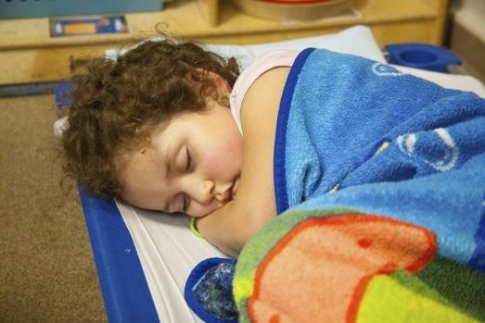
Physical Distancing: Classroom
Arrange furniture to give children more space.
Open windows for fresh air.
Place cots and cribs a good distance apart (6 feet, if possible) with children facing head to toe at naptime.

Slide 55
Physical Distancing: Meals
Seat children farther apart at meal times.
Do not pass food in common serving dishes or share serving utensils.
Serve food on individual plates for each child.
Use disposable plates, cups, and utensils, if possible.
Wear gloves when serving food.

Slide 56
Food Program
Reach out to your local CACFP sponsor for technical assistance about changes to the Child Nutrition Programs.

Slide 57
Physical Distancing
Plan activities that limit close physical contact, sharing of equipment, and waiting in line.
Maximize outdoor play and activities.
Activity idea: Hokey Pokey
https://www.youtube.com/watch?v=iZinb6rVozc
Play: Simon Says, Follow the Leader, Freeze Dance, Obstacle Course, Hop Scotch, Hokey-Poky, and other outdoor games 6 feet apart.

Slide 58
Face Coverings: Current Guidance
Adults and children over 2 years should wear a face mask that covers your nose and mouth when in the community.
A face mask offers some protection for the person wearing it, but mostly prevents the spread of virus from the person wearing it to others.
Children may not be able to reliably wear, remove, and handle masks.
Check your local orders.
Place a mask on a child (over two years old) who develops symptoms of COVID-19 during the day, if possible.
Notes:
Face coverings should be washed frequently with detergent and hot water and dried on a hot cycle. Ideally, wash your face covering after each use, and have a dedicated laundry bag or bin. Make sure the covering is comfortable – you don’t want to have to keep adjusting the mask, which means touching your face. Always wash your hands, or use hand sanitizer, before AND after touching your face or face coverings. It may not be realistic to expect children attending child care programs wear face masks to reduce the risk for transmission unless the provider determines they can reliably wear, remove, and handle masks. Some local orders state children under 12 years are exempt. Children under two years should not wear face coverings because of risk of suffocation.

Slide 59
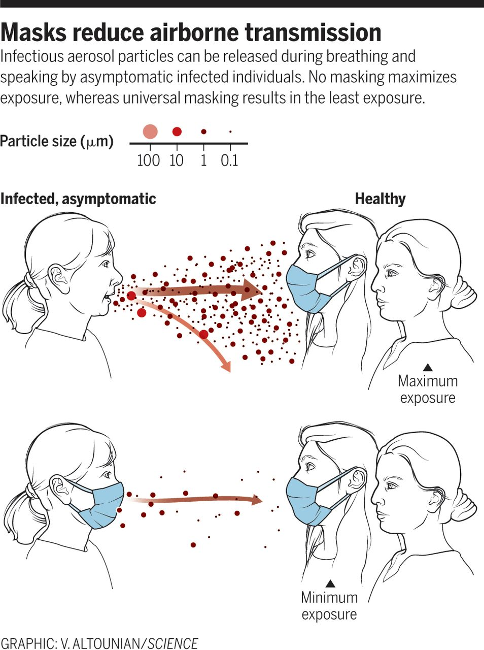
Notes:
Here’s how face coverings are effective in reducing the risk of spreading COVID-19: they cut down the amount of virus in the air.

Slide 60
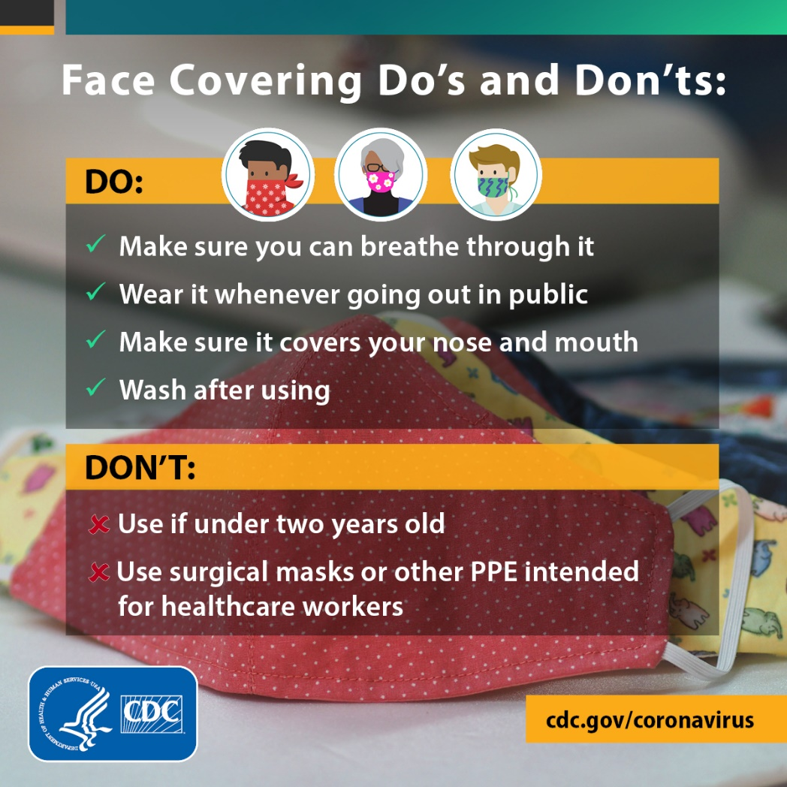
Notes:
You might to post this.

Slide 61
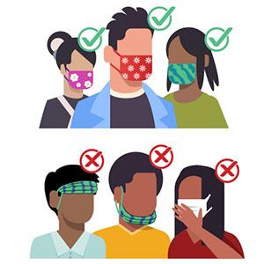

Tips for Effective Masking
Wash your hands before putting
your face covering on and after taking it off.
Secure the mask under your chin.
Fit the mask snugly against the sides of your face.
Be sure your nose and mouth are covered.
Notes:
Be ‘matter of fact’ and supportive when talking to children about face masks. Let them know this is how we keep ourselves and others around us safe.

Slide 62

On Hold…
Tooth brushing in the classroom.
Show and tell.
Hugs.
https://www.youtube.com/watch?v=Xa_qNH8u3OM
Notes:
encourage families to brush with children twice a day at home.
Ask families to keep toys and other personal belongings at home.

Slide 63
Early Childhood Teachers are Heroes
Thank you for caring for the children during the COVID-19 pandemic.
Please stay safe, we appreciate you!

