Slide 1
Health and Safety in
Child Care Settings during the COVID-19 Pandemic
Developed by the UCSF California Childcare Program with funding from the California Department of Education
June 3, 2020
2020

Slide 2
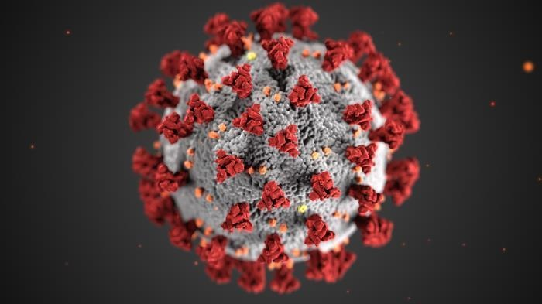
Check the CCHP homepage for regular updates on COVID-19
https://cchp.ucsf.edu
Notes:
Things are changing all the time.

Slide 3
Guidance based on
California Child Care Licensing Division (CCLD) Provider Information Notice (PIN) Social and Physical Distancing Guidance and Health Practices for Child Care Facilities in Response to Covid-19 (until June 30, 2020) https://www.cdss.ca.gov/Portals/9/CCLD/PINs/2020/CCP/PIN_20-06-CCP.pdf
Centers for Disease Control (CDC) Supplemental Guidance for Child Care Programs that Remain Open: https://www.cdc.gov/coronavirus/2019-ncov/community/schools-childcare/guidance-for-childcare.html

Slide 4
Communicate with Your Local
Public Health Department
Contact your local public health department, immediately, if you are aware of confirmed COVID-19 cases among staff or children.
Your local health department will provide guidance on when the infected person can return to the facility and if the facility needs to close.
The duration of closures due to COVID-19 illness in child care programs may be dependent on staffing levels, outbreak levels in the community, and severity of illness in infected individual.
Notes:
Check local orders for COVID-19 related directives. For example cloth face coverings.

Slide 5
Communicate with Families
Update emergency contact information and asthma action plans.
Inform families about your policies during the COVID-19 pandemic emergency response.
Require staff and family to inform your program immediately if anyone in the family is diagnosed with COVID-19.
Notes:
Use posters, social media, group texts, and/or newsletters.

Slide 6
COVID-19 is caused by a “new” corona virus.
Since it is new, people don’t have immunity to the virus.
Some people have mild cases or no symptoms at all. Older people and people with chronic health problems are at risk of getting sicker.
Notes:
A little background on COVID-19…

Slide 7

The best way to prevent COVID-19 is to avoid being exposed to the virus.
Stay home!
Notes:
This is why we have had shelter in place orders.

Slide 8
Can California child care facilities open?
Yes. Child care can open for children of parents who are essential workers and those who are working under expanded orders to re-open the economy.
Child care centers and family child care homes that are open or reopen should follow guidelines specific to the pandemic (for example, heightened cleaning and distancing requirements).

Slide 9
Who are the “essential” workers?
Essential Critical Infrastructure Workers (pdf).
Health Care and Public Health
Emergency Services
Utilities, Energy, Water, Waste
Groceries, Pharmacies
Transportation, Gas Stations
Communication and IT
Banks
*This group is growing as restrictions on local businesses are eased.

Slide 10
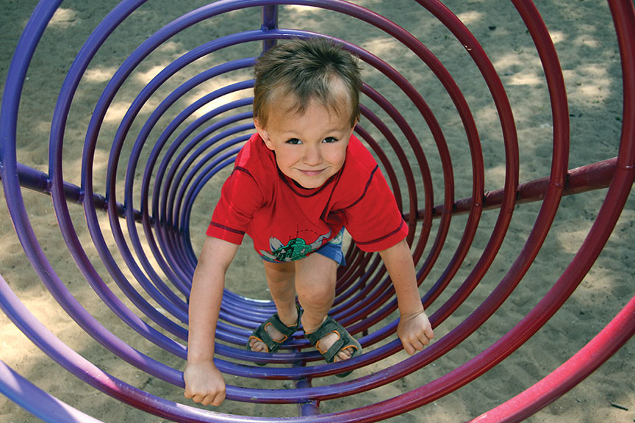
Q: How do we stay healthy and safe?

Slide 11
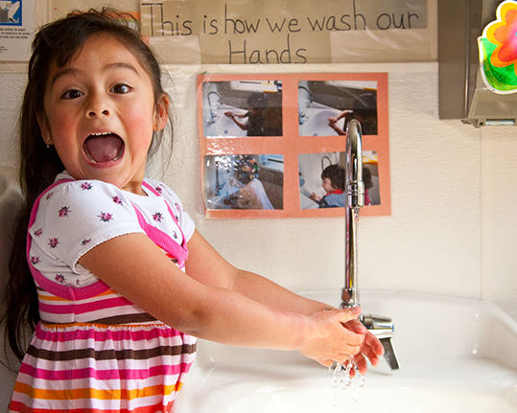
Germs spread easily among young children…
By breathing in germs that are in the air
By touching other people and surfaces with germs
By eating or drinking something with germs
Studies show that young children in child care
have symptoms of illness one third to one half of the days in the year. Young children get 6 colds a year.
This is typical.

Slide 12
COVID-19 Transmission
Air: The virus is mainly spread person-to-person spread via respiratory droplets.
The virus may live on cardboard for 1 day; plastic and stainless steel 2-3 days; in the refrigerator for over 6 hours.
Feces: The virus has been found in feces. It is unclear whether infection can be spread via body fluids (e.g. blood, stool).

Slide 13
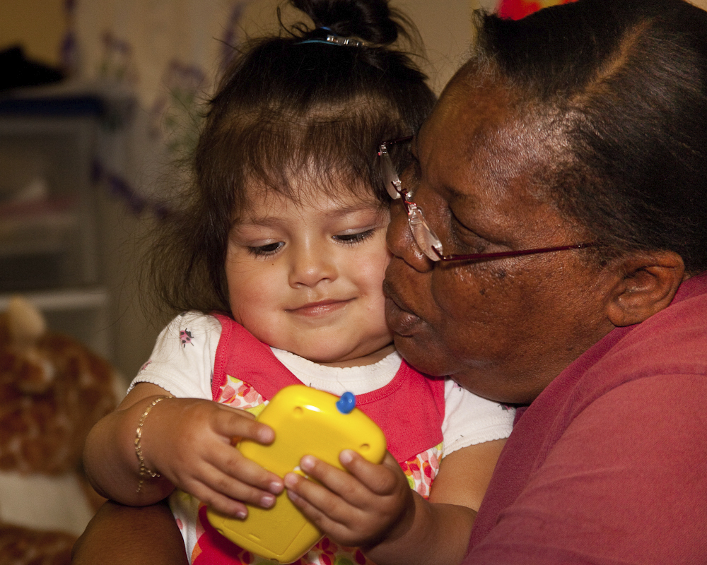
Question: Why are young children in child care settings at risk for spreading and catching COVID-19?

Slide 14
Answer:
They are in close contact with other children and their caregivers,
They are curious and touch everything,
They often put objects and their hands in their mouths,
They don’t have good personal hygiene skills,
They wear diapers or are in early stages of toilet learning,
They spend more time on the floor where germs collect.

Slide 15
COVID-19 and Children
Recent research shows that children experience lower rates of severe COVID-19 illness than adults.
The symptoms may be milder in children than adults.
Children can still spread the disease when they have mild cases or no symptoms at all.

Slide 16
Reduce the Risk of COVID-19
Reducing the risk is different than 100% preventing the spread of COVID-19.
We focus on health practices to reduce the risk of getting COVID-19.
The strategies work together to lower the risk.

Slide 17
Strategies to Slow the Spread of COVID-19
  Stay home when ill
  Personal hygiene (frequent hand washing, coughing into a sleeve, etc.)
  Cleaning and disinfecting surfaces
  Physical distancing

Slide 18
Strategies to Slow the Spread of COVID-19
  Stay home when ill
  Personal hygiene (frequent hand washing, coughing into a sleeve, etc.)
  Cleaning and disinfecting surfaces
  Physical distancing

Slide 19
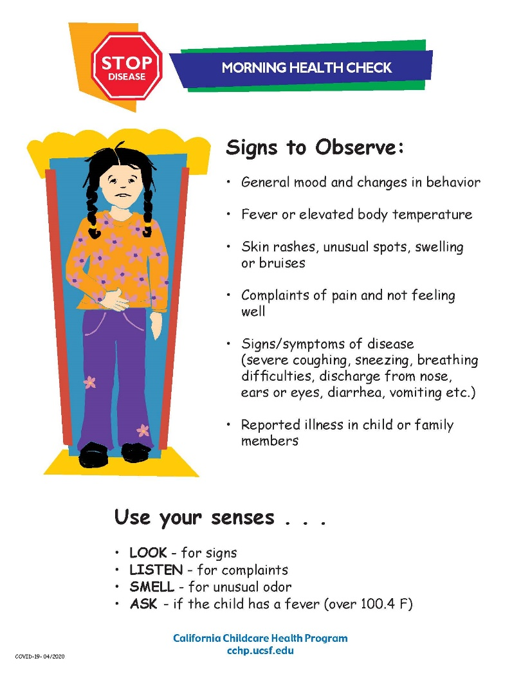
Morning Health Check
This welcome routine can help you to better understand each child, help children feel more comfortable, and foster communication with parents. It will slow the spread of disease by excluding children with signs of illness. Do not admit children with a fever (over 100.4 F), cough, trouble breathing. Ask families to keep children with signs of illness home.
Notes:
Note: it’s a best practice to document your health checks.

Slide 20
Checking for Fever
Wear a cloth face covering during the health check. Ask about fever, cough, and trouble breathing within the last 24 hours.
If you have a touchless thermometer, you can do a temperature screen of all staff and children at the beginning of the day. Otherwise, temps should be taken only when a fever is suspected. Clean and disinfect thermometers after each use.
Staff and residing family members in family child care homes should also take their temperatures and check for dry cough and trouble breathing before the child care day begins.
Notes:
Staff and children should take temperatures before arriving to work or beginning care.

Slide 21
Symptoms of COVID-19
People with these symptoms (or combinations of symptoms) may have COVID-19:
  Cough
  Shortness of breath or difficulty breathing
Or at least two of these symptoms:
  Fever
  Chills
  Repeated shaking with chills
  Muscle pain
  Headache
  Sore throat
  New loss of taste or smell
Children have similar symptoms to adults and generally have mild illness.
Notes:
Symptoms may appear 2-14 days after exposure to the virus.

Slide 22
Exclusion Criteria
Symptoms of COVID-19;
Signs of other illnesses meeting usual exclusion criteria.
Isolate a child who develops symptoms of COVID-19 during the day and ask the family to pick up the child right away. If possible, apply a face mask to ill children over two years old.
Notes:
Stricter during COVID-19 pandemic. Requires close communication with families. Isolated children are removed from the group activities but still supervised by an adult. If possible, place a face cloth on ill children over 2 years of age while they wait to be picked up.

Slide 23
Strategies to Slow the Spread of COVID-19
  Staying home when ill
  Personal hygiene (frequent hand washing, coughing into a sleeve, etc.)
  Cleaning and disinfecting surfaces
  Physical Distancing
Notes:
Handwashing is key to decreasing the spread of illness.

Slide 24
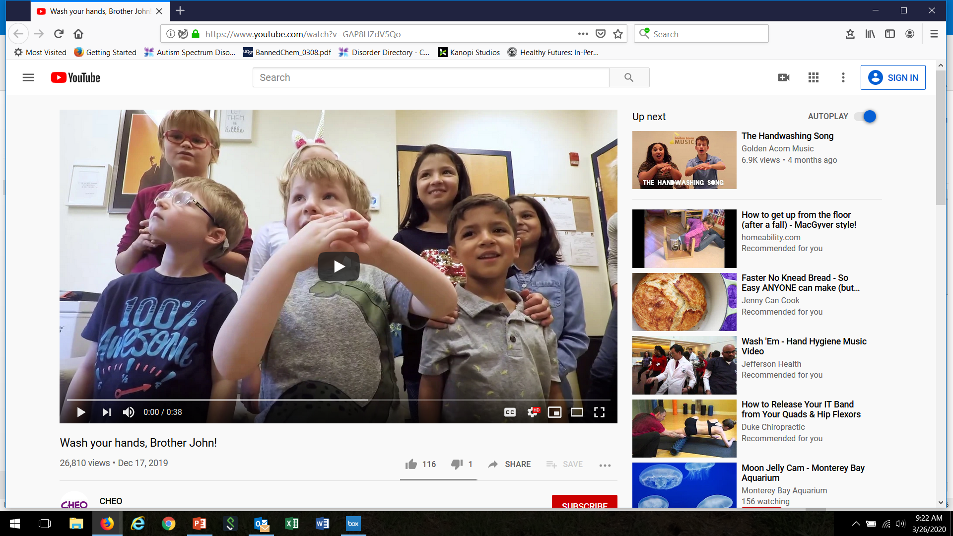
Handwashing Video
https://www.youtube.com/watch?v=GAP8HZdV5Qo

Slide 25
Wash hands upon arrival and frequently throughout the day.
Notes:
Here’s a poster you can put up near sinks and in bathrooms to reinforce proper handwashing technique.

Slide 26
Hand Sanitizer Tips
When soap and water are not available,
For adults and children over 24 months,
With products containing at least 60% alcohol,
On visibly clean hands.
Keep out of children’s reach

Slide 27

Cover your Cough and Sneeze
…with Grover!
https://www.youtube.com/watch?v=dp9z3yaxkSI

Slide 28
Ways to Slow the Spread of COVID-19
  Staying home when ill
  Personal hygiene (coughing into a sleeve, frequent hand washing, proper diapering procedures etc.)
  Cleaning and disinfecting surfaces
  Physical distancing
Notes:
Antimicrobial pesticides (sanitizers and disinfectants) kill viruses on surfaces.

Slide 29
Disinfecting
Disinfectants (antimicrobial pesticides) are already widely used in child care settings.
Have you taken the Healthy Schools Act training?
https://apps.cdpr.ca.gov/schoolipm/
Notes:
Recommend the IGM training.

Slide 30
What is the difference between cleaning and disinfecting?
Definitions
Clean: To physically remove dirt, debris, and sticky film by washing, wiping, and rinsing.
Disinfect: To kill nearly all of the germs on a hard, non-porous surface.
CFOC Schedule K: https://nrckids.org/files/appendix/AppendixK.pdf
Notes:
These terms are often used interchangeably but they do not mean the same thing. Let’s focus on cleaning and disinfecting.

Slide 31
What surfaces should be cleaned?
Toys
Bedding
Floors
Clothing (including hats)
Cribs, cots, and mats
Play equipment
Refrigerators
Always clean before applying a disinfectant
Notes:
Washing with soap and rinsing with water will clean these surfaces. The friction of cleaning removes most dirt.

Slide 32



Use products that are healthier for people and the environment
fragrance-free
free of dyes
non-antibacterial
non- aerosols (propellant)
third-party certification
*Remember, children are more vulnerable to exposure to chemicals and fumes because they are growing and developing. Their little bodies have a harder time breaking down toxins, and they breath twice as much per body weight as adults. They have softer, more absorbent skin and smaller airways. They also spend more time on the floor where chemical residues can collect.
Notes:
The next step is to choose a safe cleaning product. Many have strong fumes or try to mask odors with perfume leading to poor air quality. Some products may make marketing claims that they are “green”, but they may not be. Look for a third party certification to know if the product you are using is safer for human health and the environment. Some products are ready to use, some need to be diluted with water. Always follow label directions for proper use and use personal protective equipment such as gloves and eye wear as directed.

Slide 33
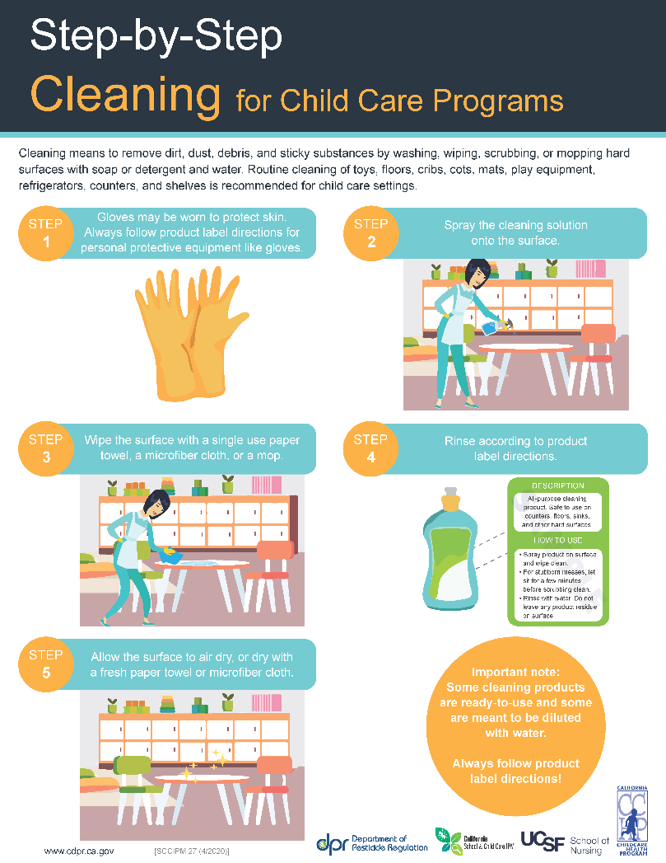

Slide 34
What surfaces should be disinfected?
Drinking fountains
Door and cabinet handles (high-touch)
Surfaces that have been soiled with body fluids
Mouthed objects (collect mouthed toys in a tub)
Toileting and diapering areas:
  Diaper changing tables and diaper pails
  Counter tops in bathrooms
  Potty chairs
  Handwashing sinks and faucets
  Toilets
  Bathroom floors
Notes:
Appropriate for use on non-porous surfaces such as diaper change tables, counter tops, door and cabinet handles, toilets, and sinks used for toileting routines including faucets, door knobs and basins
These are generally toileting areas or High-touch areas that are at high risk for collecting lots of germs, like doorknobs, bathroom faucets, and drinking fountains.

Slide 35
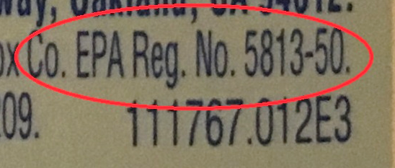
What products should I use for sanitizing and disinfecting?
Environmental Protection Agency (EPA) registered antimicrobial products
Check the product label for an EPA registration number
Notes:
Antimicrobial means the product kills germs.
A dishwasher that reaches 165 degrees F will also sanitize (dishes, toys). Choose a dishwasher that meets NSF International Standards for sanitizing.
A washing machine set to hot can sanitize cloth toys.

Slide 36
The Label Is the Law
Always follow the instructions on the label for sanitizing and disinfecting.
Do you need to mix the product with water?
How long must the product be on the surface? (dwell time)
Is it okay to use the product on food surfaces?
Do you need to rinse the product off?
  CAUTION
  WARNING
  DANGER
Notes:
Check for approved surfaces. Sanitizers must be safe for food contact surfaces
Dwell time (the time the product must be left wet on the surface and in contact with the germs to kill them)

Slide 37
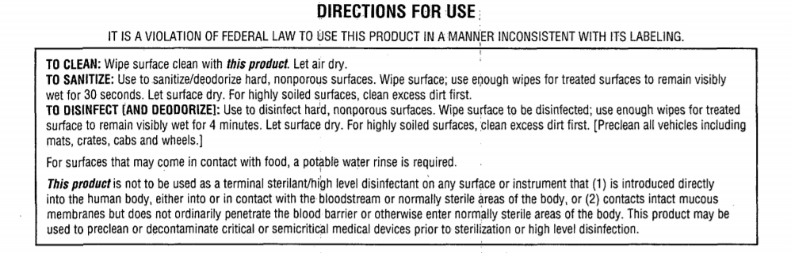
Notes:
Label reading practice
Dwell time?
Food surfaces?

Slide 38
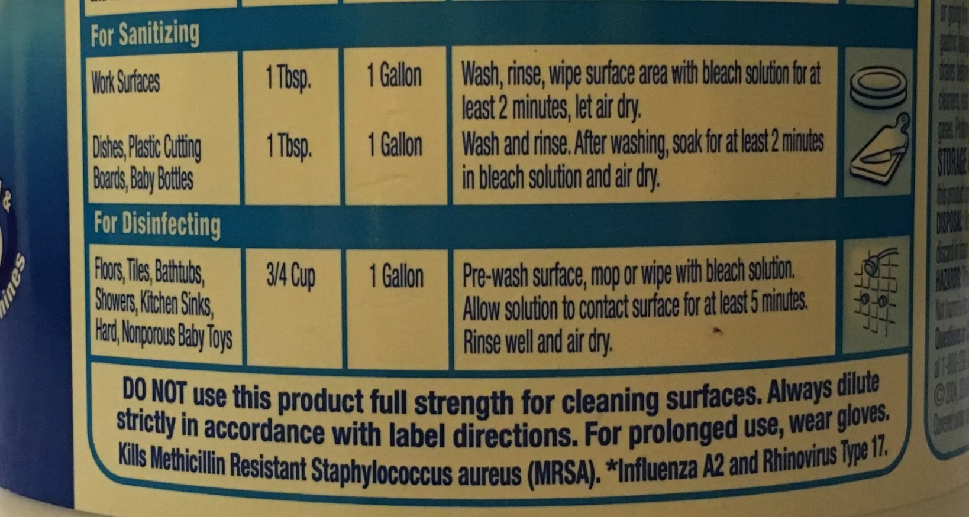
Notes:
Dwell time?
Food surfaces?

Slide 39

Design for the Environment Logo
If you see the DfE logo on an EPA-authorized label for a sanitizer or disinfectant, you can be assured that the product uses a least-hazardous active ingredient from this list:
Citric acid
Hydrogen peroxide
L-lactic acid
Ethanol
Isopropanol
Peroxyacetic acid
Sodium Bisulfate
For a list of DfE products:
  www.epa.gov/pesticide-labels/design-environment-antimicrobial-pesticide-pilot-project-moving-toward-green-end
Notes:
EPA’s Design for the Environment is the only program that authorizes sanitizers and disinfectants (antimicrobials)
It sets standards for ingredients and evaluates anti-microbial products as safer for human health and the environment.
Remember, safer antimicrobial products will still have an EPA registration number and must be used according to label instructions. All cleaning, sanitizing, and disinfecting products must be stored out of children's reach.

Slide 40
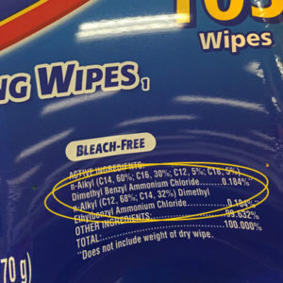
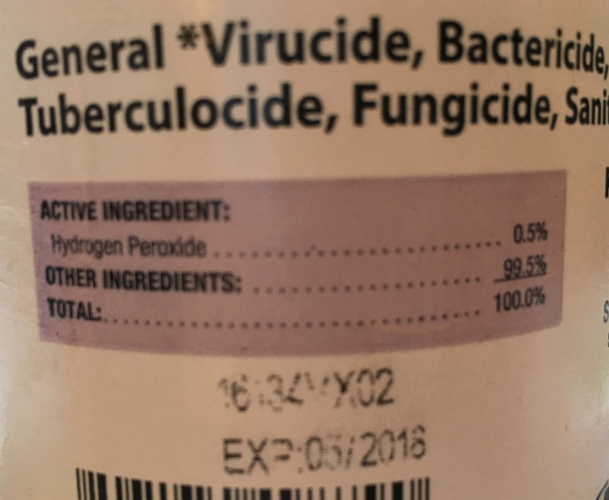
Ingredients Statement

Slide 41
Potential asthmagen active ingredients
Sodium hypochlorite (bleach)
  Mixed daily
  Protection is rarely worn
  Harmful fumes, especially full strength
Quaternary Ammonium Compounds or “Quats”
  Same respiratory risks as bleach
  Potential reproductive toxicity
  Becoming more common as a “bleach-free” product
Notes:
Some products create fumes that could trigger or even cause asthma. If you have children or staff with asthma, best to avoid products with these active ingredients.

Slide 42
Name of disinfecting product: _____________________
EPA-Registration No: __________________
Active Ingredient: ____________________
Signal Word: ________________________
Mixing Required?_____________________
Mixing Instructions____________________
Dwell time: ________
Safe for food-contact surfaces?
DfE logo or DfE-approved active ingredient?

Slide 43
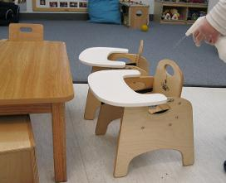
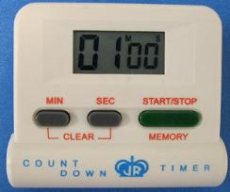
DISINFECTING AND SANITIZING STEPS
Step 1: Ensure that children are in another area
Step 2: Pre-clean using a non-antibacterial soap or detergent and water
Step 3: Apply the disinfectant or sanitizer according to product label
  Spray away from breathing zone
  Provide ventilation
Step 4: Leave the surface wet
Check the product label for the appropriate contact (dwell) time
Set an electronic timer, egg timer, watch, or smart phone to keep track of time
Step 5: Air dry or wipe the surface dry with a fresh paper towel or cloth
Notes:
Apply the sanitizer or disinfectant safely (no matter what product you use)

Slide 45

Always use caution with sanitizers and disinfectants
Provide ventilation
Hold the bottle at a safe distance away from the nose and mouth when spraying
Label spray bottle dilutions with product and date
Keep products out of children’s
reach, in a locked cabinet.
2/7/2020
bleach
Notes:
Label spray bottles with surfaces to use on (date mixed if applicable)
sanitize and disinfect when children are NOT in the area (provide a safe distance);
Never mix vinegar with bleach or ammonia with bleach
Avoid spraying sanitizers and disinfectants on surfaces close to the face (such as windows, mirrors, and partitions)

Slide 46
Continued…
Wear personal protective equipment such as
(gloves, eyewear)
Disinfect while children are not in area
The surface should be dry by the time the children return to the area
Do not mix products or reuse bottles for different products
Never mix ammonia or vinegar with bleach!
Notes:
Label spray bottles with surfaces to use on (date mixed if applicable)
sanitize and disinfect when children are NOT in the area (provide a safe distance);
Never mix vinegar with bleach or ammonia with bleach
Avoid spraying sanitizers and disinfectants on surfaces close to the face (such as windows, mirrors, and partitions)

Slide 47
What about bleach?
Commonly used because it is:
low cost
effective (if used correctly)
readily available
Use caution because it could:
irritate the skin and eyes
trigger asthma
affect breathing (even if you don’t have asthma)
damage clothing
be corrosive
Notes:
  *bleach has a short shelf life, it needs to be mixed with water daily. **Laundry bleach is not an EPA registered disinfectant! Check the label.
Notes:
Bleach is widely used in child care settings to sanitize and disinfect surfaces.

Slide 48
If using bleach:
Check to make sure it is germicidal bleach, not laundry bleach.
Mix daily, follow directions on the label for sanitizing and disinfecting. Label the bottle and date.
Use a funnel when mixing to decrease the amount of bleach inhaled.
Mix bleach into cool water to reduce fumes (rather than adding water to bleach).
Always use a measuring device.
Notes:
There are new concentrations of bleach and the user MUST read the label to identify the concentration and how to dilute it;

Slide 49
Reduce Clutter and Shared Toys
Keep surfaces clear so you can clean and disinfect them easily.
Store items you don’t use.
Discourage items coming from home.
Limit shared toys to items that can be cleaned and disinfected easily.

Slide 50
Strategies to Slow the Spread of COVID-19
  Staying home when ill
  Personal hygiene (coughing into a sleeve, frequent hand washing, proper diapering procedures etc.)
  Cleaning and disinfecting surfaces
  Physical distancing

Slide 51
Physical Distancing: Entry
Limit entry to employees that are essential.
No parent volunteers, students, or visitors. However, IEPs for children with special needs can continue.
Office staff should work remotely from home, if possible.
Refrain from hugging and shaking hands.

Slide 52
Physical Distancing: Drop off and Pick up Tips
Consider moving the sign-in station outside the facility.
Provide hand sanitizer or handwashing facilities to use before and after families sign in and out.
Do not share pens. If check-in is electronic, clean and disinfect the screens or keyboards frequently.
Assign drop-off and pick-up times for each small group to avoid a large number of people gathering outside the facility.

Slide 53
Physical Distancing: Group Size
Keep group sizes small by only caring for children of essential workers.
Families who are not “essential workers” are required to shelter-in-place with their children (stay home).
Notes:
As we know, children are not very good at social distancing,

Slide 54
Physical Distancing: Groups
Children and staff should not change groups or mix groups.
Assign groups their own room.
Keep siblings together, if possible.

Slide 55
Physical Distancing: Group Size
Group Size for Centers (Per Licensing)
Age Staff:Child Ratio Group Size
0-18 months (infant) 1:4 10
18-36 months (toddler) 1:6 10
Preschool 1:10 10
School age 1:10 10
mixed age groups 1:6 10
Notes:
Temporary until June 30, 2020.

Slide 56
Physical Distancing: Group Size (Infants-18 months)
Group Size for FCCH (Per Licensing) Provider: Child Ratio Group Size
Infants only 1:4 Infants 4
Mixed aged (2 infants) 1:6 children 6
Notes:
Some are suggesting 1:1 care for infants. These standards are temporary until June 30, 2020.

Slide 57
Physical Distancing: Group Size (Infants and Toddlers)
It is not possible to care for infants or toddlers from a distance.
Infants under one year of age are more vulnerable when sick with COVID-19.
Provide clean smocks for staff, and change children’s clothing when soiled with secretions or body fluids.
Notes:
Wear a mask for close contact and when handling body fluids, if possible.

Slide 58
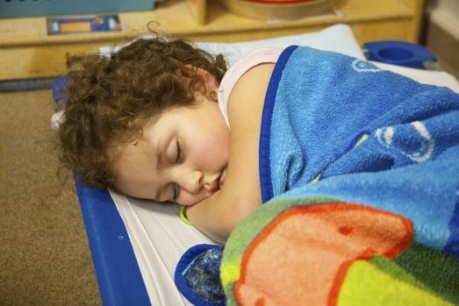
Physical Distancing: Classroom
Arrange furniture to give children more space.
Open windows for fresh air.
Place cots and cribs a good distance apart (6 feet, if possible) with children facing head to toe at naptime.

Slide 59
Physical Distancing: Meals
Seat children farther apart at meal times.
No family style eating. Serve food on individual plates for each child.
Use disposable plates, cups, and utensils, if possible.
Wear gloves when serving food.

Slide 60
Food Program Waivers
There is a Nationwide Waiver to allow flexibility in the Child Nutrition Programs in place.
Reach out to your local CACFP sponsor for technical assistance.

Slide 61
Physical Distancing
Plan activities that limit close physical contact, sharing of equipment, and waiting in line.
Maximize outdoor play and activities.
Activity idea:
https://www.youtube.com/watch?v=iLgdCNr0NIk

Slide 62
Face Coverings: Current Guidance
Adults and children over 2 years should wear a cloth face covering that covers your nose and mouth when in the community.
A cloth face covering is not intended to protect the wearer, but may prevent the spread of virus from the wearer to others. Children may not be able to reliably wear, remove, and handle masks.
Check your local orders.
Place a mask on a child who develops symptoms of COVID-19 during the day, if possible.
Notes:
Face coverings should be washed frequently with detergent and hot water and dried on a hot cycle. Ideally, wash your face covering after each use, and have a dedicated laundry bag or bin. Make sure the covering is comfortable – you don’t want to have to keep adjusting the mask, which means touching your face. Always wash your hands, or use hand sanitizer, before AND after touching your face or face coverings. It may not be realistic to expect children attending child care programs wear cloth face coverings to reduce the risk for transmission unless the provider determines they can reliably wear, remove, and handle masks. Some local orders state children under 12 years are exempt. Children under two years should not wear face coverings because of risk of suffocation.

Slide 63
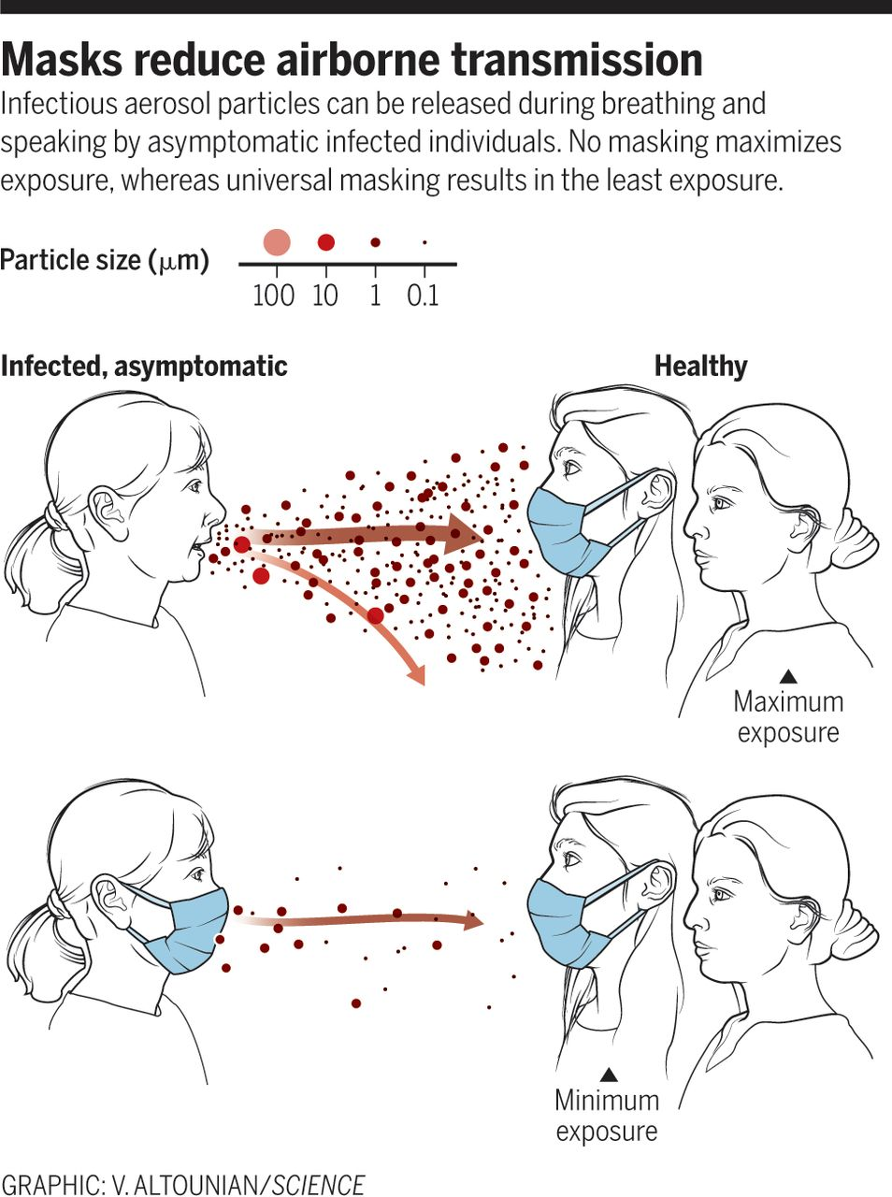
Notes:
Here’s why face coverings are effective in reducing the risk of spreading COVID-19.

Slide 64
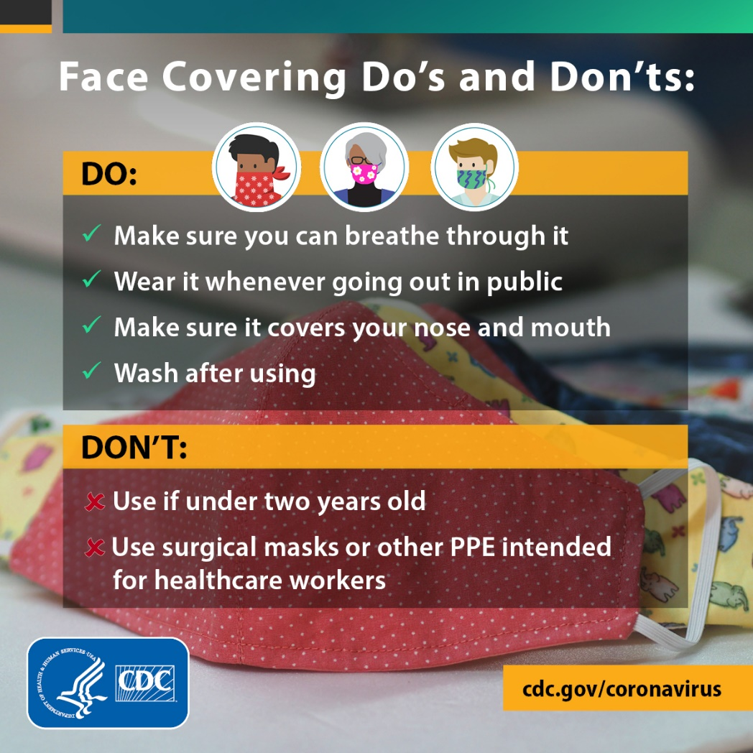
Notes:
You might to post this.

Slide 65

On Hold…
Tooth brushing in the classroom.
Show and tell.
Hugs.
https://www.youtube.com/watch?v=Xa_qNH8u3OM
Notes:
encourage families to brush with children twice a day at home.
Ask families to keep toys and other personal belongings at home.

Slide 66
Early Childhood Teachers are Heroes
Thank you for caring for the children of our essential work force during the COVID-19 pandemic.
Please stay safe, we appreciate you!

